Slide 1


Staff Safeguarding
Training Update
September 2026
Notes:
Intros & Acknowledgment that Community of Send mother obtaining solutions (COSMOS) are a dedicated group of parents and carers working together to establish a community voice aimed at improving Special Educational Needs and Disabilities (SEND) services on the Wirral.
Their aim to set up local hubs for SEND parent carers to come together and share their lived experiences. The intention is to discuss how SEND support can be improved for our young people. We will feed this back to PCPW and the Local Authority during regular meetings with the goal of obtaining solutions.

Slide 2

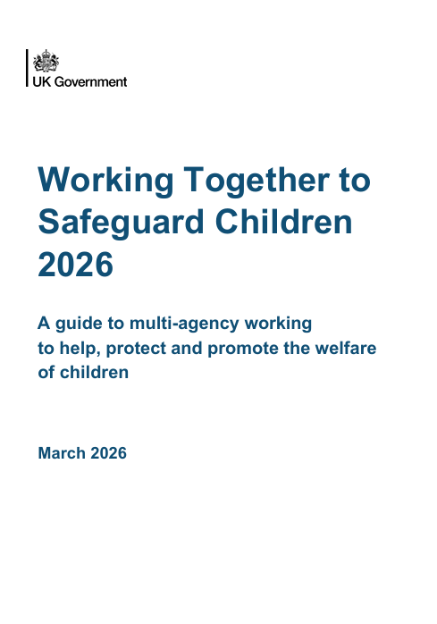
Safeguarding Definition
Preventing impairment of children’s mental and physical health or development
Protecting from
maltreatment, whether that is within or outside the home, including online
Taking action to enable all children to have the best outcomes
Children grow up in circumstances consistent with provision of safe & effective care
Providing help and support to meet the needs of children as soon as problems emerge
Notes:
WT & KCSIE breaks the definition down into 5 parts for us.
Definition of ‘family Help’. Addition of HOTH.
Definition includes preventing Impairment – To do this we need to be able to spot early signs that a child or family need help.
Taking action – including having understanding of thresholds- gives us a common language.
Safeguarding is proactive and Child Protection is reactive

Slide 3
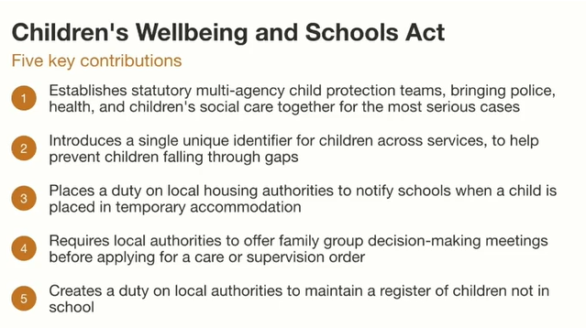
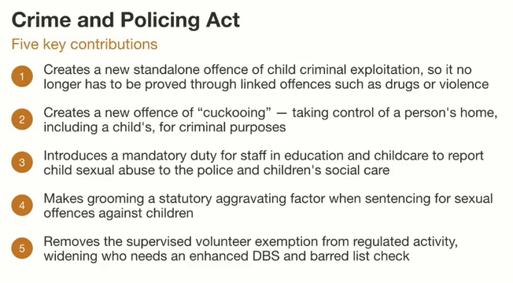
New Key Legislation
How will your team integrate the new knowledge contributions into safeguarding culture, policy and practice?
Notes:
The slide is self explanatory (both of the above acts were given royal ascent in April 2026)
New checks for Vols (2 lists, DBS and barred list – they do not talk to each other and hold different information on professionals.
A volunteer now MUST have a DBS if in Reg Activity e.g. for more than 3 days in any 30-day period, or one overnight stay.

Slide 4

1. Recognise
2. Respond
3. Refer
4. Record
5. Reflect
Safeguarding
System
Notes:
The safeguarding system is what ensures our arrangements to safeguard children and adults is robust and fit for purpose. – the steps help SLT / DSLs to ensure our response to safeguarding at any level is proactive, and not reactive!
Recognise – vigilance and confidence
Respond – trust your instincts, build strong relationships
Refer – know processes to access Family Help and beyond
Record – with care and curiosity
Reflect – be part of the improvement cycle to ensure we DO keep children safe!

Slide 5




ABUSE
Physical Abuse
Emotional Abuse
Harmful and physical touch and fabricated or induced illness
Persistent emotional maltreatment, NOW includes verbal abuse, persistent criticism, plus belittling, name calling as examples.
Sexual Abuse
Neglect
Failure to meet basic needs
Forcing or enticing a child
Think about the physical & behavioural indicators
What may you see, hear (or overhear), or be told?
Remember to consider the influence of the online community!
Notes:
Definitions change (emotional abuse) - Children may be abused by an adult or adults, a child or children. (new sheet with full definitions is below the PP on the website).
The definition of abuse means inflicting harm & ALSO failing to act to prevent harm, so if a parent or carer becomes aware their child is being abused & does nothing to stop it then they too are part of the abuse.
ASK- What is the most common type of abuse? Neglect, followed by Emotional. Of course, we will never know the real amount because so much abuse is hidden. What we do know is that most children are placed on CP Plans for neglect, neglect is very difficult to spot because it doesn’t tend to be a one off event – it is ongoing & circumstantial. Neglect is often an act of omission –no-one has set out to neglect a child can often be the result of a parent not having their needs met. Although it Very difficult to measure, we know that chronic neglect is associated with wider damage to a child than active abuse.
CP physical & sexual no’s are low are due to the fact that CYP living in these circumstances are not safe and the focus of SG processes will be removal of the child from the family home.
Over the last 5 years the government have done a lot of research into sexual abuse - data found that 1 in 10 CYP will experience CSA by the age of 16. Findings that Sexual abuse is likely Just as common as all other types of abuse but much less recognized, reported and responded to. More barriers to disclosing than other types of abuse- shame, confusion, adults often very uncomfortable talking about it.
Child abuse doesn’t just happen in the home - can take place online, in the commuinty and technology is often be used to facilitate offline abuse. Practitioners need to be mindful that CYPs can be abused and exploited through exploitation and county lines.

Slide 6

YOUR ROLE IN RECOGNISING & IDENTIFYING CONCERNS
What YOU see...
What YOU are told…
What YOU hear…
“Report, Record, Seek help if we are unsure”
What might this look like for members of the team and for you?
Notes:
YOU are the eyes an ears on the ground and may be the only person who sees, hears or are
Can you give examples to your staff . . . .
What might we see? Hear? Told?

Slide 7

Dealing with Disclosures
Disclosure
Stay calm
Take the child or adult seriously
Ask open ended questions
Offer reassurance
Listen & be attentive
Explain what you will do next
Record the child or adult’s words
Remember to use TED as a clarity tool – I’m hearing you, could you …..
Tell me more about that
Explain what you mean by …..
Describe that in more detail
Recognise
Respond
Report
Record
Reflect
Multi-agency safeguarding arrangements should include mechanisms for staff welfare, acknowledging the emotional impact of safeguarding work (WT2023). Give staff permission to check in, if they are subject to a disclosure
Notes:
Working Together & KCSIE 2026 recognises that disclosures can be distressing for staff and states that employers and safeguarding partners should ensure staff have access to advice, supervision, and emotional support. It highlights the importance of clear safeguarding policies, training, and access to DSLs so staff are not left to manage disclosures alone.
Multi-agency safeguarding arrangements should include mechanisms for staff welfare, acknowledging the emotional impact of safeguarding work.
Stay calm, listen. Don’t be afraid to ask the child questions to help your understanding “can you explain a little more about XYZ for me”.
Repeat and Feedback to the child.. “I hear you are telling me XYZ, you’ve done the right thing and been courageous”
Remember .. Building up the courage to talk to you might be the bravest thing that child has ever done. If you are in a busy environment & don’t feel able to give the situation your full attention.. Come back to it later –set a time with the child
“In order to keep you safe/your family/other children I’m going to seek some support and advice from Mrs/Mr XYZ”
BE CURIOUS!! Come from a place of safety – think the unthinkable
Professional Opinions – You can use professional opinion i.e. recording your ‘gut feeling’ / if you felt someone was being dishonest - but you should be talking to a DSL about why you feel this way? And what is your reasoning/justification for recording this? When recording it is important to stick to factual information only.
Receive - Listen actively, open body language, accept, non-judgmental. Use TED method for clarity (tell, explain, describe)
Reassure - ‘You’ve done the right thing by coming to me’, re-assure them that you have listened and hear what they are saying; don’t promise confidentiality
Respond - Tell them what you are going to do and do it. Ensure that the child is ok before leaving them alone.
Report - As soon as possible, to the Designated Senior Lead (DSL) in the setting, or your manager of your service
Record - Stick to the facts, You can use professional opinion but clarify/justify this– Think about the context - When? Where? Who? What?
Review – Take responsibility to follow up any referral (via your DSL or manager)

Slide 8
What do we all NEED to continue do?
Respond to concerns, trust your instincts!
Always share concerns about all adults in a position of trust posing a risk of harm to students or anyone
If a student is in immediate danger or at risk of harm, report, record, react…
Responding to concerns about a child or children:
Act as soon as possible
Follow the safeguarding policy which is in place
Speak to a lead in safeguarding (or senior leader) as soon as you can
Report to manager / member of SLT at the earliest point
Record with care and stay curious about the situation
Concerns about those people in a position of trust:
Tell Senior Manager immediately if:
A student discloses (about a person in a position of trust)
Have safeguarding concerns that a professional who may pose a risk of harm to students
Are making an allegation against another professional
LADO would be consulted by SLT if significant harm is suspected
When in doubt, share. It is better to be wrong and share, than to not share and have been right!
Notes:
DSL’s will / may: Manage any support for the child internally using the school's pastoral support processes / Do an early help assessment / Make a referral into IFD (this information should be kept confidential and stored securely)
Concerns about staff - (including supply staff, volunteers and contractors)If the DSL or deputy is not available, staff should: Not delay taking action / Speak to a member of the senior leadership team (SLT) /Contact the Integrated Front Door(IFD), if appropriate, and follow advice / Tell the DSL or deputy about any actions taken as soon as possible

Slide 9
Significant Updates to KCSIE 2026
Mobile phones in school
Serious violence (and violence prevention)
Legal Routes, Safeguarding & operation encompass
Child on Child, Child Criminal Exploitation & Domestic Abuse
New Risk Indicators
Guidance on supporting pupils who are questioning their gender
Information Sharing
Harmful sexual behaviour (HSB), and digital HSBs
Digital Harms & Cyber Crime
Restrictive intervention, including reasonable force
Notes:
2026 version of KCSIE has the most updates since it was first published in 2014. There will be a slide on the topics above next.

Slide 10
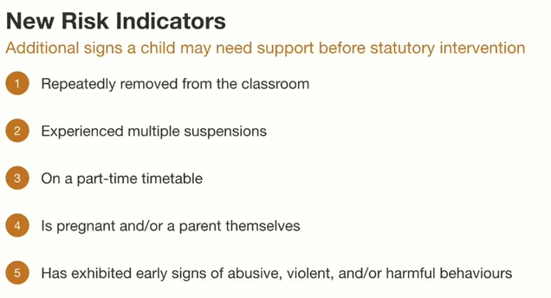
ADDED RISK INDICATORS:
Notes:
ALL professionals should be alert to the need for Family Help for a child who is also frequently missing/goes missing from education, home or care ▪ has experienced multiple suspensions, is at risk of being permanently excluded from schools, colleges and in alternative provision or a pupil referral unit ▪ has a parent or carer in custody or is affected by parental offending ▪ Is displaying non-violent Harmful Sexual Behaviours and may prevent escalation of sexual violence.
Why are the indicators so important? Potential early warnings that the child or family are in need of help

Slide 11
Mobile Phone Guidance
From September 2026, UK guidance dictates that all schools should be mobile phone-free environments by default, with phones switched off and stored away from the start to the end of the day.
Settings need to:
Brief staff and governors on the updated guidance and Ofsted’s inspection focus, so expectations and responsibilities are well understood.
Review current behaviour policy to check how clearly mobile phone expectations are set out and whether they reflect the updated guidance.
Agree a consistent approach to managing mobile phones during the school day, including how exceptions (such as medical or safeguarding needs) are handled.
Communicate early with parents and carers, explaining the direction of travel and how further information will be shared.
Check safeguarding and inclusion arrangements, ensuring reasonable adjustments, medical needs and routes for pupils to raise concerns are clearly in place
You can find the DfE guidance here: https://www.gov.uk/government/publications/mobile-phones-in-schools
Notes:
Pupils should not have access to their phones during the school day.
Exceptions in a setting could include: - e.g. pupils with medical conditions/pupils
with disabilities, young carers, sixth form. Look to include details of how this impacts your
behaviour/mobile phone policies
A model policy includes, “off and away” in lockers/bags, exceptions for medical needs, and clear consequences for violations like confiscation.
The government has updated its guidance on mobile phones in schools, strongly encouraging schools to operate as mobile phone-free environments during the school day. The aim is to support learning, reduce distraction and help schools manage risks linked to bullying, online harm and wellbeing.
Ofsted has said it will reflect this guidance in inspections from April 2026. Inspectors will discuss with leaders how mobile phones are managed, how expectations are communicated, and how consistently the school’s approach is understood and followed by staff and pupils. The focus will be on the impact on behaviour, learning and pupil wellbeing rather than on a single model being adopted.
Where schools take a different approach to the guidance or allow exceptions, inspectors will want to understand the reasons for this and how any risks are managed. Clear policies, consistency and attention to safeguarding will remain key.

Slide 12
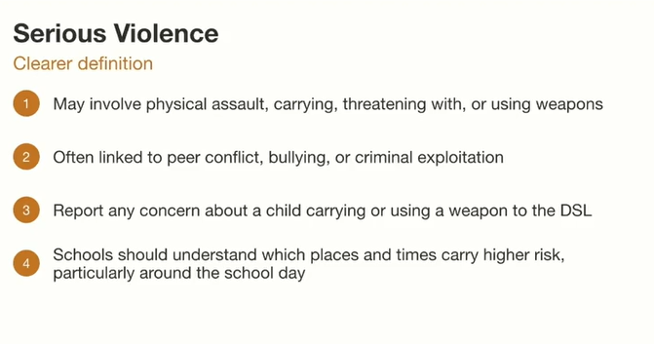
Serious Violence
In England, 70% of teachers report that they are ‘not confident’ or ‘not at all confident’ in identifying and delivering evidence-based interventions for preventing children’s involvement in violence
82% of teachers and 72% of DSLs report receiving no training on serious violence in the past 2 years.
(YEF/Teacher Tapp 2025)
https://insights.youthendowmentfund.org.uk/epic
Notes:
KCSIE 2026 includes new guidance on serious violence
A new section clarifies that serious violence is a continuing safeguarding concern, and that schools have a key role to play in protecting children from violence
Serious violence often occurs in the context of peer conflict or bullying, and it can also be associated with criminal exploitation. It may involve:
Physical assault / carrying, threatening with, or using weapons
Staff should report any concerns about a child carrying or using a weapon or expressing the intent to do so to the DSL. Staff should also be alert to the signs that a child might be at risk of being involved in serious violence, especially for pupils with disrupted education or a history of offending
FOR DSLs - Education Practice Insight Creator (EPIC) - 37 questions, average times to complete – 30 minutes.
Free digital self-assessment tool that enables education leaders to understand how well their settings’ practice aligns with the evidence for what works. Takes on average less than 30 minutes to complete and provides a tailored downloadable insights report - https://insights.youthendowmentfund.org.uk/epic

Slide 13
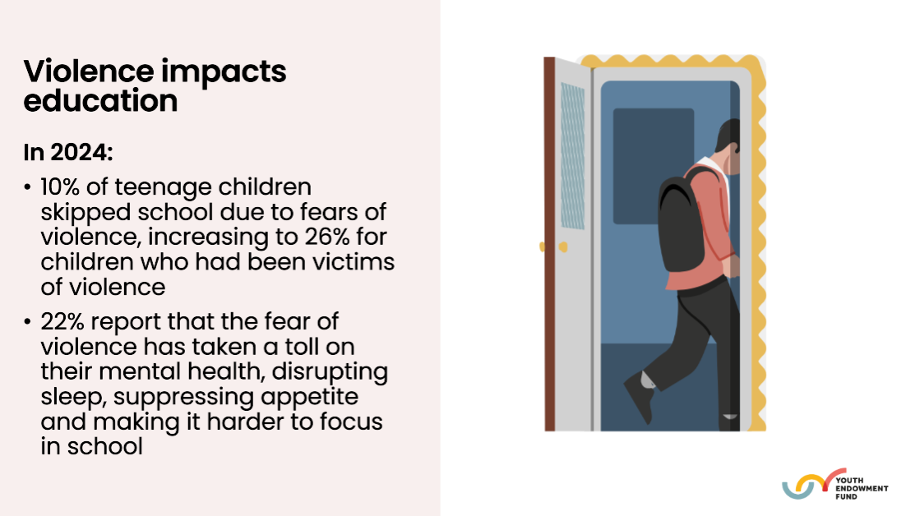
Serious Violence
Violence impacts children’s lives:
• 20% of teenage children report being victims of violence (2/3 worry about being a victim)
• 65% of victims experience violence multiple times within a year
• ½ of all teenage children in romantic relationships have experienced violent or controlling behaviours
Notes:
Alison Wilson - Regional Director - Yorks and the Humber (Department for Education)
YEF Education Change team - Dennis Simms - Assistant Director for Change in Education / Jo Goodman - Senior Change Manager / Ben Larrain - Senior Change Manager.
Vision of Youth Endowment Fund - A world where no child becomes involved in violence. To find what works and build a movement to put this into practice. YEF fund research, synthesise evidence, produce guidance, work towards system change and support sector leaders to do what works.

Slide 14
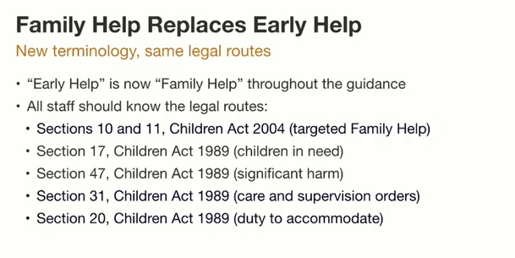
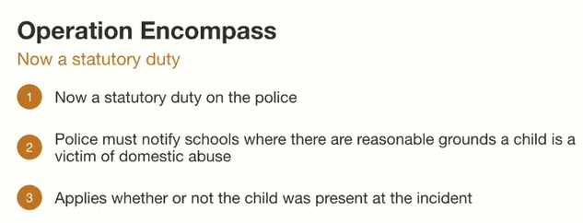
New legal Terminology & Operation Encompass
Operation Encompass is an early‑information safeguarding partnership between police and educational settings. Its purpose is to ensure that children who experience or are affected by domestic abuse receive timely emotional and practical support (where reasonable) at their setting.
Notes:
Section 10 and 11 new for the team to learn AND understand
Same with Section 31 and 20!
Staff should already be familiar with S17 & S47.
DSLs to discuss with your teams what each section means and the implications for setting processes. HOW WILL YOU ACHIEVE THIS?

Slide 15
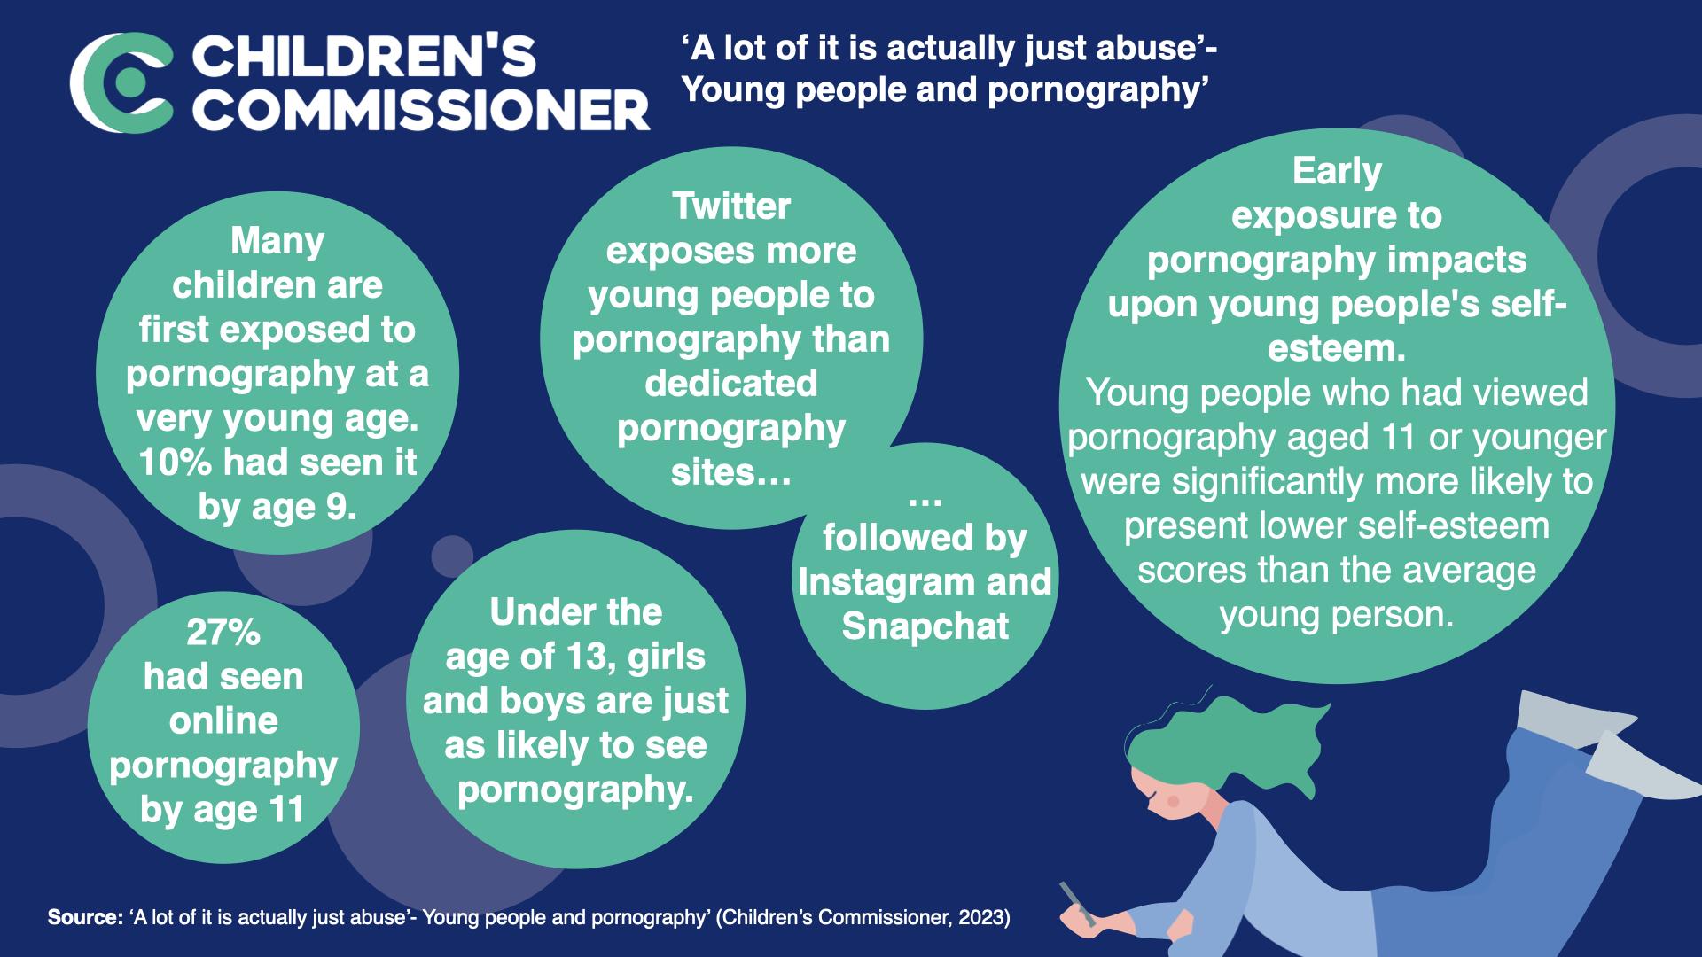
Examples of technology – Assisted Harmful Sexual Behaviours (TA-HSB’s)
Developmentally inappropriate use of pornography
Exposing other children to technology
Sexual harassment
Sending nude or semi-nudes
Harmful content
Age and stage inconsistencies
To access the full HSB identification tool, use this link - https://www.wirralsafeguarding.co.uk/harmful-sexual-behaviour/
Notes:
We know HSB’s exist on a spectrum from age and stage appropriate behaviour, to abusive, inappropriate and violent. Newer research shows technology assisted HSBs as a danger to vulnerable young people.
Examples of HSB can include - Touching genitals of other young people / Exposing themselves / Sexually explicit talk or touching of other children. Above are online / digital examples. To access the identification tool, use this link - https://www.wirralsafeguarding.co.uk/harmful-sexual-behaviour/

Slide 16
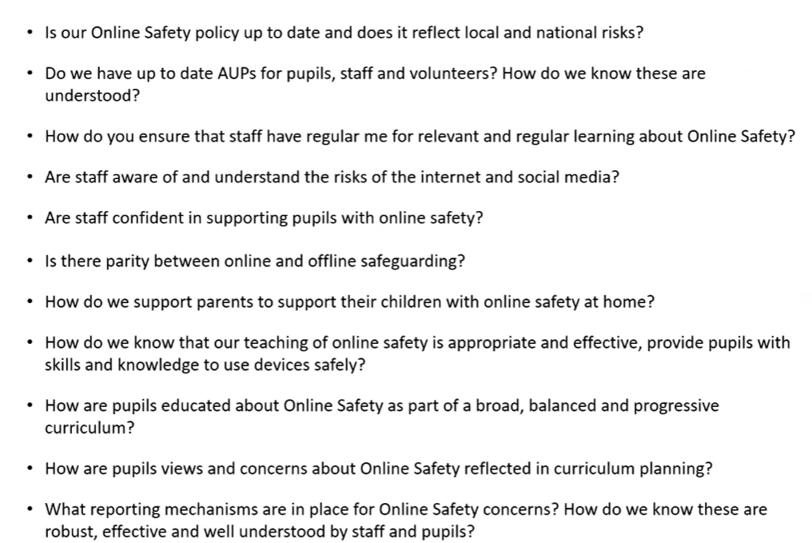
Digital Harms – Online Safety
Reflective Questions for the whole team
Notes:
AUP – acceptable use policy – what does your look like?

Slide 17
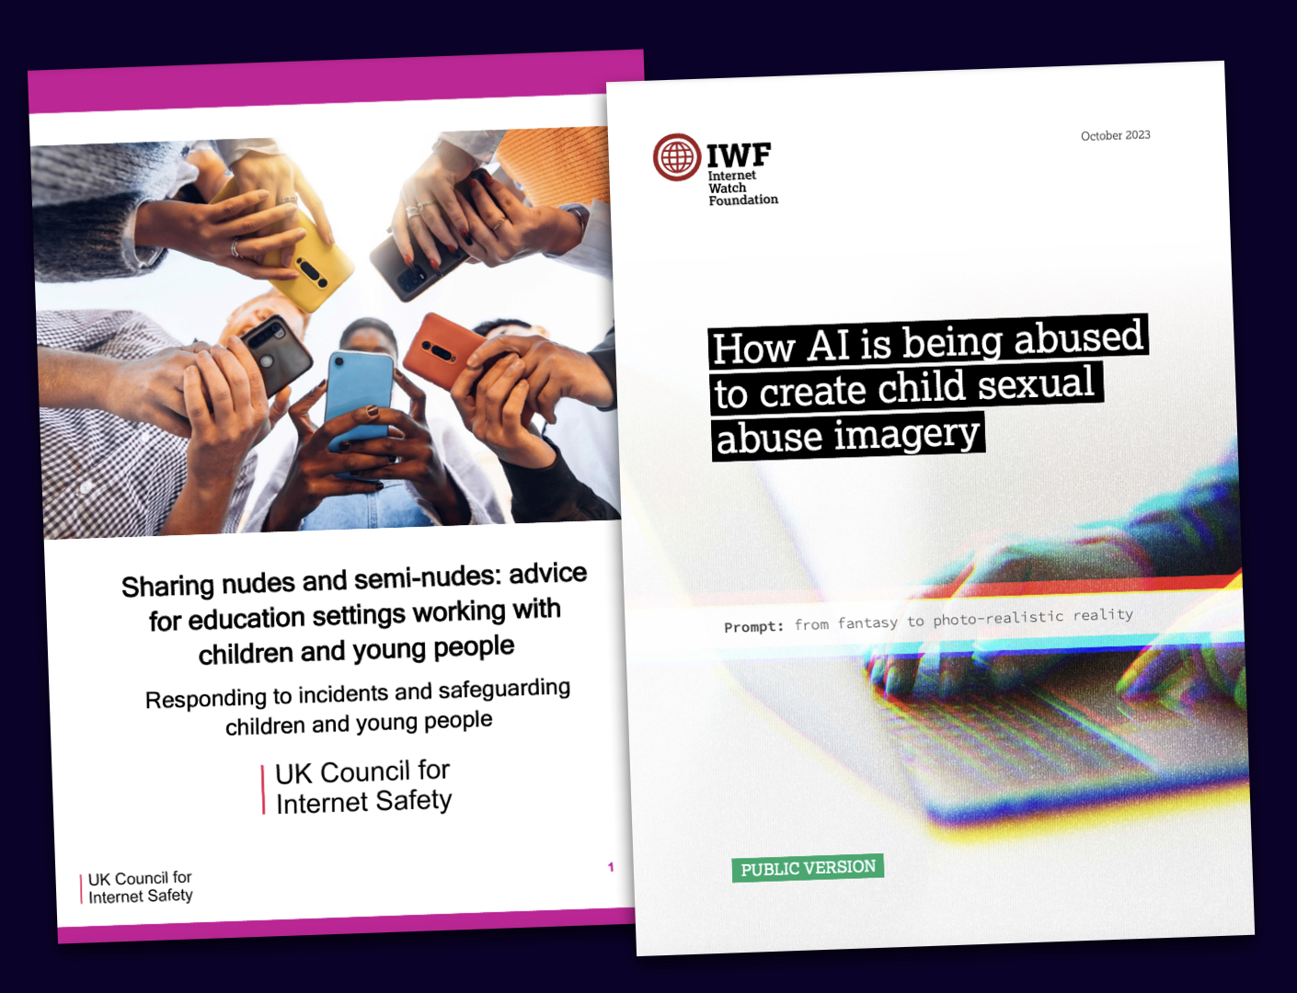

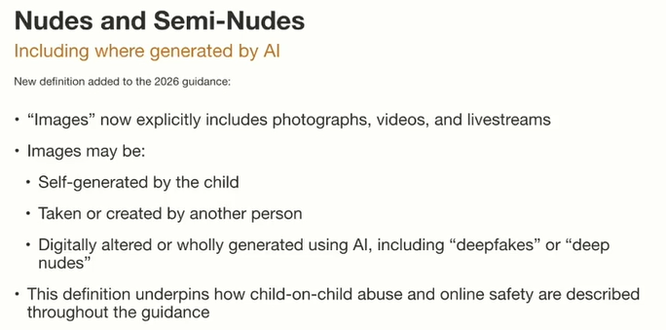

Nudes & Semi-Nudes
‘Emotional health needs drive teems to overshare, posting images of all types as the seek to be liked, admired or to escape from loneliness’ (source Look at Me: Teens, sexting and risks)
Notes:
Treat all incidents as safeguarding concerns, with the primary concern: Welfare and protection of young people involved.
Use proportional responses depending on the type and severity of the incident.
Recognise that peer-to-peer sharing can lead to school culture issues if not addressed properly.
2. Types of Incidents
Self-sharing: A minor creates and shares their own images with another minor.
Third-party sharing: A minor shares images created by another child.
Possession: A minor is in possession of images created by another minor.
Incidents may involve:
Aggravated/Adult-involved: Grooming, coercion, blackmail, sexual exploitation by an adult.
Youth-only intent to harm: Retaliatory or abusive sharing among peers.
Youth-only reckless misuse: Sharing without malicious intent, i.e., careless or naive distribution.
3. Risk Assessment
Assess motivations and severity, using typologies such as Finkelhor and Wolak’s youth-produced imagery cases.
Identify risk factors: coercion, public exposure, age disparity, digital manipulation (AI or deepfake imagery).

Slide 18
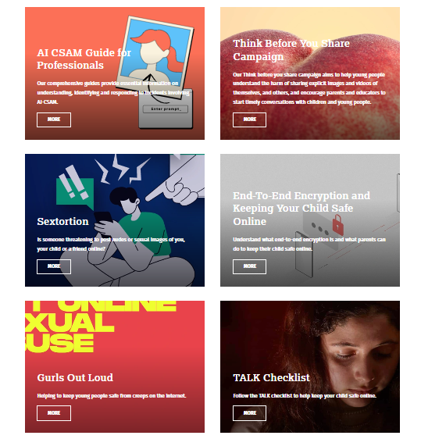

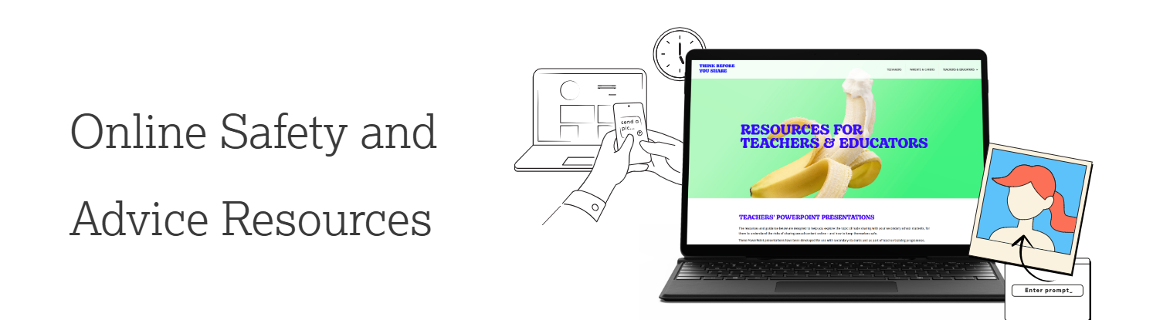
Support and Signposting
Notes:
Keeping children safe in education 2026
Info sharing - Child protection files must be maintained accurately, securely, and confidentially by the DSL at all times.
Safeguarding: This evaluation area considers whether:
The school establishes an open and positive safeguarding culture in terms of digital harms that puts pupils’ interests first / Leaders take an effective, whole-school approach to safeguarding
The factors are:
Protecting pupils from maltreatment and harm, whether within or outside the home or online; schools are vigilant, maintaining an attitude of ‘it could happen here’
Recognising that pupils who do not attend school (children missing education) might indicate safeguarding concerns, including neglect, emotional, physical or sexual abuse, or other harms both in and outside their home; these include concerns about child criminal or sexual exploitation, gangs, or online harms
Actively seeking and listening to the views and experiences of pupils, staff, and parents and carers (who we will refer to as ‘parents’ throughout, for ease of reading), and dealing promptly with any concerns

Slide 19
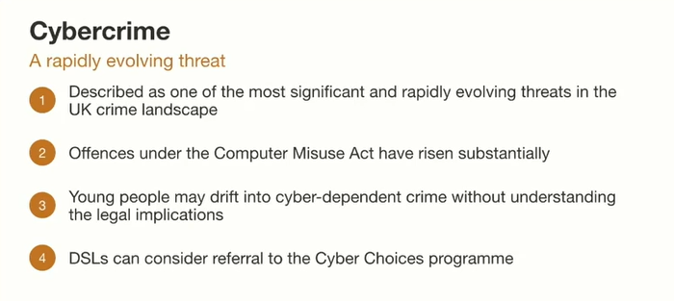
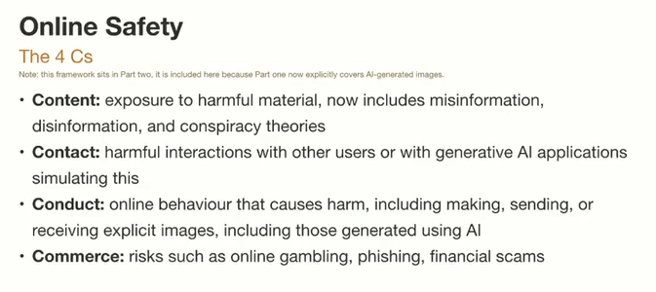

Cybercrime & Online Safety
How could the 4 C’s or cybercrime look in your setting? When in doubt, trust your gut instinct and always talk to a DSL about concerns!
Cyber Choices - National Crime Agency

Slide 20
Restrictive intervention, including reasonable force: the statutory requirements
Analysing data on restrictive interventions and reasonable force - school leaders should regularly review and analyse data on restrictive interventions to make sure that they:
Identify areas for improvement to policies and practices, particularly where strategies and interventions have not been effective
Identify areas for training and development for staff – for example, on how to use de-escalation techniques effectively
Understand regular patterns or triggers of behaviour for key pupils, to better support them through behaviour support plans
Identify when the use of restraint was used disproportionately with vulnerable pupils, including pupils with SEND
Notes:
Your governing board should regularly review and interrogate the data to make sure this is done. We'll provide support on how to do this, including questions to ask your school leaders, before the new guidance takes effect in April 2026.
Statutory recording and reporting requirements - Recording incidents
From 1 April 2026, your school has a legal duty to record and report all significant incidents (see 'Definitions' section, above) in which a member of staff uses force on a pupil, and any incidents where a member of staff uses seclusion or restraint on a pupil.
The incident should be recorded as soon as possible after the event. Ideally, this should be on the same day.
As minimum, members of staff should record the following details:
The names of the pupil(s) and staff involved
Any relevant needs or circumstances of the pupil, including if the pupil has SEND and their SEN code
The time, date, location and approximate duration of the intervention
Details of any physical injuries
Any support provided after the incident, including any medical treatment for injuries
If the staff member(s) used a restrictive intervention such as seclusion but didn't use reasonable force, the record should include:
A brief account of why the staff member(s) assessed that it was necessary to use the intervention
If they did use reasonable force, the record should include:
A brief account of the incident, including what led up to it, any known triggers that were or may have been involved, and any preventative or de-escalation strategies used
The type of reasonable force and the degree of force that was used
A brief account of why the staff member(s) assessed that it was necessary to use force

Slide 21
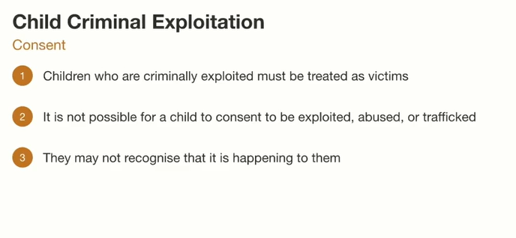
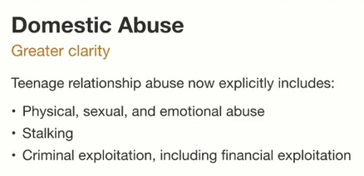
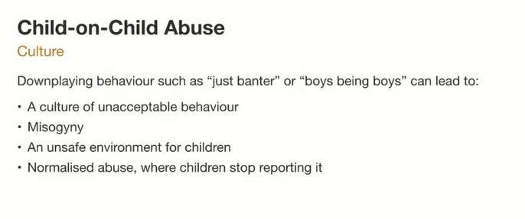
Domestic Abuse, Child on Child Abuse and CCE
How do we ensure as a team that we challenge inappropriate behaviours and see children as victims if exploitation is occurring?
Notes:
Keeping children safe in education 2026
Relationship Abuse of young people – they many not recognise the RED FLAGS related to exploitation and controlling behaviours in relationships.
Think about the culture of your setting and how we recognise the POTENTIAL for child on child abuse.

Slide 22

PREVENT DUTY – Notice, Check, Share
Notice Concerning Behaviour
  Staff should observe and recognise any worrying changes in a student's behaviour or demeanour, and report and record promptly and robustly.
Check With Colleagues
  Consult colleagues or safeguarding leads to gather more information and add to the context regarding the concern.
Share Through Safeguarding Channels
  Report concerns properly via your safeguarding systems, via a DSL (and the Integrated Front Door) if needed to ensure students are supported.
Follow Safeguarding Procedures
  Be familiar with your own setting safeguarding protocols and know the correct contacts for advice and referrals.
Notes:
The recommended approach for school staff is to Notice, Check, and Share. First, notice any concerning behaviour or changes in a student’s demeanor. Then, check with colleagues or safeguarding leads to gather more context. Finally, share the concern through the appropriate safeguarding channels, typically via the Integrated Front Door. If the concern involves potential radicalisation, a referral to the Channel process may be necessary. This structured approach ensures that concerns are handled consistently and that students receive the support they need. Staff should be familiar with their school’s safeguarding procedures and know who to contact for advice.

Slide 23
Holding and Sharing Information
Compliance with Data Protection
DSLs must comply with data protection laws including UK GDPR to safeguard children's information. However, the law does not prevent information being shared to keep a child safe
Maintaining Secure Records / Accountability
Accurate and secure record-keeping of concerns, decisions, and actions is essential for safeguarding. Fears about sharing information must not get in the way of a child’s safety.
Supporting Timely Interventions and Actions
Early information sharing is vital. Whether concerns are just emerging or they are known to social care. Staff must not assume other professionals will act!
“Effective sharing of information between practitioners and local organisations and agencies is essential for early identification of need, assessment and service provision to keep children safe.
Serious case reviews (SCRs) have highlighted fears about sharing information cannot be allowed to stand in the way of the need to promote the welfare and protect the safety of children.”
(Working Together 2026)
Notes:
The DSL must understand and comply with data protection legislation, including the UK GDPR. They are responsible for holding and sharing information appropriately to safeguard children. This includes maintaining detailed, accurate, and secure records of concerns, decisions, and actions taken. Effective information management supports timely interventions and ensures accountability in safeguarding practices. On the ground confident staff will share, report and record.

Slide 24
Supporting pupils who are questioning their gender
Social transition is where a child presents as the opposite sex. It might include:
Being referred to by
a different name
Using different pronouns
Wearing different gender-specific uniform
Participating in gender-specific sports or activities
As a setting, we should not initiate any action on social transition
Staff shouldn’t adopt any changes related to social transition
unless a decision has been made by the setting, and parents/carers have been involved
In the vast majority of cases, inform parents/carers of a pupil’s request to socially transition except in rare circumstances.
Settings must not allow pupils into facilities designated for the opposite sex, including toilets, changing rooms and residential accommodation
If in any doubt, go to the DSL or deputy DSL
Notes:
Tell staff that KCSIE 2026 includes new information on how to respond to a pupil or their parent/carer making a request to socially transition in school
Explain that social transition refers to where a child or their parent has requested that the school make changes, or put support in place, to facilitate the child presenting as the opposite biological sex. It’s not a medical process. A request to transition socially might include the pupil:
Being referred to by a different name
Using a different set of pronouns
Wearing different uniform items
Participating in gender-specific sports or other activities
Using facilities designated for the opposite biological sex (note that you’ll explain this later)
Acknowledge that it can be difficult to know the right action to take in these situations. Tell staff that they shouldn’t adopt any changes relating to social transition, unless a decision has been made by the school and parents/carers have been involved as set out in the KCSIE guidance
Explain that if a child requests changes relating to social transition, staff should talk to the DSL
Explain that your school will make decisions based on the following principles:
Its duty to safeguard and promote the welfare of all children in school
Taking a very careful approach to social transition
Its obligations under the Equality Act and Humans Rights Act
Considering ways the child may be potentially vulnerable in terms of mental health and psychosocial needs, such as their family and peer relationships
The importance of actively involving parents/carers as a matter of priority and treating their views with importance
Explain that if a child who is questioning their gender asks for support from the school, the school should inform parents/carers unless in the “rare circumstances” that involving parents or carers would constitute a great risk to the child than not involving them. Explain that, in these cases, it’s for the DSL to determine what action is needed to safeguard the child
Explain that, under the new KCSIE guidance, schools must maintain single-sex spaces including toilets, changing rooms and residential accommodation (with no exceptions). This means that you cannot allow pupils into facilities designated for the opposite biological sex or allow them to participate in sports designated for the opposite biological sex
Staff should also be aware of the possibility of discriminatory bullying and harassment in the case of children questioning their gender, take steps to prevent it and follow the school’s usual behaviour and sanctions procedures
Tell staff that gender-questioning children may also be vulnerable to other safeguarding concerns – tell staff that you’ll discuss this in more detail in the next section of this training
Tell staff that they can talk to you or another trusted member of senior staff if they’re concerned about how to approach the issue, or your school’s policy towards it
If your school has a policy/procedure on responding to and supporting pupils questioning their gender or wishing to socially transition, tell staff where to find it. If your school is developing a policy, reassure staff that they’ll have this in due course
Source:
GOV.UK – Department for Education (DfE), Keeping Children Safe in Education. https://www.gov.uk/government/publications/keeping-children-safe-in-education--2

Slide 25

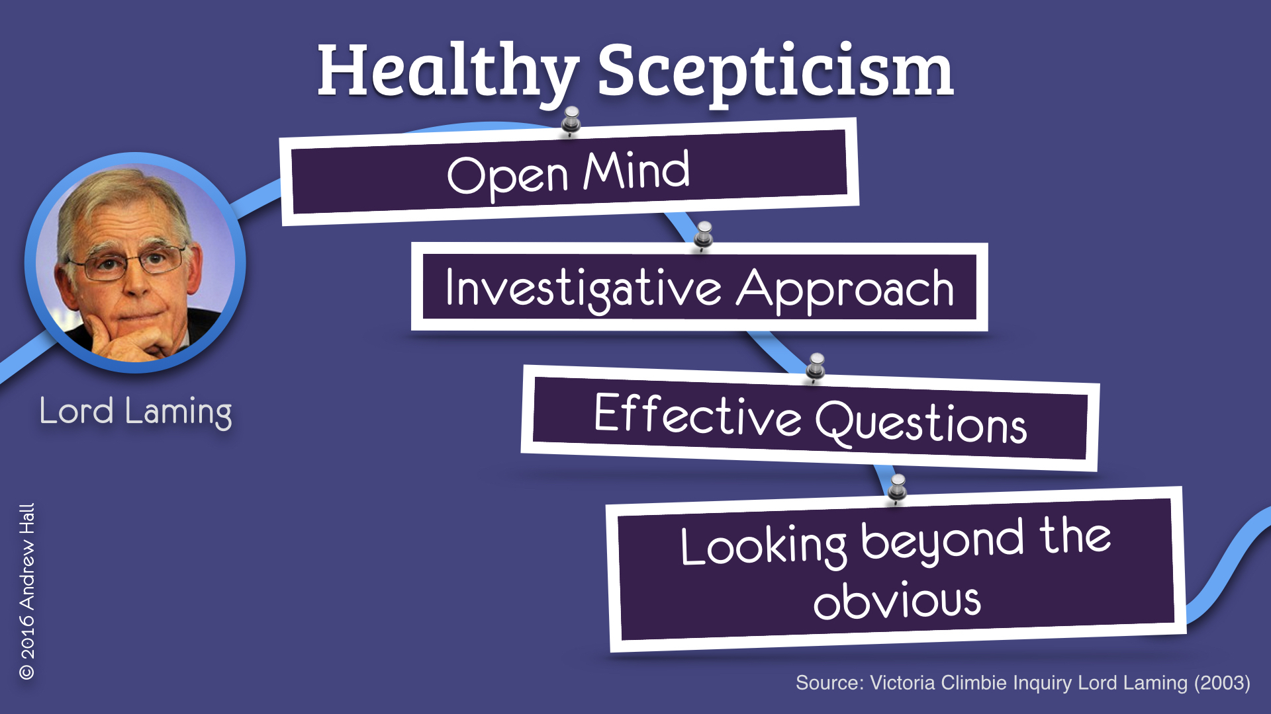
Professional Curiosity
What happened? Who was involved?
Note key details!
What can I do to help? Child friendly questions, with structure
How is it affecting the child
Intersectionality?
What do you need to move forward / help?
‘… it is the capacity and communication skill to explore and understand what is happening within a family rather than making assumptions, or taking a single source of information and accepting it at face value’
Being inquisitive & having difficult conversations is an important part of being professionally curious and providing effective safeguarding
Notes:
For ALL the above slides, it is important that staff stay curious, think the unthinkable and when appropriate to do so, ask questions
Lord Laming (independent reviewer for Victoria Climbe inquiry) talks about ‘respectful uncertainty’ which lies at the heart of the relationship between professionals and families.
PROFESSIONAL CURIOSITY (PC) is ‘the critical evaluation of information that families (or children) give to professionals
Questions drawn from restorative justice practice can be asked:
What has happened
PC is a key skill in SG, a way of engaging & communicating with CYPS and families, Doing our best to explore circumstances & taking an interest in people’s lives & avoiding making assumptions.
PC is all about not being afraid to ask questions of families, and do so in an open way, so they know that you are asking to keep the children safe, not to judge or criticise.
PC can be thought of as Healthy Scepticism ~ Respectful Uncertainty.
Comes out in serious case reviews that PC wasn’t evidenced, perhaps because practitioners were overly optimistic or lacks the confidence to ask sensitive Qs.
In order to be PC we need to test out our hypotheses of what is happening in a family, and get information from different sources. For e.g. a child presenting differently, speak to them about it & they share nothing of concern. Speak to other staff, siblings, parents, parents who have separated, other agencies.
“I’m wondering” .. “I’d like to talk to you about xyz” - Asking relevant questions to gather historical and current information
Being curious & having difficult conversations is an important part of being professionally curious and providing effective safeguarding
Ref page on website & 7 min briefing

Slide 26
Processes & Policies
Track and Monitor
Plus, robust procedures in place to deal with ALL types safeguarding concerns
Systems to record and track safeguarding concerns, the decisions made and all and the actions taken
Creating a Safe Culture
Training & Staff Support
Transparency & Consistency
Where all concerns about children are shared, recorded and dealt with appropriately
To ensure that adults working for and behalf of children are clear in how to safeguard
Notes:
Processes- ensure staff are aware & feel confident to use them. And policies: child protection, pupil behaviour and staff behaviour (your code of conduct).
Track-DSLs need daily tracking of systems
T&C when it comes to SG decisions and actions taken.
Training & staff support- Staff must understand particular vulnerabilities which make CYP more at risk of harm; SEND, LGBTQ, CLA
Safe culture doesn’t happen by accident, it is carefully nurtured and planned, reflected upon.

Slide 27
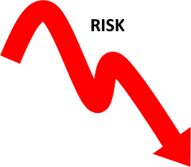

Everyone Has a Duty of Care to minimise risks to students and vulnerable adults, we must all take responsibility by:
Reducing opportunities and tolerance for ANY inappropriate behaviour
Creating environments where such behaviour is neither possible nor acceptable
Promoting early detection and the responsive pathways to share concerns
Encouraging vigilance and clear pathways for reporting any behavioural issues.
Ensuring robust staff support systems that protect EVERYONE
Providing guidance, supervision, and emotional support to empower staff in their safeguarding duty.
Building a strong, holistic safeguarding culture
One that is clearly understood, actively embraced, and consistently upheld by EACH PERSON.
Notes:
In order to reduce the risk of low level concerns arising we can take these steps:
Reducing acceptability by responding to them at the first opportunity. Low level concerns can arise from inadvertent or thoughtless behaviours – DSLs & SLT need to support staff to recognise them whether within themselves or another staff member.
Examples include:
Making inappropriate or personal comments
Breaching professional boundaries (e.g. favouritism, over-familiarity)
Using intimidating, shaming, or belittling language
Ignoring safeguarding procedures or concerns

Slide 28

Whistle Blowing
All staff and volunteers should feel able to raise concerns about poor or unsafe practice and know that such concerns will be taken seriously by the senior leadership team.
Where an adult feels unable to raise an issue, or feels that their genuine concerns are not being addressed, other whistleblowing channels are open to them:
Whistleblowing Advice Line is available for all workers - 0800 028 0285 / Email help@nspcc.org.uk
Students cannot be expected to raise concerns in an environment where staff members fail to do so
Notes:
If staff feel they can’t raise concerns then should have whistleblowing procedures in place.
Without these an environment where it is acceptable to harm children can develop.
Appropriate whistleblowing procedures should be put in place for such concerns to be raised with the school’s or college’s senior leadership team.
NSPCC Advice line
Key Point to remind staff: It’s better to report and get it wrong than not report and a child is abused.

Slide 29
What we ALL need to continue to do?
Take Time
To read and make sure you understand the range of guidance & policies about safeguarding relevant to you
Help Create
A positive, student focused, collaborative culture where everyone can speak out or share their concerns
Know & respond
To the signs and indicators of abuse / neglect, including online concerns & get to know the students
Report & record
Any concerns about students, including concerns about professional adults / those in positions of trust
Commit
to and engage in continued professional development, be professionally curious & stay vigilant!
Notes:
◼ Identify children and learners who may need early help or are at risk of neglect, abuse, grooming or exploitation
◼ Help prevent abuse by raising awareness among children and learners of safeguarding risks and how and where to get help and support if they need it
◼ Help those children who are at risk of abuse and need early help or statutory social care involvement, keeping accurate records, making timely referrals where necessary and working with other agencies to ensure that children and learners get the help and support they need
◼ Manage allegations about adults who may be a risk and check the suitability of staff to work with children, learners and vulnerable adult

Slide 30

To sum up:
Think the unthinkable…… it could happen anywhere
Stay vigilant and remember you are never alone in safeguarding!
Notes:
Think the unthinkable…… it could happen here!
Stay vigilant and remember…….. you are never alone in safeguarding

