Slide 1

STAFF SAFEGUARDING TRAINING UPDATE
SEPT 2025
Wirral safeguarding Children partnership
https://www.wirralsafeguarding.co.uk/schools/
Notes:
Supporting staff to feel comfortable and confident in their SG responsibilities
Your never alone in Safeguarding – when in doubt, ask!

Slide 2

The Safeguarding Role
Safeguarding and promoting the welfare of children is everyone’s responsibility. Everyone who comes into contact with children and their families has a role to play. In order to fulfil this responsibility effectively, all practitioners should make sure their approach is child-centred. This means that they should consider, at all times, what is in the best interests of the child
Keeping Children Safe In Education 2025 & Working Together to Safeguard Children 2023
Notes:
Unchanged definition from last year - No single practitioner can have a full picture of a child’s needs and circumstances. If children and families are to receive the right help at the right time, everyone who comes into contact with them has a role to play in identifying concerns, sharing information and taking prompt action.

Slide 3
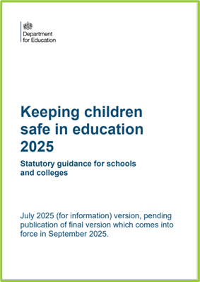
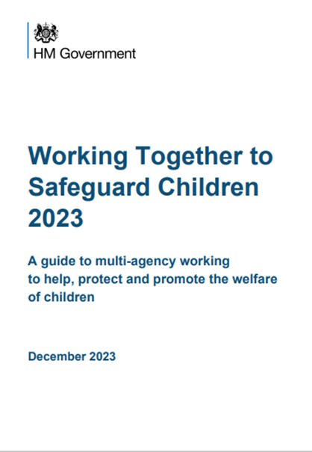

Preventing impairment of children’s mental and physical health or development
Protecting from
maltreatment, whether that is within or outside the home, including online
Taking action to enable all children to have the best outcomes
Children grow up in circumstances consistent with provision of safe & effective care
Providing help and support to meet the needs of children as soon as problems emerge
Safeguarding Definition
Notes:
WT breaks the definition down into 5 parts for us.
1: Definition of ‘Early Help’
2: SG Means protecting CYP from Maltreatment – From all forms of abuse (4 categories) and being aware that abuse can happen not just at home but also outside of the harm, CYPs can be risk of abuse from their peers, exploitation, county lines and we also must be aware that abuse can occur online, from cyberbullying, radicalisation or online sexual abuse.
3:Not only are we trying to protect CYPs from abuse also to re-inventing Impairment – To do this we need to be able to spot early signs that a child or family need help.
4:Safe & Effective care – This can be ambiguous, one persons understanding of what is safe & effective care, may be different to another. We are all individual, one persons view of an unsafe situation may be different to another persons. That’s OK, that’s why we need to work together & know that no-one person is solely responsible for SG a child’s – we need to work together with our colleagues and other agencies. It’s the reason why we have local thresholds and assessment frameworks – these give us a common language so that we can come to a shared understanding of what level of risk a child is at.
5:Best Outcomes – As said, this is the responsibility of everyone in the childs life- parents/carer, extended family, health services- Schools are in a key position to Promoting Physical and Mental Wellbeing; from helping them to build healthy relationships, promoting education and building self esteem, aspiring them to have goals and teaching signs of abuse.
Everyone who comes into contact with children and their families has a role to play.
All practitioners should make sure their approach is child-centred. This means that they should consider, at all times, what is in the best interests of the child.

Slide 4


The Threshold of Need
Integrated Front Door
9am - 5pm (Mon to Fri) - 0151 606 2008
Outside of these hours call - 0151 677 6557
In an emergency always dial 999.
UNDER DEVELOPMENT DUE TO PATHFINDER PROGRAMME
Notes:
Responding to need - A common language and understanding of children’s needs across all agencies. It empowers agencies to make the right decision for children and their families and enables agencies to be able to evidence improvement or deterioration with a family. This also supports staff in making a high-quality assessments of a family and highlights the positives within a family as well as any concerns. Links to threshold on a page document. Introduce Section 17 and Section 47 here and the distinction. S17 - CIN process . S47 CP processes. Mention RFS and also the CAF now EHAT.
AS Notes - Explain sections of the childrens act (17/47) E.g’s of cases going from green>/red>green (i.e. DV perp going to prison). E.g’s of immediate sig harm. Continuum supports quality assessment & referral.

Slide 5
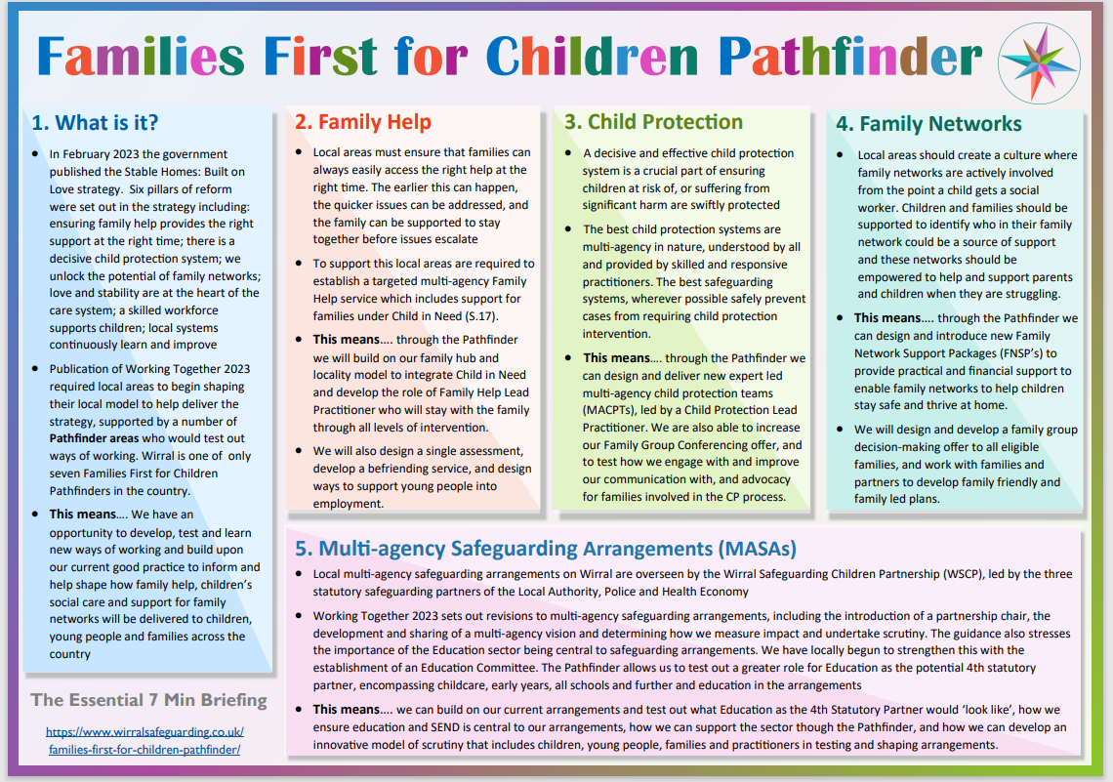

To find out more about Pathfinder Programme visit –
Families First for Children Pathfinder - Wirral Safeguarding Children Partnership

Slide 6


EARLY HELP AND OUR RESPONSE TO SAFEGUARDING:
‘Providing early help is more effective in promoting the welfare of children than reacting later. Early help means providing support as soon as a problem emerges, at any point in a child's life, from the foundation years through to the teenage years’
Professionals should be alert to the need for Early Help for a child who:
is frequently missing/goes missing from education, home or care
has experienced multiple suspensions, is at risk of being permanently excluded from schools, colleges and in alternative provision or a pupil referral unit
has a parent or carer in custody or is affected by parental offending
Is displaying non-violent Harmful Sexual Behaviours and
may prevent escalation of sexual violence.
Remember that the child’s safety is paramount.
Notes:
Early Help is what we want to be providing for all CYPs and families, as soon as a problem emerges we want to identify and respond to it. All the legislation and guidance tells us that in order to prevent problems from escalating and a child becoming at risk of harm then we need to be reacting as soon as we see a problem
Staff need to know how to identify children who may benefit from early help & what your local early help process is.
Staff need to know the signs of abuse and neglect, and what to do if a child makes a disclosure. KCSIE makes particular reference to responding to concerns around:
-missing-guidance language has been updated Moving away from terminology that suggests CYPs are deliberately missing education and encouraging prof. curiosity. The Terms are now ‘unexplainable & persistent’ we need to consider possible safeguarding risks e.g county lines.
-suspensions & risk of exclusion, in an AP or PRU- added vulnerabilities, be open to questioning whats going on underneath their behaviours
-parent in custody-these CYPs can feel isolated or ashamed. These CYPs can suffer with poor mental health, lack of support networks, can have experienced trauma if witnessed crime/arrest, more likely to be involved/drawn into crime.
SG responses should always keep the safety of the child at the centre.

Slide 7
YOUR ROLE IN IDENTIFYING CONCERNS MATTERS!!!
What we see...
What we hear…
What we are told…
“Report, Record, Seek help if we are unsure”
Notes:
EVERY staff member are the eyes and ears on the ground and may be the only person who sees, hears or are told something – it is vital we respond!
What might we see? Hear? Be told??

Slide 8

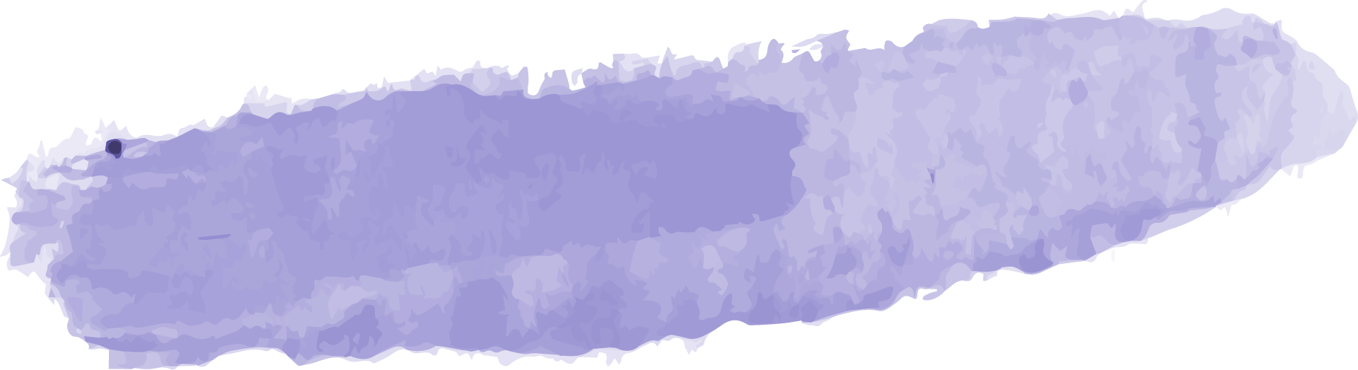


Physical Abuse
Emotional Abuse
CHILD ABUSE
Sexual Abuse
Neglect
Harmful touch and fabricated or induced illness
Persistent emotional maltreatment
Failure to meet basic needs
Forcing or enticing a child
Think about the physical & behavioural indicators
Discuss in groups what you may see, hear, be told?
!
Remember to consider the influence of the online community!
Notes:
Abuse is a form of maltreatment of a child. All types include inflicting harm, or by failing to act to prevent harm. Although it sometimes is abuse does not have to be a physical act with intent, for example a lot of CYP who are neglected the parent has not set out to do it, rather they lack the skills to care for their child or are preoccupied or prioritising their own needs (i.e. substance misuse)
Children may be abused by an adult or adults, institutions and also a child or children.

Slide 9
Learning from these case reviews emphasise that:
NSPCC – November 2021
Organisations need appropriate safeguarding and child protection procedures
Practitioners need to have the skills to identify indicators of child abuse (also child sexual abuse)
Practitioners need to apply professional curiosity
Practitioners need to take the child’s lived experience into consideration
Risk Factors and learning for improved practice
https://www.wirralsafeguarding.co.uk/pan-merseyside-masa-practice-learning-reviews-emerging-themes/
Notes:
Summary of Risk Factors around working in the early years sector - Case reviews published since 2017 highlight that practitioners don’t always have the right training to recognise and respond to child protection concerns or know what to do if they do have concerns. (Mention 100 days of SG)
All staff working in an early year's setting should have regular and ongoing safeguarding training early years settings should share information with other agencies.
Not able to recognise or identify indicators of child abuse, which meant that appropriate action to protect children wasn’t taken. In one situation, a manager dismissed concerns about a child having blue lips because the child was ‘very small and feels the cold’. The child was later found to have been experiencing neglect and physical abuse.
Some members of staff were aware of concerns about children, but these weren’t shared with nominated DSL. This was sometimes because the organisation did not have a formal process for recording and responding to concerns. Sometimes practitioners recognised that a child’s parents and carers needed support but didn’t consider the impact this would have on their ability to provide safe and loving care for their child or children. This meant the focus was on the adults, with support or services arranged for parents and carers, but children’s services weren’t informed.
In some situations, practitioners missed opportunities to find out more about a child’s home environment because they were not curious about the child’s lived experience outside the setting. For example, practitioners didn’t always seek further information from children, parents or carers when children had bruises or injuries. This meant that possible child protection concerns weren’t always recorded or responded to and practitioners weren’t able to identify patterns of behaviour that might cause a concern.

Slide 10

What do staff NEED to continue do?
Responding to concerns, trust your instincts!
Always share concerns about all adults in a position of trust posing a risk of harm to children
If a child is in immediate danger or at risk of harm, report, record, react
Responding to concerns about a child or children:
Act as soon as possible
Follow your child protection/safeguarding policy
Speak to your DSL (or senior leader) as soon as you can
Record and stay curious
Concerns about a staff member / those in a position of trust:
Staff should tell a Head Teacher immediately if they:
A child discloses (about a person in a position of trust)
Have safeguarding concerns that a member of staff is posing a risk of harm to pupils
Are making an allegation against another member of staff
When in doubt, share. It is better to be wrong and share, than to be right and not share
Notes:
DSL’s will / may: Manage any support for the child internally using the school's pastoral support processes / Do an early help assessment / Make a referral into IFD (this information should be kept confidential and stored securely)
Concerns about staff - (including supply staff, volunteers and contractors)If the DSL or deputy is not available, staff should: Not delay taking action / Speak to a member of the senior leadership team (SLT) /Contact the Integrated Front Door(IFD), if appropriate, and follow advice / Tell the DSL or deputy about any actions taken as soon as possible

Slide 11

Record Keeping:
Cases of good practice continue to indicate that quality,
meaningful records are always:
Contemporaneous (Up to date)
Formal / professional (steer clear of jargon)
Confidential (need to know basis)
Clear in evidencing the voice of the child
Clear in evidencing the impact of abuse on the child
The author owns the information
Clear evidence of any assessment tools used
Summarises concerns, actions and impact
Can demonstrate multi-agency working
Recording systems need to be contextual, follow the child’s journey, and tell the child’s story
Records should include:
• a clear and comprehensive summary of the concern
• details of how the concern was followed up and resolved
• a note of any action taken, decisions reached and the outcome and impact of interventions
Notes:
Quality Record Keeping is essential in good safeguarding practice.
Records must be kept of all SG concerns.
Are staff confident about the system you use? How do you know?
KCSIE tell us .. All concerns, discussions and decisions made, and the reasons for those decisions, should be recorded in writing. This will also help if/when responding to any complaints about the way a case has been handled by the school or college.
Quality of record should:
1: Be contemporaneous - include the time and date the disclosure was made or time/date the issue / concern arose. Also The time and date the record is being made e.g if it is made the day after or a few days this should be clear.
2: Formal, Clear and unambiguous notes- Make it accessible for all to read. Clear Records of any decision making / actions
3: Confidential
4: Voice - Should be include an accurate record of what has been said, using the child’s words if possible. An accurate record of what has been seen – if recording a physical injury/mark/bruise use good practice to use a body charts.
5: Impact – how they have presented upon telling you the disclosure/noting the concern
6: Whether the information is 1st hand, 2nd hand, fact or opinion- did you hear it from another staff member? Another parent? Should be clear who has written the info.
7: Assessment Tools – encouraged to strengthen evidence.
Schools are often asked to contribute to assessments & reports for social care or legal proceedings, so ensuring records meet all of the above will assist when contributing.
Child’s story – Remember CYP can request their records after their 13th Birthday.

Slide 12
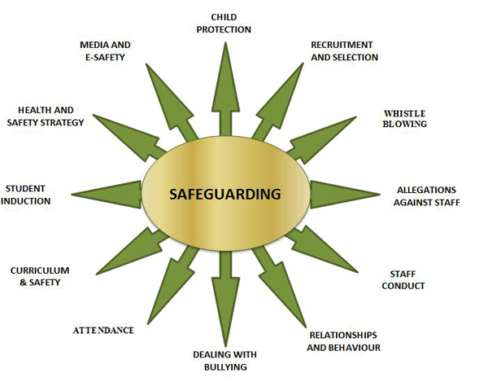


ACTIVITY - HOW CAN YOU HELP TO SAFEGUARD CHILDREN?
What other processes do we have to safeguard?
Are they part of a safeguarding action plan?
How do we together assess and celebrate the effectiveness of safeguarding practices?
Notes:
Talk through the elements - Ask the delegates what processes does the school or college have to safeguard?
See what other answers they suggest – are they already part of your action planning?
How do they know what they can safeguard and how can we assess the effectiveness of safeguarding practices?
Staff need to know how to identify children who may benefit from early help, what your local early help process is and each staff member’s role in accessing early help.
Family circumstance presenting challenges for the child, parental drug and alcohol misuse, adult mental health issues and domestic abuse (was toxic trio research found this is unhelpful
Is misusing alcohol and other drugs themselves
AI- imagery support imposed.
has returned home to their family from care
Is at risk of ‘honour’-based abuse such as Female Genital Mutilation or Forced Marriage - EXPAND
is a privately fostered child – Non family 28 days +
persistently absent from education, including persistent absences for part of the school day.

Slide 13
A strong, proactive safeguarding culture helps…
Identify those who may need early help or are at risk of neglect, abuse, grooming, radicalisation or exploitation
Prevents abuse by raising awareness among children and adults of a wide range safeguarding risks and how and where to get help and support if they need it
Effectively manages allegations and low-level concerns about adults who may be a risk and checks the suitability of staff to work with the most vulnerable
The making of timely referrals where necessary and work proactively with other agencies to ensure that children get the help and support they need
Notes:
◼ Identify children and learners who may need early help or are at risk of neglect, abuse, grooming or exploitation ◼ Help prevent abuse by raising awareness among children and learners of safeguarding risks and how and where to get help and support if they need it ◼ Help those children who are at risk of abuse and need early help or statutory social care involvement, keeping accurate records, making timely referrals where necessary and working with other agencies to ensure that children and learners get the help and support they need ◼ Manage allegations about adults who may be a risk and check the suitability of staff to work with children, learners and vulnerable adult

Slide 14
What Can Be Done to support all the most vulnerable?
▪ Look for opportunities to be proactive not reactive
▪ Create an open culture where communication can happen
▪ Challenge unacceptable behaviours
▪ Educate about identity, safe relationships, safe messages (think about all the opportunities to focus on preventative education e.g. – teaching content, circle time)
▪ Think about the context of the issues you are faced with
▪ Model appropriate responses, be the best version of you
▪ Be open minded and do not make assumptions
https://www.youngminds.org.uk/media/qs5luamr/vulnerable-groups-toolkit.pdf
Notes:
The assessment should consider: ▪ The support and protection provided to the victim and any witnesses ▪ The support provided to the alleged perpetrator and an evaluation of ongoing risk ▪ The support to all other children at the school/college (and adult students/staff if appropriate) ▪ The assessment must be recorded (written or electronically)
Safeguarding Lead or Deputy should complete a risk and needs assessment immediately

Slide 15

ACTIVITY – HOW DO WE OVERCOME THE COMPLEX CHALLENGES FOR SEND CHILDREN?
Communication barriers and difficulties in managing or reporting challenges for SEND children
Being more prone to peer group isolation or bullying (including prejudice-based bullying) than other children.
Assumptions that indicators of possible abuse such as behaviour, mood and injury relate to the child’s condition without further exploration
The potential for children with SEND or certain medical conditions being disproportionately impacted by behaviours such as bullying, without outwardly showing any signs
Being unable to understand the difference between fact & fiction. Repeat behaviours in schools or colleges
Notes:
Keeping Children Safe in Education remind us of the additional safeguarding vulnerabilities of children with SEND. However, if we are to ensure their effective safeguarding, we need to probe these points more deeply. To start, we need to be conscious that children with SEND are not a single group with identical needs. Ensuring their safeguarding requires us to consider their individual needs, strengths and difficulties.
Effective safeguarding is dependent on knowing and listening to our children.

Slide 16
Risk and Vulnerability Factors for SEND children
No barriers to Communication
Enough information on staying safe
A focus on decreasing Isolation
Minimising the Dependency on others
Adequate support
Limited Access to Support Systems
~
Assessments should seek to understand how parents are supported to meet the additional needs of caring for a disabled child
~
What other support is available in Wirral?
Are we clear on if there is ….. ?
https://www.sendlowirral.co.uk/
Notes:
Five recognised areas of vulnerability are detailed and should be minimised as much as possible for the child to thrive and stay safe.
There are several factors that contribute to disabled children and young people being at a greater risk of abuse.
Disabled children and their families may have limited access to support systems. Support may not be available due to lack of funding or it may not be appropriate for the child’s physical, emotional or cultural needs. This can make it difficult for parents to provide the care their child needs and add to the pressure of caring for a disabled child.
If you are assessing the needs of a child & family with disabilities:
Seek to understand if the parents understand and are supported to meet the additional needs of caring for a disabled child.
Professionals should be aware of the range of services available to families and disabled children. Families and children should be referred to these services accordingly.
What services are in Wirral for families & disabled children? SENDLO
Wirral Council SEND Improvement notice May 2024 – Expanding teams & services, improving EHCP waiting times
Ref – NSPCC SG children with SEND course (E-Learning £30)

Slide 17
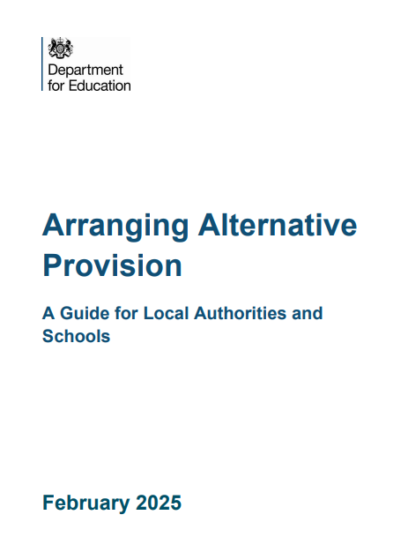
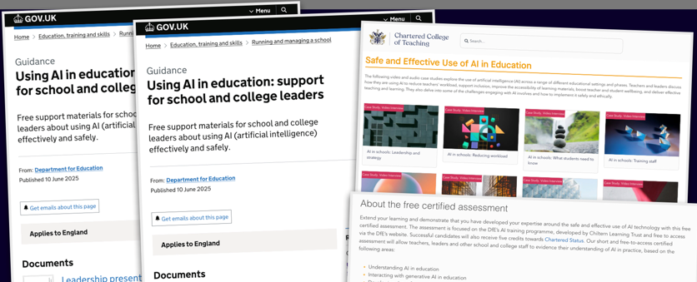
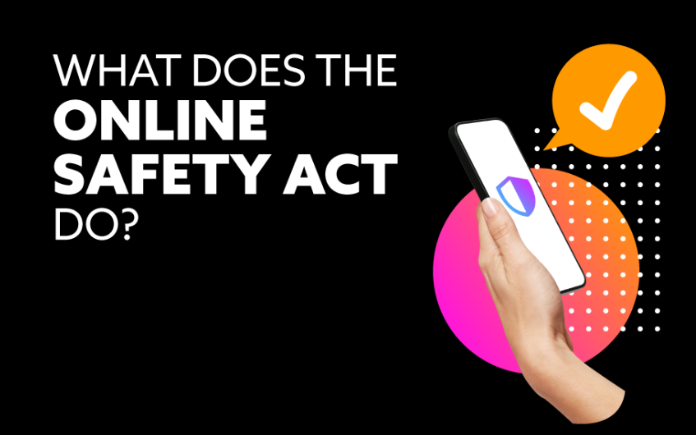
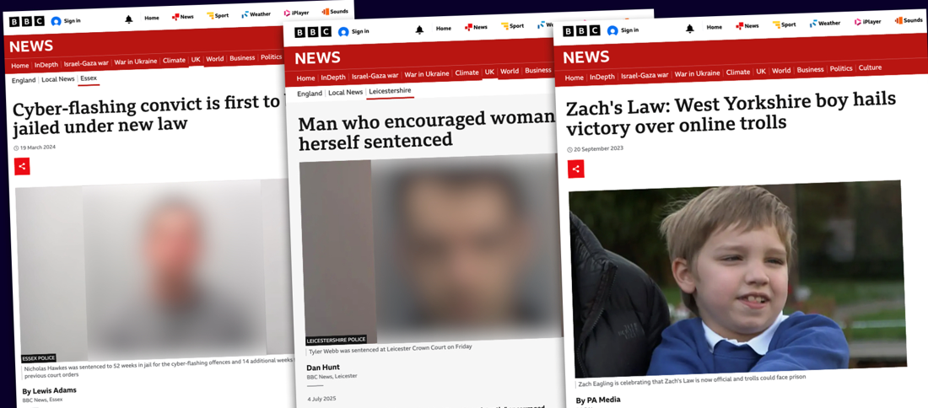
What’s new in safeguarding
Notes:
AI guidance
AP guidance
CSA recommendations
Online Safety Act - https://www.gov.uk/government/publications/online-safety-act-explainer/online-safety-act-explainer

Slide 18
What can we expect following on Keeping Children Safe in Education 2025?
Links to DfE policy paper on Generative artificial intelligence (AI) in education
More on Martyn's Law & Protective Security - formally the Terrorism (Protection of Premises) Act 2025
Child sexual exploitation and abuse report – Government key recommendations to follow
Further support for gender questioning children – their needs and vulnerabilities explored
EYFS statutory framework – link to changes for September 2025 and next steps
Updates on influencers, Incel Culture and the Manosphere and their effect on radicalisation
Notes:
Implementation of the newly published standards for 'Filtering and Monitoring'. In particular all staff are to understand their role in this, and DSLs are expected to have the 'lead responsibility’ – what does this mean for your setting and the DSL team. Every school should have digital filtering systems in place to block harmful content & provide reports of both CYPs & staff trying to access it.
Where schools are used for non-school activities, those providers are expected to meet the guidance in Keeping Children Safe in Out of School Settings (see paragraph 167)
Guidance around Miss Ed has changed- Moving away from terminology that suggests CYPs are deliberately missing education and encouraging prof. curiosity. The Terms are now ‘unexplainable & persistent’ we need to consider possible safeguarding risks e.g county lines.
A DFE consultation is currently in place on how schools can make considered and lawful decisions in relation to children who are questioning their gender, whilst Considering their needs and vulnerabilities. The proposed draft provides guidance on steps to take if a child requests social transitioning i.e. changing name, uniform, pronouns, use of facilities.. And protecting CYP questioning their gender from bullying and abuse. Schools should follow KCSIE guidance on page 55.
Updated resources –SEND online safety teaching toolkit developed by Childnet, booklets to support CYP who are involved in police investigations and going to court, Shorepsace- web safe space for teens worried about sexual behaviour.
Terminology has changed from ‘vulnerable’ to radicilsation to ‘Susceptible to radicalisation – to acknowledge that every child is vulnerable
Forced Marriage: Since February 2023 it has also been a crime to carry out any conduct whose purpose is to cause a child to marry before their eighteenth birthday, even if violence, threats or another form of coercion are not used. As with the existing forced marriage law, this applies to non-binding, unofficial 'marriages' as well as legal marriages.
Shortlisted candidates’ informed that online searches may be done as part of pre-recruitment checks
Following the end of the work of the Independent Inquiry into Child Sexual Abuse (IICSA), the obligation to 'preserve records' for the inquiry has now been removed.

Slide 19
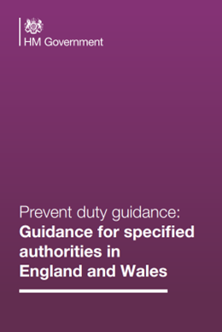
What is Prevent duty in Education?
N
OTICE
HECK
S
HARE
C
The Prevent duty requires all education providers ‘to help prevent the risk of people becoming terrorists or supporting terrorism’. This includes safeguarding learners from extremist ideologies and radicalisation.
Providers should consider the needs of children, young people and adult learners at each stage of the safeguarding process, and in line with their existing safeguarding processes, skills and experience (updated Sept 2023)
Notes:
The Prevent duty (updated 07 Sept 2023) is to have due regard to the need to ‘Prevent’ people from being drawn into terrorism. In July 2015, the Prevent Duty for Further Education in England and Wales also came into force. Schools should, however, be mindful of their existing duties to forbid political indoctrination and secure a balanced presentation of political issues.

Slide 20
PREVENT & MARTYN’S LAW
The Terrorism (Protection of Premises) Act 2025
The new Terrorism (Protection of Premises) Act 2025, also known as Martyn’s Law, places a duty on those responsible for premises and public events, including schools, requiring them to take appropriate action to strengthen public safety against acts of terrorism.
There is to be implementation period of 24 months, during which the Home Office will release statutory guidance to assist settings in understanding and fulfilling their requirements. Ultimately, the Act aims to improve preparedness across the UK in response to the evolving threat of terrorism
https://nationalcollege.com/news/the-terrorism-protection-of-premises-act-2025-passes-into-law
Notes:
The Act received Royal Assent on 3 April 2025, and is undergoing an implementation period of 24 months, during which the Home Office will release statutory guidance to assist stakeholders in understanding and fulfilling their requirements. Ultimately, the Act aims to improve preparedness across the UK in response to the evolving threat of terrorism.
Under the Act, ‘premises’ fall into two categories based on expected attendance: ‘standard duty’ and ‘enhanced duty’.
Standard duty premises – which expect to host 200 or more individuals – are required to maintain basic procedures to respond effectively to potential threats.
Enhanced duty premises – anticipating 800 or more attendees – face more stringent obligations to implement comprehensive security measures that further mitigate risks and enhance safety. However, under the Act, enhanced duty requirements will not apply to premises used for childcare or primary, secondary, or further education. Such settings will always count as standard duty premises – even if their attendees exceed 800 people.

Slide 21
CONTEST AND PREVENT 2025
Children may be susceptible to radicalisation into terrorism. Similar to protecting children from other forms of harms and abuse, protecting children from this risk should be a part of a schools or colleges safeguarding approach.
Extremism is the vocal or active opposition to our fundamental values, including democracy, the rule of law, individual liberty and the mutual respect and tolerance of different faiths and beliefs. This also includes calling for the death of members of the armed forces.
Radicalisation is the process of a person legitimising support for, or use of, terrorist violence.
Terrorism is an action that endangers or causes serious violence to a person/people; causes serious damage to property; or seriously interferes or disrupts an electronic system. The use or threat must be designed to influence the government or to intimidate
Notes:
ASK- What is extremism? Extremism means fundamental opposition to British Values; democracy, the rule of law, individual liberty, mutual respect and tolerance.
What is radicalisation? It’s the process by which extremism comes about – GROOMING – No different to SG CYPs from exploitation
Just like other SG risks, radicalisation is another form of harm that CYP need to be protected against. Schools play a crucial role in protecting CYP from radicalisation.
If a school is concerned that CYP is being radicalised they should consider a referral to CHANNEL Programme which is part of the governments counter extremism plan. In 2022 (most up to date figures) there were over 6000 CYP referred to Prevent. Schools are the biggest sources of referrals into Prevent. The referral is not about criminalising CYPs but supporting & deterring CYPs from extremist & terrorist ideologies.

Slide 22

PLEASE REMEMBER
You are never on your own….All concerns should be shared with appropriate staff – a DSL is your first port of call
Most children live in loving and caring families and communities, who want the best for their child(ren), but we need to stay vigilant and trust your instincts
Notes:
You have a huge role to play in safeguarding children - by being vigilant, by listening to them and by passing on your concerns.

Slide 23

What continues make staff vulnerable and why?
Individually
Being alone with a child
Administering first aid / giving medication
Restraining a child (de-escalation)
Use of technology (Social networking sites)
Conversations with parents (1:1)
When a child seeks affection (in person or online)
Providing intimate personal care
The emotional impact of safeguarding children
Systematically
Lack of training or support
Being unclear about procedures / guidance
When you fail to report a concern or seek advice
Poor communication
Failing to record
Culture and ethos
WHAT ELSE SHOULD WE BE CONSIDERING AND HOW ARE WE MINIMISING ALL VULNERABILITIES?
Notes:
Keep ourselves safe when working with children.
Are situations that can put us more at risk of allegations:
Being alone – learning discussions or sensitive discussions i.e. bullying discussion
CYPs are taken out of the classroom for medication/first aid to a quiet environment
Restraint – a CYP may react to a distressing situation by displaying behaviours which are a harm to themselves or others. In schools we want to use our policies to reduce the need for restrictive intervention however there may be times when it is the only realistic option to protect a child or others i.e. a child about to run into a busy main road or a child is attacking another pupil or staff member and refuses to stop when asked. Wherever possible it should be avoided and we should adopt proactive, preventative and none restrictive approaches when dealing with challenging behaviour. Restraint is distressing for both CYP & Staff. Restraint should be recorded and reported to SLT/DSLs, post incident support given to both CYP & staff and a review of the circumstances afterward to minimise risk of it happening again.
CYPs seeking to communicate online
1:1 with parents particularly if it’s a sensitive issue
Times staff need to provide Intimate care due to health reasons
Vulnerabilities can manifest themselves due to systems and organisationally – link to a position of trust!

Slide 24
Protection and lowering risk
When working 1:1 with young people or vulnerable adults – Make sure to:
Tell an appropriate member of the team, preferably someone with safeguarding responsibility (DSL), the time and place when you are alone with a child.
Choose a suitable venue: use a room with windows so people can see in / or leave the door open (risk assess).
Ensure the person knows they have the right to stop the one-to-one contact at any time and make sure they know how to complain.
Explain to the child or vulnerable adult that they can access support if they need to talk about anything.
Keep a record of the fact you were alone with a child or vulnerable adult, recording the reason you were alone and describing what happened.
Notes:
Best practice for one-to-one working -There are several measures you should put in place when working alone with a child or young person to make sure you are both protected.
Safeguarding is most successful when all aspects are integrated together. Three key elements include a clear safeguarding ethos (culture), policies that sets out clear expectations and processes, and high-quality training that ensures staff know what to do and do it consistently.

Slide 25
What we ALL need to continue to do?
Take Time
To read and make sure you understand the range of guidance & policies in your setting
Help Create
A positive, child focused culture where children can speak out or share their concerns with staff
Know & respond
The signs and indicators of abuse / neglect, including online concerns & get to know your learners
Report & record
Your concerns for children, including concerns about professional adults / those in positions of trust
Commit
to and engage in continued professional development, be professionally curious & stay vigilant
Notes:
◼ Identify children and learners who may need early help or are at risk of neglect, abuse, grooming or exploitation
◼ Help prevent abuse by raising awareness among children and learners of safeguarding risks and how and where to get help and support if they need it
◼ Help those children who are at risk of abuse and need early help or statutory social care involvement, keeping accurate records, making timely referrals where necessary and working with other agencies to ensure that children and learners get the help and support they need
◼ Manage allegations about adults who may be a risk and check the suitability of staff to work with children, learners and vulnerable adult

