Slide 1


Ketamine Awareness
Narrated PowerPoint Presentation
May 2024

Slide 2
Aims of session
Understand what Ketamine is
Discuss prevalence in our community
Effects and Risks
Wirral Response to risks
Notes:
This session has been developed in response the growing prevalence of Ketamine within our community over the last 12-18 months.

Slide 3
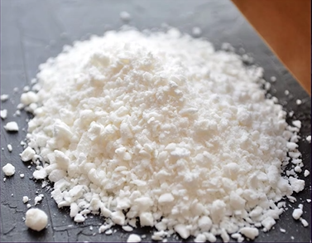
What is Ketamine?
Ketamine is an anaesthetic and analgesic (pain killer)
Used recreationally for its dissociative and psychedelic properties
Often sold as a white (or off-white/light brown) powder of tiny crystals, with a similar appearance to that of Cocaine
Taken by sniffing or orally

Slide 4
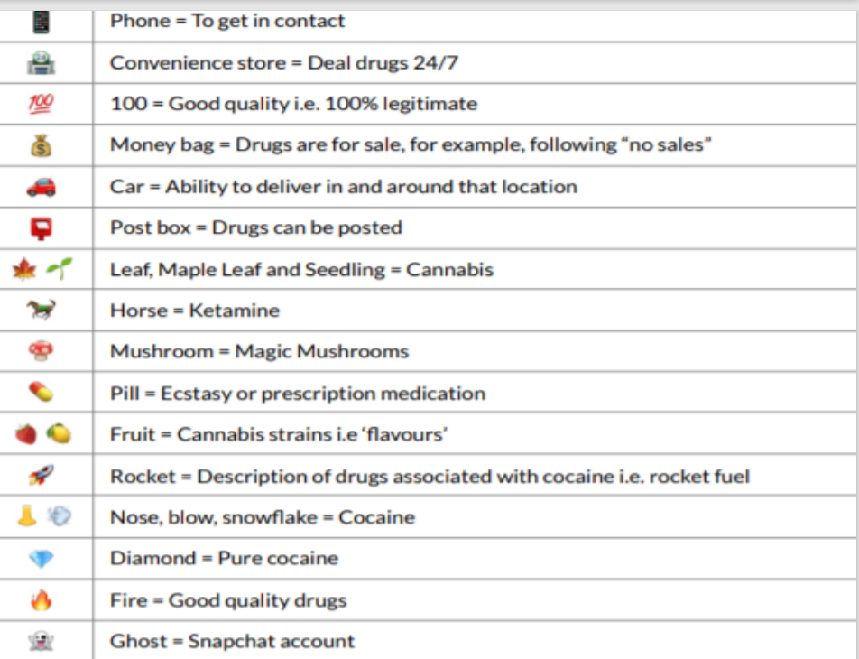
What is Ketamine?
Local street names include K, Ket, Kenny, Special K
Young people can access via social media

Slide 5
Prevalence of Ketamine
A more noticeable presence of Ketamine in our community since 2022, with a significant increase of referrals into services over the last year naming Ketamine as the drug of choice
Predominantly produced in Asian countries, the increased popularity in Europe in recent years has drawn the attraction of local OCGs involved in Cocaine supply.
The UK is also believed to be a key transit country in relation to the onward supply of Ketamine
Recent reports state that recreational use of Ketamine may overtake that of Cocaine due to availability and price
Since 2015/16 there has been a 1840% increase in Ketamine related offences within Merseyside from 10 offences in 2015/16 to 194 offences in 2022/23. Year on year, the number of Ketamine offences has increased.

Slide 6
Effects of Ketamine
15-20 mins to work on average
Effects last 30 mins – 1 hour
Ketamine is a general anaesthetic, so it reduces sensations in the body.
Ketamine can alter perception of time and space, in some cases causing hallucinations
Ketamine can stop a person feeling pain

Slide 7
Effects of Ketamine
It can make people seem slower, more relaxed and chilled out, but it can also stop people from being able to move properly and from making sense.
K-Hole
This feels like your mind and body have separated and you can't to do anything about it – which can be a very scary experience.
Increased heart rate and blood pressure.
Feeling of confusion, becoming agitated, delirious and disconnected from reality.

Slide 8
Why do young people take it?
Ketamine is Cheaper than other drugs- local young people report paying between £15-£30 for 1 gram
Availability
Can produce feelings of dream-like and detached, chilled, relaxed and happy
At low doses it can produce states similar to ecstasy
Psychonauts - A term refers to those who have an interest in exploring and expanding their consciousness through use of psychoactive substances
Notes:
Users of Ketamine may view this is their primary reason for consumption.

Slide 9
Risks of using Ketamine
Ketamine is a very powerful anaesthetic that can cause serious harm. Taking ketamine can be fatal, particularly if it is mixed with other drugs or alcohol
Nausea
Damage to short and long term memory
Flashbacks and problems with concentration
Regular use can cause depressing and occasionally psychotic symptoms such as hallucinations
Paralysis of muscles and the mind’s loss of touch with reality
Ketamine can cause serious bladder problems

Slide 10
Ketamine Bladder Syndrome
Ketamine can cause serious bladder problems, with the urgent and frequent need to pee.
This can be very painful, and the pee can be blood-stained.
Although stopping using ketamine can help, sometimes the damage can be so serious that the bladder needs surgical repair or even removal.
Can lead to incontinence.
Abdominal pain, sometimes called ‘K cramps’, have been reported by people who have taken ketamine for a long time.
Evidence of liver damage due to regular, heavy ketamine use is emerging.
Recently a young person in Wirral has undergone bladder surgery due to prolonged use of ketamine.

Slide 11
Clinical trials for treatment of depression
Medical grade ketamine is now being researched as a potential treatment for severe depression, but it is too early to know the results of this research.
NHS Licensed nasal spray
Not routinely used
For people diagnosed with depression who have not responded to other treatments
Self-pay treatment service

Slide 12
Wirral Ketamine Campaign
Combatting Drugs Partnership Wirral is a nationally mandated partnership which aims to break drug supply chains, deliver a world-class treatment and recovery system, and achieve a shift in the demand for drugs.
Launch Mid June 2024
All schools will receive a letter to parents , PSHE 30 min Lesson Plan & Staff Training.

Slide 13
End of presentation
Local support services
Response Drug & Alcohol Service; a confidential service for 13-19 year olds. Parents can contact on 0151 666 4123 or via response@wirral.gov.uk
Wirral Ways Change Grow Live; is a drug service for adults. Contact 0151 665 1335, wirral.services@cgl.org.uk or http://www.changegrowlive.org/wirral-ways
Integrated Front Door; for advice and guidance on safeguarding queries 0151 606 2008
www.wirralsafeguarding.co.uk/ketamine
Notes:
Thankyou for taking the time to learn about this important issue.
Contact details for our local substance misuse service are listed here, along with our integrated front door for safeguarding advice.

