Slide 1

STAFF SAFEGUARDING TRAINING UPDATE
SEPT 2024
Wirral safeguarding Children partnership
https://www.wirralsafeguarding.co.uk/schools/
Notes:
Supporting staff to feel comfortable and confident in their SG responsibilities
Your never alone in Safeguarding – when in doubt, ask!

Slide 2
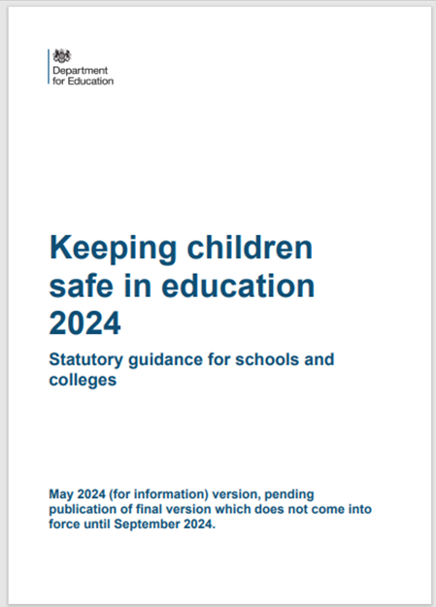

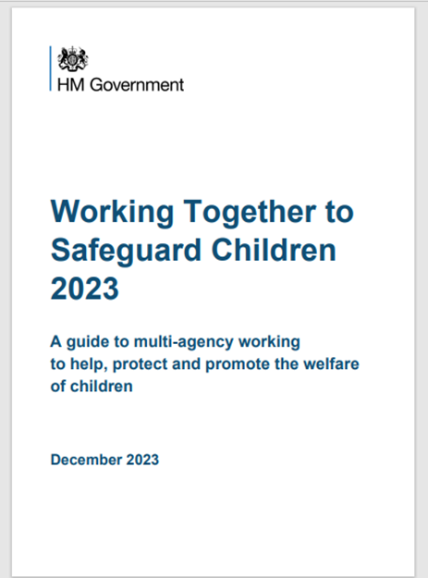
Safeguarding Definition
Preventing impairment of children’s mental and physical health or development
Protecting from
maltreatment, whether that is within or outside the harm, including online
Taking action to enable all children to have the best outcomes
Children grow up in circumstances consistent with provision of safe & effective care
Notes:
Providing help and support to meet the needs of children as soon as problems emerge = Early Help
Maltreatment – All forms of abuse (4 categories) also Harm Outside The Home (HOTH). The has been a big push over the last few years to ensure we as practitioners know how to respond to HOTH including child exploitation and child on child abuse.
Preventing Impairment – To do this we need to be able to spot early signs that a child or family need help
Safe & Effective care – When we spot those early signs of abuse or neglect, we need to support families with a strengths-based approach.
Best Outcomes – Schools are a key partner in Promoting Wellbeing of CYP (Physical and Mental Health). Importance of RHSE?
Everyone who comes into contact with children and their families has a role to play.
All practitioners should make sure their approach is child-centred. This means that they should consider, at all times, what is in the best interests of the child.

Slide 3

Integrated Front Door
9am - 5pm (Mon to Fri) - 0151 606 2008
Outside of these hours call - 0151 677 6557
In an emergency always dial 999.
Notes:
Responding to need - A common language and understanding of children’s needs across all agencies. It empowers agencies to make the right decision for children and their families and enables agencies to be able to evidence improvement or deterioration with a family. This also supports staff in making a high-quality assessments of a family and highlights the positives within a family as well as any concerns. Links to threshold on a page document. Introduce Section 17 and Section 47 here and the distinction. S17 - CIN process . S47 CP processes. Mention RFS and also the CAF now EHAT.
UPDATED in light of Working Together to Safeguard Children – Dec 2023.

Slide 4

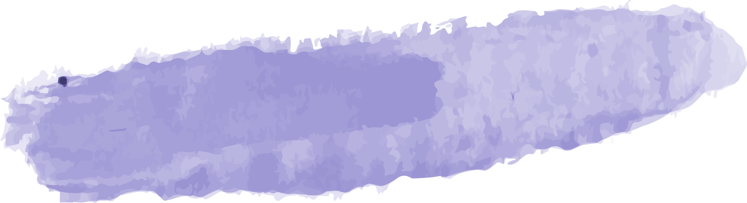


Physical Abuse
Emotional Abuse
CHILD ABUSE
Sexual Abuse
Neglect
Harmful touch and fabricated or induced illness
Persistent emotional maltreatment
Failure to meet basic needs
Forcing or enticing a child
Think about the physical and behavioural indicators
What about the influence of the online community?
Notes:
Abuse is a form of maltreatment of a child. All types include inflicting harm, or by failing to act to prevent harm. Although it sometimes is abuse does not have to be a physical act with intent, for example a lot of CYP who are neglected the parent has not set out to do it, rather they lack the skills to care for their child or are preoccupied or prioritising their own needs (i.e. substance misuse)
Children may be abused by an adult or adults, institutions and also a child or children.

Slide 5
YOUR ROLE IN IDENTIFYING CONCERNS
What we see...
What we hear…
What we are told…
Notes:
EVERY staff member are the eyes and ears on the ground and may be the only person who sees, hears or are told something – it is vital we respond!
What might we see? Hear? Be told??

Slide 6

Professional Curiosity
Children may not feel ready or know how to tell someone they are being abused, exploited or neglected, and children may feel embarrassed, humiliated or threatened – this shouldn’t prevent staff from having ‘professional curiosity’ and speaking to a Designated Safeguarding Lead (DSL) when concerned
‘… it is the capacity and communication skill to explore and understand what is happening within a family rather than making assumptions, or taking a single source of information and accepting it at face value’
Professional Curiosity is a combination of looking, listening, asking direct questions, checking out and reflecting on ALL the information you receive.
First seen in Working Together to safeguard children 2018
Notes:
How to be professionally curious:
Don’t be afraid to ask questions of families, and do so in an open way, so they know that you are asking to keep the children safe, not to judge or criticise.
Be open to the unexpected and incorporate information that does not support your initial assumptions into your assessment of what life is like for the child in the family.
Seek clarity either from the family or other professionals.
Be open to challenging, or having challenged, your own assumptions, views and interpretations as to what is happening – triangulate the information you hold.
Consider what you see as well as what you’re told. Are there any visual clues as to what life is like, or which don’t triangulate with the information you already hold?
Comes out in case reviews & CP Cases that PC isn’t evidenced or robust

Slide 7

What do staff NEED to do?
Responding to concerns :
Act as soon as possible
Follow your child protection/safeguarding policy
Speak to your DSL (or senior leader) as soon as you can
Concerns about a staff member / those in a position of trust:
Staff should tell a Head Teacher immediately if they:
A child discloses (about a person in a position of trust)
Have safeguarding concerns that a member of staff is posing a risk of harm to pupils
Are making an allegation against another member of staff
Responding to concerns
Concerns about all adults in a position of trust posing a risk of harm to children
If a child is in immediate danger or at risk of harm
Notes:
DSL’s will / may: Manage any support for the child internally using the school's pastoral support processes / Do an early help assessment / Make a referral into IFD (this information should be kept confidential and stored securely)
Concerns about staff - (including supply staff, volunteers and contractors)If the DSL or deputy is not available, staff should: Not delay taking action / Speak to a member of the senior leadership team (SLT) /Contact the Integrated Front Door(IFD), if appropriate, and follow advice / Tell the DSL or deputy about any actions taken as soon as possible

Slide 8


Safeguarding and Early Help – What is new?
SEND
Sexual harassment and violence
Honour-based abuse
Harmful Sexual Behaviours
Mental Health needs
Child Exploitation (CE)
High Risk Behaviours (ASB)
Gangs, violence organised crime
Family Circumstances
Child on child abuse
Parental Offending
Internet Safety
Private Fostering
LGBTQ+
Gender Questioning
Missing from care, home, school
Bullying
Cyberbullying / Artificial Intelligence
Risk of radicalisation
Notes:
Most of these topics are covered on our website & in 7 min briefings Possible Face to Face Activity – each table picks one & ask what you may see, HEAR, or be TOLD?
Staff need to know how to identify children who may benefit from early help, what your local early help process is and each staff member’s role in accessing early help.
Family circumstance presenting challenges for the child, parental drug and alcohol misuse, adult mental health issues and domestic abuse (was toxic trio research found this is unhelpful
Is misusing alcohol and other drugs themselves
AI- imagery support imposed.
has returned home to their family from care
Is at risk of ‘honour’-based abuse such as Female Genital Mutilation or Forced Marriage - EXPAND
is a privately fostered child – Non family 28 days +
persistently absent from education, including persistent absences for part of the school day.
Government Consultation: Child Sexual Abuse Mandatory Reporting
7 year investigation the Independent Inquiry into Child Sexual Abuse (IICSA) gathered evidence and a common reason for these failures was the prioritisation of protecting an individual or institution from reputational damage over the safety and wellbeing of children.
The government is launching a consultation to set out proposals for creating a mandatory reporting duty of Child Sexual Abuse in England.
Staff need to know how to identify children who may benefit from early help, what your local early help process is and each staff member’s role in accessing early help.

Slide 9
LGBTQ + and Gender Questioning Children
Children who are lesbian, gay, bi-sexual, transgender, queer and / or questioning can be vulnerable because:
https://www.theproudtrust.org/ - resources for pupils and staff
pupils don’t need to be lesbian, gay or bisexual to be subject to bullying. They may still be on the receiving end of this abuse if they are perceived to be lesbian, gay or bisexual, regardless of their own identity
Feel different and isolated from their peers
Be at a higher risk of homophobic, biphobic, or transphobic hate crimes
Not feel as though they have a trusted adult to talk about their identity with
Be a more likely target for bullying
They may:
Notes:
We will look at this particular group in more detail:
pupils who are, or are perceived to be, LGBTQ+ (lesbian, gay, bisexual, transgender, queer and/or questioning)
Highlight that nearly half of LGBTQ+ children experience bullying in school, and 1 in 10 find themselves having to leave their family home due to their sexuality or gender identity
Explain they may be more vulnerable as:
They may be a more likely target for bullying and/or hate crimes related to their sexuality and/or gender identity. News stories and campaigns by famous figures such as JK Rowling may increase the level of targeted attacks
They may be aware that they are in some way different from their peers, or that they don’t fit in, and can’t be themselves
They may not be ‘out’ to friends or family, and may be worrying about coming out at home or to their friends. If they’re worried about coming out to family, it’s likely that they don’t have a trusted adult to share their concerns with
Emphasise to staff that pupils don’t need to be lesbian, gay or bisexual to be subject to bullying. They may still be on the receiving end of this abuse if they are perceived to be lesbian, gay or bisexual, regardless of their own identity

Slide 10
It can be difficult for any child who has experienced abuse to get the support they need, but disabled children (or SEND) may face extra problems.
Safeguarding our most vulnerable
Less likely to tell someone about experiencing abuse / more likely to delay telling someone than their non-disabled peers
Communication barriers may prevent adults fully understanding what the child is telling them.
Some adults may not focus on a disabled child’s views.
The professional response may be affected if they lack skills or experience in working with disabled children.
Adults may not understand or respond to a disabled child’s safeguarding needs.
How do we offer additional support?
Notes:
There are several factors that contribute to disabled children and young people being at a greater risk of abuse.
Disabled children and their families may have limited access to support systems. Support may not be available due to lack of funding or it may not be appropriate for the child’s physical, emotional or cultural needs. This can make it difficult for parents to provide the care their child needs and add to the pressure of caring for a disabled child.

Slide 11
What Can Be Done to support those most vulnerable?
▪ Look for opportunities to be proactive not reactive
▪ Create an open culture where communication can happen
▪ Challenge unacceptable behaviours
▪ Educate about identity, safe relationships, safe messages (think about all the opportunities to focus on preventative education e.g. – teaching content)
▪ Think about the context of the issues
▪ Model appropriate responses
▪ Be open minded and do not make assumptions
https://www.youngminds.org.uk/media/qs5luamr/vulnerable-groups-toolkit.pdf
Notes:
The assessment should consider: ▪ The support and protection provided to the victim and any witnesses ▪ The support provided to the alleged perpetrator and an evaluation of ongoing risk ▪ The support to all other children at the school/college (and adult students/staff if appropriate) ▪ The assessment must be recorded (written or electronically)
Safeguarding Lead or Deputy should complete a risk and needs assessment immediately

Slide 12
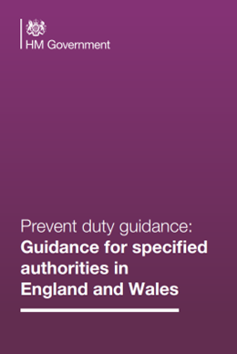
What is Prevent duty in Education?
N
OTICE
HECK
S
HARE
C
Notes:
The Prevent duty (updated 07 Sept 2023) is to have due regard to the need to ‘Prevent’ people from being drawn into terrorism. In July 2015, the Prevent Duty for Further Education in England and Wales also came into force. Schools should, however, be mindful of their existing duties to forbid political indoctrination and secure a balanced presentation of political issues.

Slide 13
CONTEST AND PREVENT 2024
Extremism is the vocal or active opposition to our fundamental values, including democracy, the rule of law, individual liberty and the mutual respect and tolerance of different faiths and beliefs. This also includes calling for the death of members of the armed forces.
Radicalisation is the process of a person legitimising support for, or use of, terrorist violence.
Terrorism is an action that endangers or causes serious violence to a person/people; causes serious damage to property; or seriously interferes or disrupts an electronic system. The use or threat must be designed to influence the government or to intimidate
Children may be susceptible to radicalisation into terrorism. Similar to protecting children from other forms of harms and abuse, protecting children from this risk should be a part of a schools or colleges safeguarding approach.
Notes:
ASK- What is extremism? Extremism means fundamental opposition to British Values; democracy, the rule of law, individual liberty, mutual respect and tolerance.
What is radicalisation? It’s the process by which extremism comes about – GROOMING – No different to SG CYPs from exploitation
Just like other SG risks, radicalisation is another form of harm that CYP need to be protected against. Schools play a crucial role in protecting CYP from radicalisation.
If a school is concerned that CYP is being radicalised they should consider a referral to CHANNEL Programme which is part of the governments counter extremism plan. In 2022 (most up to date figures) there were over 6000 CYP referred to Prevent. Schools are the biggest sources of referrals into Prevent. The referral is not about criminalising CYPs but supporting & deterring CYPs from extremist & terrorist ideologies.

Slide 14

What could make staff vulnerable and why?
Individually
Being alone with a child
Administering first aid / giving medication
Restraining a child (de-escalation)
Use of technology (Social networking sites)
Conversations with parents (1:1)
When a child seeks affection (in person or online)
Providing intimate personal care
Systematically
Lack of training or support
Being unclear about procedures / guidance
When you fail to report or seek advice
Poor communication
Failing to record
Culture and ethos
WHAT ELSE SHOULD WE CONSIDER?
Notes:
Keep ourselves safe when working with children.
Are situations that can put us more at risk of allegations:
Being alone – learning discussions or sensitive discussions i.e. bullying discussion
CYPs are taken out of the classroom for medication/first aid to a quiet environment
Restraint – a CYP may react to a distressing situation by displaying behaviours which are a harm to themselves or others. In schools we want to use our policies to reduce the need for restrictive intervention however there may be times when it is the only realistic option to protect a child or others i.e. a child about to run into a busy main road or a child is attacking another pupil or staff member and refuses to stop when asked. Wherever possible it should be avoided and we should adopt proactive, preventative and none restrictive approaches when dealing with challenging behaviour. Restraint is distressing for both CYP & Staff. Restraint should be recorded and reported to SLT/DSLs, post incident support given to both CYP & staff and a review of the circumstances afterward to minimise risk of it happening again.
CYPs seeking to communicate online
1:1 with parents particularly if it’s a sensitive issue
Times staff need to provide Intimate care due to health reasons
Vulnerabilities can manifest themselves due to systems and organisationally – link to a position of trust!

Slide 15
Protection and lowering risk
When working 1:1 with young people or vulnerable adults – Make sure to:
Tell appropriate member of the team, preferably someone with safeguarding responsibility (DSL), the time and place when you are alone with a child.
Choose a suitable venue: use a room with windows so people can see in / or leave the door open (risk assess).
Ensure the person knows they can stop the one-to-one contact at any time and make sure they know how to complain.
Explain to the child or vulnerable adult that they can contact support if they need to talk about anything.
Keep a record of the fact you were alone with a child or vulnerable adult, recording the reason you were alone and describing what happened.
Notes:
Best practice for one-to-one working -There are several measures you should put in place when working alone with a child or young person to make sure you are both protected.
Safeguarding is most successful when all aspects are integrated together. Three key elements include a clear safeguarding ethos (culture), policies that sets out clear expectations and processes, and high-quality training that ensures staff know what to do and do it consistently.

Slide 16

What we need to continue to do?
Identify those who may need early help or are at risk of neglect, abuse, grooming or exploitation
Help prevent abuse by raising awareness among children and adults of safeguarding risks and how and where to get help and support if they need it
Manage allegations and low-level concerns about adults who may be a risk and check the suitability of staff to work with the most vulnerable
Keep accurate records, make timely referrals where necessary and work proactively with other agencies to ensure that children get the help and support they need
Notes:
◼ Identify children and learners who may need early help or are at risk of neglect, abuse, grooming or exploitation ◼ Help prevent abuse by raising awareness among children and learners of safeguarding risks and how and where to get help and support if they need it ◼ Help those children who are at risk of abuse and need early help or statutory social care involvement, keeping accurate records, making timely referrals where necessary and working with other agencies to ensure that children and learners get the help and support they need ◼ Manage allegations about adults who may be a risk and check the suitability of staff to work with children, learners and vulnerable adult

Slide 17
Evidence of successful safeguarding arrangements
Children & Staff feeling safe and protected
Responding proactively to safeguarding at ALL times
Effective child protection systems and staff behaviour policies, processes and practice
Strong Identification with trusted adults by children
The ability to evaluate the effectiveness of our safeguarding
Notes:
Children and staff feeling safe
A positive and effective 'culture of safeguarding'
Staff who are knowledgeable about vulnerability of children with whom they work
Staff are open about discussing good and poor practice – and how to address it
Leaders and Governance are modelling behaviour and expectations
Childrens wishes and feelings are considered, their voice is heard
Parents feel encouraged to be involved in their child’s education and feel welcomed within the setting.

