Slide 1



Annual Report
2023-24
Leasowe Lighthouse 1763

Slide 2
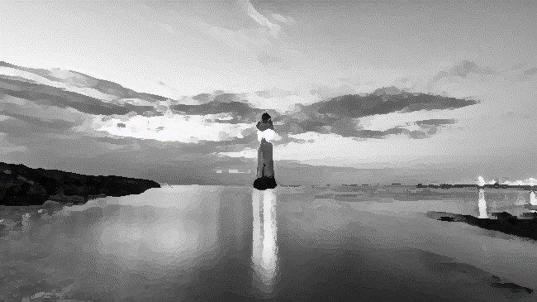
Introduction
Safeguarding partners are required to publish an annual report. The full report is available on the WSCP website: Annual Report 2023-24, along with an easy read report on-a-page
The report aims to provide an assessment of multi-agency activity to safeguard children and includes a summary of WSCP activity, including case reviews, auditing, data and the delivery of training across the partnership, as well as progress against priorities
The report includes an independent scrutiny assessment of the functioning and effectiveness of the WSCP
New Brighton Lighthouse 1827
wirralsafeguarding.co.uk/annualreport23

Slide 3
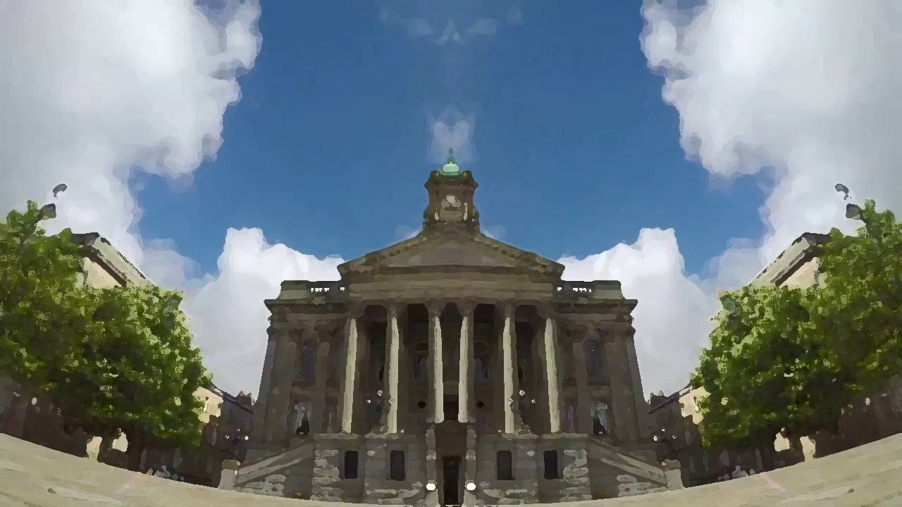
Journey of the Child
The report provides a view of Wirral’s children profile with the If Wirral had 100 children graphic. It also presents an illustration of Disparity for children in Wirral, highlighting where the greatest need is.
Early Help and Prevention - demand for early help increased significantly during 2023.The early help offer in Wirral remains very strong and was praised by Ofsted. The Cradle to Career project in Birkenhead continues to support local communities and divert families away from social care. The Family Toolbox also provided one-stop help to many families.
Children’s Social Care - performance information shows there were over 24,000 contacts in 23/24 with one-third converting to referrals. In March 2024 there were 372 children subject to a child protection plan, 2819 children in need, and 777 children looked after, which has fallen since 2022.
Birkenhead Town Hall 1887
wirralsafeguarding.co.uk/annualreport23

Slide 4

Systemic Practice
Systemic Practice was launched as the multi-agency partnership model of practice in October 2023. To prepare for the launch training for the workforce has been delivered since September 2022 to over 600 staff.
Systemic Practice is a relationship-based model which emphasises people’s relationships as key to understanding their experiences. It also stresses the importance for families to be able to build strong, trusting and purposeful relationships with the practitioners supporting them.
As well as training the WSCP has also published briefings, resources and guidance on the virtual systemic practice hub and has delivered a number of skills workshops. A practice lead is also in post in children’s services to support practitioners and teams with using the model in practice.
The WSCP have also partnered with the Centre for Systemic Social Work, and staff are now receiving advanced training in the model.
Bidston Observatory 1866
wirralsafeguarding.co.uk/annualreport23

Slide 5

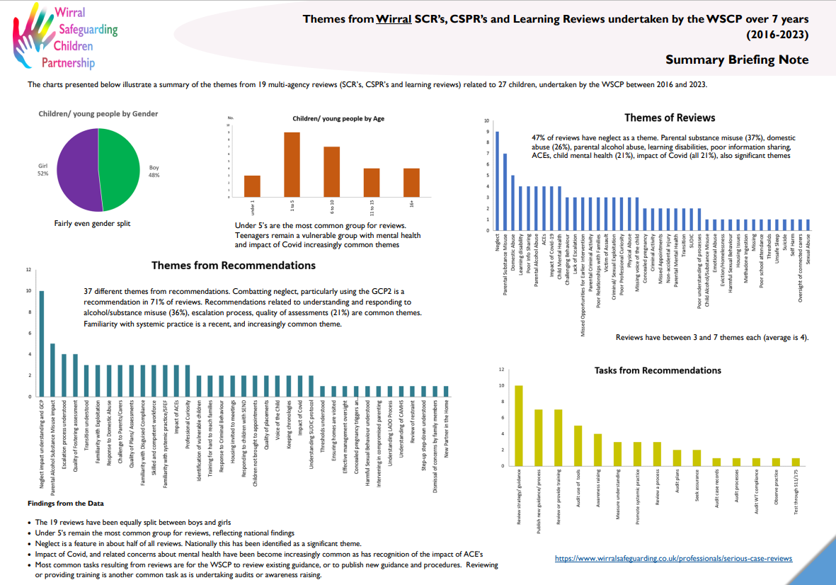
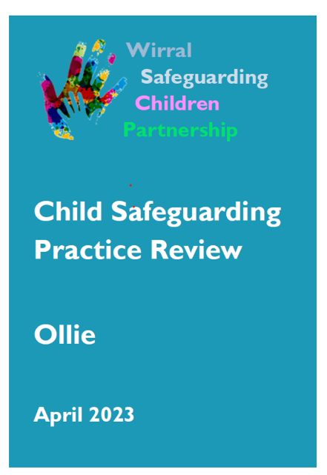
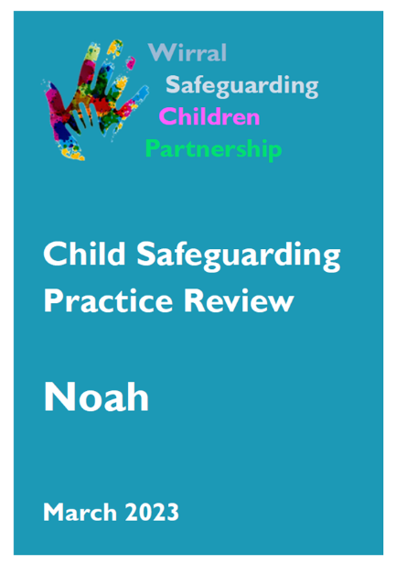
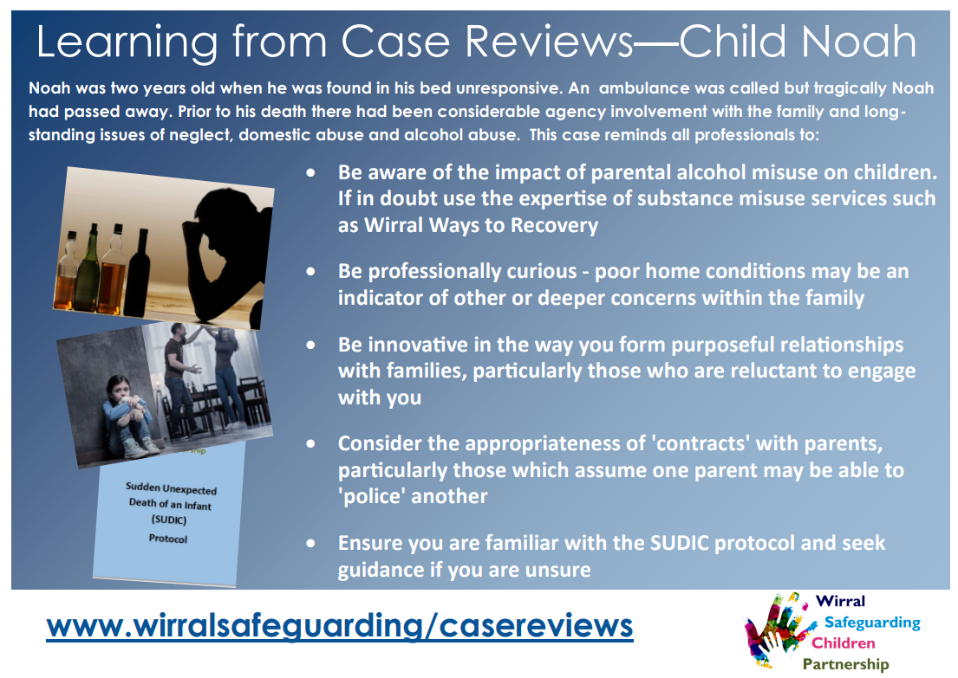
Learning from Case Reviews
In 2023 the WSCP published the Child Noah and Child Ollie Safeguarding Practice Reviews. Noah tragically died at home, and although his death was not suspicious the case highlighted the complexities of working with families with multiple issues. Ollie died as a result of injuries sustained by co-sleeping. The case highlighted the importance of safe sleep messaging.
Learning reviews were also completed on Emily and Lily who suffered abuse and neglect, and the Taylor children who suffered physical abuse. A review was also undertaken on behalf of the LA into a case managed by the SEND service, and a summary of findings from across reviews was published.
Birkenhead Park 1847
wirralsafeguarding.co.uk/annualreport23

Slide 6
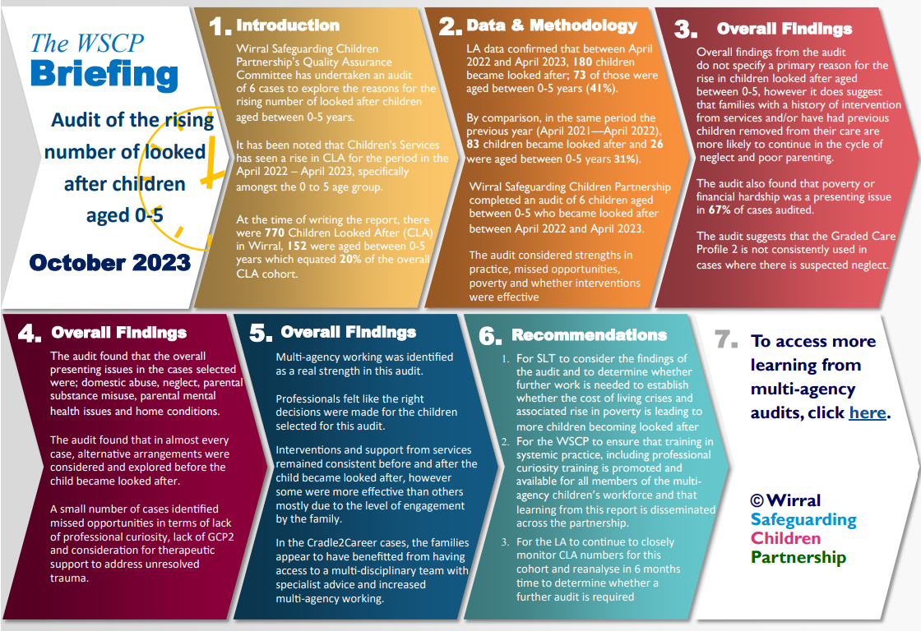
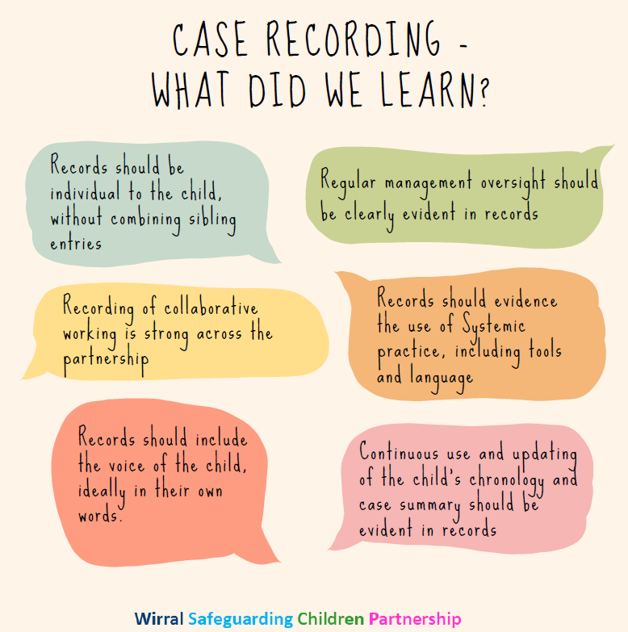
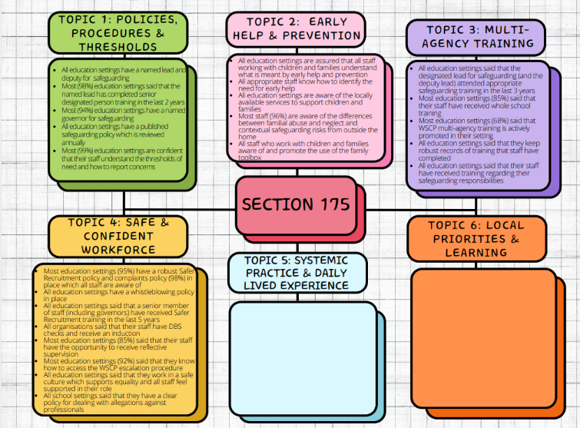
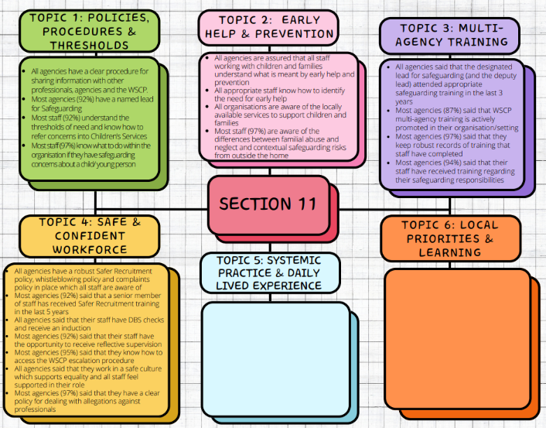
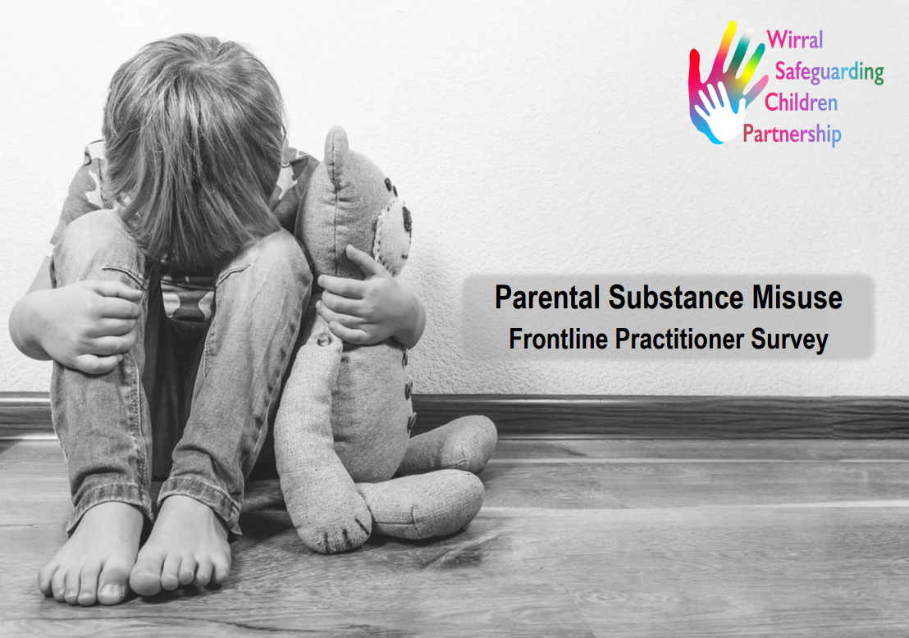
Learning from Audits
The WSCP undertook a number of multi-agency audits about the number of 0-5 children looked after, impact of parental substance misuse, pre-birth arrangements, quality of case recording and child exploitation. The WSCP also continued to deliver its comprehensive S11/175 programme of safeguarding audits of partner organisations, schools and colleges.
Leasowe Lighthouse 1763

Slide 7
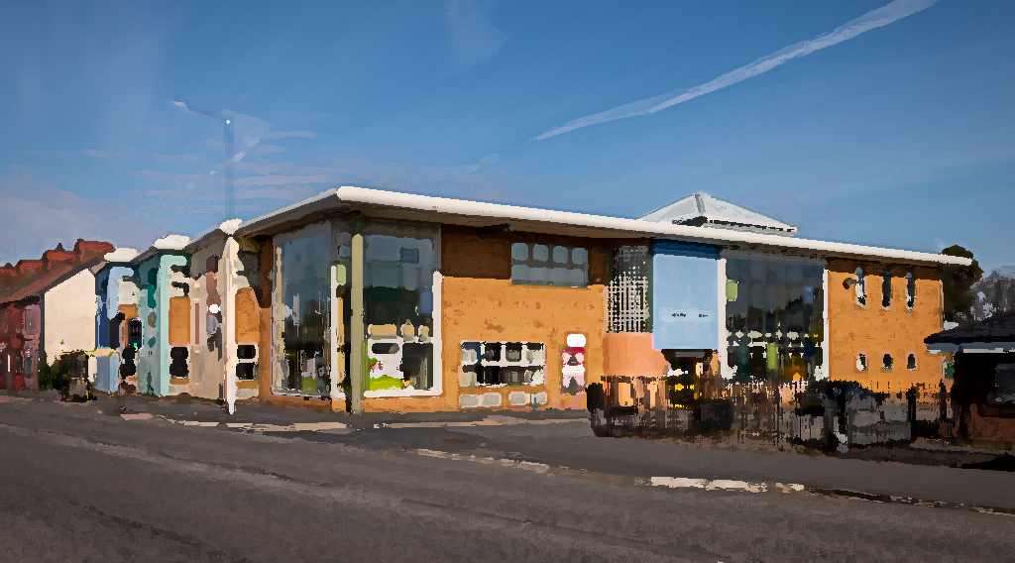
Multi-Agency Working
To illustrate some of the different ways agencies have worked together to safeguard and improve outcomes for children, young people and families, WSCP has published a series of Single Agency Reports and Case Studies, with the hope they provide a glimpse into the work which takes place every day in Wirral to keep our children safe
A wide range of organisations, such as Merseyside Fire and Rescue, Our Space, Advocacy / Right side of Care, Barnardo's, WEB, RASA, Youth Justice Service, Open Door, The Lighthouse Centre, Blue Skies Ahead, Wirral Community Health, and Cheshire and Wirral Partnership, have this year highlighted examples of good and effective safeguarding practice – all of which can be found here – multi-agency working
Bidston St James Centre, Birkenhead
wirralsafeguarding.co.uk/annualreport23

Slide 8
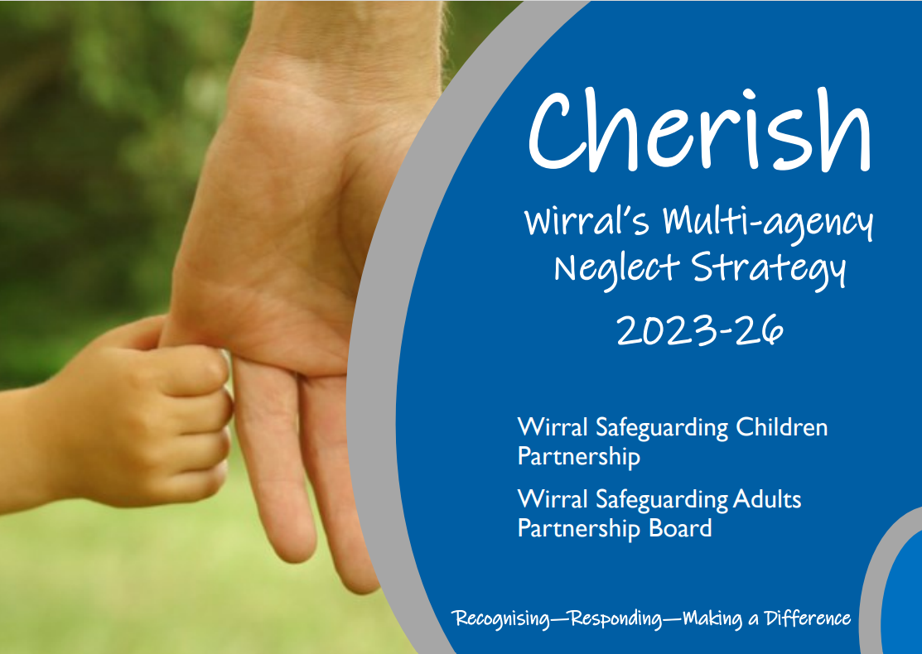
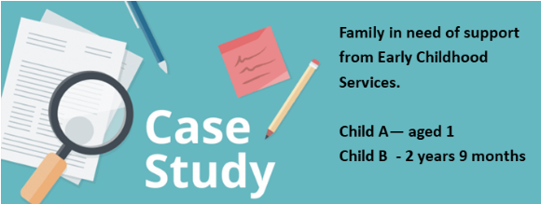
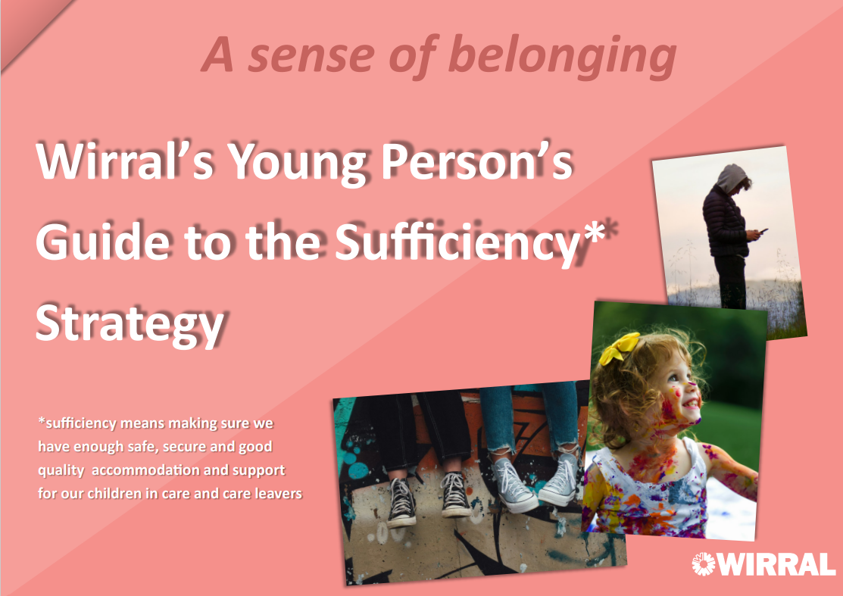
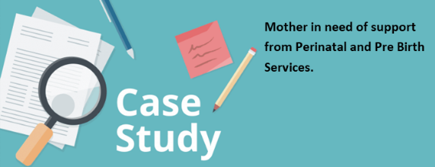
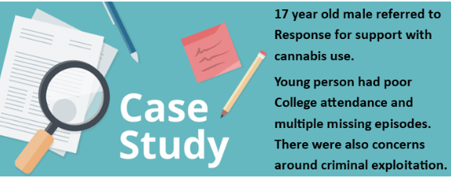
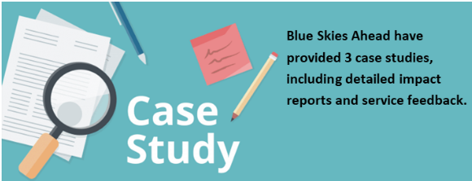
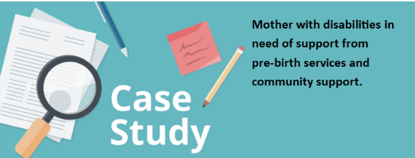
Examples of Case Studies and Strategies
Birkenhead Town Hall 1887
wirralsafeguarding.co.uk/annualreport23

Slide 9
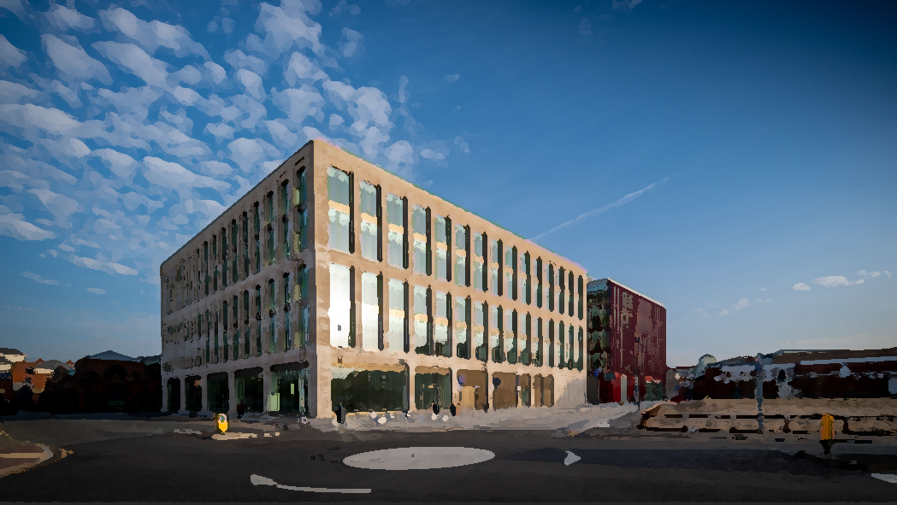
Multi-Agency Training
Throughout 2023-24 the WSCP continued to deliver a comprehensive programme of multi-agency training and training for schools and colleges. During 2023 the WSCP delivered 60 full multi-agency training events to 956 practitioners from across the partnership, and 31 events to 493 staff from education
Feedback about training remains extremely positive, with professionals providing examples of how the training has helped them make a real difference to children & families.
WSCP has delivered a programme of shorter spotlight briefings and continues to publish 7-minute briefings and other resources.
The annual Big Learn safeguarding event in 2023 was attended by over 300 professionals, and included 18 different presentations and briefings, and a market-place of 32 organisations.
Mallory Building 2023
wirralsafeguarding.co.uk/annualreport23

Slide 10


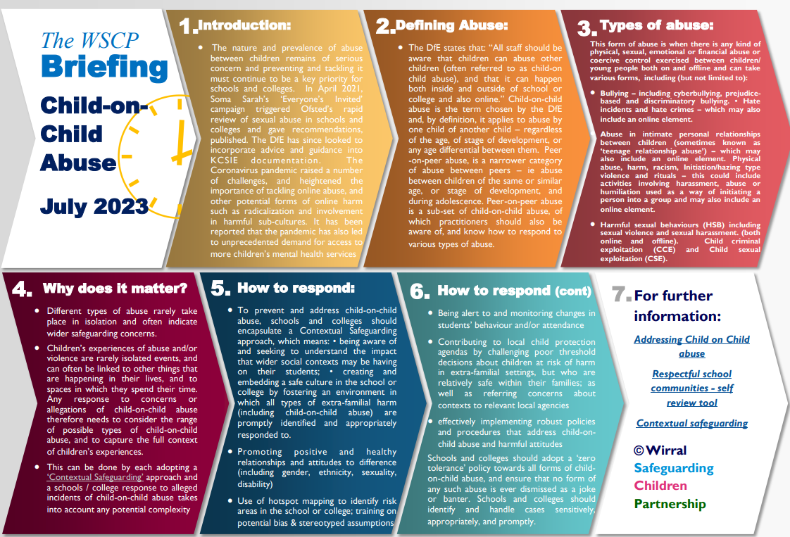
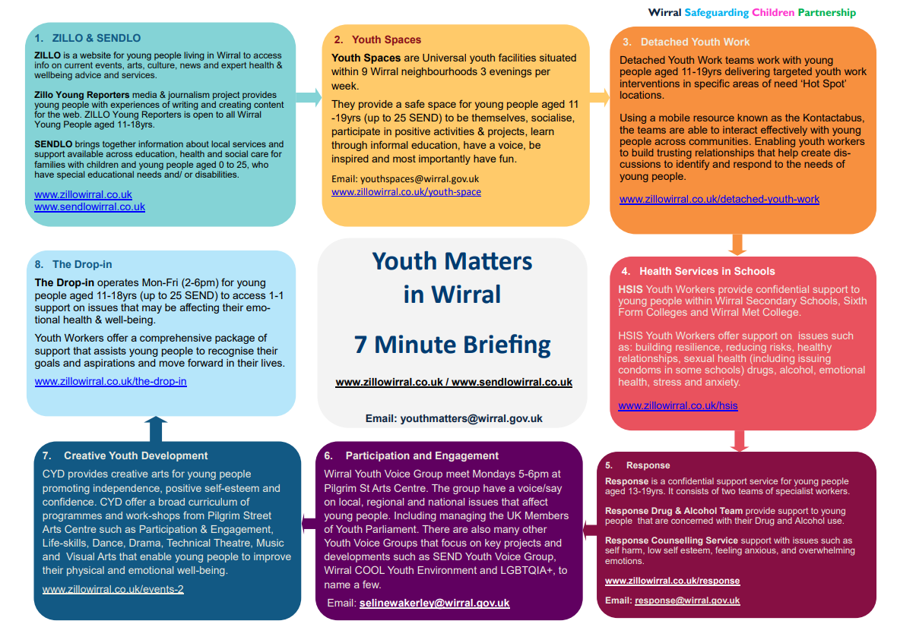
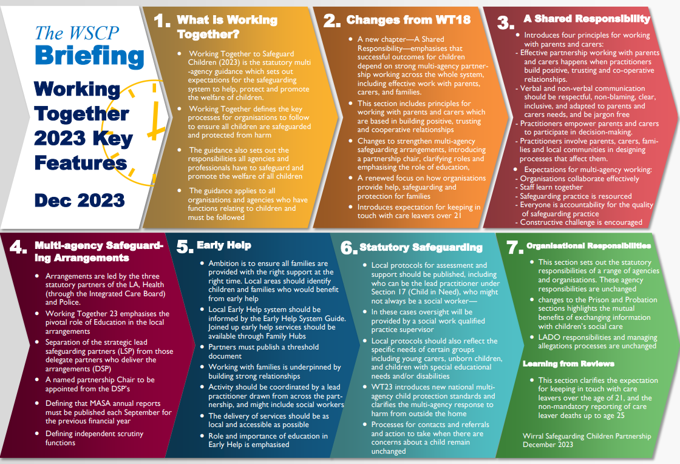
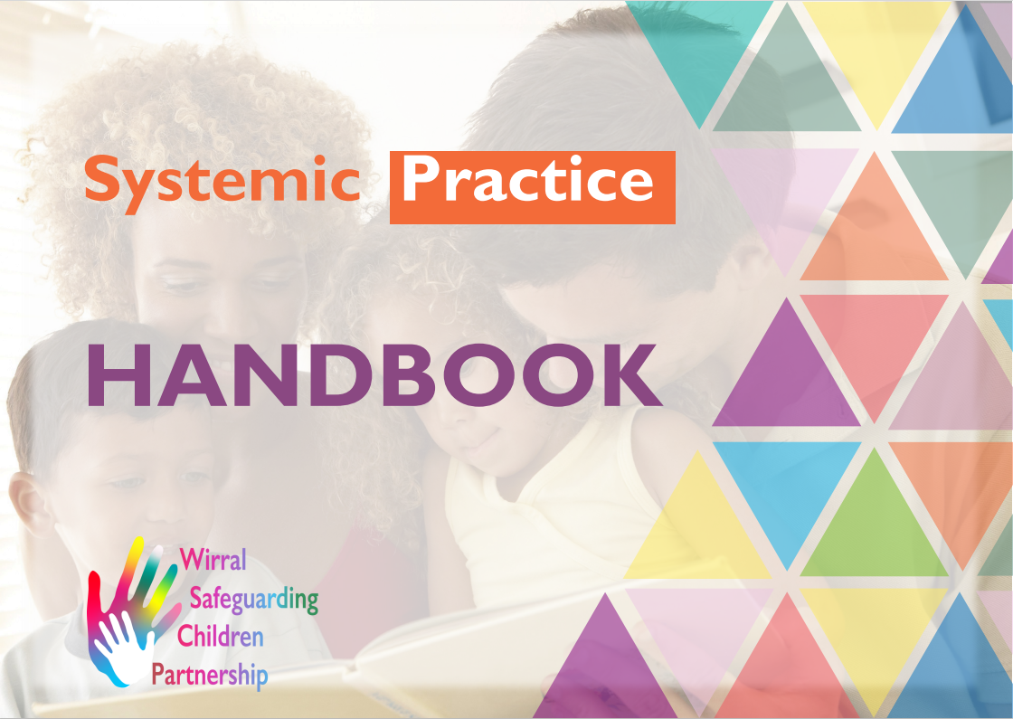
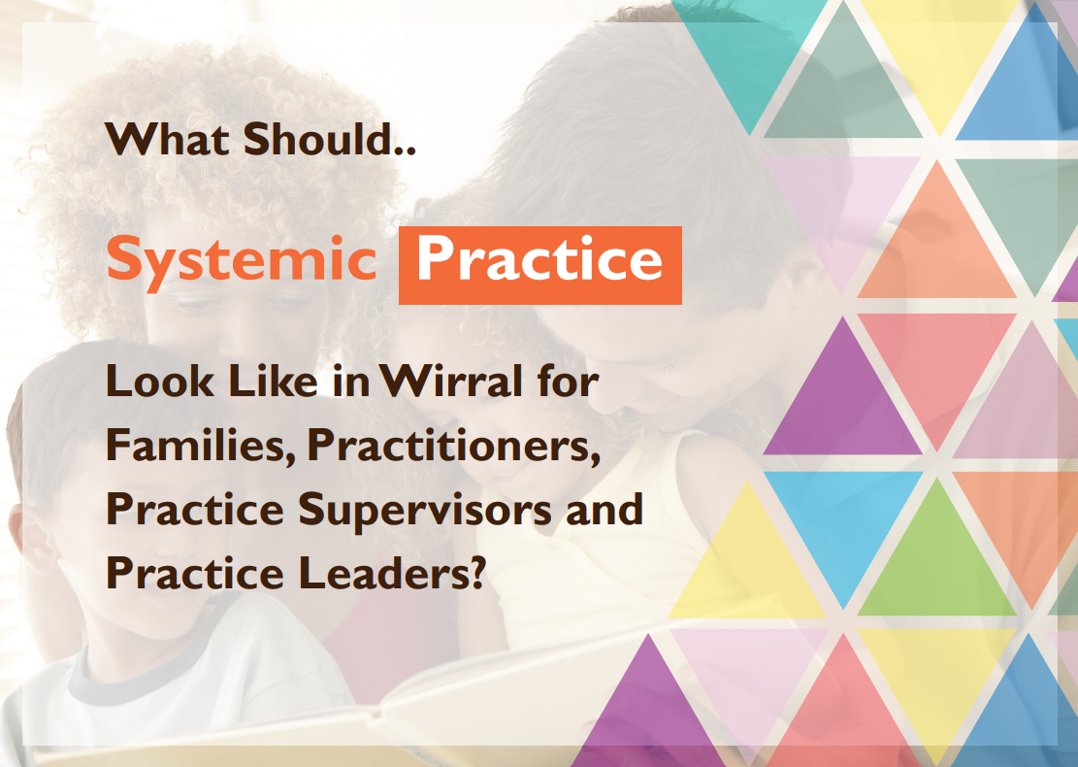
Examples of Briefings and Resources
Marine Lake, West Kirby
wirralsafeguarding.co.uk/annualreport23

Slide 11
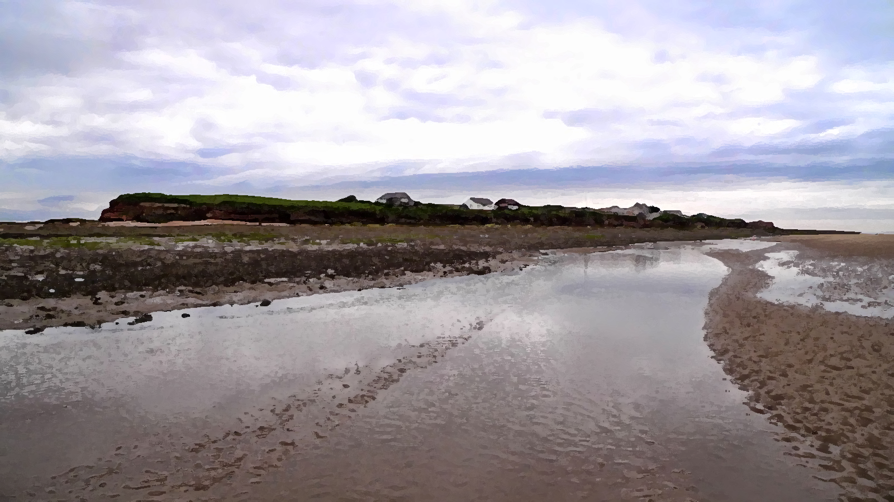
Progress Against Priorities
In 2023 the refreshed Business Plan included four priority areas:
Priority One – Implementation of a strategy to tackle neglect.
Priority Two – Introducing a systemic practice approach to working with children, young people and families.
Priority Three – Evaluating the impact of the Breaking the Cycle programme.
Priority Four – Safeguarding and Education.
The annual report includes a detailed summary of progress against the priorities from 2023, including what was achieved and what remains to do.
Hilbre Island
wirralsafeguarding.co.uk/annualreport23

Slide 12
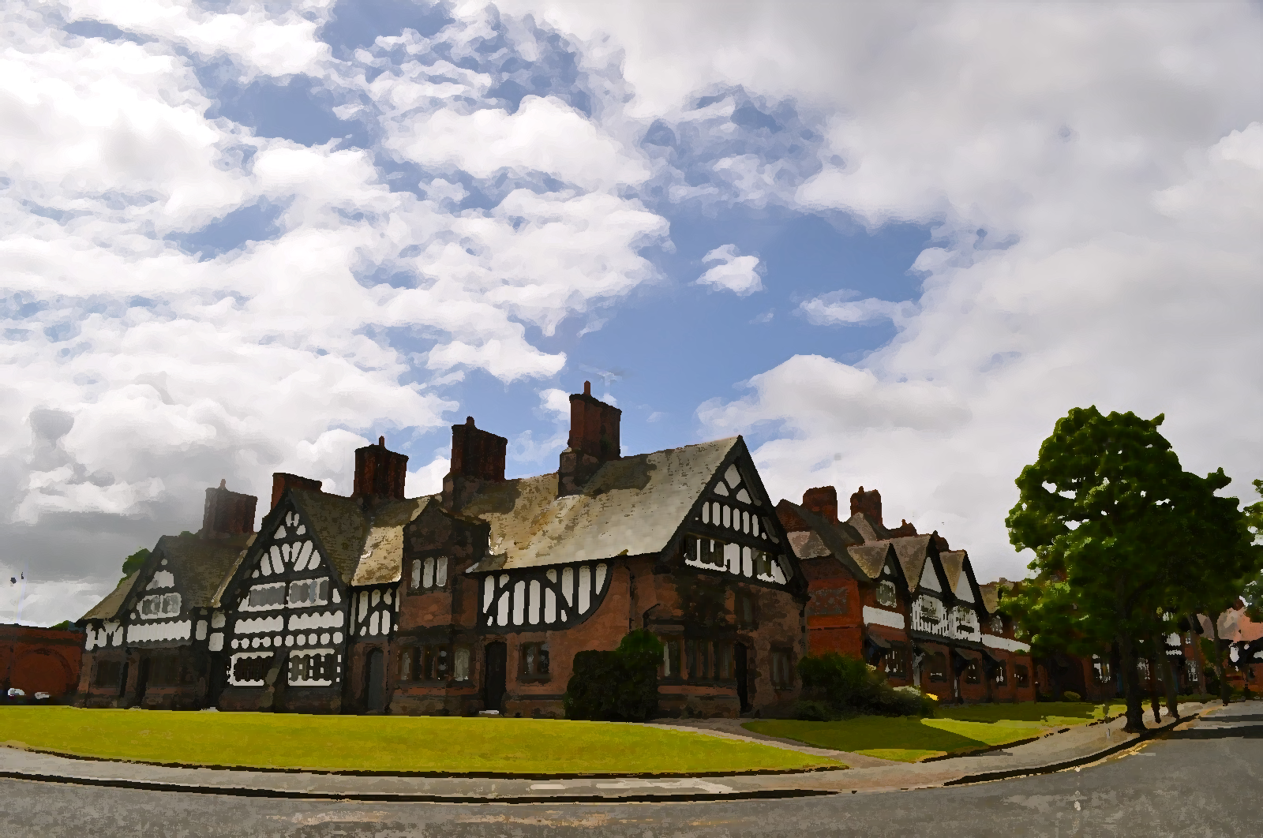
Progress Against Priorities - Headlines
 | Tackling Neglect: | Embedding Systemic Practice: | Evaluating Breaking the Cycle: | Safeguarding in Education:
Progress | Strategy successfully developed, published and launched. A steering group in place overseeing the implementation of the strategy delivery plan. Refreshed multi-agency neglect training in place and Graded Care Profile (GCP)2 relaunched. A Quality Assurance Framework and outcomes measures in place, to report on progress, impact and next steps. | Launched in October 2023 and multi-agency training in place, to date over 500 professionals trained. An expansion of training offer and the completion strategic leaders' sessions. Threshold of need reviewed and an auditing schedule underway. The Quality Assurance framework is in place to assess the impact of model and to report progress and impact. | Auditing of cases and scrutiny of key performance data and information shows evidence of impact. Appointment of new training officer to evaluate wider training needs. Reporting recommendations to support the wider development of trauma informed practice in place. | A well represented safeguarding committee, working on key issues across the Education sector Education LADO (Local Authority Designated Officer) in post and linking strongly with education partners Chair contributes to the Executive Committee as voice of the sector.
Port Sunlight 1888
wirralsafeguarding.co.uk/annualreport23

Slide 13
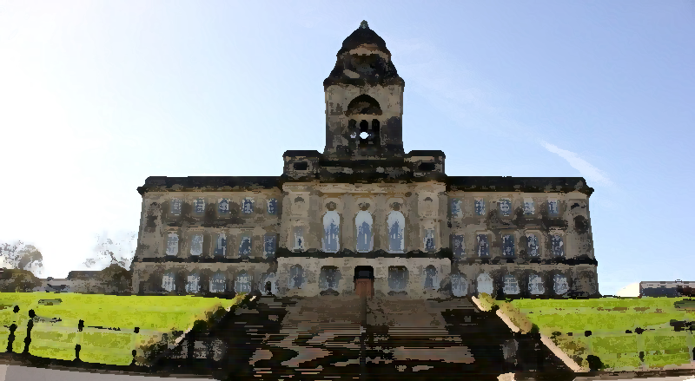
Business Plan 24-25
The WSCP Business Plan sets out priority areas of work for development. These are in addition to our ‘business as usual’ activities and will typically change every couple of years as they become embedded. WSCP’s three key priorities for 2024-25 are:
Embedding Systemic Practice – During 2024, WSCP will begin the embedding phase of systemic practice. This means we will audit and gather feedback from practitioners, services and families to evidence the impact of the model of practice.
Safeguarding and Education – Building on the establishment of a safeguarding in education committee, the WSCP as part of the Pathfinder programme will, over the next 12 months, test the new roles of lead and delegated safeguarding partners for education.
Embedding Change – Following the publication of Working Together to safeguarding children 2023, important reforms to multi-agency safeguarding arrangements will take place this year, many through the Pathfinder programme.
Wallasey Town Hall 1920
wirralsafeguarding.co.uk/annualreport23

Slide 14

Further Information
WSCP Annual Report (online)
Annual Report on-a-page
WSCP Business Plan 2024-26
WSCP Progress Against Priorities
WSCP Case Reviews
WSCP Multi-agency Training
WSCP Learning from Audits
Marine Lake, West Kirby
wirralsafeguarding.co.uk/annualreport23

