Slide 1




Update on Wirral Statement of Action for SEND
JULY 2022 EDITION
For:
Parents and carers
Children and young people
Stakeholders, partners, employees

Slide 2
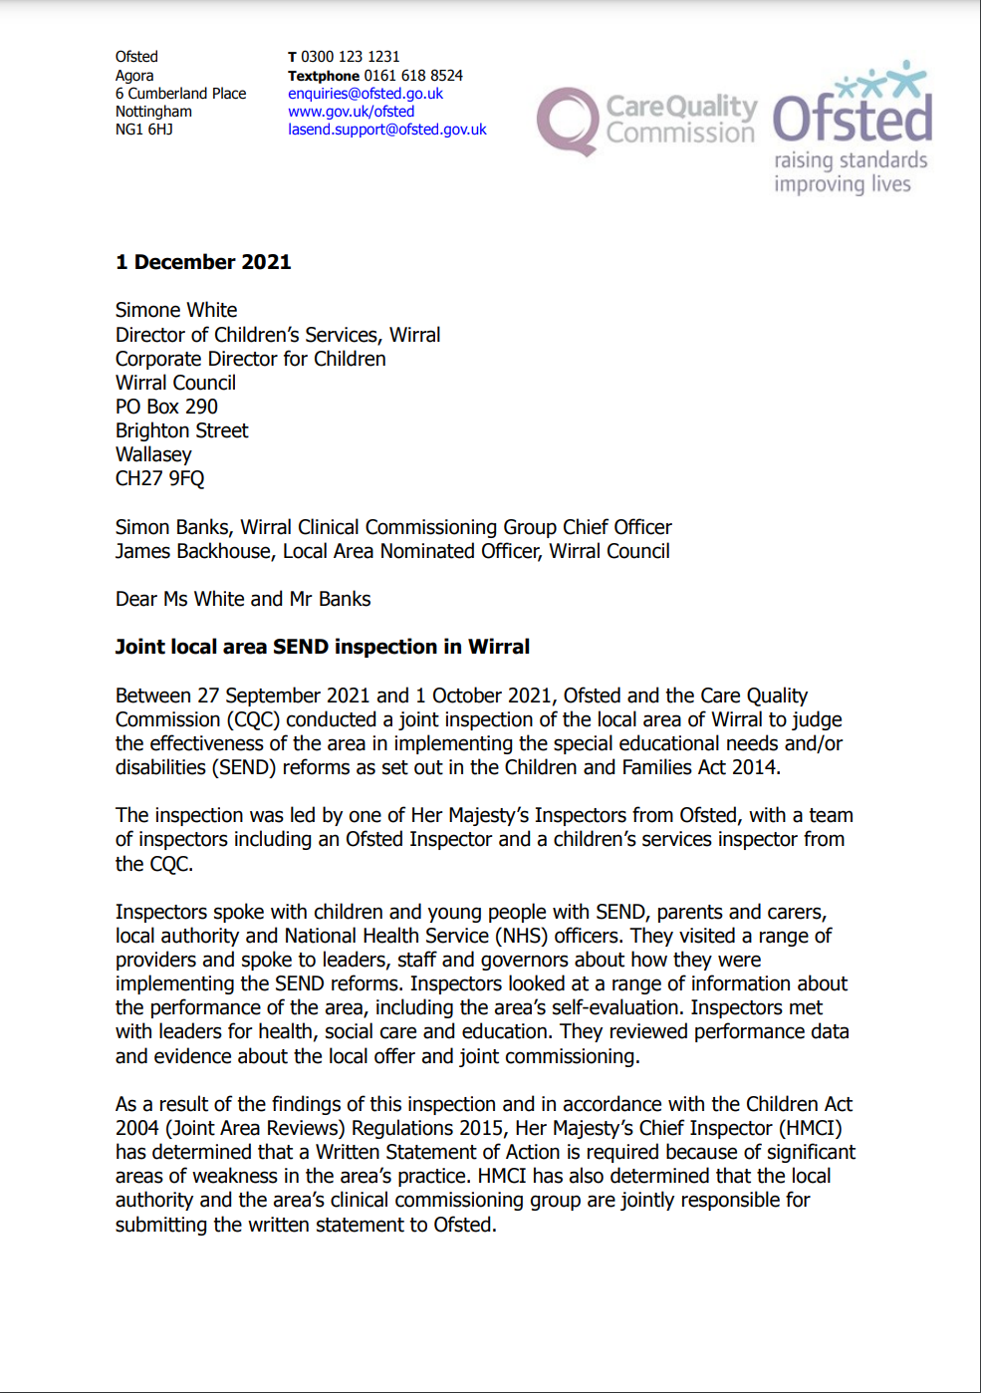
About the local area SEND inspection.
In September 21, the local area, which includes the council, schools and health services was inspected by Ofsted and the Care Quality Commission (CQC).
The inspection looked at services and support for children and young people with SEND.
After the inspection, Wirral local area was asked to produce a ‘Written Statement of Action’ to address the problems that had been identified during the inspection.

Slide 3
What is the Wirral Statement of Action?
There are six workstreams in the Wirral Statement of Action which are intended to address the weakness identified:
Workstream
Area of weakness to be addressed
Workstream 1
Data Analysis & Joint Commissioning
lack of accurate, up to date and useful information which informs the area’s plans and evaluates the impact of their actions
lack of joint commissioning of the services in the area.
Workstream 2
EHCP’s and Annual reviews
weaknesses in the quality and timeliness of Education Health Care (EHC) assessments and annual reviews
Workstream 3
Co-production, relationships, communication
The lack of meaningful co-production with parents & carers
Fractured relationships between the area and the Parent Carer Partnership Wirral and the impact of this on the area’s progress in implementing the reforms
Poor communication with parents and carers across the area

Slide 4
What is the Wirral Statement of Action?
There are six workstreams in the Wirral Statement of Action which are intended to address the weakness identified:
Workstream
Area of weakness to be addressed
Workstream 4
Inclusive Practices
The graduated response not being consistently applied across all schools and settings
Workstream 5
Local provision and strategic oversight
High level of parental dissatisfaction with the area’s provision
Lack of effective strategic oversight to ensure effectiveness of plans and provision and hold leaders, managers and partners to account
Workstream 6
Local Offer
The published local offer not being well publicised and not providing parents and carers with the information that they need

Slide 5

What progress has been made?
Changes to SEND Senior Leadership
In her role as Deputy Director for Children’s Services, Elizabeth Hartley has taken responsibility for operational elements relating to local authority SEND Services.
A pen portrait of Elizabeth is provided.
Elizabeth’s role is intended to complement the current Assistant Director for Education in driving improvements across the local area for all children and young people with SEND.

Slide 6
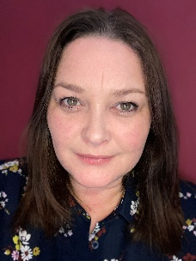
Elizabeth Hartley, Deputy Director
For over twenty years I have worked with children, young people and families across Merseyside to help them get the best out of life. I have had many amazing experiences as a practitioner, a manager, and a leader- every role has been a privilege.
I started my career in education, with 8 years delivering a combined pastoral and teaching role. I enjoyed my time in schools but felt that the pastoral role- supporting children and families with their needs beyond the classroom-was where my passion lay. This motivated me to seek a change and I moved into the voluntary sector to manage fixed-term projects for almost 2 years. This was a fantastic experience and one which has continued to influence how I work within my current role in the Local Authority as I am a passionate champion for third sector organisations and the vital role they play in supporting families. I joined Wirral Council in 2009 as a Team Manager and have worked my way up through the hierarchy to become an Assistant Director in 2018. My time as AD has been amazing as I have had the opportunity to bring about significant change for children and families across the borough through some key pieces of work including our Community Matters early help initiative, Supporting Families programme and our co-produced domestic abuse strategy. I am a caring leader with strong ethics and work with determination to create meaningful partnerships. I believe in people, community, possibility and second chances.

Slide 7
Workstream 1: Data analysis and joint commissioning
Progress
66% of system audit templates have been completed to identify where information can be accessed
The Joint Strategic Needs Assessment was approved at the SEND Transformation Board
Joint commissioning forum has been replaced by the new sub-group, led by Strategic Joint commissioning lead
Next steps
A new data Dashboard to be presented at the next SEND Transformation Board – this will include different key performance indicators to measure progress
The data Dashboard will sit within performance framework to ensure key risks are highlighted at the right time

Slide 8
Workstream 2: EHCPs and Annual reviews
Progress
A new quality monitoring framework for independent and non-maintained schools has been outlined.
There has been some improvements in the timeliness of issuing Education Health and Care plans within 20 weeks.
Next steps
A new EHCP flow chart is in development and will be shared and published in July
New guidance documents for parents and carers are in their final stages and due to go live by end of July/early August subject to support from Parent Carer Participation Wirral.
Please note: Some actions within this workstream have been delayed in order to allow for meaningful co-production with parents and carers

Slide 9
Workstream 3: Co-production, relationships and communication
Progress
A co-production plan for the Wirral Statement of Action has been agreed setting out when collaboration and communication with parents and carers is essential
More opportunities for face to face discussion with parents and carers have been made available
Actions relating to co-production have been delayed due to ongoing discussions with the Department for Education
Next steps
Department for Education co-production events will be held in July to agree definition and pathways.
A communications policy is in draft with consultation to take place with staff teams before being presented to Children’s Senior Leadership Team for sign off.

Slide 10
Workstream 4: Inclusive practices
Progress
There is now a regular communication from the Assistant Director for Education to school headteacher providing them with important SEND related information
A schools training audit is being completed and a training provider being used to support ‘whole school SEND’
Next steps
A ‘universal offer’ has been devised and will be shared with wider stakeholders before approval.
A new Continuing Professional Development offer will be finalised and shared across the education sector

Slide 11
Workstream 5: Local provision and strategic oversight
Progress
An audit of 25 complaints has been completed and a report taken to the SEND Transformation Board to present the findings and learning from complaints.
An additional inclusion base has been commissioned to make total of five bases for children and young people with Autism Spectrum Disorder and Social Emotional and Mental health
Next steps
A quality assurance tool (Invision 360) will be implemented to monitor the quality of the professional advice from education, health and social care.
Launch of neurodevelopmental pathway with easy read version overview to be published on the local offer website.

Slide 12
Workstream 6: Local offer
Progress
Research of other local offer sites has been completed with good practice examples sourced and will be used to inform the development of a new site
Meetings now in place and demonstrations of potential new platforms reviewed
Next steps
The second phase of the workstream will be focussed on relaunch activity, promotion of the Local Offer and ongoing programme of awareness. In addition, consideration of ongoing evaluation of effectiveness.

Slide 13
What is Parent Carer Participation Wirral saying?
(the Parent/Carer Forum)
“PCPW understand for parent, carers, young people and children that nothing seems to have changed or improved since the inspection and we know there is a lot of frustration in the local SEND community regarding this.
PCPW are aware and involved in significant work being undertaken by the Local Area.
We are hopeful that everyone will start to see changes soon. PCPW are working hard to ensure that the Parent Carer voice is heard, listened to and acted upon.” PCPW

Slide 14


Your feedback…

