Slide 1
Systemic Practice
Day 4
Poppy Frost, Amanda Coyne, Alex Woods, Sarah Bolton and Emily Hardy

Slide 2
What will we be covering?
Domains of production
Safe uncertainty
First and second order change
Reflecting teams

Slide 3
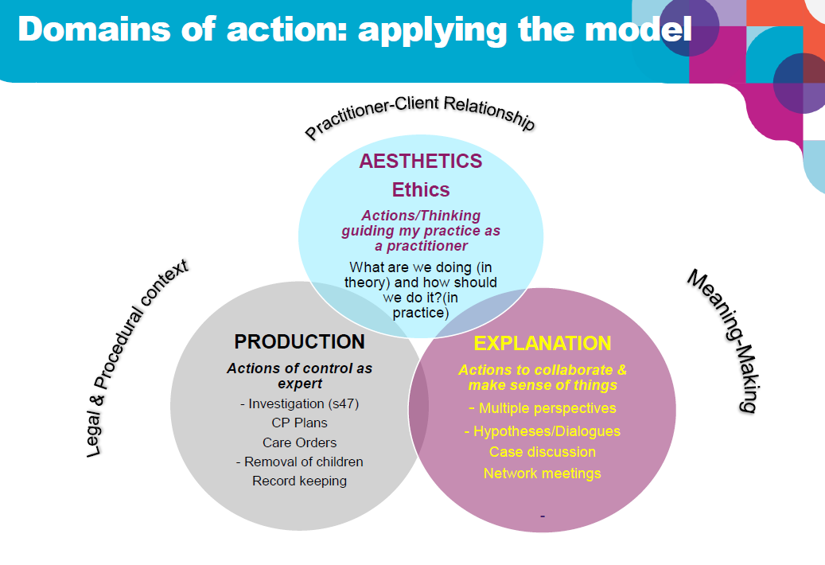

Slide 4
Production – the What
Explanation – the Why
Aesthetics – the How
We behave as if there is one objective reality (‘Universe)
Clear set of policies, protocols and procedures
Judgements can be made
Consent is not always necessary (CP enquiries and plans, care orders, etc)
Issues of safety and risk and dealt with in this domain
View of reality as ‘Multiverse’ (multiple different perspectives and realities)
Different explanations, though not necessarily all equally useful
Curiosity is about pattern and ‘fit’
Hypothesising and reflection
Requests for help are made sense of in this domain
Move to working with
Our values and ethics about the way we work –how we pay attention to how we do what we do
•How we do our relationships with others –use of self
•Attending to power, discrimination and oppression in our relationships with families (self-reflexivity, anti-oppressive practice )
•How we move between production and explanation domains

Slide 5
Think about a dilemma you have previously or currently face, which domain were you situated in? What might have been impacting on this?

Slide 6
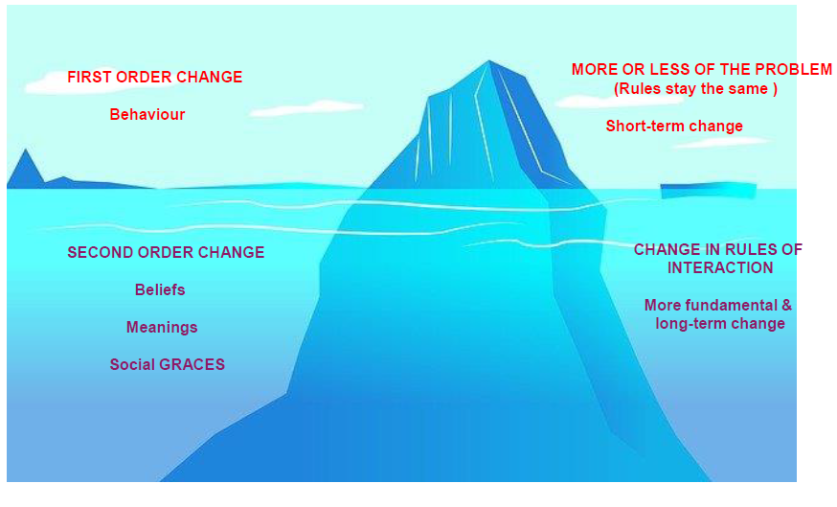

Slide 7
First and second order change
Extrinsic driver – external imperative to achieve compliance as evidence of change(systems conditions – rigour)
Intrinsic driver – internal vision to create better social worlds for children, families and communities (creativity – imagination)
These are not mutually exclusive. They are co-dependent
First order change – changes happen at the level of behaviour – people do something differently
Second order change – changes happen at the levels of relationship and identity

Slide 8
Activity
In small groups discuss a time when you have either made a change or failed to make a change? What were the intrinsic and extrinsic change drivers?

Slide 9
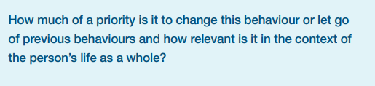
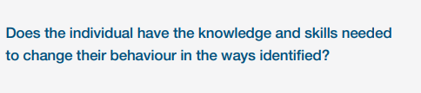
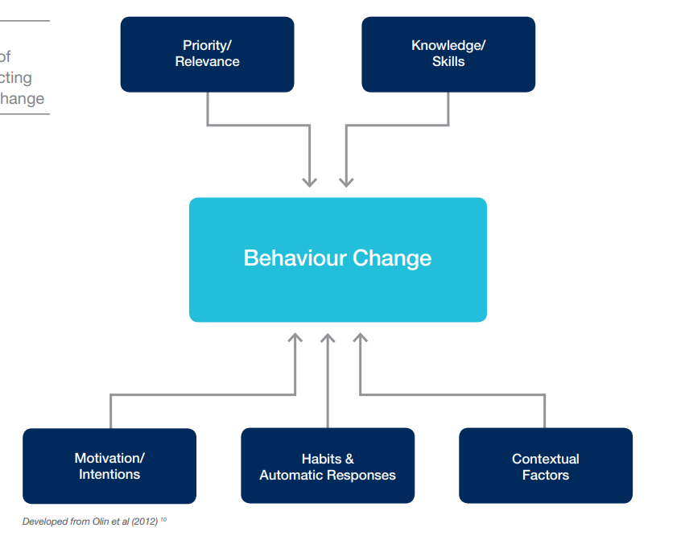
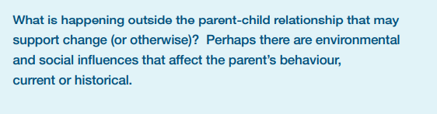
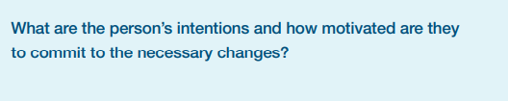

Factors that affect change

Slide 10
Thinking about a family you are working, map the factors affecting change.
Include discussions linked to first and second order change

Slide 11


Slide 12
RISK is not something that is occurring now
It is the prediction of undesirable or harmful behaviour which may occur in the future
ACTUAL HARM is the term we use when we are talking about current or past dangerous or detrimental behaviour
A clear risk assessment will separate what has been actual harm from what is a potential risk

Slide 13
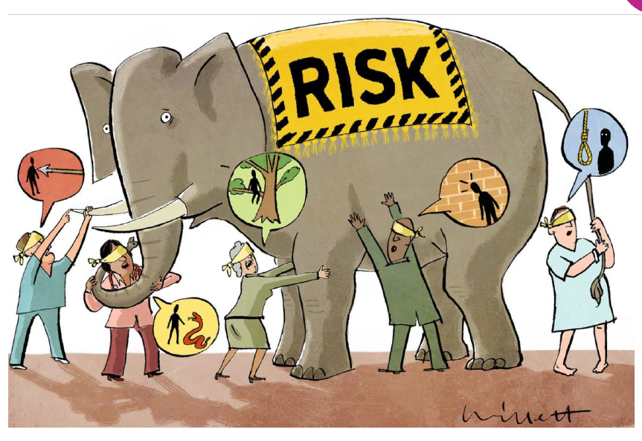

Slide 14
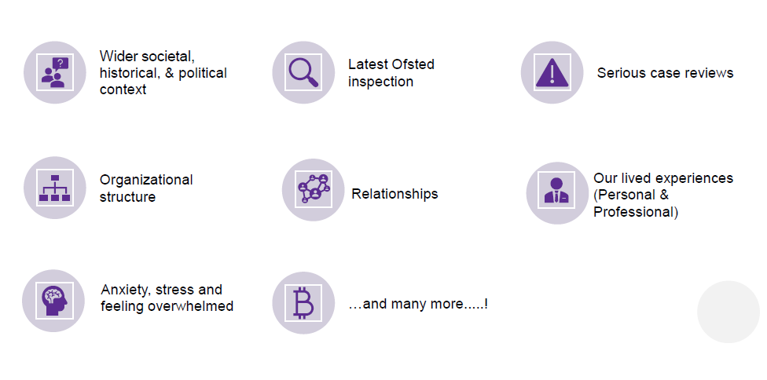
What factors might influence our decision making?

Slide 15
Social defences against anxiety
•Task-centred care rather than person centred
•Depersonalisation and categorisation of patients
•Detachment and denial of feelings
•Focus on ritual performance of tasks
•Reducing the weight of responsibility with checks and counterchecks

Slide 16
Safe uncertainty
Complete certainty is an illusion. Certainty and safety can be confused as the same thing.
If we can better understand how a family functions, we have a better chance to manage our feelings and position of uncertainty.
Risk can be lowered through a developed relationship in which we can attend to difficult issues

Slide 17
Safe Uncertainty
This is a key concept in the systemic practice, which helps us conceptualise and think about risk.
It is important to acknowledge that risks cannot necessarily be eliminated, but they can be managed and reduced
Risk management should therefore be understood as risk reduction, with no situation considered entirely risk free
Risk assessment matrices and check lists can be helpful in guiding understanding but they cannot be absolutely relied upon to provide definitive answers
Risk exists on a continuum rather than being a specific score on a checklist or matrix
Risk changes over time (be dynamic) dependent on a wide range of different factors

Slide 18
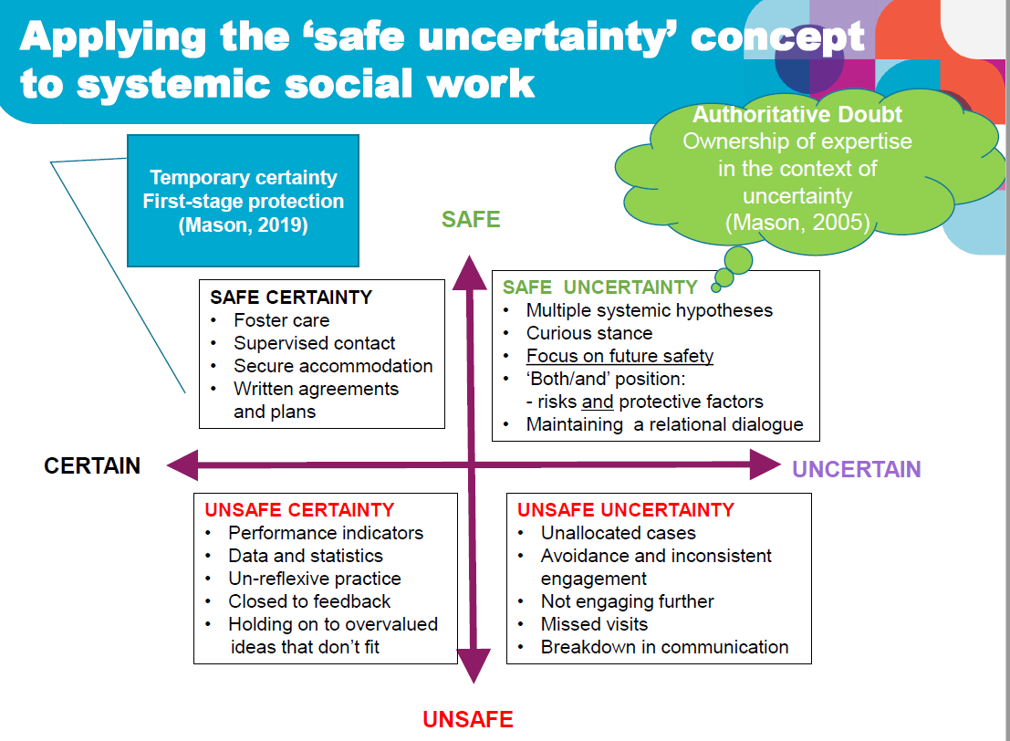

Slide 19
In your groups think about a family you are working with or have worked with and map it on the quadrant.

Slide 20


Slide 21
Group reflective conversation
Case presentation (case history, genogram) (10-15mins)
Dilemma presented. (5 mins)
The group asking clarifying questions (lineal) (5 mins)
The group explore multiple ideas about what may be influencing the current situation, what do we think may influence change? (think about questioning styles, SGs, single stories, patterns) (15 mins)
Presenter shares what resonated most with them. (10mins)
Next steps (5 mins)

