Slide 1
Day 3 – Systemic Continues
Amanda Coyne & Alex Woods

Slide 2
Recap day 1 & 2
Coordinated management of meaning (CMM)
Action Versus meaning
Milan/Post Milan
Hypothesising & Curiosity
Questioning styles

Slide 3

Check in:
Since the last session, how have you applied or thought about systemic ideas?
In tables discuss…

Slide 4
CMM – Co-ordinated Management of Meaning
The roots are in communication theory and social constructionism.
It is a framework that enables us to understand patterns of communication and the context in which this happens.
It is a hypothetical hierarchy of context (One context is influenced by another)
E.g. Ending/goodbye at a party

Slide 5

When you are leaving a party how do you leave?
How would this be different if you were at;
a works party?
a family party?
Party with friends
Business meeting?

Slide 6
Action vs meaning
Communication is complex and can lead individuals to either join or ‘other’. Sometimes this is not just about what HAS been said, but equally what has NOT been said.
Reflecting on communication exchanges can highlight different perspectives and opportunities/missed opportunities to connect.

Slide 7

Back to our party…
What meaning do people attach to different actions?
The sneaker
The hugger
The grand departer
The thanking the hoster
The other
Intentionality v’s how the action is received…

Slide 8
CMM video
https://www.youtube.com/watch?v=V_YwBmrYTDs

Slide 9
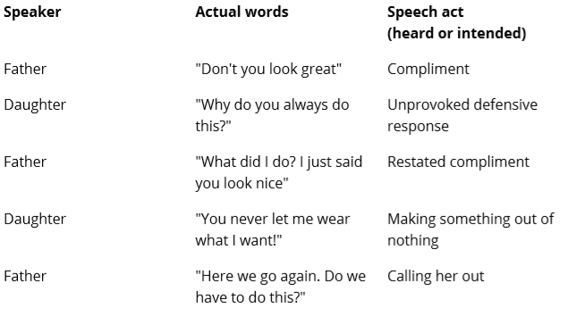
Father context

Slide 10
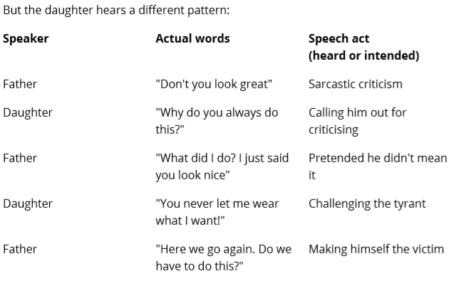
Daughter context
Notes:
Think about this is in the context of your role?
Performance conversations?
Keis keto diet

Slide 11
In your groups…..
Think about this is in the context of your role. Share ideas of when your actions/words have created an unintended afterlife.

Slide 12


Slide 13
CMM and the Hierarchical Model Pearce and Cronen
Contextual force exerts a stronger downwards influence on the context below, to maintain the status quo.
The effect different levels of context have on communication.
Culture
Family/Life Scripts
Relationship
Episode
Speech act
Implicative force exerts an upwards influence on the context above, to redefine or change the context above.
The effect the communicated response has on higher levels of context.
Notes:
Make reference to the example of the earlier exchange

Slide 14
The Hierarchy model is used to help us think about the multiple context that we are attending to in our conversation with others.
Our context, drivers, values and lived experience will all contribute to the creation of our highest context.
If we are not talking about the same thing then we can get muddled and “un-coordinated”.
Examples…
Notes:
Receiving an email from higher management, teacher can I talk to you
Manager dealing with child PPO’s – have you approved my mileage
SW doing statement for court – highest context
IRO – Invite list

Slide 15
Using this idea in practice
Speech act: What are the family saying to each other in an argument?
Episode: How often is this happening? When was the last time this happened?
Relationship: What is the arguing doing to the relationship?
Family/Life Scripts: Is arguing ok? What do you think your mum/dad/you should do together? What does arguing look like/represent in your family?
Culture: Is arguing normal in families? Do other families argue? Do they argue better?
Think of a family and think about how some of these ideas might be helpful…

Slide 16
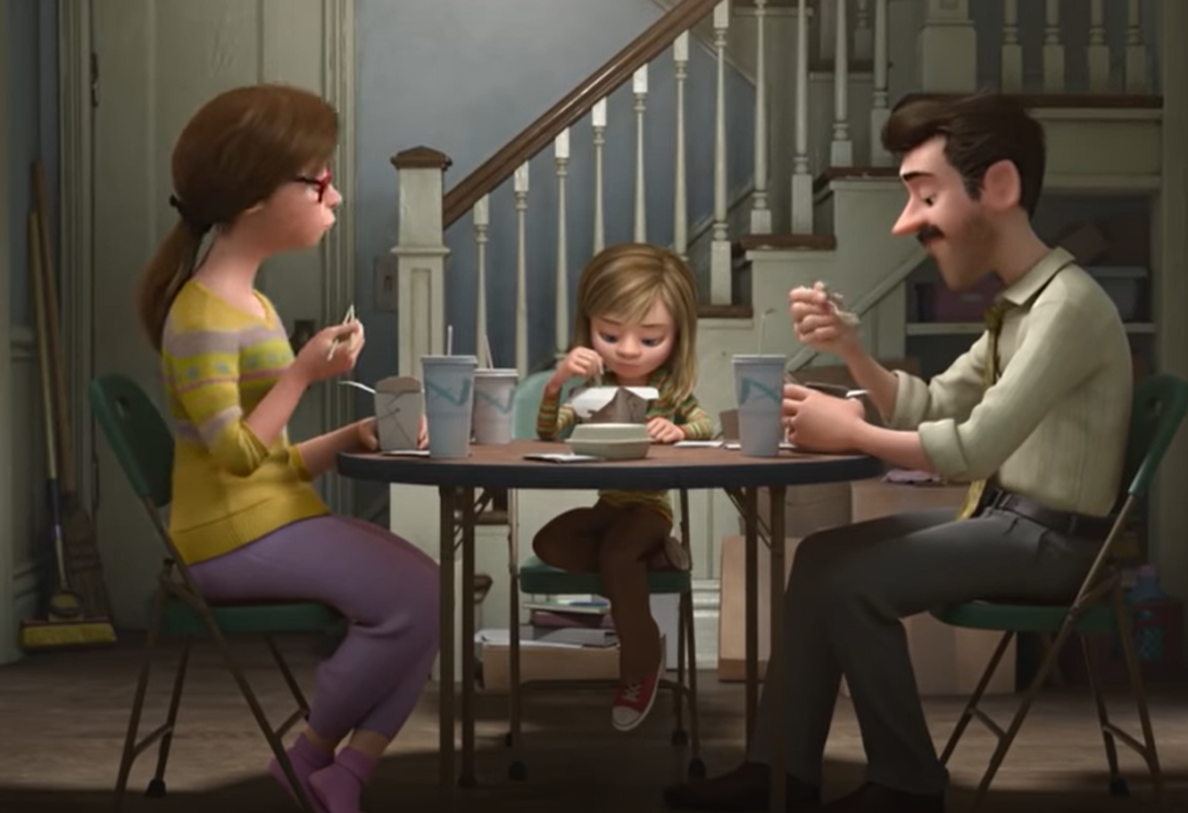
https://www.youtube.com/watch?v=Cjgdiy_SGjA

Slide 17
In your groups…….
From watching the clip, which stories have been unheard/untold?
How has the story telling impacted on the exchange between Riley and her parents?

Slide 18
LUUUUTT – Patterns of communication We choose what we communicate
Lived stories-what we actually did or are doing
Unknown stories- information that is missing
Untold stories- what we choose not to say
Unheard stories- what we say that isn`t heard or acknowledged
Untellable stories- Stories that are forbidden or too painful for us to tell
Story telling- the manner in which we communicate
Stories told- what we say we are doing.

Slide 19


Slide 20
Hypothesising
Definition – an idea that forms the basis for reasoning; as a starting point to explore further.
Neither true nor false but more or less useful
We will always have a hypothesis, based on previous experience, research, personal experience – but not always made explicit.
Notes:
Falling in love with your hypothesis
Having the answer.
Stops us being curious?

Slide 21
Tommy is 12 years old. School have referred to the MASH. Over the last few months they have noticed Tommy’s mum (Marion) has come to collect Tommy and has been intoxicated and emotional.
Tommy seems quieter than usual and is looking unkempt, he is forgetting his packed lunch and homework more frequently than usual.
Up until a few months ago it would be his Dad (Geoff) who would be their primary contact. They haven’t been able to get in contact with him to talk about their concerns.
Tommy’s friend (Nick) has a told a teacher that Tommy is spending a lot at his house and he seems reluctant to go home.
Notes:
Group

Slide 22
Activity
Thinking of the case study what hypotheses do you have?
Following the LUUUTT model, what might we consider are the stories lived and the stories told for the family?

Slide 23

Don’t Marry your hypothesis
The danger of falling love with our hypotheses
Notes:
The moment we stop being curious we are not open to ideas.

Slide 24


Slide 25
Why is curiosity important?
“In pressurised working environments where an emphasis is placed on completing assessments within brief timescales, our focus on collaborative Inquisitive practice can wane and we find ourselves thinking about families in hostile and judgemental ways.
If untended to, these feelings govern our interventions with families and we become ensnared in patterns…of disrespect and distrust”
Pipe and Richardson 2015.
Notes:
Sysmtemic doesn’t give you a fixed framework for working with a family. Or uninform approach. Recognising that we are all different and we all bring something difference

Slide 26

Curiosity Definition: A state of open wondering, tentative suggestion and ideas. This can be a hard stance to keep hold of and we should be attending to this and supporting it via consultations, supervision, and self-reflexivity. How can we be curious in our roles?
Notes:
How can you use these idea where you are.
Best practice models influence across a wide system.
All layers.
Signs of Safety you are looking at a family
Systemic you can apply in every aspect so not just about working with families its about our whole way of thinking and applied in any area of work.

Slide 27
Finding ways to continue being curious
Join with the Logic – understanding vs agreeing
Invite alternative perspectives. What else might it be?
Acknowledge your bias (and your gut)
- What do you notice? – Why? – What are you going to do with this?
Think about how you are being influenced.
Create safe and respectful conversations.
Think about impact of your professional position/power and the wider influence of the professional network or system.
Not assume meaning – when you say X, can you tell me more about what you mean by that? Suggest re-frames, how are these received? E.g. Could shouting be reframed as worry?
Notes:
Brene Brown sympathy vs empathy video?

Slide 28
Framing and re-framing
Different circumstances, perspectives and lived experiences will lead to different felt realities and viewpoints. This will influence the way in which we frame our experiences of working with families.
How might we use re-framing to re-write narratives for families?
‘Mum has spent all of her benefits on Christmas presents for the children and now cannot afford gas. She has failed to prioritise the basic needs of the children.’

Slide 29


Slide 30
Curiosity through questioning…
A way in which we can ensure we are maintaining a curious approach is through our questioning styles……
“Systemic-less” example

Slide 31
The role of questions
1) To gather information
2) To share and explore hypotheses
3) To encourage people to reflect
4) To intervene

Slide 32
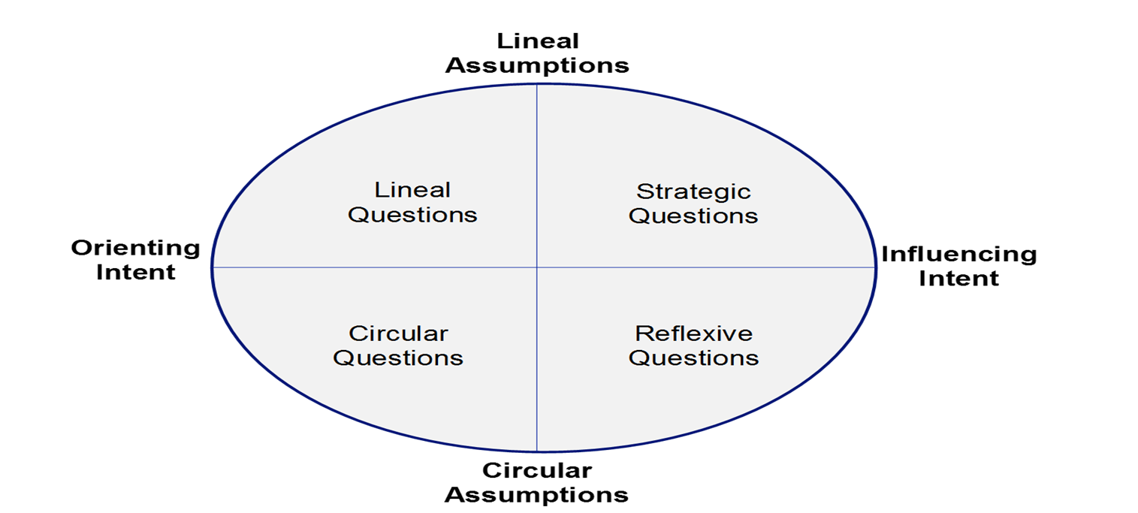
Karl Tomm - Interventative Interviewing
MAPPING
Questions which try to clarify key facts or context. There is a sense of investigating and clarifying.
ENCOURAGING DOWN A PATH
Questions which are influencing in a more directive or corrective way. Trying to change behaviour or elicit a response.
RELATIONSHIP Questions that are aimed at exploring relational patterns and positions within the family system.
POSSIBILITES ARE EXPLORED Questions which introduce a difference and influence people to think differently.

Slide 33
Karl Tomm says…
Lineal questions
Investigation questions: “Who, what, where, when, why?”
Usually begin with these when helping us to understand a ‘problem’
Used to gather information
Can sometimes make the person being questioned feel uncomfortable as they can imply something is wrong that ought not to be.
Who was there? When did this happen? Where were you when this was happening?

Slide 34
Circular questions (understanding difference)
Relationship questions help us better understand relationships, patterns and positions better.
The word ‘circular’ is assuming that everything is somehow connected to everything else.
Who else worries? Who do you think worries the most? What does she do when she worries? What do you do when you see her worrying?
These types of questions are less blaming and tend to elicit a more neutral response.
When family members/others say/hear these answers it can have a big impact.

Slide 35
Strategic questions
Influencing questions ….are asked to make suggestions about what the next possible steps might be or something that might be helpful to change based on lineal assumptions.
Examples: “Why don’t you talk to him about the problem instead of the children?”
“What would happen if you suggest he take some responsibility?”
For some families this directive approach might seem necessary to encourage a change but too much of it may be disengaging

Slide 36
Reflexive questions
Exploring questions…are intended to influence the person/family in a certain way and based on circular assumptions you have made.
This is more of a suggesting approach based on the fact that families’ are experts in their own lives and we are therefore not directly instructing but suggesting.
From observations you are guiding people/families to used their own resources
Examples: “If you were to share with him how worried you were and how it was getting you down, what do you imagine he might think or do?”
“If this depression/low mood suddenly disappeared, how would your lives be different?”
This way of questioning is encouraging people to reflect upon their current perceptions and actions and consider new options.

Slide 37
A Systemic-full approach

Slide 38
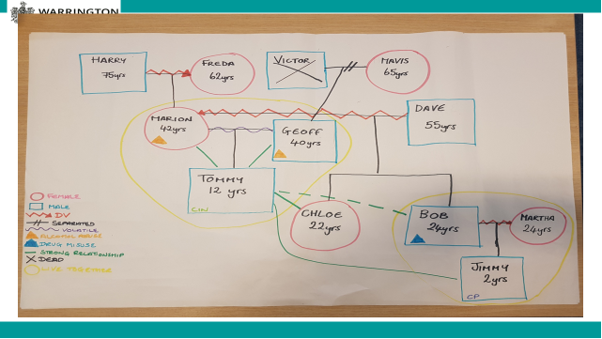

Slide 39
Tommy – age 12
I live with my mum and dad, Marian and Geoff
Currently I’m feeling worried about them as they keep drinking and this makes them argue
I’m often late to school because I struggle to sleep and wake up late. My grades are now suffering.
I have a really good group of friends – I’m able to talk to my friend, Nick, if anything is bothering me.
I’m close to my big sister, Chloe, who I often stay with when mum and dad are drinking/ arguing.
I see my brother Bob once a month when I go to visit Jimmy. I don’t get on with Bob as he was always mean to mum when he lived at home, but I love being an uncle. I just worry about Jimmy sometimes because I know that Bob and Martha argue in front of him a lot.
Life at home is usually good. I love taking my dog on walks with mum and dad. It’s just recently that things have felt bad.
I know that dad has been upset about grandad dying last year. He drinks a lot and then starts to cry.
Mum drinks too. She says that she worries dad is going to leave us.

Slide 40
Marian – 42
I’m the daughter of Harry and Freda
I witnessed domestic abuse as a child– incidents would usually result in my dad leaving home for weeks at a time.
Mum would become depressed during such incidents and I would have to look after her.
As I entered my teenage years, drinking alcohol would help me cope with the responsibilities at home.
I left home and met Dave shortly after. I had met him as he drove the bus I used to get to my first job.
18 months after meeting Dave, I gave birth to Bob.
Dave became violent after we had Bob. I would drink alcohol to help me feel better.
I gave birth to Chloe.
After a significant incident, where Dave threatened to harm the children, I entered in to refuge. Bob was 9 and Chloe was 7 at the time.
I moved in to a new house and got a new job. I met Geoff there. He was such a good support and took on Bob and Chloe as his own. This was the first time in my life when I felt settled.
Tommy arrived a few years later. This was a happy time, although it coincided with Bob presenting us with some challenges in his teenage years.
Chloe was and always will be my rock! She takes after me in that she always wants to care for people.
Last year, Geoff’s dad, Victor, died. Victor had raised Geoff by himself and they were very close.
Geoff withdrew completely. He was very quiet and would say negative things about the pressure he was under. He started to drink during the day. I was worried that he was going to leave, like dad used to.
The only way I felt I could connect with him again was to drink with him. Things have now got out of hand.

Slide 41
Activity
Using your case study and your hypotheses, what are you curious about?
What questions might we ask Marion/Tommy?

Slide 42
Check out
What are you going to take away from today?

