Slide 1
Introduction to Systemic Practice
Alex Woods
Amanda Coyne

Slide 2
Expectations for training
Have a chance to think about how these fit with what you know and do already.
2 days now then a further 2 days next month.
All the days are interconnected and we will be building on things gradually.
Our approach will be:
Introduce idea/topic
Model this for you in practice
Practice Session in smaller group
Feedback to wider group
Be mindful of size of group. Lots of opportunity for small group discussion.
We want to create a space that feels safe, fair and respectful.
Only share what you feel comfortable sharing. There is no expectation for you to share and disclose information.
Space for your questions.
Feedback about how today was for you and thoughts you have for future sessions.
Notes:
Sarah

Slide 3
Introduction
Introduce yourself, your role and tell us two things about yourself.
Notes:
Introductions - who we are. We will be sharing about ourselves.
Sarah

Slide 4




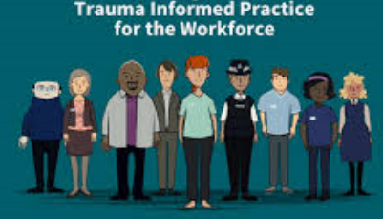

Practice Models
Notes:
Poppy
These are some different practice models used in local authorities, in Warrington, systemic based practice is our practice model.
Dean -
How can you use these idea where you are.
Best practice models influence across a wide system.
All layers.
Signs of Safety you are looking at a family
Systemic you can apply in every aspect so not just about working with families its about our whole way of thinking and applied in any area of work.

Slide 5
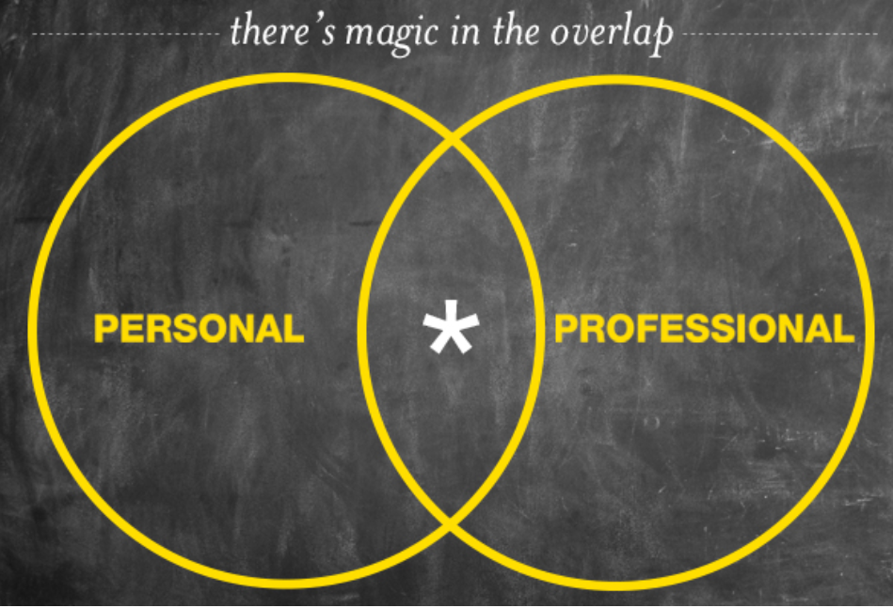
Systemic Practice Model
Overarching philosophy/culture
Method/approach
Tools and Techniques
Notes:
Poppy
Systemic doesn’t give you a fixed framework for working with a family. Or uninform approach. Recognising that we are all different and we all bring something difference

Slide 6
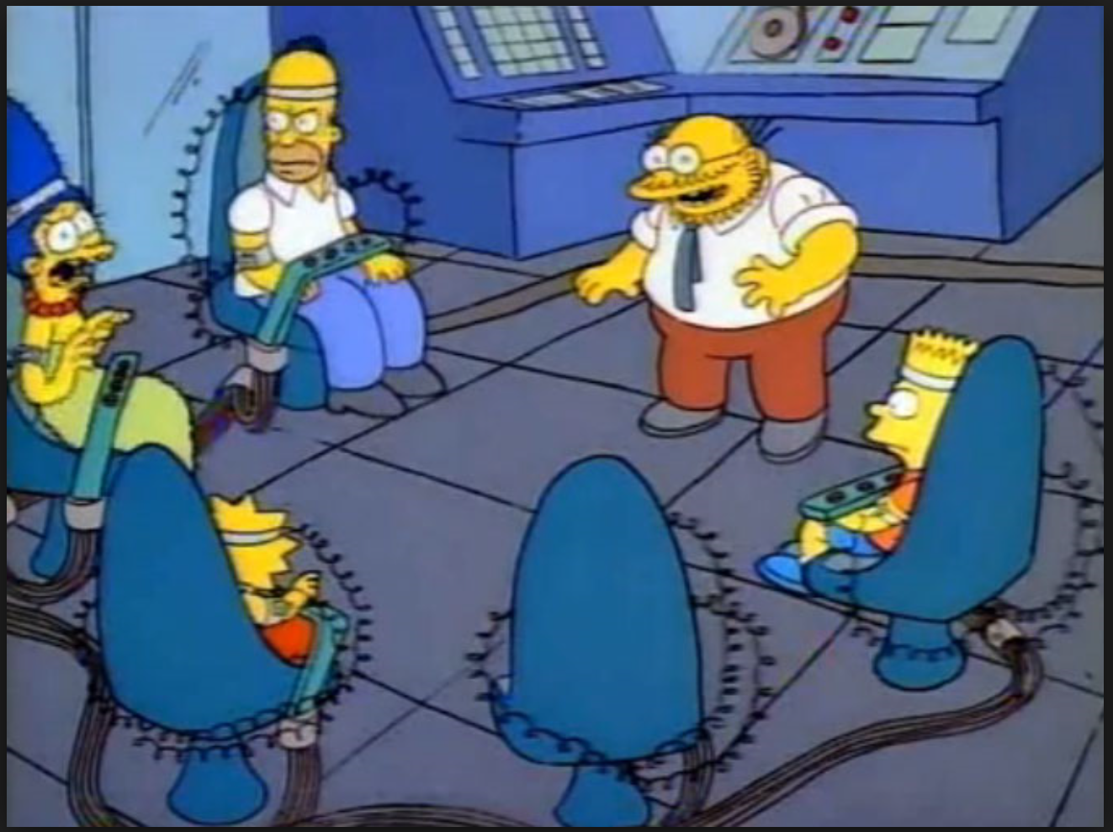
Our core model – Systemic practice
Using genograms
Understanding intergenerational relationships/patterns
Self reflexivity and use of self - the importance of understanding self and provide framework for thinking about how we make our assessments.
How we managing risk and uncertainty – holding the truth lightly.
Understanding different narratives and perspectives – Social Graces.
Hypothesising
Language and the construction of language – the power of language.
Context - without context there is no meaning
The problem is the problem not the individual/group.
Thinking about the professional system alongside the family system. Systems and sub-systems – siblings, partner, friends……….
Notes:
Poppy
Contents page of what we will cover
Hope is to cover these areas
At the moment you might recognise some of these, or none of these, both are ok.

Slide 7
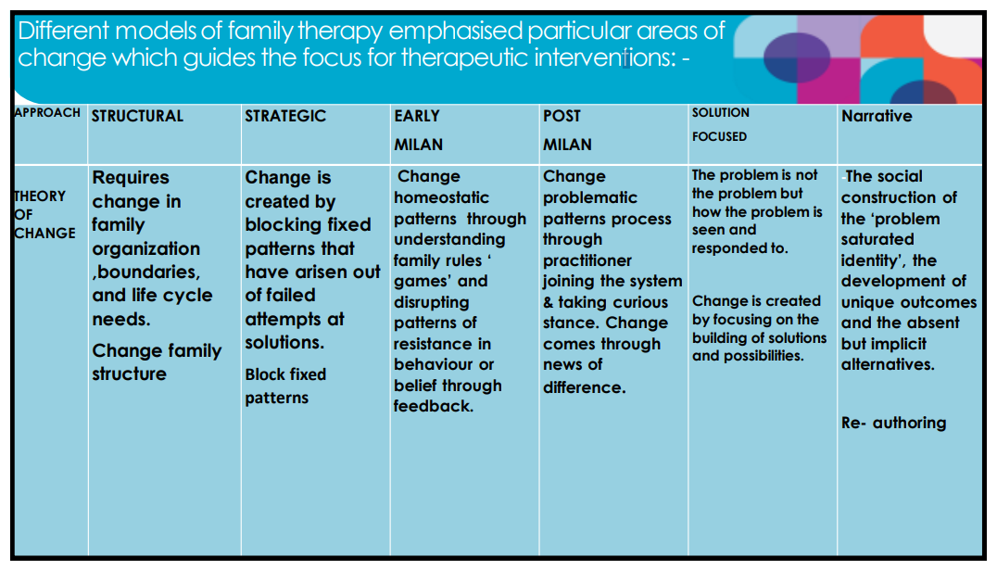
Notes:
Sarah
Systemic practice is rooted in family therapy – these are the different schools of thought within family therapy
Important to understand the influence of this on the practice model
Early schools of thought – doing too
Now – doing with
Recognising that families are not all the same – difference is ok and we need to work with this difference
What works for one family, might not work for another.
Early concepts – exploration around cybernetics and systems theory.
First phase – 1950’s to mid 1980’s saw the introduction of structural approaches – acknowledging the influence of hierarchies within family systems. It also saw the introduction of strategic approaches – noticing that we as practitioners were able to influence outcomes based on our approaches to families.
Second phase – mid 1970’s-mid 1980’s Early and post Milan. More discoveries around the influence of curiosity and social constructionism and the influence these could have on outcomes for families.
Third phase – 1980’s to 2000’s – Further introduction of solution focused approaches, narrative therapies and coordinated management of meaning, broadening our thinking around different perspectives and the power of communication

Slide 8
So what did this mean?
- A move away from the focus being on the individual – understanding patterns of interactions between rather than within – attention paid to sub-systems.
- A focus on organisational patterns within families – working to disrupt dysfunctional relationships to create healthier systems.
- Stronger ideas about what ‘functional’ and ‘dysfunctional’ families looked like (particularly relevant to structural approaches).
- Earlier approaches meant that the family saw the therapist as the expert – ever evolving!
Notes:
Sarah/Poppy
Non expert position
Understand the family before we understand the problem

Slide 9
Systemic Practice in Child Protection Social Work
Values focus and whole system change
  Believing in families
  Manage risk together proactively
  Collaborative and respectful
  Focus on direct work to help Families Change
  Parenting support; reduce care numbers, train staff
And…
  Do it together
Notes:
Sarah/Poppy

Slide 10
Self Reflexivity
Reflexivity rather than reflecting.
Use of self in social work and an awareness of your what constitutes your‘self’.
Learning how our personal history can resonate in professional practice.
How our own stories and experiences influence our practice, assessments
Influence our leadership style.
Notes:
Poppy

Slide 11
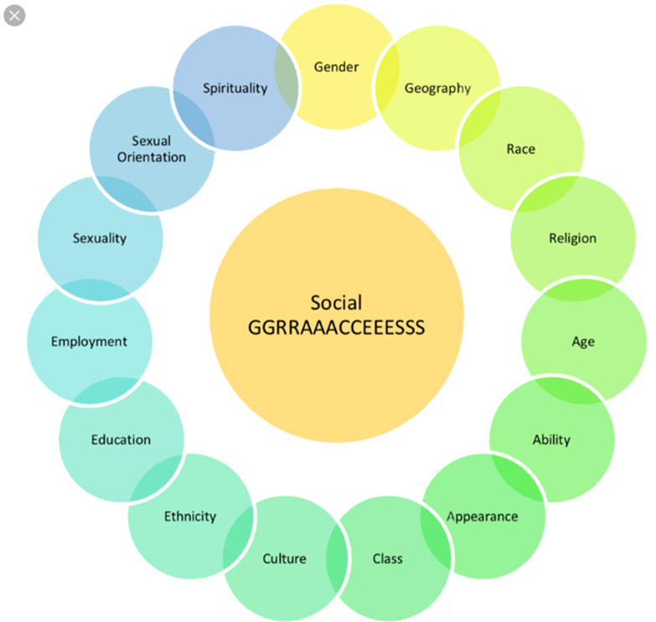
The Social GGRRAAACCEEESSS
Notes:
Guess our graces

Slide 12
The Social GGRRAAACCEEESSS
The Social GGGRRAAACCEEESS are an acronym that describe different personal characteristics
When we think about the GGGRRAAACCEEESS we also think about them within the context of whether they are visible or invisible, and where they are voiced or unvoiced.
We also think about them in relations to power and privilege.
Notes:
Sarah

Slide 13
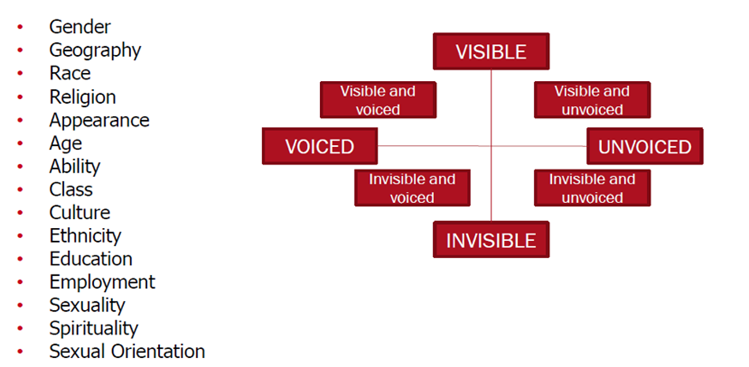
The Social GGRRAAACCEEESSS
Any others ??????????
Notes:
Sarah

Slide 14
Exercise
In your groups have a discussion about what you think our social graces are?
What SGs are easier to talk about than others, which ones did you avoid talking about? Why?

Slide 15
Intersectionality

Slide 21

Video
Being A Man 2014 | Being a Black Man - YouTube

Slide 22
Things to think about…..
Why are the GGRRAAACCEESSS important when working with families?
Why might it be important to pay attention to our personal and family stories when working with families?
Try mapping out the GGRRAAACCEEESS for some of the children and families you work with. Are there particular areas you feel you know more about than others, are there other areas you need to explore to help you get a better understanding of the family?
How do the GGRRAAACCEEESS with the professional network impact on the family, relationships, assessments?

Slide 23
Things to think about……
Your own GGRRAAACCEEESS compared to your line manager. Are these similar or different? What impact does that have?
Think about the GGRRAAACCEEESS in the context of your team/professional networks? Are there lots of variation of the GGRRAAACCEEESS within your team, or are you in a team where there lots of similarities.
How might these influence the dynamics within the team/network and the way you work?
Notes:
Not just a helpful framework, but a critical position to take.
Practitioners – How do our GGRRAAACCEEESS influence our relationships and the assessments we make?
Professional Groups – How do our GGRRAAACCEEESS impact on how we work together and our work with children and families. Particularly thinking about any dominant or privileged GGRAAACCEEESS in the professional system compared to the family system
Managers – Using supervision to unpick and understand how GGRRAAACCEESS influence ideas about the case. The supervisor needs to construct a supervisory context in which these conversations can take place, and feels safe for conversation to take place.
Leaders – Influence our ability to be curious and challenge dominant ideas. The nature of oppression and of privilege means that any discussion of these issues often becomes a highly charged, avoided, and divisive experience.
Organisations – Provides opportunities to think about power and difference and how these shape decision making, service delivery, outcomes etc.

Slide 24

Break

Slide 25
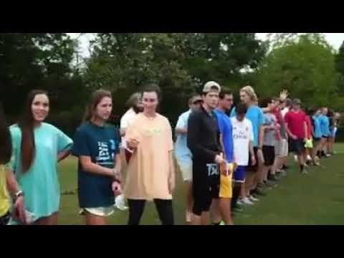
Privilege
Notes:
Poppy
Part of self – reflexivity is understanding privilege
Privilege, as understood and described by researchers, is a function of multiple variables of varying importance, such as race, age, gender, sexual orientation, gender identity, neurology, citizenship, religion, physical ability, health, level of education, and others.
Video or in person depending on room size etc

Slide 26
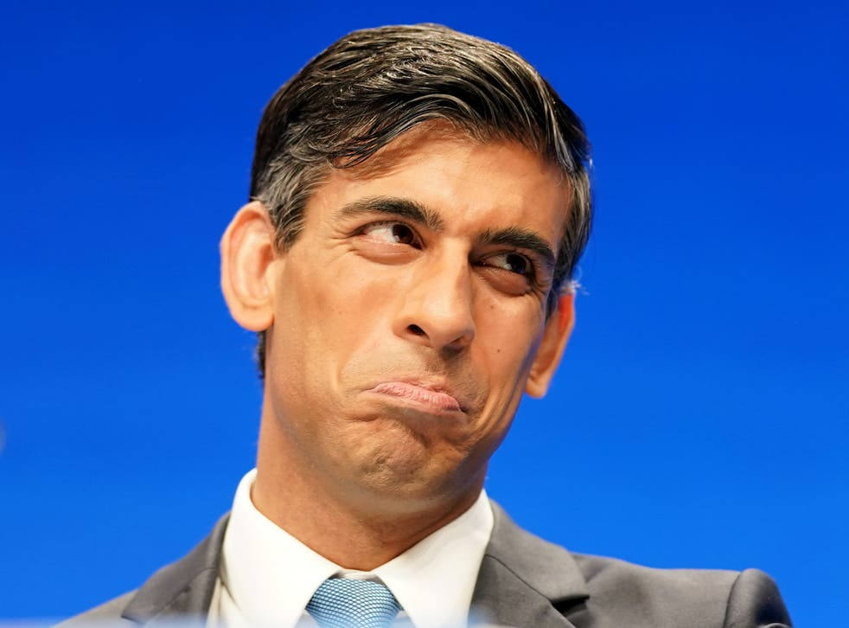
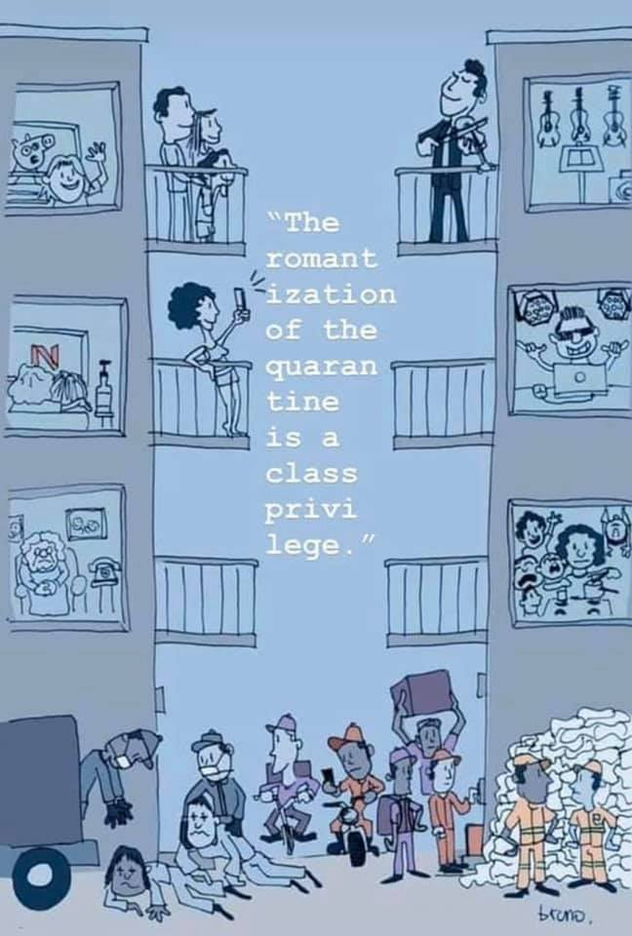
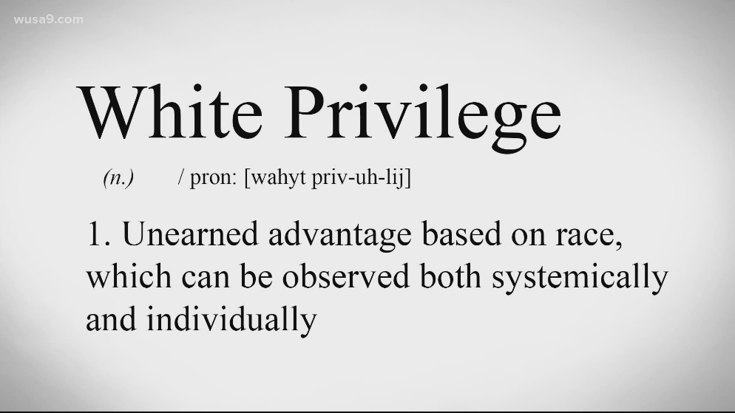
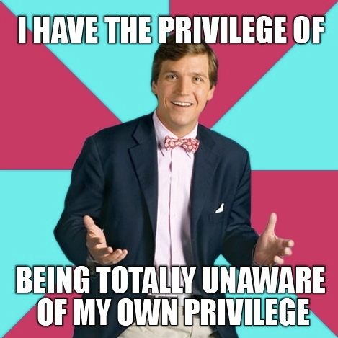
Privilege
Privilege describes benefits that belong to people because they fit into a specific social group or have certain dimensions to their identity. You can have (or lack) privilege because of your race, gender, sexual orientation, ability, religion, wealth, class among many other characteristics.
Having privilege means having an advantage that is out of your control and that you didn’t ask for. You may not even notice it until you educate yourself about its existence.
Notes:
Poppy
Alex https://www.youtube.com/watch?v=4K5fbQ1-zps
It is hard to acknowledge one’s own privilege because privilege is the other side of oppression. Some people are against talking about privilege because they don’t want to be framed as the aggressors or complicit in a system that gives them an advantage at the expense of others. Other critics of the word ‘privilege’ mistake it for a blanket term that suggests that, if you have a privilege, your whole life has been easy.

Slide 27
Do you have privilege?
Have you ever been the only person of your race in a meeting at work?
Have you ever been stopped by security for no reason?
Do you have to think about accessibility before you go somewhere new?
Is filling out you title, gender or sexuality on a form a frustration or annoying experience for you?
Have you ever had to pass on a great opportunity due to a lack of finances or financial ‘safety net’?
Notes:
Poppy

Slide 28
Where you answered ‘No’ to any of the above, it means you enjoy an effect of a certain type of privilege.
Where you answered ‘Yes’ to any of the above, you probably don’t need to be told that the obstacle you reported experiencing is not universal
To accept privilege is to accept that the ‘playing field’ we work on is made uneven by various advantages and disadvantages. This means that opportunity is not equal and not all achievements are earned fair and square
Notes:
Poppy
Mand – Liverpool accent
https://www.hivelearning.com/site/are-you-privileged/

Slide 29
Power and Difference
Some stories will be made more available to us than others most to maintain the suppression of marginalised groups.
Thinking about power and difference. Which voices are privileged and how may this impact on our practice?
How can I/you be more mindful in our practise when considering power?

Slide 30
What ideas do we have about how this may influence your work with children and families? Where do you see power at play most?

Slide 31
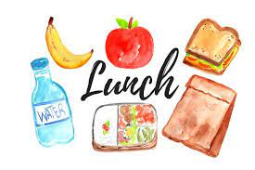
Notes:
Breakaway group

Slide 32
Genograms

Slide 33
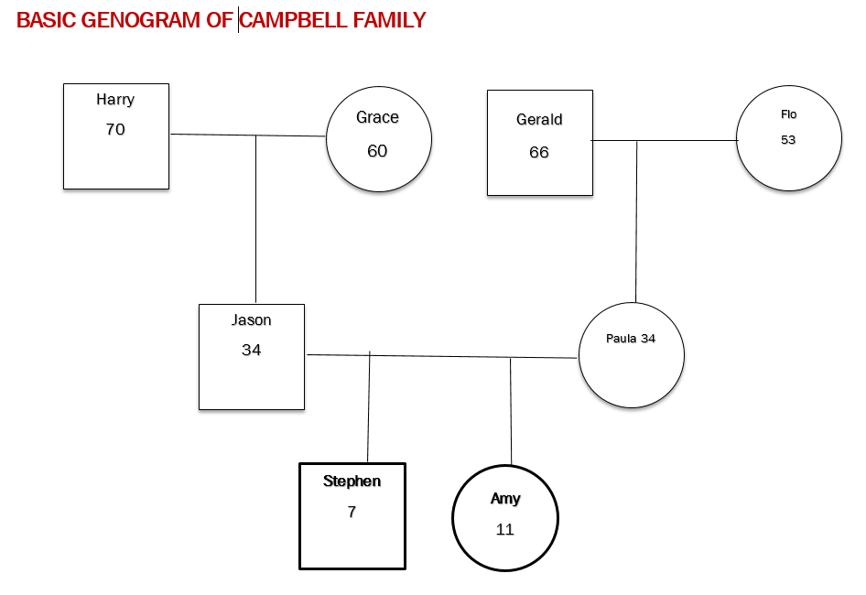

Slide 34
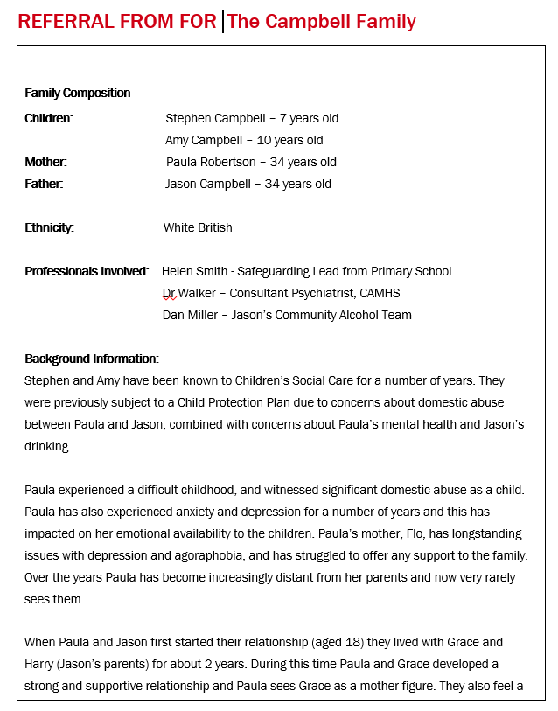
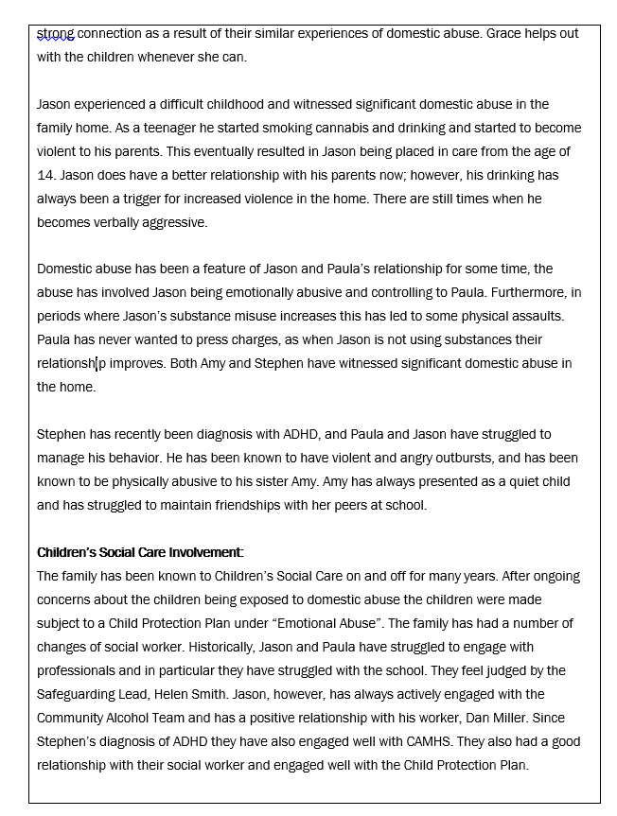
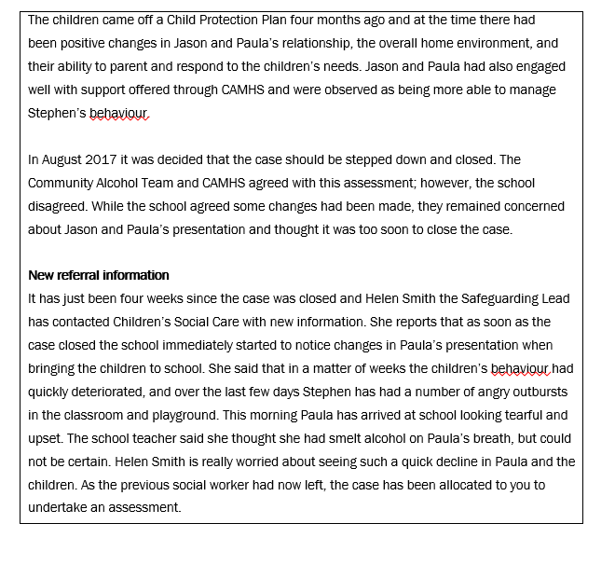
Understanding the family history

Slide 35
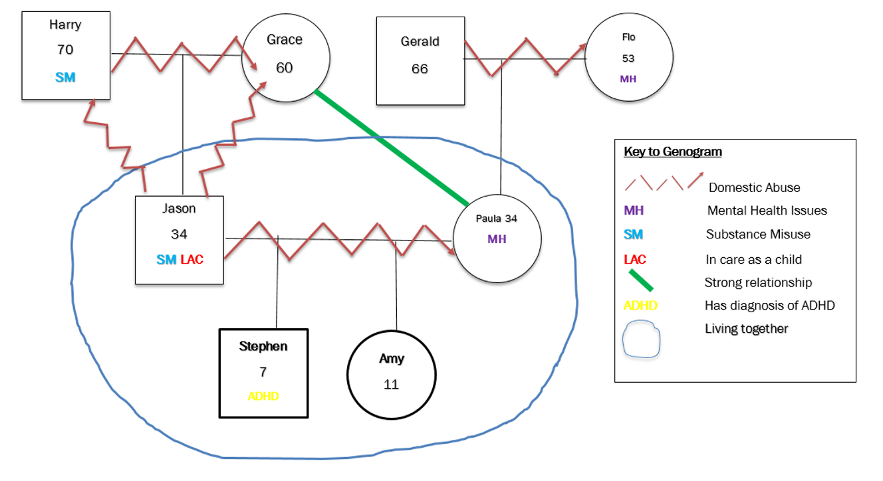
Its not rocket science it’s a lot more complicated than that!

Slide 36
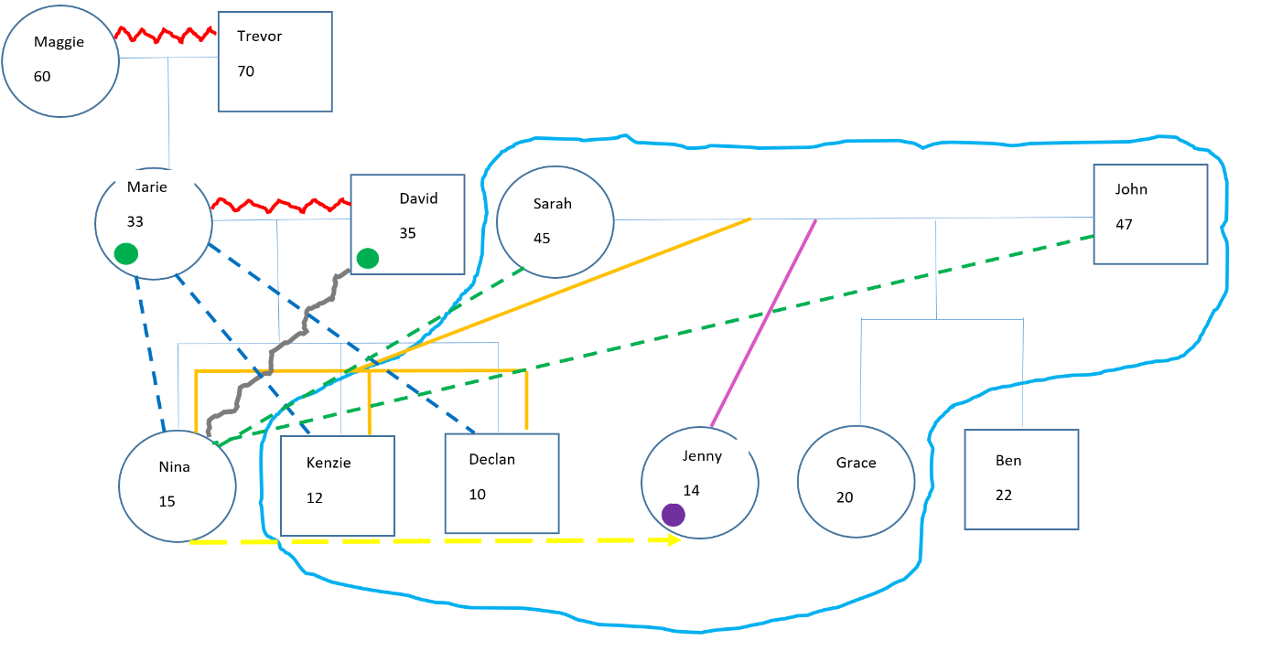
Example genograms

Slide 37
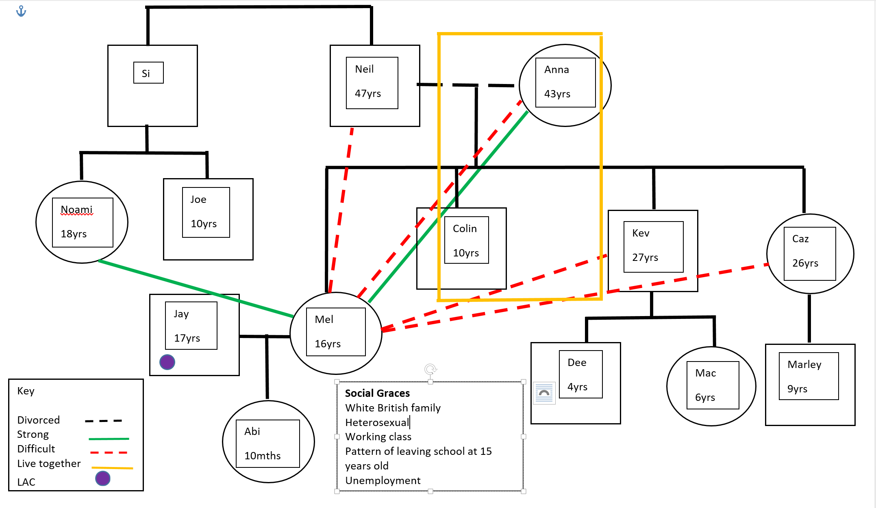

Slide 38
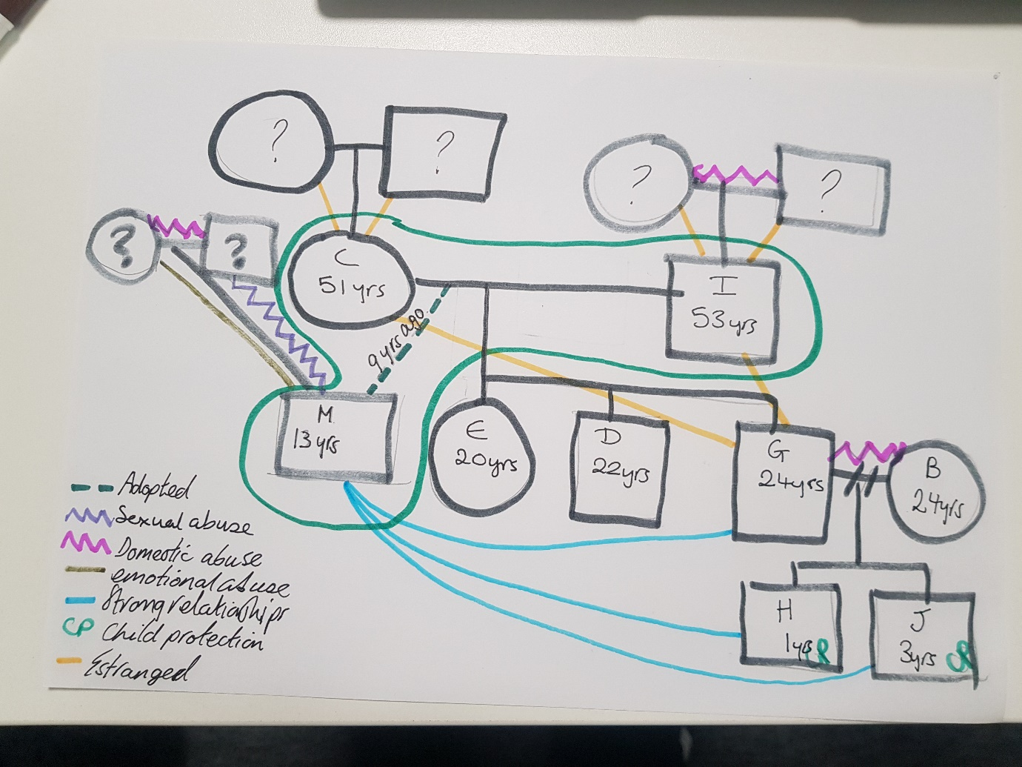

Slide 39
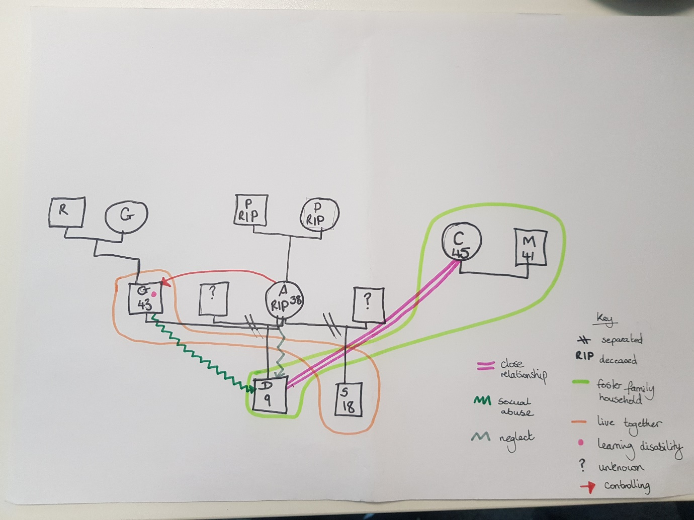

Slide 40
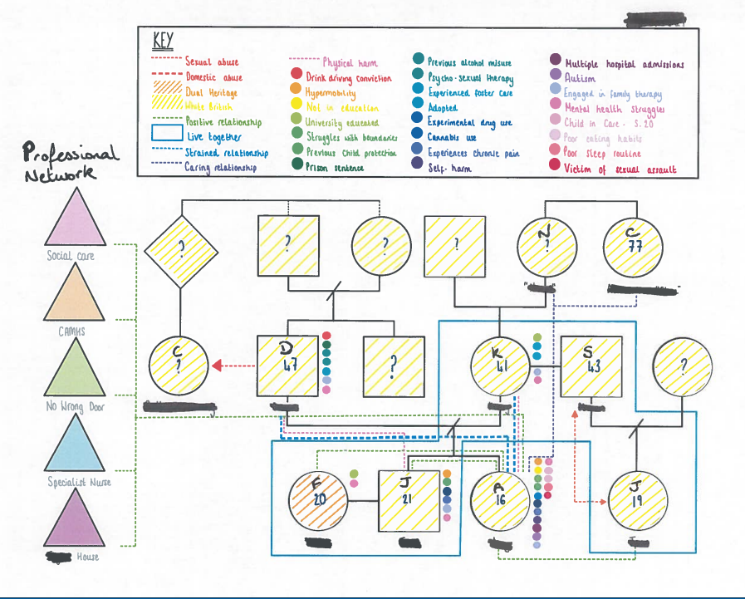

Slide 41
What to include on Genograms.
At least Three Generations
Presenting issues and factors. i.e. Mental Health, Substance Misuse
A range of relationships both strong relationships and those consider.
Social Graces
Include the date it has been completed. Genograms evolve over time they are organic.

Slide 42
How to complete a Genogram.
Take care these can be very powerful
Try not to impose meaning- remain curious
Know when to stop or pause.
Think of the context to the session; if you are completing this as part of an assessment the person may be anxious about what they share
Alternative to genograms: ecomaps; timelines.
Let the person take the lead if they feel comfortable doing so.

Slide 43
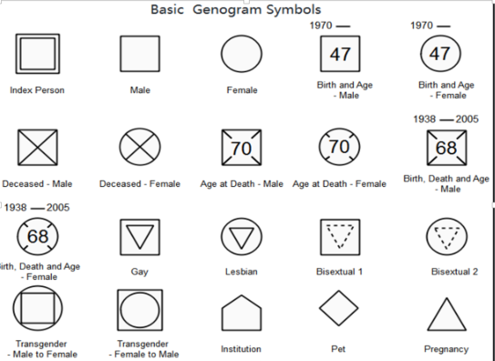
GENOGRAMS – The Basics of Recording

Slide 44
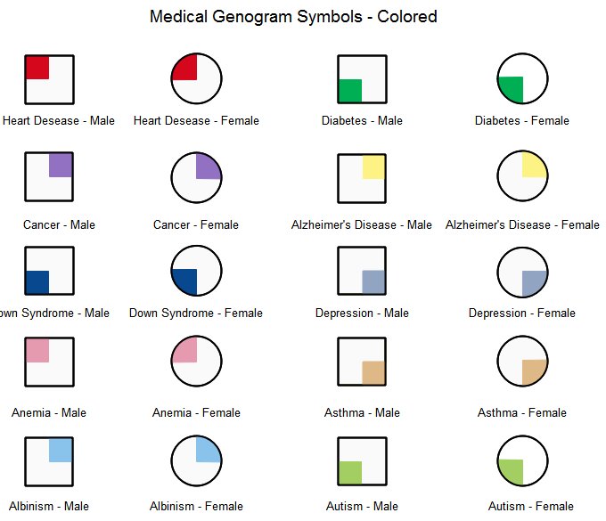
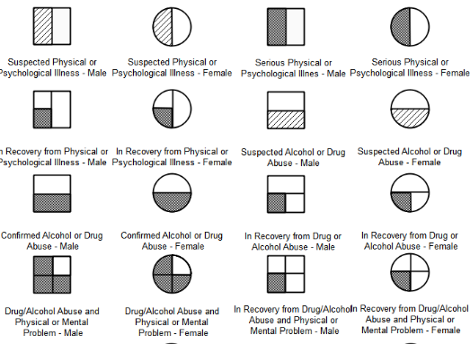
Recording key issues

Slide 45
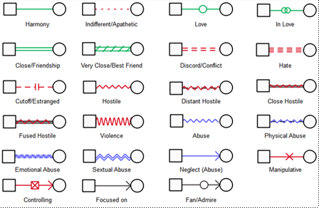
Recording Relationships

Slide 46
Genogram Practice Exercise 1
Work together to draw the genogram of a member of your group.
Ask questions that might help you understand and find out more information about the wider family system
Please only share as much information as you feel comfortable sharing.

Slide 47
Group Feedback
What discoveries did you make?
What questions did you ask?
How did it feel for those who shared their story?

Slide 48
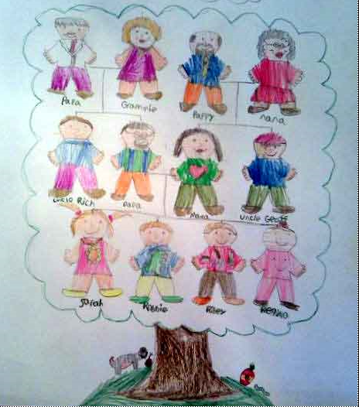
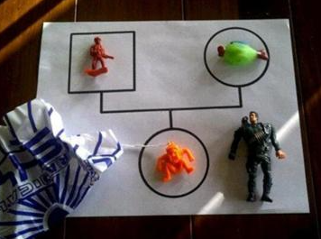
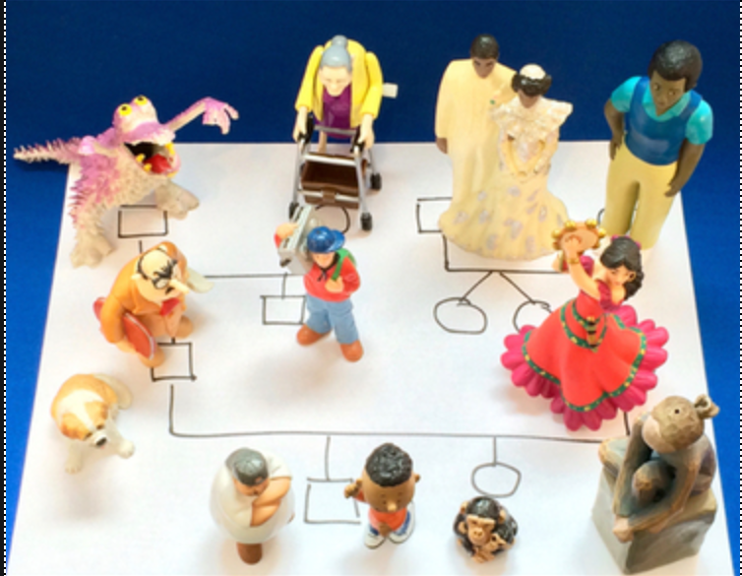
Genograms as a Direct Work tool

Slide 49
Genograms in Practice
When you get a referral draw a Genogram based on the information you have.
They are an assessment tool not an admin task. Building a picture overtime.
Should be completed with every family and at the beginning of every assessment.
Bring to supervision when discussing a case. Where are there gaps?
Reflective Supervision tool.
Will be a key document to be included in referrals i.e. all referrals to Legal Gateway.
Important tool to help us understand how our own family structure and relationships influence the way we work.

Slide 50
GENOGRAM – Good Practice Points
Get children involved or do them with children – be creative.
They should include three generations.
Have pens and paper at the ready!
Include a key on your Genogram
They should highlight and note areas of strength in the family system as well as things we might be worried about.
Be creative! Think about how you can use them with children and families.
People often worry about drawing Genograms and getting them wrong.
DON’T WORRY Just have a go.

Slide 51
Check out
What are you going to take away from today?

