Slide 1


Slide 2
Aims of this training session
This training is designed to equip you with the knowledge, information and skills that you will need to discuss ICON: ‘Babies cry, you can cope’ with parents and carers
The training will help you to:
  share the message that crying in babies is normal
  support parents/carers to soothe their baby
  support parents to cope with a baby’s crying
  understand more about Abusive Head Trauma
  understand it is a form of child abuse

Slide 3
Background
AHT is abuse and is preventable
Crying is a known trigger
70% of babies who are shaken, are shaken by men
Our goal for ICON is to communicate to parents/carers that they can expect crying, prepare for it and cope with it
Our target is to reduce the incidence of AHT triggered by crying

Slide 4
Some more “crying baby” facts
Crying is a normal part of child development which can have a significant negative impact on the emotional health of parents
All babies will cry a lot from the ages of 2 weeks to 3-4 months, but this can vary from baby to baby
Crying seems to peak in the late afternoon and early evening… but this can vary

Slide 5
Some more “crying baby” facts
Crying is sometimes misdiagnosed as colic
No one is really sure why babies cry so much in this period… research is ongoing
An immature nervous system may make babies more irritable… Crying is their only means of expression!
ICON is an evidenced-based delivery method

Slide 6
Factors that can trigger AHT
In one survey, half of the mothers interviewed reported that their child’s crying made them feel like harming their child. Such feelings are rarely acted on, but it can be a trigger for a parent to actually harm and abuse their child.
Research shows that babies are most likely to be shaken when they are 2-3 months old… the time when babies cry the most.

Slide 7
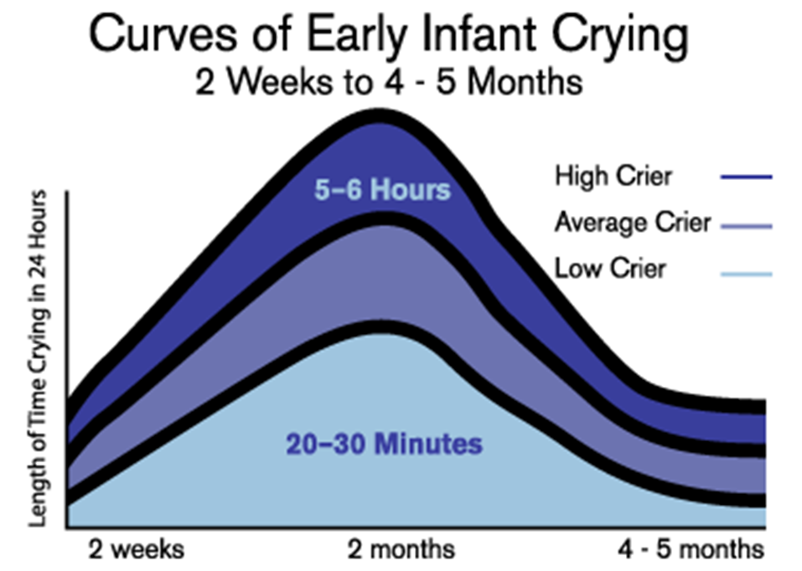
Normal Crying Curve

Slide 8
But… It’s not just the baby
Excessive infant crying can be associated with:
Parental stress
Depression
Possible relationship problems
Feelings of guilt, inadequacy and helplessness
Remember… this is a new experience for most parents

Slide 9
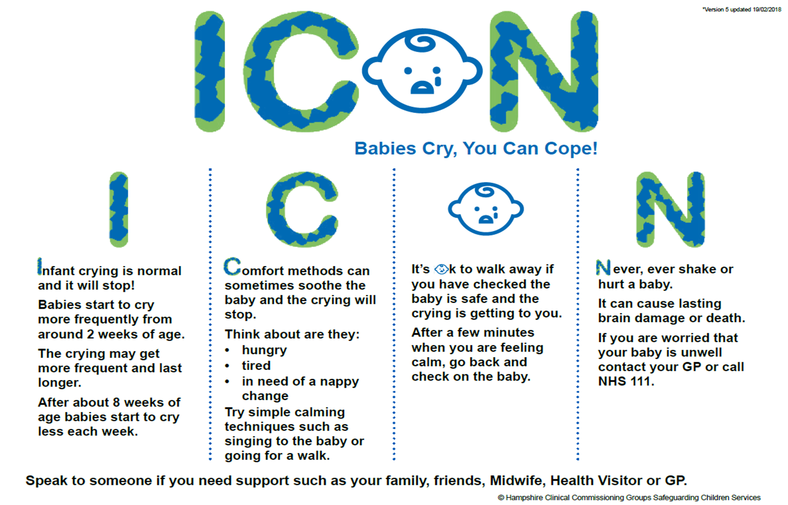

Slide 10
More factors about Abusive Head Trauma
AHT is the most common cause of death or long term disability in babies
24 out of 100, 000 hospital admissions for babies are due to abusive head trauma
200 children are killed or hurt annually in the UK
These figures certainly underestimate the real numbers involved

Slide 11

Are some babies more at risk than others?
Research shows that the most at risk babies are:
Baby boys
Babies under 6 months old
Babies born pre-term or at low birth weight
Babies who have more contact with health services

Slide 12
Cost
Human and Emotional
Financial
  Hospitalisation
  Long term health and educational needs
  Medical equipment
  Legal proceedings
  Child Safeguarding Practice Review
Loss of societal productivity

Slide 13
How can professionals help parents?
By offering ICON as an alternative to a situation where frustration (often linked to tiredness) can lead to abuse
By discussing the issues raised
By talking through the key points in the ICON leaflet

Slide 14
Introducing ICON to a parent/carers
Help parents understand that crying is normal… all parents can feel like this
Explain that crying is a normal part of development
Reassure parents that babies are not doing this on purpose
Support parents in coping with their own emotions and stress (Coping with Crying Plan)
Teach parents soothing and safe sleep techniques
Inform parents/carers about sharing the ICON leaflet with anyone who cares for your baby.

Slide 15



Slide 16
When to discuss ICON
ICON will be discussed at several “touch-point” throughout the antenatal and postnatal journey
Birth of child / Discharge Plan
Who - Midwives
Resources - leaflets/posters
10-12 day Postnatal Visit
Who - Midwives
How - talk
10-14 day Birth Visit
Who - Health Visitors
How - talk
How - talk and leaflet
Resources - leaflet & Red Book
Training - eLearning/PowerPoint slides
6-8 Week Check
Resources - leaflet & Red Book
Who - GPs
How - talk
Training - eLearning/PowerPoint slides
Training - eLearning/PowerPoint slides
Resources - leaflet & Red Book
Training - eLearning/PowerPoint slides
AnteNatal Check
Who WUTH Midwives - 16 week check - 36 week before birth check WCHC Health Visitors - 30 - 36 week check
Resources - leaflets/posters, email
Training - eLearning/PowerPoint slides
Wider Messages
Who - Social care / Police / A&E / Family Wellbeing / Early Help / Early Years settings / PVI / Walk-in Centres / NeoNatal (being developed - York)
Resources - leaflets/posters
Training -eLearning/PowerPoint slides
How - talk and leaflet
6-8 Week
Visit
Who - Health Visitors
How - talk
Resources- digital link, leaflet & Red Book
Training - elearning/PowerPoint slides
How - talk and leaflet/video consultation - Safe Sleep agenda)

Slide 17
Key talking points:
Step One: Infant crying is normal and it will stop
It’s a good idea to deliver this message alongside the information about safe sleep. This information is also included on the ICON leaflet and is a good starting point and a way to lead into the topic of crying. If babies aren’t asleep, they are sometimes crying.
Start with ‘Hello my name is…. I just want to spend a few minutes talking with you about why and when babies cry and give you some information to take home with you’.

Slide 18
Step Two: Comfort methods can sometimes soothe a baby and the crying will stop.
Talk about ways to comfort a crying baby. Ask what methods the parents/partners have tried or thought about trying to comfort a crying baby? If they’re an experienced parent ask what methods they have tried in the past and what they find works. Talk through the techniques referred to in the leaflet. 2
Mention that sometimes, a baby will continue to cry for no obvious reason and that it doesn’t necessarily mean they are doing anything wrong. They need to think about what they can do, to keep themselves calm, which will help them to cope with the baby’s crying.

Slide 19
Ask the parents/partners to jot their ideas on the C section of their ‘My Personal ICON Plan’
• Comfort methods they can try….
• Who will they call if the crying won’t stop?
• What will they do if they need a few minutes to themselves? What makes them feel better?
This is an opportunity to reinforce that if they are worried that the crying won’t stop, it’s OK to contact a health professional such as their HV, Midwife, GP or 111.

Slide 20
Step Three: It’s OK to walk away if you have checked the baby is safe and the crying is getting to you.
Ensure that the parents/partners understand that walking away from their baby is a strategy for coping and that they should try to comfort and soothe the baby before employing this method.
Make sure you emphasise that the parents/partners must make sure the baby is safe before walking away and emphasise that they must gently place the baby in a cot or moses basket.
After walking away, they should go back to check on baby after a few minutes when they feel calmer. This is an opportunity for the parents/partners to call someone they’ve listed for help and support.
Emphasise the need for parents/partners to find time for themselves to help them cope through what can be a really stressful time for all parents/partners.

Slide 21
Step Four: Never ever shake or hurt a baby.
Refer to the leaflet ‘What not to do’ and point out how some people looking after babies can sometimes get so angry and frustrated with a baby’s cry that they lose control and shake or hurt their baby, which is very dangerous and can lead to lifelong injuries and potentially death.
Suggest to the parents/partners that it is important that they share the ICON information with everyone who looks after their baby as it’s not only parents who get frustrated by a baby’s cry.

Slide 22



Follow us on Social Media!
http://iconcope.org/
https://www.facebook.com/iconcope/
https://twitter.com/ICON_COPE

Slide 23
http://iconcope.org/for-professionals/
Report:
https://www.wcmt.org.uk/fellows/reports/abusive-head-trauma-case-prevention
Resources:
http://iconcope.org/wp-content/uploads/2019/10/NHS-PCCG-ICON-LEAFLET.pdf
http://iconcope.org/wp-content/uploads/2018/06/99830_NHS-Icon-Poster-A3L-1pp-1.pdf
http://iconcope.org/wp-content/uploads/2018/06/ICON-poster-6.pdf
http://iconcope.org/icon-fridge-magnet/
Advice for parents/carers:
http://iconcope.org/parentsadvice/

