Slide 1




Safeguarding Plus
Webinar for Wirral Schools
https://www.wirralsafeguarding.co.uk/schools-webinar/
Wirral
Safeguarding
Children
Partnership
July 2020

Slide 2


https://www.wirralsafeguarding.co.uk/schools-webinar/

Slide 3
Presentations
Welcome and Introduction
Support from WSCP and making referrals
Role of, and support to Designated Safeguarding Leads
Child Bereavement – Support from Bereavement UK
Mental Health – Support from CAMHS
Domestic Abuse and Parental Conflict
Early Help Support
Health Services in Schools
Health and Safety
Plenary
David Robbins WSCP Manager

Slide 4
Introduction
WSCP and LA have received a number of queries and anxieties from schools ahead of pupils returning
Common queries related to children’s mental health, affect of lockdown, impact of DA, impact of bereavement, unseen safeguarding concerns etc.
Purpose of webinar to highlight areas of support (but by no means exhaustive)
https://www.wirralsafeguarding.co.uk/schools-webinar/
David Robbins WSCP Manager

Slide 5
Wirral Safeguarding Children Partnership
David Robbins
WSCP Manager

Slide 6
Support from WSCP
Website – www.wirralsafeguarding.co.uk
Dedicated schools pages on the website, thematic pages for professionals, page accompanying this webinar
Policies, procedures and guidance, including annually updated safeguarding policy
Virtual training offer, multi-agency and school specific
Safeguarding support offered through Amanda Waterfall, WSCP Education Officer
David Robbins WSCP Manager

Slide 7
Making a Referral
Ensure staff are aware (and DSL has been on WT training) of the thresholds of need
WSCP website has link from every page to concerned about a child. Includes link to the multi-agency referral form. Page includes referral pathway
Please phone the IFD if you have any concerns 0151 606 2008 or speak to social care link worker
For Levels 2/3 contact the Early Help Team 0151 608 6510 or earlyhelpteam@wirral.gov.uk
David Robbins WSCP Manager

Slide 8
Designated Safeguarding Lead
Amanda Waterfall
WSCP Education Officer

Slide 9

Designated Safeguarding Lead
Keeping Children Safe in Education (2015) saw the first time the government set out the role of the Designated Safeguarding Lead (DSL) in an formalised way for the Education Sector.
Often schools have a DSL and deputy DSL (& sometimes more staff from SLT). They should have the status and authority within the school to carry out the duties of the post, including committing resources and supporting, empowering and directing other staff.
Amanda Waterfall, Education Officer, WSCP
Notes:
The role of the Designated Safeguarding Person was specified in the Children Act (2004) to ensured that every organisation had a “named person” for safeguarding children and young people.
Prior to that, for a number of years, the role had frequently been known as the Child Protection Officer. The Designated Safeguarding Person has safeguarding responsibility at both a strategic level within the organisation and on a day to day basis.

Slide 10

Designated Safeguarding Lead
The designated safeguarding lead should receive appropriate DSL training, to be refreshed every two years in order to:
Understand the assessment and referral process for providing early help and intervention
Have a working knowledge of how local authorities conduct a child protection case conference and a child protection review conference and
be able to attend and contribute to such meetings effectively when required
Amanda Waterfall, Education Officer, WSCP
Notes:
The National commitment to the importance of the DSL role was embedded into KCSIE 2015: The role of the DSL ‘should be given the time, funding, training, resources and support to provide advice and support to other staff on child welfare and child protection matters and to contribute to the assessment of children’ (Keeping Children Safe in Education – 2015: 11)
KCSIE 2020 extends the importance of the DSL and states that: The designated safeguarding lead (and any deputies) are most likely to have a complete safeguarding picture and be the most appropriate person to advise on the response to safeguarding concerns. (P5, 2020)
The 4 Key areas are predominantly to: manage referrals, support and empower staff, to raise awareness of SG responsibilities and refer to the Local Authority Designated Officer (LADO) when needed. They empower staff to recognise signs of abuse, to know how to respond to disclosures and when it is appropriate to make a referral. Ensure staff know how to access to and understand the school’s Child Protection Process and the Safeguarding Policy and that ALL staff have a working knowledge of Wirral Safeguarding Children Partnership and of the Integrated Front Door.

Slide 11
Designated Safeguarding Lead
-current picture for DSL’s
SAFEGUARDING RESPONSIBILITIES REMAIN THE SAME
STAFF MAY HAVE NEEDED TO STEP INTO DSL ROLE
CERTIFICATION OF DSL MAY HAVE LAPSED
VITAL USE OF SUPPORT NETWORKS
Amanda Waterfall, Education Officer, WSCP
Notes:
The government released safeguarding support documents for schools in March 2020 which highlighted that the role of the DSL remains the same during the Pandemic. Statutory SG duties are also unchanged, however we have needed to respond to SG concerns in a variety of new ways. DSL’s have needed to be available to staff, but this has been on site, and both virtually or on the phone.
When numbers in a team decreased, other members of the team have been able to step into a safeguarding support role. DSL’s whose training had lapsed during the COVID-19 pandemic, they were re-assured that this was not an issue and asked to carry on with their SG role as per usual.
The government also urged that senior leadership teams in school support each other to respond to safeguarding concerns quickly, pro-actively and with consistency. This was the message echoed by WSCP across the website, in Newsletters and in.

Slide 12

Designated Safeguarding Lead
-WSCP Support for DSL’s
Dedicated school website pages (https://www.wirralsafeguarding.co.uk/schools-2/)
Safeguarding newsletter & updates
School specific safeguarding training
School Safeguarding Health Check
To access virtual DSL Training please visit:
www.wirralsafeguarding.co.uk/safeguarding-training-for-schools/
Amanda Waterfall, Education Officer, WSCP
Notes:
Schools are using the WASH and primary Heads meetings to support each other, and Wirral safeguarding children partnership has dedicated pages for safeguarding in schools on the website.
To access, follow the links, as the pages specifically for schools cover a range of topics and hosts the updated annual safeguarding policy for schools to use.
Communications via email, newsletter and webinars to keep all schools up to date on current SG policy and practice. changes.
A package of training for schools which includes: DSL both full session and refresher, Safer Recruitment, Managing Allegations, whole staff training, plus WSSG drop in’s for staff that missed their whole school session.
Schools can request a ‘SG health check’ which audits their safeguarding practice across the school.
The post of Education Officer will have been operating for 3 years this coming January and I am available to deliver bespoke packages of training to schools, or groups of schools

Slide 13

Support for Bereavement
Shirley Potts, Director of Regional Development
Notes:
The covid-19 pandemic has raised so many issues. Dealing with bereavement will be one of them, but this is just a brief overview and signposting to some resources. More in depth bereavement awareness training is available through Child Bereavement UK – we’ve been offering webinars to schools across the country.

Slide 14

Bereavement
Shirley Potts, Child Bereavement UK
Notes:
So, alongside our training arm, we support families when a child has died, and we support children when anyone significant to them has died.
As a charity, we are accustomed to talking to grieving families about death and bereavement, but they are topics that are not normally discussed with as much frequency as they are currently – in the media, across society and within families. The pandemic will, sadly, also result in even more bereaved families. Suicide is, unfortunately, another major cause of death. We have produced this webinar to help organisations in supporting children and young people when they are bereaved through someone taking their own life.

Slide 15
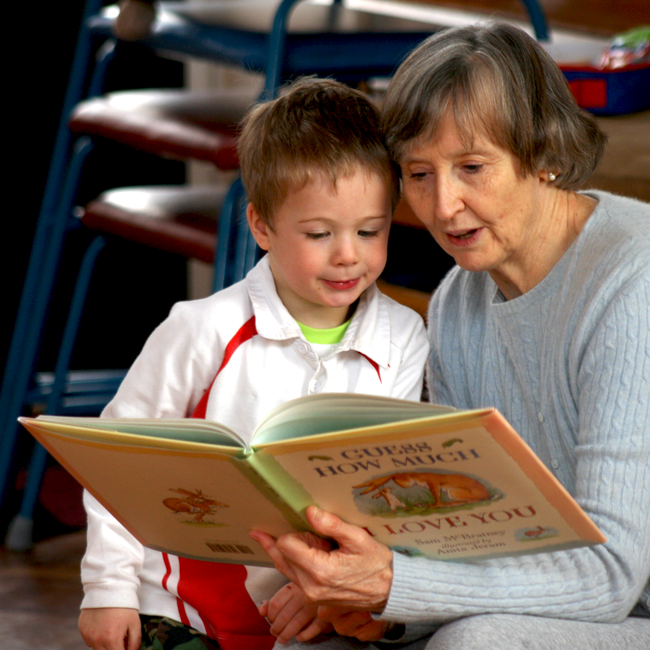
Bereaved Children
The virus has highlighted children’s anxieties
Approximately 23,600 parents of dependent-age children die in the UK each year
That’s nearly 800 bereaved children each week
Thousands more will experience the death of a grandparent
Shirley Potts, Child Bereavement UK
Notes:
The statistics on the screen can be quite shocking. These are not easy things to talk about….but children and young people are often picking up much more from the media – and their friends – than we appreciate, so silence on our part is not a very healthy option. We know Coronavirus is particularly lethal amongst older generations – and children may well have heard this too. We know, too, that even the majority of older sufferers are surviving the virus so we need to be balanced in our conversations with children – highlighting hope but not dismissing their anxieties.
Grandparents are often very involved in children’s lives these days – where parents work, it is often grandparents doing the school run and covering holidays.
Death of a parent is life-changing – but death of a grandparent can be devastating too.

Slide 16

Talking with children about coronavirus
Children’s understanding of death and grief will vary according to their stage of development.
Allow children and young people to ask their questions…. including those about death
Be as honest as possible in our responses
Permission and honesty
Shirley Potts, Child Bereavement UK
Notes:
Permission to ask questions – and honesty in our answers. Sounds simple – but giving “permission” involves being available and unshockable. The younger they are, the less filter they will have and some enquiries can take you aback. Children need to know you are open to whatever they need to ask. Be as matter-of-fact as possible. Whilst we can keep stressing that the majority of those who were infected with the virus are surviving, we should also acknowledge that this is the first time many children will have heard so much about death. At Child Bereavement UK we always advocate using very clear vocabulary – especially with younger children – and terms like “passed away” and “lost” can be meaningless to them.

Slide 17

Some Suggestions
Acknowledge their sadness
Maintain a dialogue
Listen and make no assumptions
Give regard to their age and understanding
Help them make sense of what they may hear about coronavirus
Allow them to see your grief when sad things happen
Understand they don’t have to be sad all the time – permission to play and socialise too.
https://www.childbereavementuk.org/get-support#app
Shirley Potts, Child Bereavement UK
Notes:
There are books and activities we can recommend as well as an app for older youngsters and film clips, and short guidance films on our website.

Slide 18





Support and Information
Information sheets
Short guidance films
Bereavement policy template
Information for parents and carers
A guide for schools
@cbukhelp
www.childbereavementuk.org
Shirley Potts, Child Bereavement UK
Notes:
Make use of our resources. There are lots of ways for Child Bereavement UK to offer support and information.
Our national helpline and live chat are available every day from 9am to 5pm, both families and professionals are welcome to contact us.
The website has a dedicated School section and many useful Information Sheets and Short Guidance Films.

Slide 19

Wirral CAMHS Update
3rd July 2020
Moya Sanders
Acting Team Manager
Wirral PMHT
Moya Sanders, CWP
Notes:
Good Morning
My names Moya sanders, im the Acting Team Manger for the Wirral Primary Mental Health team
Thank you for inviting us to join the safeguarding school support webinar.

Slide 20
Mental Health and Covid-19
The Coronavirus is profoundly affecting life as we know it around the globe.
Isolation, social restrictions and education shutdown can all affect children & young people’s mental health.
We are likely to increase an increase of anxiety, trauma and bereavement presentations.
Moya Sanders, CWP
Notes:
Life changed significantly overnight for millions of people around the world. For our children and adolescents their usual routine has been completely disrupted. For many, the restrictions imposed during the lockdown mean they are no longer accessing education, attending normal hobbies or groups and social restrictions have meant seeing friends and family has been limited.
Vulnerable children living in situations where there may be abuse, DV, parental physical/ mental health problems may be especially likely to see their mental health suffer.
CAMHS are expecting to see a influx of referrals which may cause further strain on an already struggling service. Therefore it is imperative that parents and professionals seek reliable advice and guidance early on in the problem cycle.

Slide 21
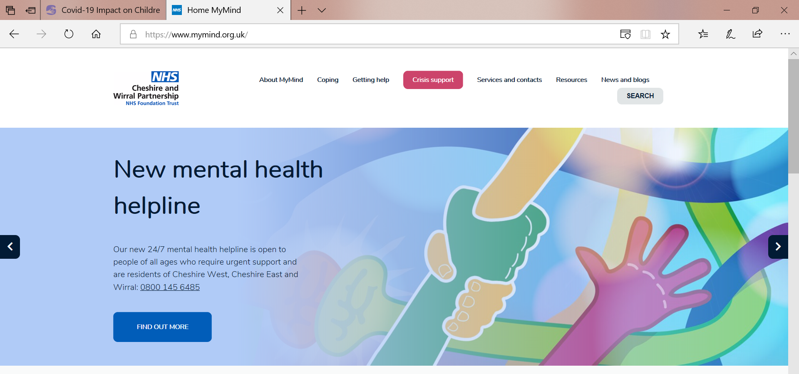
Where to go for Support
CWP CAMHS website: www.mymind.org.uk
Moya Sanders, CWP
Notes:
The Mymind website offers support for children and YP across the whole of the Cheshire Wirral Partnership. You can access Wirral Specific support through services and contacts or through the professionals tab.
Our camhs my mind website has resources on various mental health difficulties including mental health in relation to covid-19. Resources are divided into sections for parents, professionals and children YP.
The website will soon have trainings uploaded from Wirral camhs PMHT as we are currently unable to deliver these face to face, we are working on adapting them to be available remotely on the website.

Slide 22
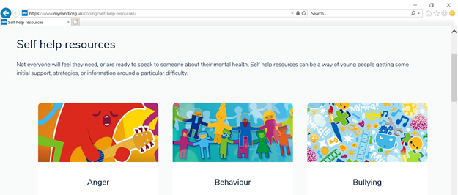
Self-help Resources
Moya Sanders, CWP
Notes:
As well as numerous resources for different symptoms
The website also has links to other supporting agencies such as Anna Fraud, Bereavement uk and mind ed

Slide 23
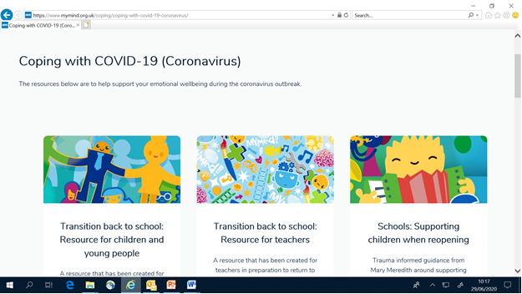
Covid-19 Resources
Moya Sanders, CWP
Notes:
We also have covid-19 specific resources.

Slide 24
Crisis Line
CWP Crisis line:
0800 145 6485
PMHT/MHST teams (for consultation/ resources/ termly meetings)
Moya Sanders, CWP
Notes:
In response to the covid-19 crisis we also set up a CWP wide 24/7 crisis line which is open to people of all ages who require urgent support around their mental health. This is staffed by qualified mental health professionals who can give advice on the concerns.
There is a Primary Mental Health worker or Education Mental Health Practitioner attached to every school on the Wirral. They can offer advice consultation/ termly meetings via phone/ video conference.
If you don’t know who the link worker is for your school you can email cwp.WirralPMHW@nhs.net

Slide 25
CAMHS Referral Criteria
Moderate / severe anxiety and depression
Eating disorder
Psychosis
Conduct disorder with moderate to severe mental health problems
Emerging emotionally unstable personality disorder
ADHD / ASC with other moderate to severe mental health problems
Self harm with suicidal ideation / emotional disregulation
Moya Sanders, CWP
Notes:
CAMHS referral criteria is moderate- severe mental health problems which are having a significant impact on daily functioning.
If your school has an Mental Health Support worker then you may be able to speak with them if you have concerns for a child who has more mild-moderate mental health problems as they are offering some direct work to these populations.
If your school does not have a Mental Health Support worker attached to it, please speak to your PMHT link worker for advice.

Slide 26
Referring into CAMHS
There is a self-referral form & guidance on the My Mind website
Click:
“Services and contacts”
“Wirral”
“Wirral CAMHS 0-18 team” or “Wirral CAMHS CHOICE clinic”
Moya Sanders, CWP
Notes:
You can refer to camhs via various routes:
You can complete a self referral on our website (as long as you have parental consent to do so if your referring on behalf of a family)
There is guidance also attached, please ensure you read this before completing your referral
You can access the referral form by clinking services and contacts, Wirral, 0-18 team or choice clinic (next Page)

Slide 27
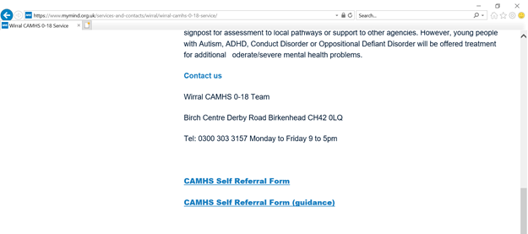
Referring into CAMHS
Moya Sanders, CWP
Notes:
The Wirral CAMHS referral form and guidance, can be found at the bottom of the page.

Slide 28
Referring into CAMHS
Referral via professionals GP/school/ social worker
If urgent, support & referral can be made through crisis line 0800 145 6485
Moya Sanders, CWP
Notes:
Professionals such as GP’s, social workers, schools can also refer via the website or letter.
if urgent support is needed, the crisis line can give advice, and refer to necessary CAMHS team if appropriate.

Slide 29
Thank you
Moya Sanders, CWP

Slide 30
Domestic Abuse and Parental Conflict
Early Help
Jane Egan
Early Help Partnerships Manager

Slide 31
Domestic Abuse or Parental Conflict?
Key features of Domestic Abuse:
Fear, Coercive Control, Discernible Victim /Perpetrator.
Key features of Parental Conflict:
Frequency, Intensity and Poorly Resolved Arguments.
BOTH environments can be particularly damaging to children’s emotional and social development, which can disrupt their ability to learn at school and develop future adult relationships.
Training to support your understanding and awareness of how to support a family/ individual /child who may be affected by the above please go to https://www.wirralsafeguarding.co.uk/training/
Jane Egan, Partnerships Manager, LA

Slide 32
What services are currently available to families affected by DA and PC?
Domestic Abuse:
Contact Integrated Front Door if you feel that a child may at risk of harm from Domestic Abuse, or Police if an immediate safeguarding concern. 0151 606 2008
Family Safety Unit – 0151 666 4914
Karma Nirvana - 0800 599 9247 – will provide advice and information in relation to honour based abuse and harmful practices
Both victim and perpetrator support and a variety of services are available from the ‘It’s Never Ok ‘website https://www.itsneverokwirral.org/
Jane Egan, Partnerships Manager, LA

Slide 33
What services are currently available to families affected by DA and PC?
Parental Conflict:
Wirral Children’s Services are currently offering FREE training to raise awareness of and spot signs of Parental Conflict and to support practitioners and those with direct contact to parents, children and young people, to be in a position to help parents to acknowledge and understand the impact upon their children and take steps to reduce parental conflict, independently or with support.
Self-help support for parents is available through:
Me You and Baby Too https://click.clickrelationships.org/content/parenting-together/me-you-and-baby-too/ Following practitioners attending Reducing Parental Conflict training a practitioners guide will be available to support parents through this programme.
Click Relationships https://click.clickrelationships.org/home/parenting-apart/
Mencap for parents and young adults with a learning disability. https://www.mencap.org.uk/advice-and-support/relationships-and-sex
Jane Egan, Partnerships Manager, LA

Slide 34
Accessing Early Help
Self-help is the easiest, fastest and most empowering way for most families to gain the help they need, when they need it. Early help can be as simple as the provision of information, to local community support. Information is available from:
Wirral Infobank https://www.wirralinfobank.co.uk -Find out about local community support services, online events and up-to-date advice and information on the coronavirus (COVID-19) situation. There is an A-Z of local services and a Key Word search option.
Early Help pages @ Wirral Safeguarding Children Partnership website https://www.wirralsafeguarding.co.uk/professionals/what-is-early-help/
Wirral.gov.uk offers help for a range of issues including COVID 19 updates, emergency food provision, local welfare assistance, small businesses and grant funding. https://www.wirral.gov.uk
Wirral food bank https://wirral.foodbank.org.uk/get-help
Young people cam also access My Mind for support around their mental health https://www.mymind.org.uk/
Kooth is an online mental wellbeing community resource for young people www.kooth.com/
Local Offer information for children and young people with SEND https://localofferwirral.org/
Children’s Centres and My Child Can Facebook page https://www.wirral.gov.uk/early-years-and-childcare/childrens-centres
Jane Egan, Partnerships Manager, LA

Slide 35
When a family needs a bit more help
If a family finds it difficult to know what type of support might help them best, talking to them about their worries and strengths can help decide of the types of support needed. If you need to talk through which services may be best suite you or the family can:
Use the self-help information (on previous slide) to contact services directly and help your family or young person to access and engage with that support service.
Call the Early Help Team if you can’t find what you need or you feel the family needs help to plan what will help them, and you are unable to be the key professional to help develop the family plan. 0151 608 6510 or earlyhelpteam@wirral.gov.uk
Young Person’s Helpline 0808 196 4147 for help, advice and support on a range of issues that may affect young people.
All schools have a named Locality Attendance Officer (LAO) who is able to offer advice to schools and parents / carers around school attendance issues. The LAOs will be offering to work in partnership with schools to directly support the planned return of all pupils in September.
Parents / carers can also contact a Locality Attendance Officer direct via the Wirral Helpline (0151 606 5050) and by selecting the ‘schools’ option.
Call the Integrated Front Door and ask to speak to the Early Help Triage worker for advice about a family plan you are supporting as the Key (Lead) professional if you feel that you need help to review any problems you/the family are encountering with plan. 0151 608 2008
During the COVID19 response period you could discuss a child or family for whom you have concerns with your s school Social Care School Link (speak to Early Help Team for named school link details 0151 608 6510).
Jane Egan, Partnerships Manager, LA

Slide 36
Health Services In Schools (HSIS)
Michelle Langan, HSIS Team leader

Slide 37

Health Services In Schools (HSIS)
Who are we
What do we offer
How can you access us now.....
Assembly
Michelle Langan, HSIS Team leader

Slide 38

Who are we?
Team of Professionally qualified Youth Workers
Working in partnership with all Wirral Secondary Schools, Alternative Provision, Wirral Six Form & Wirral Met College
Our usual business – providing a 'protected weekly drop in' service
Michelle Langan, HSIS Team leader

Slide 39
What do we offer ?
A confidential service
Support
Core offer
Michelle Langan, HSIS Team leader

Slide 40
How to access us now…….
Email
MS Teams
Phone
Michelle Langan, HSIS Team leader

Slide 41
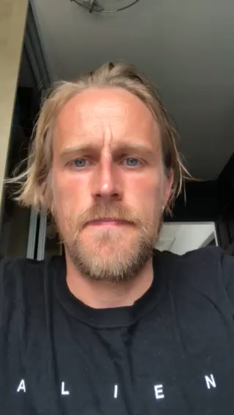
Health Services in Schools
Confidential Service
My name is Paddy
I am your HSIS Youth Worker in school
I am still available and you can contact me via email: patricrogers@wirral.gov.uk
Or you can call me on 0151 666 3779
You can also ask your Head of Year how to contact me
Michelle Langan, HSIS Team leader

Slide 42

HSIS – Resources
HSIS Leaflets
HSIS referral
HSIS staff contact details
HSIS School Timetable
Assembly presentation
HSIS Youth Worker to contact school in September
Michelle Langan, HSIS Team leader

Slide 43

Health and Safety
Lorraine Adamson and Andy McMillan, H+S

Slide 44

Health and Safety: what have we been up to?
Comprehensive Health and Safety Advice to schools from the outset of Covid -19. Advice support and guidance on Covid -19 related issues to schools including updates as new guidance has been released.
Now part of work force cell with Children’s Services, HR and Public Health to ensure support and advice is consistent and relevant. This means information to schools will be consistent across the 3 departments.
Provision of a comprehensive risk assessment for covid -19 including a large range of controls to support the varied schools across the borough.
Regular amendment updates to schools to ensure any newly identified hazards are shared to support schools with Risk assessment.
Working with Transport, highways and facilities to plan for September and ensuring Health and Safety is at the heart of those plans.
Reviewed and offered support where necessary on Schools Covid-19 Risk Assessments.
Provided FAQ to schools throughout the covid-19 crisis to updated on safety questions and try to pre-empt any safety challenges schools may face.
Lorraine Adamson, H+S

Slide 45
Health and Safety: Going forward
Currently working on webinar training packages that can be accessed on line. The first one being cleaning and caretaker training to be delivered during the summer holidays but accessible throughout the year.
Live session on key subjects to support schools such as Risk assessment and working at height.
Regular termly updates on topics such a weather controls.
Training booklets to go along side the webinars so schools can be confident training has been understood.
Refresh on Fire risk assessment to help schools keep on top of action plans.
Interrelated HR SLA offering arrange of discounts up to £300 for schools and allows Schools, Health and Safety and HR Consultancy to work more closely to provide advice on shared issues such as reasonable adjustments and stress risk assessments.
Lorraine Adamson, H+S

Slide 46
Occupational Health and EAP
Wirral Council Occupational Health Service
The Occupational Health Service has continued to operate throughout the pandemic, but there are some changes to how the service has been operating;
  Service delivery
  Mental Health
  Physiotherapy
EAP (Employee Assistance Programme)
  EAP Service and Features for staff
  Management Support
Andy McMillan, H+S
Notes:
Service Delivery
From Thursday 19th March 2020 all Occupational Health appointments were switched to remote delivery via telephone. Once it is safe to do so, the service will look to resume face to face appointments.
Mental Health
Referrals for MH are also continuing with recommended support for via the EAP - Health Assured is still proceeding as normal (Face to face, online or telephone). Should face to face counselling not be an option because of shielding, personal preference or in the event of self-isolation, and both the counsellor and the employee is well enough to continue their sessions, then sessions can continue either as structured telephone or online video counselling, providing this has been mutually agreed by both parties. The EAP also provides CBT if required
Physiotherapy
From Monday 23rd March 2020 all face to face physiotherapy services were cancelled until further notice. In the meantime the service is continuing to offer Video and Telephone consultations in line with the CSP guidance and these have been very effective in providing patients with an early diagnosis, and the essential advice and exercise programme to self-manage their condition. Referrals can be made via the portal in the usual way to access this service. The physio service have also contacted all patients that were in active treatment when lockdown was announced, to advise that if they needed to speak to a Physio about their condition, to get in touch by e-mail and they would contact them to provide advice
The EAP has continued to offer a 24/7 support service
EAP Service and Features for staff - Along with every employee being able to access up to 6 sessions of counselling support, per issue per year, it’s also good to remind staff that the service can support with a variety of other issues, which may be more prevalent during covid-19, such as; Legal Advice, Financial information, Relationship Advice, Family Issues, Bereavement support, Childcare Support, Domestic Abuse, Tax Information, Consumer Issues, Drug & Alcohol Issues, Gambling Issues, Housing Concerns. There is also a variety of health and wellbeing resources available such as webinars, videos, articles on the website and health ap
Management Support
The EAP service is also able to offer managerial support. Health Assured can help managers deal with important issues such as workplace conflict, holding difficult conversations or communicating change. The support required from managers because of covid-19 has likely increased. The service is accessible via the usual helpline number. The service works by providing an additional source of help in dealing with people issues that you may not have experienced before or may appreciate receiving additional support with. Their management advisors have a thorough understanding of emotional health in work as well as managerial requirements, and therefore work with managers to coach them in these issues when supporting their employees.

Slide 47
Wirral Safeguarding Children Partnership
David Robbins
WSCP Manager

Slide 48
End of Presentation
Next Steps
Questions
https://www.wirralsafeguarding.co.uk/schools-webinar/
David Robbins, WSCP Manager

