Slide 1

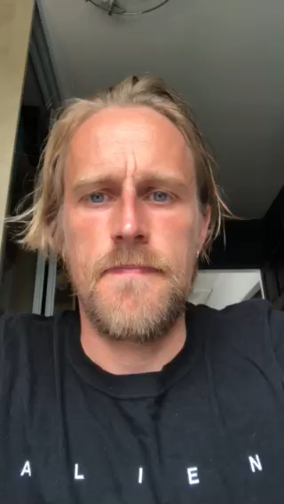
Health Services in Schools
Confidential Service
My name is Paddy
I am your HSIS Youth Worker in school
I am still available and you can contact me via email: patricrogers@wirral.gov.uk
Or you an call me on 0151 666 3779
You can also ask your Head of Year how to contact me

