Slide 1

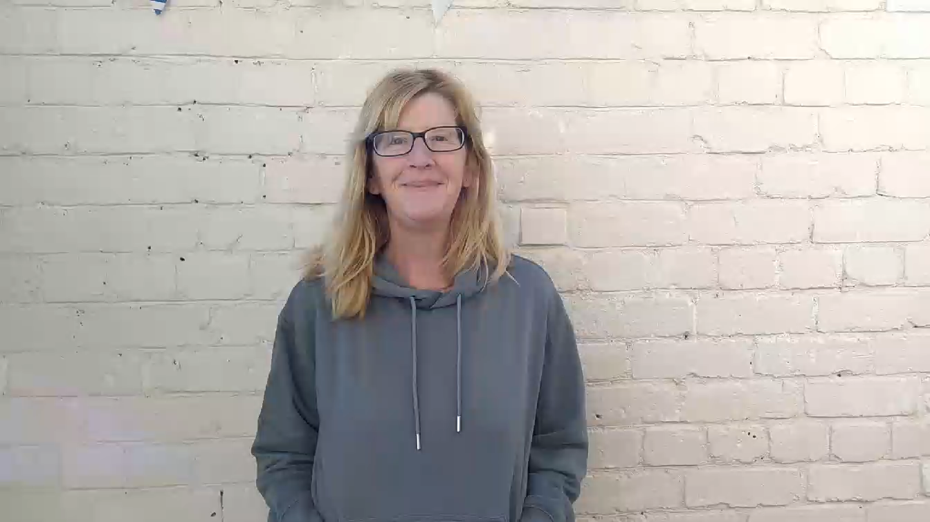
Health Services in Schools
Confidential Service
My name is Kersti
I am your HSIS Youth Worker in school
I am still available and you can contact me via email: kerstilawson@wirral.gov.uk
Or you can call me on 0151 666 3738
You can also ask your Head of Year how to contact me

