Slide 1

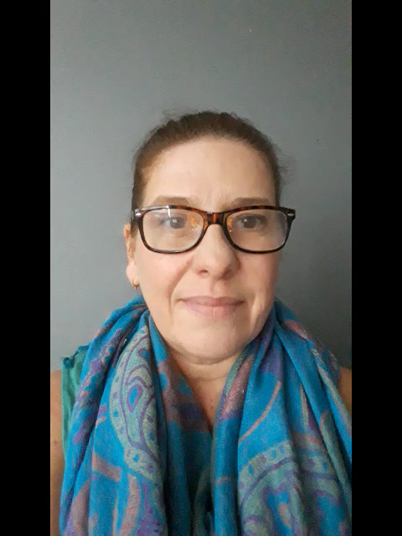
Health Services in Schools
Confidential Service
My name is Jo
I am your Youth Worker in School
I am still available; you can contact me via email: joanneseggie@wirral.gov.uk
Or 0151 666 – 3781
You can also ask your Head of Year how to contact me

