Slide 1
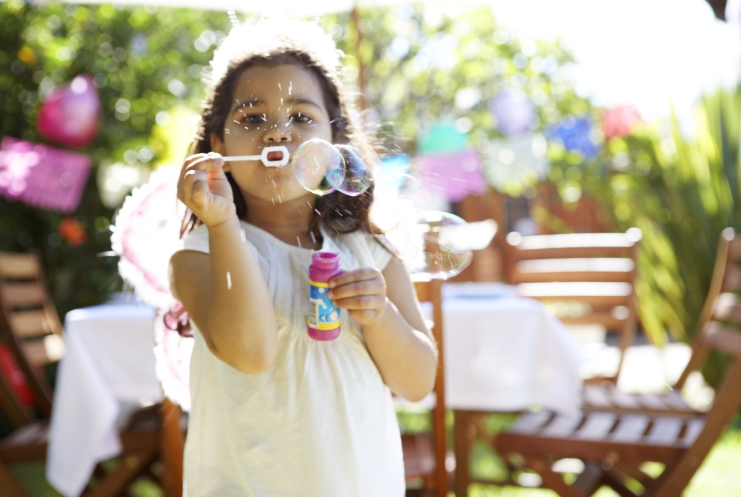

Capturing the Daily Lived Experience of children and their parents and carers
Supporting Families Enhancing Futures
Notes:
NOTE: To change images on this slide, select a picture and delete it. Then click the Insert Picture icon
in the placeholder to insert your own image.

Slide 2

5 SFEF Principles
Make connections – similarities/ discrepancies in the information gathered from the child, adult and professionals
Identify strengths within the family including protective factors for the child as well as areas we are worried about
Increase understanding of triggers for child and adult behaviours
Increase understanding of the impact on the child of adult behaviours
Support plans will be child focussed with clear expected outcomes
Understand the world of the child(ren)
Understand the world of adults
Recognise family strengths as well as concerns
Engage families in the change process
Measure change through actions and interventions that lead to child focussed outcomes

Slide 3
Why is the information captured important?
Daily lived experiences will help to inform assessments, plans and reviews
Information gathered from the perspective of the family will form ‘different parts of the jigsaw’ of the child’s lived experience to add to those of professionals
Support offered to the family will be focused on achieving positive outcomes for the child based on the needs that are and are not being met
Lived experiences will help us to understand the impact of what we are worried about for the child on their mental health and wellbeing
Capturing the daily lived experiences throughout the support episode will identify if there are changes being reported by the child and adult
If progress is not evident the plan needs to be reviewed to identify what is preventing change for the child
When things are going well ‘Celebrate Success’ and build on the positives

Slide 4
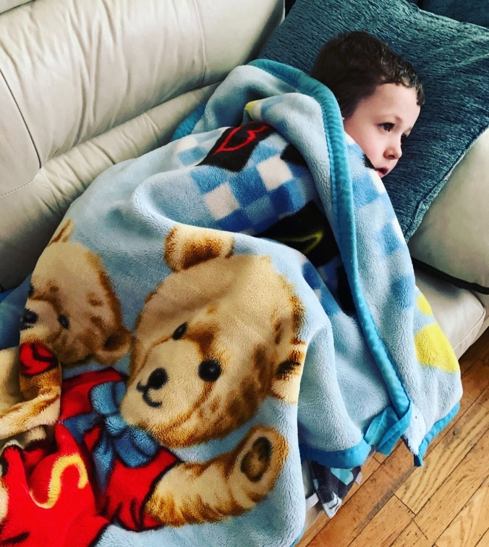

Be creative when having the conversation
“When I woke up it was dark so I went to wake mummy up to play. She said go back to sleep. I was hungry so went downstairs to get some crispies but I couldn’t find any. I got my blanky and put the telly on but it didn’t work so I snuggled on the couch to wait for mummy to come down”
Freddy age 4
“I wake up most mornings dreading what the day will bring; has the electric gone off in the night again? Has the bread gone mouldy? Freddy’s been up since four this morning. He doesn’t need much sleep, he’s full of energy. I’m shattered already”
Freddy’s mum
Refer to the Daily Lived Experience Guidance and Case Studies for Professionals for more information: https://www.wirralsafeguarding.co.uk/sfef-online-training-resources/
Consider:
Who has a trusting relationship with the child and adult?
Where will the conversation take place?
When is the best time for the child or adult to talk to the professional?
How will the conversation be encouraged and how will it be recorded?
Remember to record conversations using the child’s and adult’s own words and phrases as much as possible – this is their account of a typical day for them

Slide 5

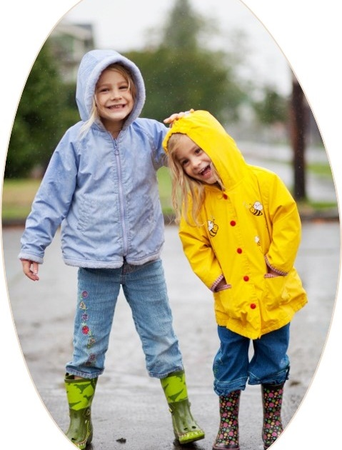
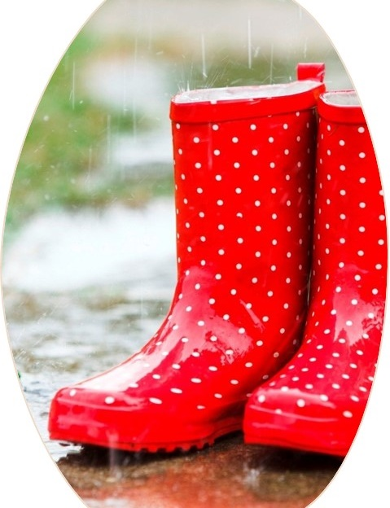
Be Curious…..
Refer to the Prompts for Practitioners and Conversation Starters resources:
https://www.wirralsafeguarding.co.uk/
Notes:
Use of open-ended questions
Picking up on body language and facial expressions
Enabling the person to talk at their own pace

Slide 6
Gabby’s lived experience
Whilst listening to the conversation between Gabby and the professional listen out for the:
Use of open ended questions
Pace of conversation
Reflective listening technique
Tone of voice
Think about the information that is being shared by Gabby and how this will help to support the assessment process.
Gabby, aged 16, has recently moved to Wirral with her mother after fleeing a domestically violent relationship. They are living in a bedsit whilst waiting for a rented property to become available.
There is no history of involvement from services prior to this move. Gabby’s mother describes herself as a ‘proud woman’ and wants to ensure her daughter is ok as leaving their family home has been a traumatic experience for them both.
Gabby agreed that the conversation to capture her lived experience could be recorded; you can listen to an excerpt of her lived experience on the next slide.
She asked who would hear her lived experience and what it was going to be used for as she didn’t want to cause any more trouble for her mother.

Slide 7



Gabby’s lived experience
Gabby’s lived experience gives us an insight into her passion to be active and her aspirations to continue her education. We learn about her friends and support network and how she is supporting her mother.

Slide 8
Importance of Analysis
Analysing the information that has been captured from the lived experience is crucial to ensure assessments are focussed on the child’s needs
Ask yourself “so what?” - The daily lived experience will enhance the information gathered during the assessment process and help to make sense of it from the child’s own perspective
A child focussed assessment will lead to a child focussed care plan being clear about:
What are we worried about?
What needs to change for the child?
What will be done to support the family to make changes?
Who will do this?
When will it be done?
You can access Effective and SMART plans training resource on the WSCP website: https://www.wirralsafeguarding.co.uk/sfef-online-training-resources/

Slide 9

Tools and Resources
Flower drawn on a flip page
Button box
Double decker bus or train
Flip page/ paper/ pens
Surface Pro drawing app
Recording a blog on the phone
Building blocks or sand in a tray (young children enjoy these)
Jelly-bean tree
Next Steps Cards
3 Houses
Prompts for practitioners
http://www.socialworkerstoolbox.com/

Slide 10
Key points
Be curious and use open ended questions to encourage the child and parent/ carer to tell you about what life is like for them
Capture conversations over a couple of occasions especially if the child is young
Record the conversation using the person's own words and phrases
Be creative and capture conversations using different mediums
Consider which professional is best to have the conversation and what the best time of the day is for the person to talk to you
Compare and contrast – is the child telling you something different to what professionals observe? Is the parent/ carer saying something very different to the child?
Analysis of the information from the lived experiences will inform the assessment
Capture the lived experience of the child and parent/ carer at the start of the assessment process and then for every review to identify if the child’s lived experience is improving

Slide 11
For SFEF information and resources please visit the Wirral Safeguarding Children Partnership Website: https://www.wirralsafeguarding.co.uk/
Notes:
NOTE: To change images on this slide, select a picture and delete it. Then click the Insert Picture icon
in the placeholder to insert your own image.

