Slide 1
Missing From Home or Care
Wirral Overview

Slide 2
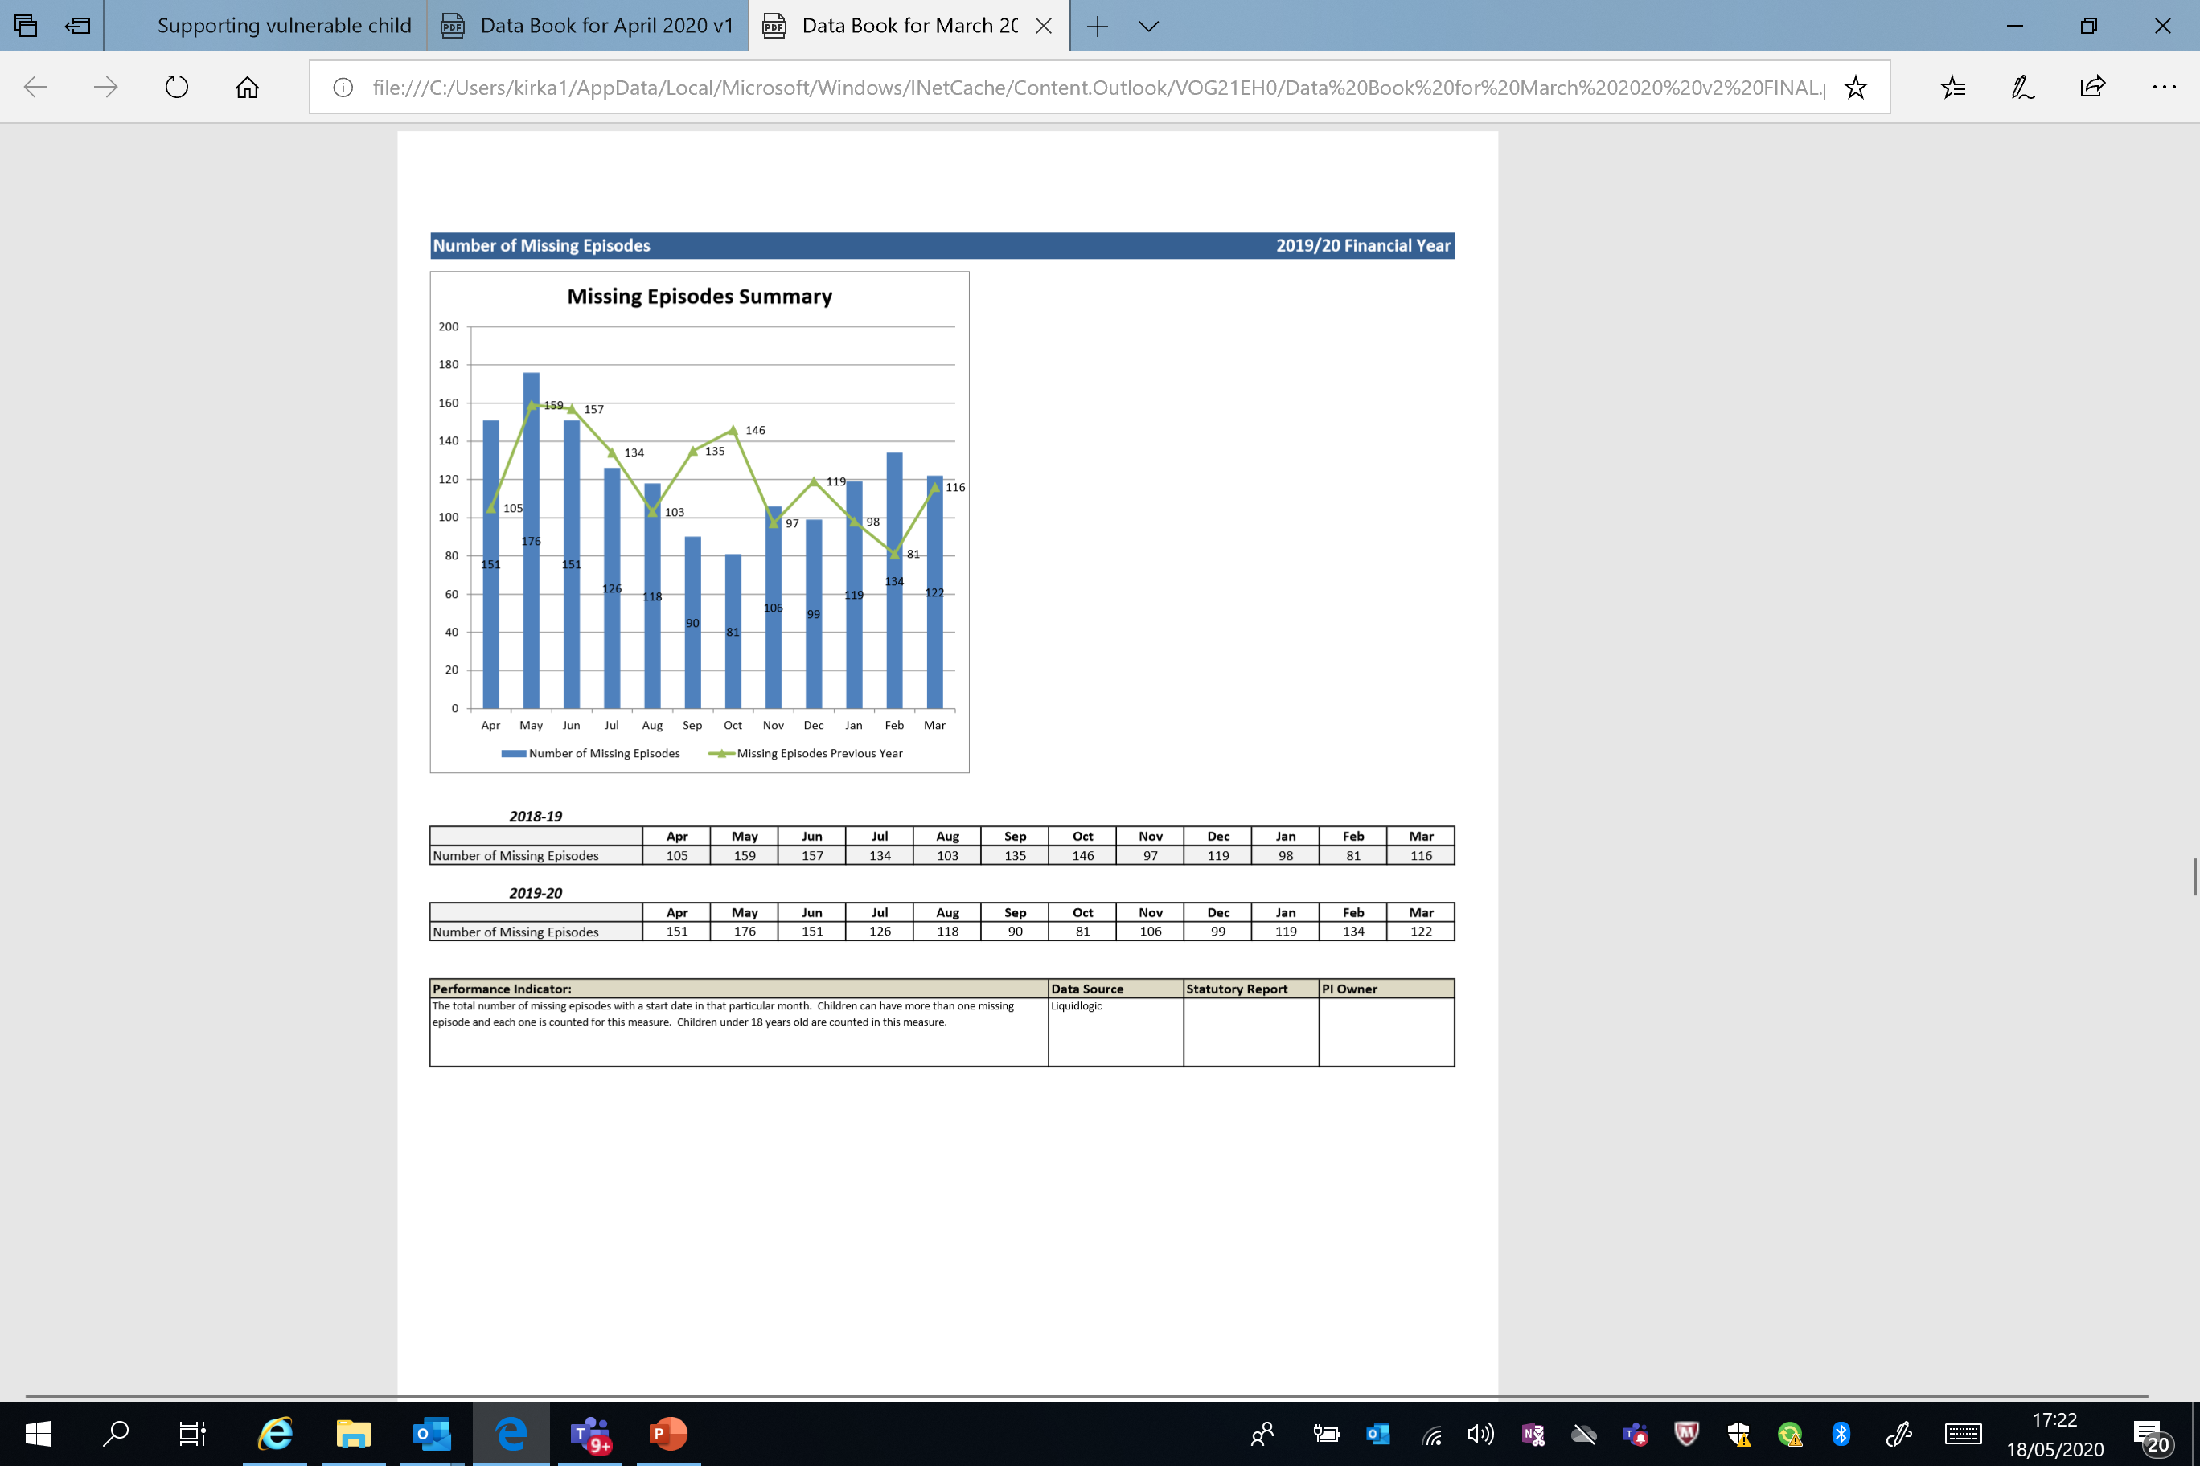
Analysis – Average Missings Per Child (MPC)
  January 2019 1.82 MPC
  January 2020 1.94 MPC
  February 2019 1.55 MPC
  February 2020 2.37 MPC
  March 1-23rd 2019 1.4 MPC
  March 1-23rd 2020 2.04 MPC
Increasing repeat rate. Potentially better recording of episodes on LCS, however increased focus on 3/30 & 9/90 in next quarter & work with repeat locations may impact on MPC.
Seeking to benchmark MPC with other LA’s.

Slide 3
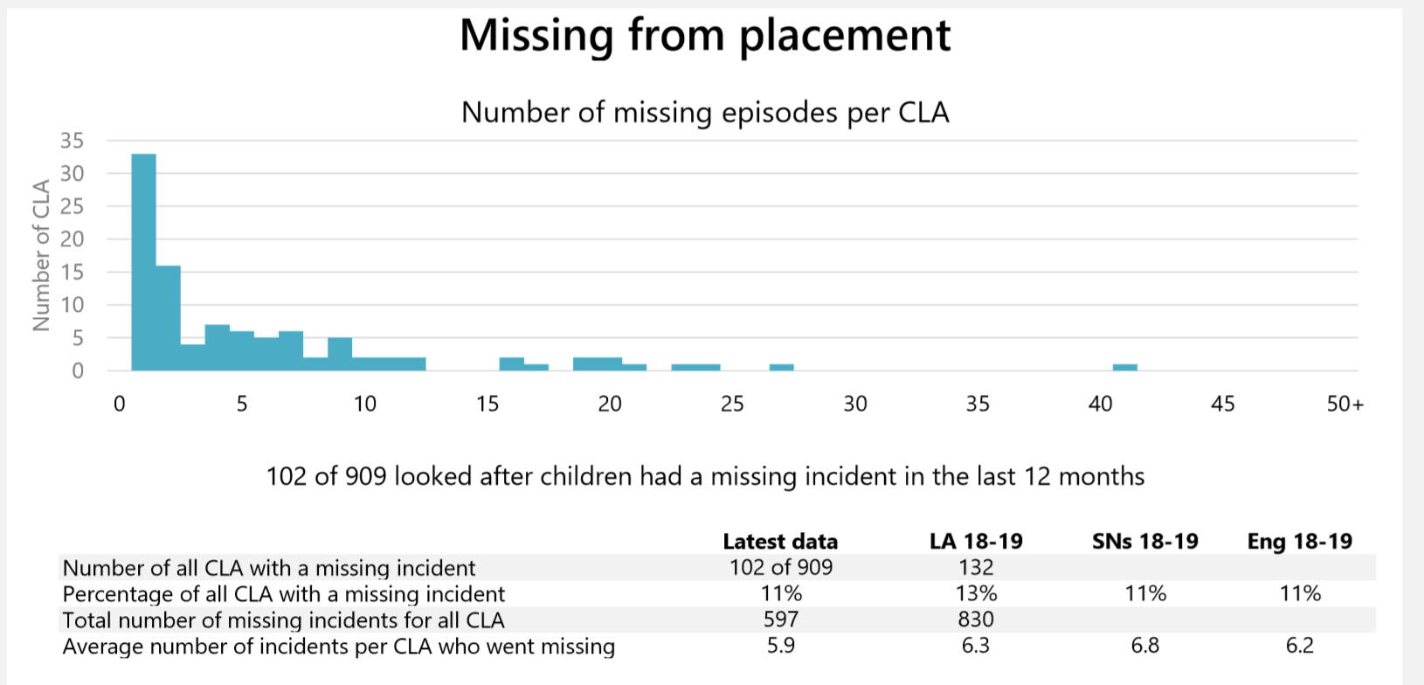
Notes:
In line with SN for CLA with missing incident %
Below SN and England for average number of incidents per CLA.
Lower % with incident than LA last year.
Lower average number of incidents than LA, SN and Eng last year.

Slide 4
Lockdown Period

Slide 5
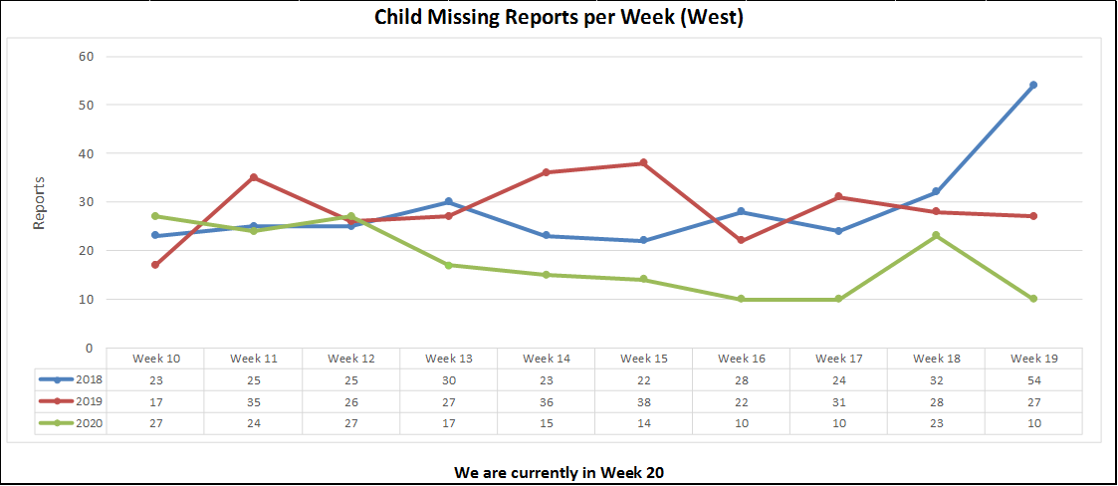
Lockdown
Notes:
Police Missing reports for Wirral Children and Young People

Slide 6
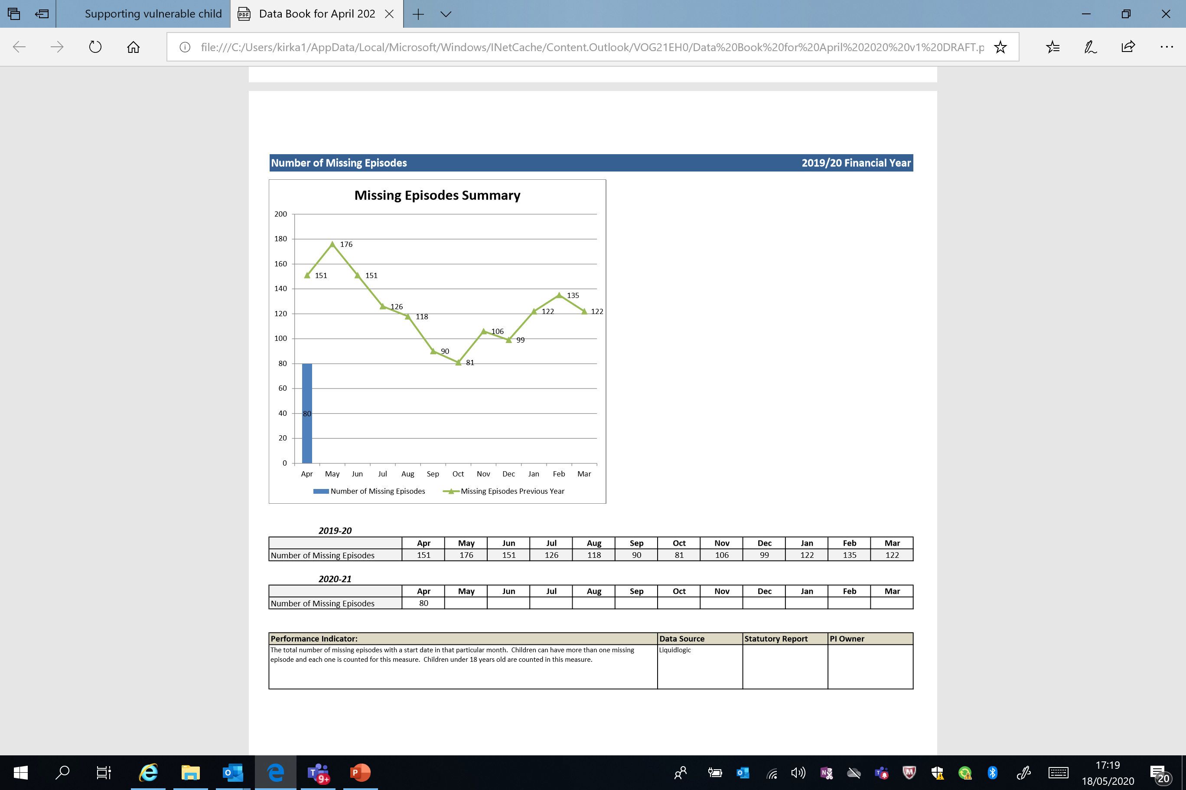
23/03/19 – 11/05/19 |  |  | Lockdown 2020
256 Incidents | 116 C&YP |  | 123 Incidents | 53 C&YP
54% Reduction in Missing C&YP 52% Reduction in missing incidents
Jan – March 2020 - compared to Lockdown Period 2020
Numbers | % | Period Missing | % | Numbers
282 | 74% | Under 24 Hrs | 77.2% | 95
90 | 23.7% | 1-6 Days | 17.8% | 22
6 | 1.5% | 1w – 28 Days | 4.8% | 6
1 | .25% | Over 28 Days | 0% | 0
LA Data Quality – Return Home Interviews
23/03/19 – 11/05/19 RHI offered on LCS = 35%
23/03/20 – 11/05/20 RHI offered on LCS = 78%
Notes:
The % of C&YP missing for over a week has increased.
RHI recorded appropriately on LCS is increasing. This is positive and should look to match Catch 22 data.

