Slide 1


Section 175 Audit Support
Narrated PowerPoint Presentation
Notes:
This briefing on Section 175 Audit process will consider:
What the 175 audit is
What the 175 audit consists of
The timeframes for completing each topic within the audit
The content of each topic and the types of evidence could be uploaded by educational settings

Slide 2

National Commitment
Section 175 of the Education Act (2002) requires local education authorities and the governing bodies of maintained schools and FE colleges to make arrangements to ensure that their functions are carried out with a view to safeguarding and promoting the welfare of children.
(The Education Act – 2002: 13)
Notes:
Section 157 of the 2002 Education Act and the Independent School Regulations (2003) convey the same responsibilities on all other non-maintained settings.
It is vital that Wirral schools and colleges can demonstrate that they are meeting key statutory duties and following safeguarding children and young people guidance. The government acknowledged the requirements and so settings are asked to complete the annual audit. This is done on-line, enabling them to provide information to the WSCP on how they discharge their duties and help to keep children and young people on Wirral safe.

Slide 3

Local Commitment
The Wirral Safeguarding Children Partnership (WSCP) is the key statutory body for co-ordinating and ensuring the effectiveness of arrangements to safeguard and promote the welfare of all children in Wirral. It is the duty of the WSCP to hold agencies to account in terms of their safeguarding arrangements and practices.
Notes:
Section 157 of the 2002 Education Act and the Independent School Regulations (2003) convey the same responsibilities on all other non-maintained settings.

Slide 4

What is the responsibility of education settings?
All educational settings to whom the duty applies should have in place the safeguarding arrangements set out the act.
In addition schools should have regard to specific guidance given regarding Safeguarding Children and Safer Recruitment in Education and Dealing with allegations of abuse against teachers and other staff.
Notes:
Annually the specific safeguarding requirements do change (to ensure we respond to current safeguarding concerns), however key areas, such as policies and procedures, managing allegations, safeguarding children and safer recruitment will also feature. Using the online too, schools have the opportunity to upload key documents as evidence and use the findings from the audit to create their own action plan.

Slide 5

Topic 1 – Policies and Procedures
(Date open: 01 Apr – Deadline for completion 31 May )
Evidence:
Named DSL / Deputy DSL / Safeguarding Governor (plus training dates)
Named person for Operation Encompass and also Child Exploitation link
Annual update and renewal of safeguarding policy (plus safeguarding statement on website and in reception)
Examples of learning from any Quality Assurance activity undertaken in the last 12 months
Current anti - bullying policy
A pathway for extremism and radicalisation
Notes:
The Section 175 audit is a SELF ASSESSMENT TOOL and topic 1 (entitled Polices and Procedures) asks education settings to provide assurance that appropriate policies and procedures are in place and that staff understand the thresholds of need and how to report safeguarding concerns. Evidence can include those detailed on this slide (for an in-depth look at what the topic 1 and all the topics cover, please read the Section 175 support document below the presentation on the website).

Slide 6
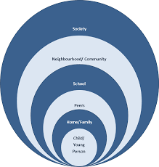
Topic 2 – Contextual Safeguarding
(Date open: 01 Jun – Deadline for completion 31 Jul )
Evidence:
Contextual Safeguarding Training attended
Use of Staff newsletter/website to inform staff and parents about Contextual Safeguarding (Inc. Criminal Exploitation, County Lines)
Team briefing notes/agenda to evidence discussion about contextual issues
Leaflet/posters/lesson plan to evidence awareness of contextual issues with young people
Notes:
This topic asks education settings to provide assurance that staff within education settings understand Contextual Safeguarding and Wirral’s approach to contextual issues. Contextual Safeguarding is an approach to understanding, and responding to, young people’s experiences of significant harm beyond their families. Contextual safeguarding recognises the impact of the public/social context on young people’s lives, and consequently their safety. This approach seeks to identify and respond to harm and abuse posed to young people outside their home.

Slide 7

Topic 3 – Multi-Agency Training
(Date open: 01 Sep – Deadline for completion 31 Oct )
Evidence:
Team briefing notes and agenda to evidence discussion about training opportunities, and when training has been attended
Evidence of attendance at training, for example a certificate from whole school training, or other types of multi-agency training
Governor and Senior Leadership Team oversight of the school’s training log
Notes:
This topic asks education settings to provide assurance that staff have attended appropriate multi-agency training and how learning is then tested in school. Is learning helping to shape and identify of safeguarding priorities.

Slide 8

Topic 4 – Safe & Skilled Workforce
(Date open: 03 Dec – Deadline for completion 31 Jan 2021)
Evidence:
Evidence of attendance at training, for example a certificate from Safer Recruitment training / Managing Allegations training
A copy of current Safer Recruitment policy and action plan
A copy of complaints policy and examples of use
Evidence of how whistleblowing policy is promoted across the setting
Staff know how to access the WSCP multi-agency escalation procedure
Notes from any reflective supervision or 1:1’s meetings to support staff
Notes:
This topic asks education settings to provide assurance that robust and effective safer recruitment procedures are in place and that staff are suitably trained. This also covers Managing Allegations and whistleblowing.

Slide 9

Topic 5 – Understanding the Daily lived Experience of Children
(Date open: 01 Mar 2021 – Deadline for completion 30 Apr 2021 )
Evidence:
Supervision template/anonymised evidence of SFEF incorporated in supervision
Examples of tools used to gather views of children and young people
Anonymised examples of views of children and young people
Examples of the confidence staff have when using the SFEF approach
Training log shows SFEF training attendance
Notes:
This topic asks education settings to provide assurance that staff understand the Supporting Families Enhancing Futures approach (SFEF). How SFEF is used in practice and asks schools to explore how they are capturing evidence of the daily lived experience of children and of the child’s wishes. The Wirral Safeguarding Children Partnership (WSCP) developed a model for working with children, young people and their families across levels 3 and 4 (Team Around the Family, Child in Need and Child Protection) of the Wirral Continuum of Need. The model is called Supporting Families Enhancing Futures (SFEF) and has a focus on understanding how issues affect the child’s lived daily experience. To find our more about SFEF, go to www.wirralsafeguarding.co.uk/professionals/supporting-families-enhancing-futures/

Slide 10
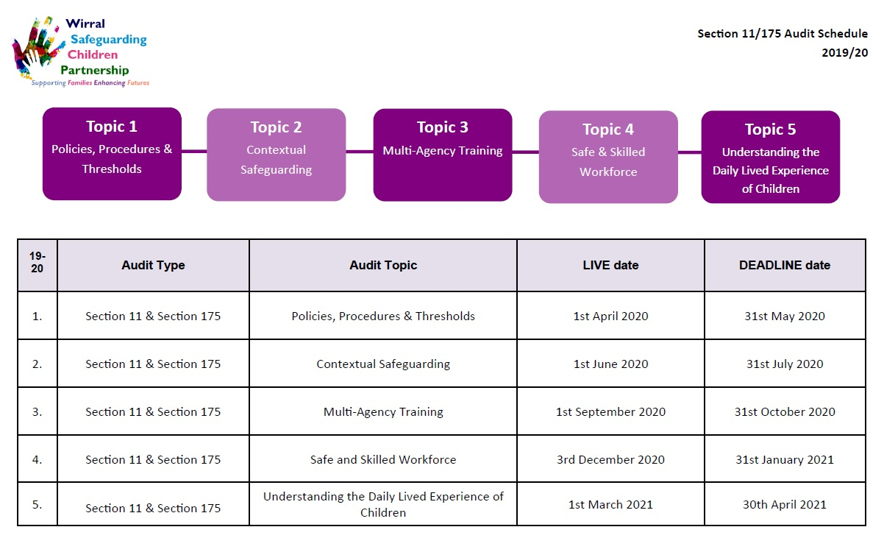
Section 175 Schedule:
Notes:
This slide shows the entire schedule for both 175 audit for 2019 – 2020. The WSCP dip samples Section 175 audits completed by schools and will request evidence to support the safeguarding arrangements assessment. The WSCP will offer support to schools via a ‘health check’ . For more details, please contact Amanda Waterfall on 0151 666 4822 / 07795 617 644

Slide 11
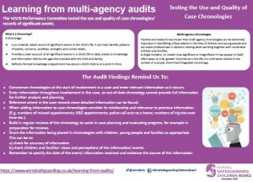
Wirral Auditing and Learning from Section 175
To view the topic learning reports and to access a series of posters that detail learning from audits follow:
www.wirralsafeguarding.co.uk/learning-from-audits/
Notes:
From each topic, the safeguarding partnership’s quality auditor analyses and summarises the finding into topic reports and posters for learning. A full audit report is also completed and circulated and can inform and empower safeguarding leads.
There is a lot to be gained from considering the analysis of the audit returns from across the range of Wirral schools and I urge you to take a look at these reports. For those members of the school team who complete the audit, gaining confidence in the evidence submitted should grow year on year.
You can access a full section on learning from safeguarding audits by logging onto WSCP’s website and following the link on this slide.

Slide 12
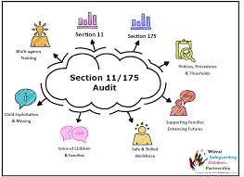
Section 175 Links:
To complete the audit topics, click on the link below:
https://www.wirralsafeguarding.co.uk/professionals/section-11-175-audit/
For more information on the audit, log onto Wirral Safeguarding Children Partnership (WSCP) –
www.wirralsafeguarding.co.uk
Or contact:
katryan@wirral.gov.uk
amandawaterfall2@wirral.gov.uk
Notes:
If you feel as though you need any help or support with completing the 175 audit, or advice on what evidence to submit, please contact Kat Ryan (Quality Auditor) or Amanda Waterfall (Education Officer) on 0151 666 4822

