Slide 1



SAFER RECUITMENT
Narrated PowerPoint Presentation
Notes:
This briefing intends to support those responsible for safer recruitment in a school to:
Understand the roles & responsibilities involved in the process and apply the criteria outlined in Working Together to Safeguard Children (2018)
Understand how to apply safer recruitment to the COVID-19 situation
Understand how the process supports the development of a safer workforce

Slide 2

What is Safer Recruitment?
Safer recruitment is a set of practices to help make sure your staff and volunteers are suitable to work with children and young people. It's a vital part of creating a safe and positive environment and making a commitment to keep all children safe from harm.
Notes:
Safer recruitment should be a continual process of improvement for every school, club, business or organisation, whose work or services involves contact with children and young people
Having a safer recruitment policy in place is a vital step towards keeping the children and young people who have contact with staff and volunteers safe.
But it's also important to establish clear written procedures and make sure everyone who is involved with any form of recruitment knows how to follow them. This will ensure that staff and volunteers are recruited safely and fairly, and that children’s safety is being considered at every stage of the process.

Slide 3

Changes to Safer Recruitment
The Bichard Report following the Soham Murders (June 2004)
Guidance for Safer Working Practices (May 2019)
Notes:
Bichard Report was published in June 2004 following the murders of Holly Chapman and Jessica Wells (often know as the Soham Murders). Ian Huntley was convicted in 2003. The report revealed that he had been investigated in the past for sexual offences and burglary, but had still been allowed to work in a school as none of these investigations had resulted in a conviction.
David Westwood, Chief of Humberside Police was suspended. The inquiry criticised Humberside Police for deleting information relating to previous allegations against Huntley and the report criticised Cambridgeshire Constabulary for not following vetting guidelines. An added complication in the vetting procedures was the fact that Huntley had applied for the caretaker's job under the name of Ian Nixon, although he did state on the application form that he was once known as Ian Huntley. It is believed that Humberside Police either did not check under the name Huntley on the police computer – if they had then they would have discovered a burglary charge left on file – or did not check either name.

Slide 4

Why agencies need to safeguard?
For those agencies whose job it is to protect children and vulnerable people, the harsh reality is that if a sufficiently devious person is determined
to seek out opportunities to work their evil, no one can guarantee that they will be stopped. Our task is to make it as difficult as possible for them to succeed…
Bichard Enquiry 2004 (p12)
Notes:
Home Secretary David Blunkett announced an inquiry into the vetting system which allowed Huntley to get a caretaker's job at a school despite four separate complaints about him reaching social services. One of the pertinent issues surfaced almost immediately when Humberside Police (where all the alleged offences had taken place) stated that they believed that it was unlawful under the Data Protection Act to hold data regarding allegations which did not lead to a conviction.
More recently, the safer recruitment consortium have updated their practice support document on Safer Working Practices to include areas such as GDPR.

Slide 5

National Commitment
Governing bodies and proprietors should prevent people who pose a risk of harm from working with children by adhering to statutory responsibilities to check staff who work with children, taking proportionate decisions on whether to ask for any checks beyond what is required and ensuring volunteers are appropriately supervised.
(Keeping Children Safe in Education – 2019: 42)
Notes:
Our Safer Recruitment processes ensure that schools are minimising the contact opportunities for people who may want to harm children or young people. It is the aim and OBJECTIVES of SR : Prevent opportunities, Deter unsuitable candidates from either applying for roles or gaining access into schools, Reject those people who are unsuitable or cannot carry out their duties safely, and Detect unsafe practice
Each school or college should have written recruitment and selection policy and procedure in place (Keeping Children Safe in Education 2019 – P:42)

Slide 6
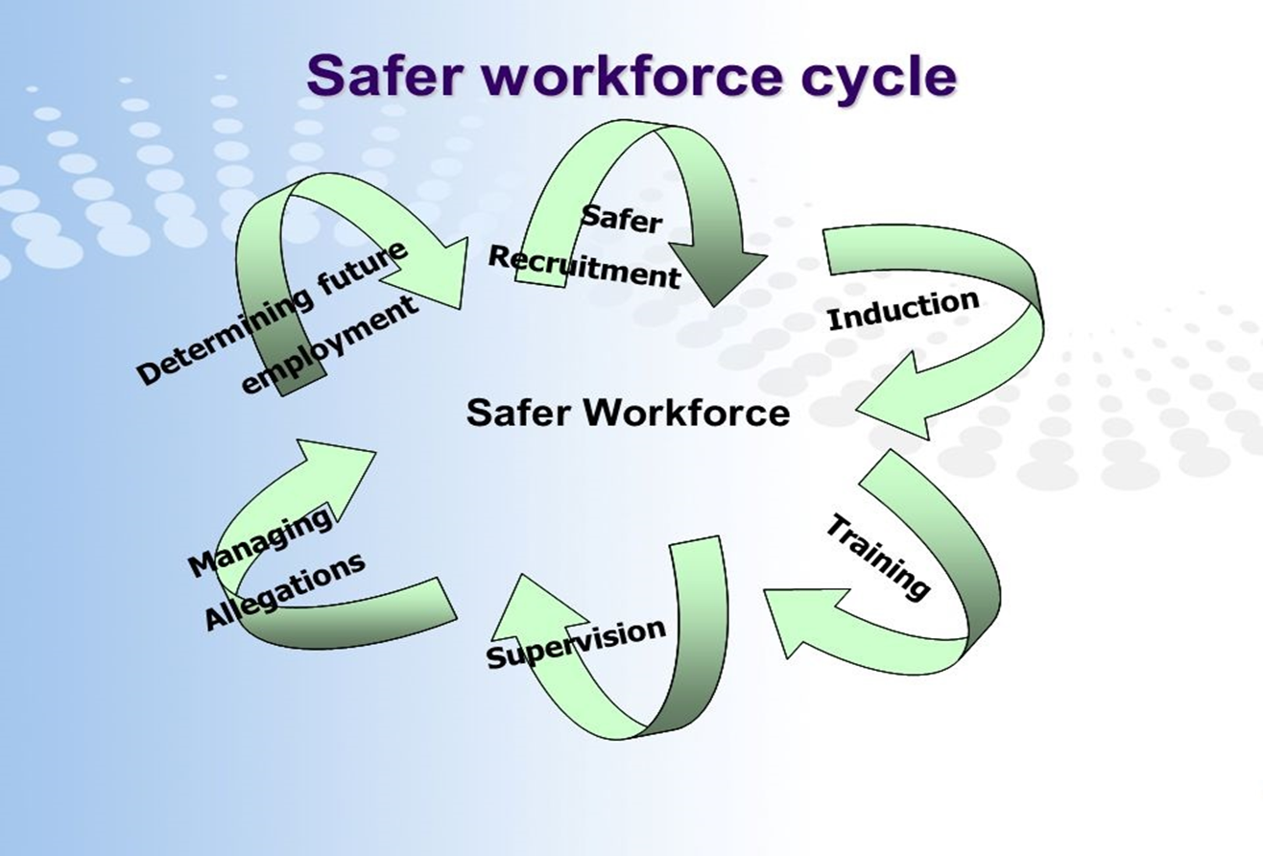
The Safer Workforce Cycle
Organisations who work with or on behalf of children and young people need to be vigilant in their recruitment, selection and retention of staff
Notes:
Part of an effective, safer workforce is about establishing effective recruitment and selection procedures and this requires time, careful preparation and the use of a range of skills.
Organisations who work with or on behalf of children and young people need to be vigilant in their recruitment, selection and retention of staff.
Abusers will target these organisations and be extremely adept at presenting themselves as caring and trustworthy individuals.
Some indicators of abusive behaviour can emerge through inappropriate attitudes or inconsistent reactions and a vigorous recruitment and selection process provides important opportunities to deter and prevent offenders from gaining access to children and young people through their work

Slide 7

Elements of Safer Recruitment
Pre-Interview & Advertising
Receipt of applications
Short list prepared
Seeking References
Receipt of references
Invitation to interview
Notes:
There are many elements of Safer Recruitment that need to be considered, think about and discuss with your Senior Leadership Team and those involved in recruitment in school. Please see the additional handout link that has been uploaded with presentation for more in depth information to consider.
Use this, along with the Action Plan to ensure that your school has considered each aspect of the process.
Often, Serious Case Reviews highlight the importance of effective recruitment and vetting procedures, not least the case of William Vahey in 2014, who joined a UK school whose systems were lax, and the school had not considered the potential for grooming behaviour once a person was working in a school. William had worked in a range of schools across the world, where he took advantage of poor safeguarding procedures to sexually abuse young boys.

Slide 8

Elements of Safer Recruitment
Interview Arrangements
Interview & THE Day of Interview
Upon Appointment
DBS Clearance
Starting of the Role & Induction
Review of policy
Notes:
Plan the whole of your recruitment process in advance to make sure you have a consistent approach every time you recruit a new staff member or volunteer.
Taking a planned and structured approach will help:
•minimise the risk of appointing someone unsuitable
•ensure you select the right person for the role
•make sure the process is fair
•make sure there are records of the process for future reference.
Following a written procedure also means you’re less likely to miss anything out.
See presentation handout to think about your schools action plan for recruitment and selection. Also, please download the action planning support document to work on with SLT / School staff.

Slide 9

Disclosure and Barring Service
(DBS) checks
The danger is that too much reliance will be placed on CRB [now DBS] checks. There is a concern that many abusers do not have convictions and no intelligence is held about them. Therefore the selection and recruitment process if properly conducted is an important indeed essential safeguard
(The Bichard Inquiry Report 2004)
Notes:
The DBS was established under the Protection of Freedoms Act 2012 and started operating on 1 December 2012. Standard: This is regardless or not of whether they are spent under the Rehabilitation of Offenders Act 1974. The law allows for certain old and minor matters to be filtered out. Schools use the enhanced DSB
In relation to volunteers, KCSIE (P44) - The school or college should undertake a risk assessment and use their professional judgement and experience when deciding whether to obtain an enhanced DBS certificate for any volunteer not engaging in regulated activity. In doing so they should consider:
• the nature of the work with children;
• what the establishment knows about the volunteer, including formal or informal information offered by staff, parents and other volunteers;
• whether the volunteer has other employment or undertakes voluntary activities where referees can advise on suitability;
Volunteers with DBS’s need to be on the SINGLE CENTRAL RECORD – an audio briefing

Slide 10

Response to COVID 19
Continue to check all staff and volunteers working within your school (use risk assessments if needed)
Record all workers on site each day (a daily log)
Staff supporting across locations do not need another DBS certificate
Notes:
The government has released guidance on how schools should continue to safeguarding children and young people and key points are highlighted in the slide:
It is essential that unsuitable people do not gain access to children or to the children’s workforce.
It is vital that at this time, we do not take shortcuts, and it is alright to share a healthy professional suspicion about why volunteers want to support your school at this time. If you do not know the person who volunteers to help, then find out what you can and risk assess the situation.

Slide 11

What is needed?
Leaders need to ensure that:
They have child protection strategy that include disciplinary procedures
They have in place appropriate and effective arrangements for safeguarding and protecting children and young people via commissioned services
There is an effective recruitment and selection policy, which is regularly reviewed
Notes:
Use the action planning template to reflect on current safer recruitment practice in your school and to make any changes needed, which highlights that leaders need to continue to :
Prepare to recruit
Select the right people to interview
Carry out thorough background checks and assess risk
Remain vigilant throughout the recruitment process
Respond to inappropriate behaviour and unsafe practices
Staff with responsibility for managing allegations to have a clear understanding of local procedures for managing allegations against adults who work with or on behalf of children and young people.

Slide 12

Links to learning:
Wirral Safeguarding Children Support - Safer Recruitment, Selection and Supervision: https://www.wirralsafeguarding.co.uk/procedures/1-9-safer-recruitment-selection-supervision-staff/
Safer Recruitment Resources: https://learning.nspcc.org.uk/safeguarding-child-protection/safer-recruitment/?_ga=2.75912534.213657060.1537174421-1679295208.1533026074
Revised Guidance for Safer Working Practice for Adults who work with Children and Young People in Education 2019:
https://www.saferrecruitmentconsortium.org/GSWP%20Sept%202019.pdf
Notes:
They have a safer recruitment policy and key staff attend appropriate training
There is a named senior manager for safeguarding (DSL)
Staff working with children receive regular reflective supervision
Staff are aware of their responsibility to the managing allegations process and to ensure that nominated staff attend training
Respond to inappropriate behaviour and unsafe practices
WSCP link is great for recruitment and selection, as well as how to support staff through supervision.

