Slide 1


Safeguarding Children
Basic Awareness
Narrated PowerPoint Presentation

Slide 2
Objectives
In this module we will cover the following areas:
What is meant by Safeguarding Children
The 4 types of abuse and how to recognise them
How to respond to concerns
The pathway for reporting those concerns.

Slide 3
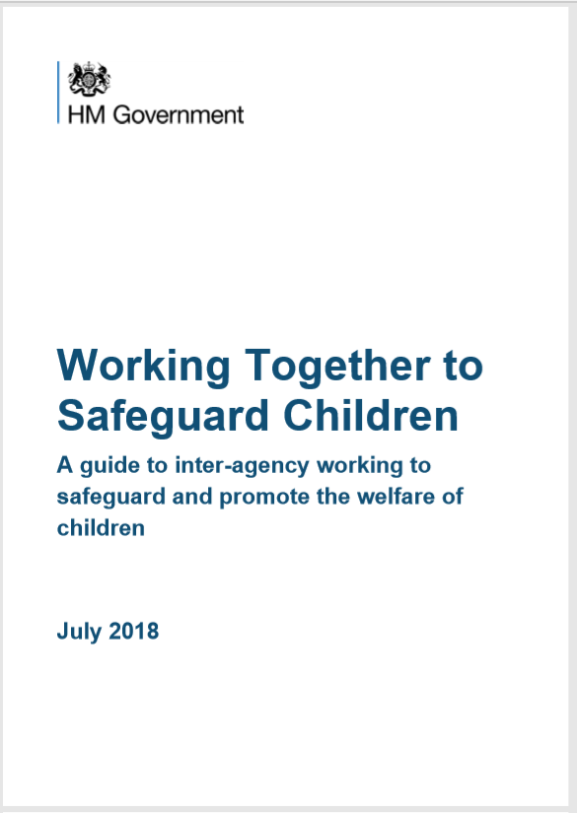
Safeguarding Children Definition
..“the action we take to promote the welfare of children and protect them from harm - is everyone’s responsibility. Everyone who comes into contact with children and families has a role to play.”
Working together to safeguard children (HM Government 2018)

Slide 4
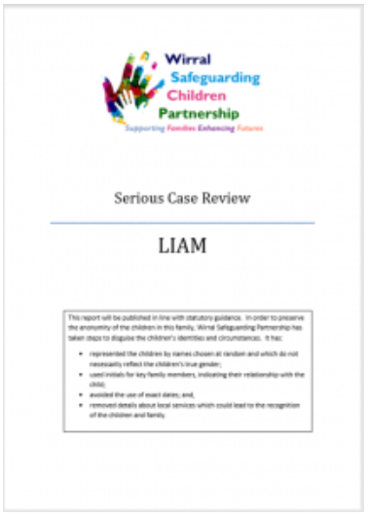
Serious Case Reviews
Why do we need to be aware of the importance of Safeguarding Children? Over the years there have been a number of cases, where children have been seriously harmed or died. When these cases have been reviewed it has been shown that with better safeguarding processes the child may well have been protected.
“…when things go wrong there needs to be a rigorous, objective analysis of what happened and why, so that important lessons can be learnt and services improved to reduce the risk of future harm to children.”
Working Together to Safeguard Children (HM Government)

Slide 5
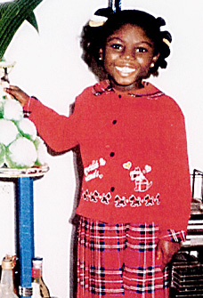
Victoria Climbie
Victoria arrived in England in April 1999 from the Gold Coast. She was brought over by her Great Aunt for a ‘better life’. Within a couple of weeks they had moved into the flat of a man they met on a bus and Victoria began to suffer the most horrific abuse. In the time she lived in this country (just under a year), Victoria came into contact with four social services departments, three housing departments, two specialist child protection teams of the Metropolitan Police, two hospitals and a family centre managed by the NSPCC amongst many other professionals. Concerns were recorded but none were shared. People who knew the family personally raised concerns, such as a child minder, and these concerns were not acted upon. On the 25th February 2000, Victoria was declared dead at 3.15pm in the intensive care unit at St Mary's with 128 separate injuries to her body. Victoria’s case is one that has had the most impact in terms of changes to current processes, with the introduction of the Children’s Act 2004.

Slide 6
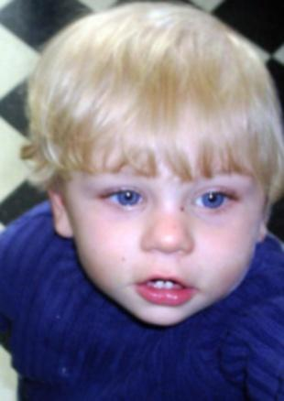
Peter Connelly
Born in March 2006, Baby Peter was known to services from the outset. He died at the hands of his mother and her boyfriend in August 2007. Similar to Victoria’s case, at the time he died Baby Peter was known to a number of agencies and they all failed to safeguard him. This was the same London Borough as Victoria’s case 7 years earlier. An enquiry undertaken after his death found the following failings: Professionals were overly optimistic of mum; The issue of the ‘hidden male’ – professionals did not question the mother’s relationship and were not fully aware of the other adults in the house; There was a lack of communication between agencies. As with the Laming report into Victoria’s death, Peters case led to significant changes in safeguarding.

Slide 7
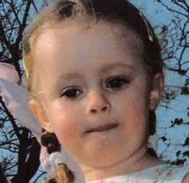
Chloe Fletcher
Chloe Fletcher was 4 when she was drowned in the bath by her mother and died, in 2009. At the time of Chloes death, 9 agencies had been working with the family, some through the Team Around the Family model. There had been concerns raised by professionals and family members about her mothers mental health, domestic abuse relationships, and inability to manage day to day care of Chloe. None were really acted on or recorded. Decisions were made without involving other professionals who may have known the family better and there was intermittent engagement from mum. The case was never escalated to Social Care despite a long history of concerns.

Slide 8
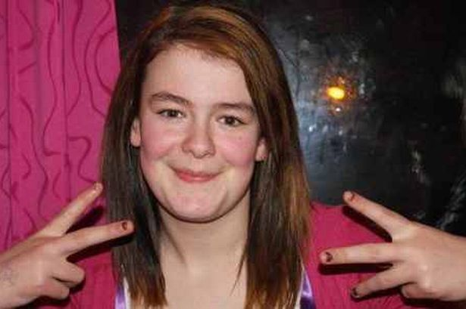
Hannah Windsor
Hannah Windsor was murdered by her boyfriend in May 2012, Hannah was 17 years old. There had been involvement with services from an early age but the assessments had been inconsistent, support was intermittent, decisions were made with no reason recorded. Despite maternal alcohol misuse and Hannah’s conflict with her mother there was little support offered. At a young age, it was recognised that Hannah had learning difficulties and she was later diagnosed as having Attention Deficit Hyperactivity Disorder (ADHD), as a result of this Hannah could be quite challenging to work with. It was known she was in a relationship with Adam Lewis who had a history of difficult and criminal behaviours. Hannah was in supported accommodation when she disappeared and was found murdered on Bidston Hill. Hannah’s case raised the issue of the vulnerability of teenagers and the support needed during the transition to adulthood.

Slide 9

Legislation and statutory framework
Cases like those discussed will often lead to changes in legislation or safeguarding processes:
Children Act 1989
Children Act 2004
Working Together to Safeguard Children 2018

Slide 10
Children’s Act 1989 and 2004
The 1989 Act starts from the premise that the best place for a child to be is in the family home unless there is risk of significant harm. This is where we get the distinction between Section 17 and Child in Need and Section 47 Child at Risk of significant harm - the point where there will be statutory intervention in a families life – known as Child Protection
The 2004 Act does not replace the 1989 Act but is an addendum to it. The changes to the legislation came about as a direct response to the case of Victoria Climbie.
The 2004 Act introduced Local Safeguarding Children Boards (now the Safeguarding Partnerships) to ensure a more co-ordinated approach to local child safeguarding processes
It also led to publication of the Working Together 2006 document (reviewed every 3 years)

Slide 11
Working Together 2018
Working Together 2018 reaffirms that safeguarding is everyone’s responsibility.
This is statutory guidance that sets out key roles for individual organisations and agencies to deliver effective arrangements for safeguarding
For services to be effective each professional and organisation should play their full part and must adopt a child-centred approach with a clear understanding of the needs and views of children.

Slide 12
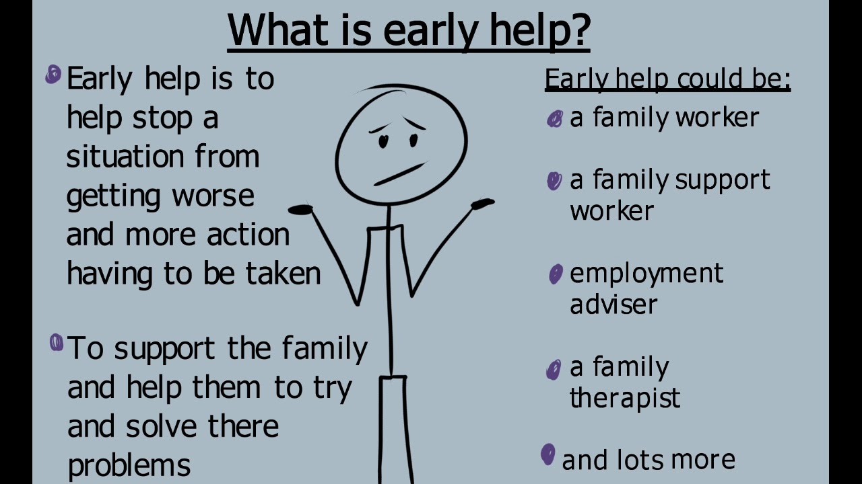
Early Help
‘ Providing early help is more effective in promoting the welfare of children than reacting later. Early help means providing support as soon as a problem emerges, at any point in a childs life, from the foundation years through to the teenage years’

Slide 13
4 Types of abuse
The risks posed to a child are divided into 4 different categories as identified by the Childrens Act 1989. we can recognise these by thinking about the signs and symptoms a child might display:
Physical – unusual bruising, inconsistent explanations for injuries, inappropriate clothing, child displaying aggressive behaviour or flinching.
Emotional – being ignored or belittled by the parents, child being clingy or withdrawn behaviour
Neglect – lack of food or appropriate clothing, lack of emotional warmth, child may appear smelly or dishevelled, and may display clingy behaviour with professionals
Sexual – direct sexual contact, making the child watch pornographic material, child sexual exploitation, child may display sexually inappropriate behaviour/knowledge, could be clingy or withdrawn.

Slide 14
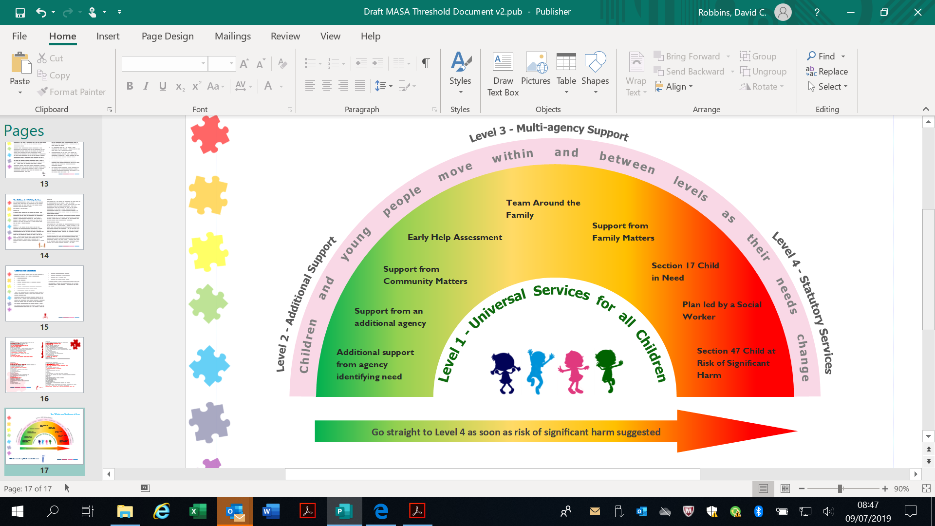
Thresholds
When assessing the needs of a child we should be able to recognise these different forms of abuse, and be able to evidence those concerns when requesting services. We should also have some understanding of where they fit on the threshold of need.
Full Thresholds Document:
https://www.wirralsafeguarding.co.uk/multi-agency-thresholds/

Slide 15
How should we respond to disclosure?
Receive - Listen actively, open body language, accept, non-judgmental. Use TED (tell, explain, describe)
Reassure - ‘You’ve done the right thing by coming to me’, reassure child that you have listened and hear what they are saying; don’t promise what can’t be delivered
Respond - Tell what you are going to do and do it. Ensure child is ok before leaving
Report - As soon as possible, to your Safeguarding Lead or the Integrated Front Door
Record – facts not opinions – When? Where? Who? What?

Slide 16
Level 4 –– Child in Need/ Child Protection
Assessment and Intervention
Information
Follow up
Concern about a child?
Call the Integrated Front
Door 0151 606 2008
Complete Request For Services Form and send through within 24 hours to IFD@wirral.gov.uk
IFD Manager reviews referral
and makes decision within 24 hours.
Level 3 - Early Help
Consult
Disclosure
Level 1/2 – Universal/
community
Remember the childs safety is paramount – if immediate risk of harm call 999

Slide 17
Further information
https://www.wirralsafeguarding.co.uk/public/concerned-about-a-child/
https://www.wirralsafeguarding.co.uk/procedures/
https://www.wirralsafeguarding.co.uk/multi-agency-thresholds/

