Slide 1


Neglect
Training
Narrated
Power Point

Slide 2
Objectives
For learners to:
Have an increased knowledge of what is meant by ‘neglect’ and how to recognise it
To understand the longer term impact of neglect
To have more confidence in how to report concerns.

Slide 3
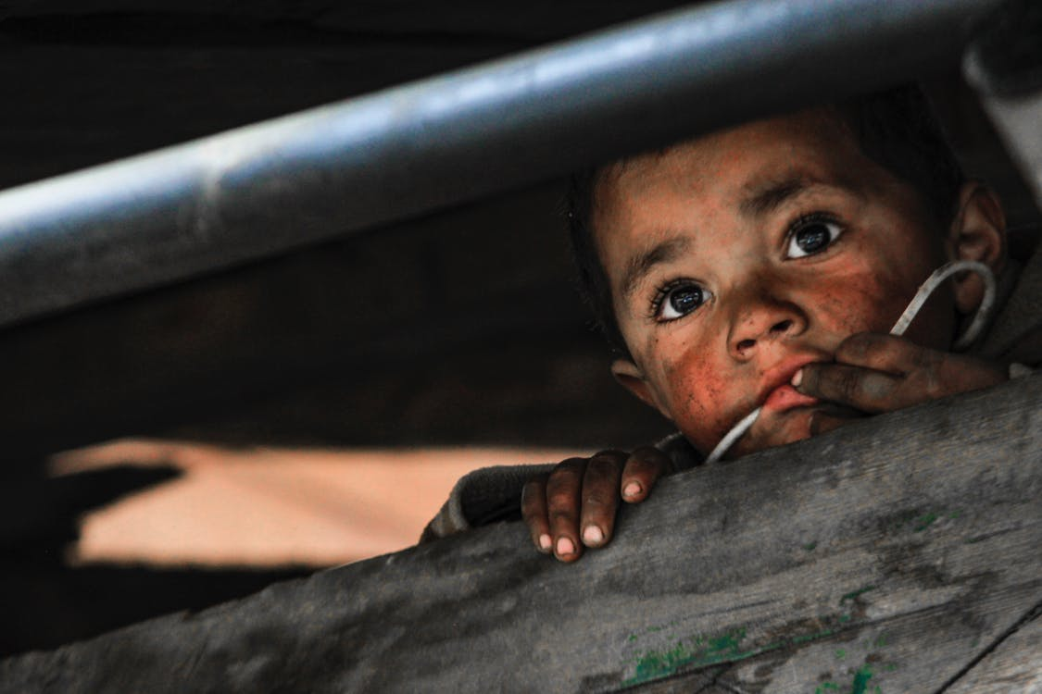
What is neglect??
When we hear a child has been neglected, what image springs to mind?
Is it the child who is dirty and unkempt?
The child who is hungry and scavenging for food?
The child locked in the house and living in squalor?

Slide 4
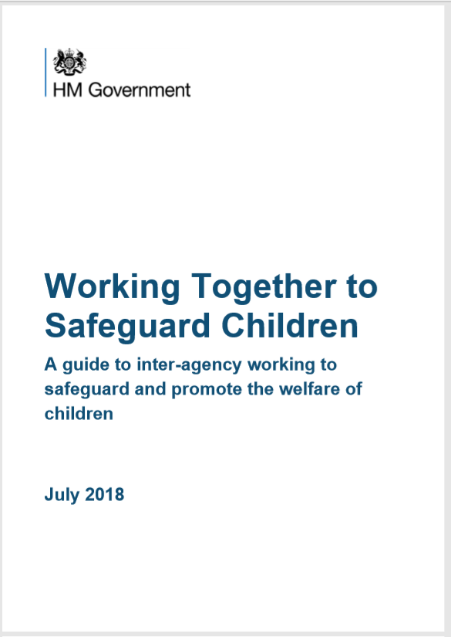
What is neglect??
Working Together 2018 identifies neglect as:
‘The persistent failure to meet a child’s basic physical and/or psychological needs, likely to result in the serious impairment of the child’s health or development. Neglect may occur during pregnancy as a result of maternal substance abuse.
Once a child is born, neglect may involve a parent or carer failing to:
provide adequate food, clothing and shelter (including exclusion from home or abandonment)
protect a child from physical and emotional harm or danger
ensure adequate supervision (including the use of inadequate caregivers)
ensure access to appropriate medical care or treatment
It may also include neglect of, or unresponsiveness to, a child’s basic emotional needs.

Slide 5
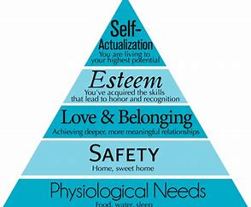
What is neglect??
It is true that neglect will often be reflected in a child’s living conditions and provision of basic needs, and this is often the neglect first recognised by professionals. However, equally as important is the emotional warmth, the safety and the developmental needs of the child.

Slide 6
Why is it important that we recognise neglect?
Statistics from the NSPCC state:
1 in 10 children have experienced neglect
Over 26,000 children were identified as needing protection from neglect in 2016
Neglect is the most common reason for taking child protection action
33% of contacts to the NSPCC’s helpline were concerns about neglect
25% of referrals to the NSPCC’s helpline for neglect were from neighbours/ community
42% of the concerns that the NSPCC’s helpline referred to police or children’s services related to neglect
Neglect is a factor in 60% of serious case reviews

Slide 7
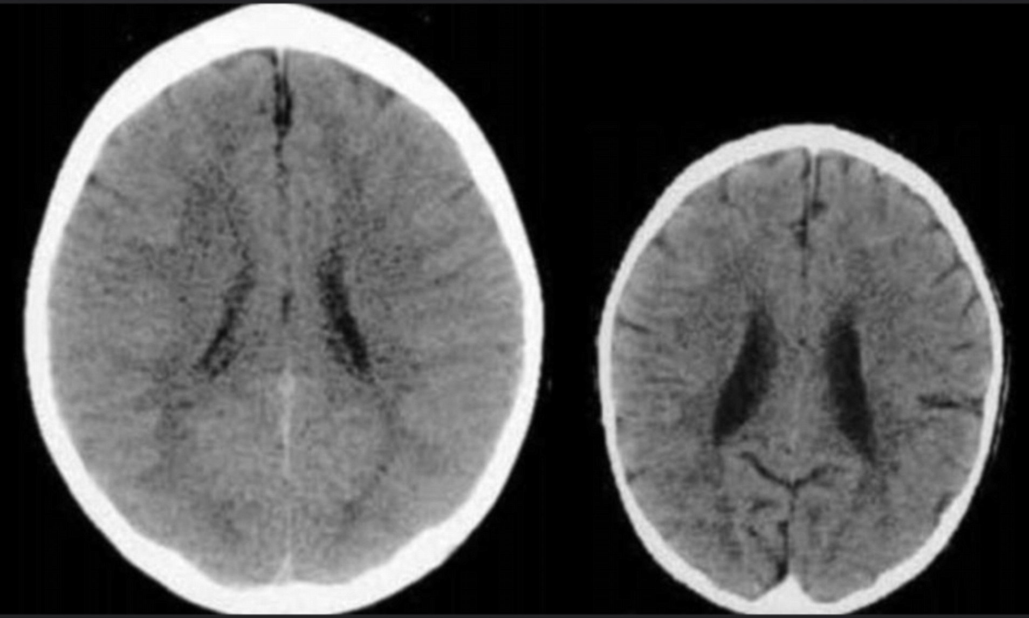
Why is it important that we recognise neglect?
Neglect is often long term corrosive and can lead to major issues later on in life. The picture to the right shows the impact of neglect on the brain of a 3 year old child.
“Neglect is an insidious form of maltreatment. It starves the developing mind of stimulation. It denies the child information and interest about the self and others.” Professor David Howe
“Neglect slowly and persistently eats away at children’s spirits until they have little will to connect with others or explore the world.”
Erikson and Egelan, Howe D (2005)

Slide 8
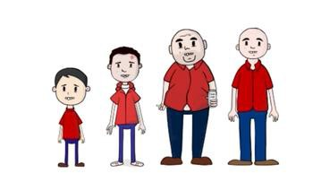
Why is it important that we recognise neglect?
Chronic neglect is associated with a wider range of damage than active abuse. Longer term outcomes can include:
Death
Delayed development
Emotional difficulties - anger, anxiety, sadness or low self-esteem
Mental health problems such as depression, eating disorders, (PTSD), suicidal thoughts, self harm
Problems with drugs or alcohol
Poor physical health
Struggles with relationships
Difficulties with learning, lower educational attainment, difficulties in communicating
Behavioural problems including anti-social behaviour, criminal behaviour

Slide 9
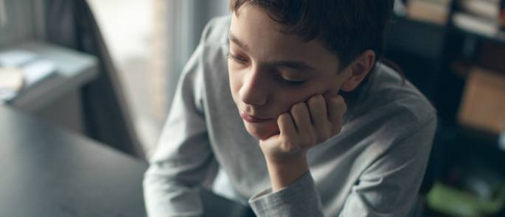
Case study 1 Jamie aged 11
My dad says I need to look after myself so I am not a wimp! People used to call me smelly and stuff but they don’t anymore because I stand up for myself. I cant be bothered to go to school and sometimes my dad says I don’t have to. He takes me out in his taxi instead. Sometimes I sneak out at night to go and meet my friends. Mum and dad don’t ever notice. We go and hang out at the park and sometimes we get hold of booze. I sneak back in when it is late and get away with it!

Slide 10
Case study 1 Jamie aged 11
What kind of neglect is Jamie suffering?
Safety and developmental need (also some suggestion of lack of hygiene and clean clothes)

Slide 11

Case study 2 Sam 18months
I live with mummy and my big sister. I like going to nursery and I have lots of friends. When I come home I play with my toys and I have yummy tea. I am nice and warm and I have a bright room. Sometimes I wish mummy would cuddle me. Mummy is always very busy and sometimes she can be a bit shouty. It makes me feel lonely but I don’t really cry anymore cause when mummy shouts I get scared!

Slide 12
Case study 2 Sam 18months
What kind of neglect is Sam suffering from?
Emotional as his basic and developmental needs seem to be being met.

Slide 13
What to do if we have concerns
If when working with a family you have concerns that the child or children in that family are suffering from neglect you should seek advice from your Safeguarding Lead.
An assessment should be completed either by someone trained to complete the Graded Care Profile 2 or by making a referral to the Integrated Front Door.
For more information on how to make a referral and how to complete the GCP2 training please see the Wirral Safeguarding Children Partnership website.
Remember the impact of neglect can be reversed but we need to respond and react.

Slide 14
Further Information and Support
https://www.wirralsafeguarding.co.uk/professionals/neglect/
https://www.wirralsafeguarding.co.uk/training/courses/
https://www.nspcc.org.uk/what-is-child-abuse/types-of-abuse/neglect/
https://www.actionforchildren.org.uk/what-we-do/our-impact/safeguarding-children-from-neglect/

