Slide 1



Graded Care Profile 2
A tool for the assessment of neglect

Slide 2

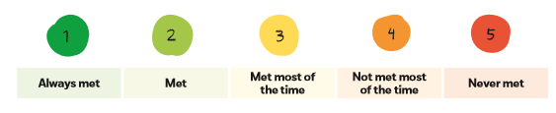
What is the GCP2?
GCP2 is an evidence based tool to help practitioners assess when poor parenting becomes neglectful.
The Tool uses a grading system which measures the quality of care from 1, where the child is always first to 5, where the child is not considered.

Slide 3

Why was it developed?
Developed by Dr Shrivastava and the NSPCC the GCP2 looks at what life is like for the child. This ensures the child is kept central to the assessment.
There is strong evidence that the identification and assessment of neglect presents particular difficulties for practitioners.
This leads to assessments being subjective with a lack of evidence base.
Over 60% of serious case reviews show the child/children were suffering from neglect and this is often missed.

Slide 4
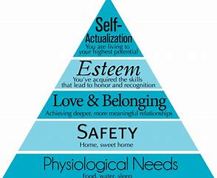
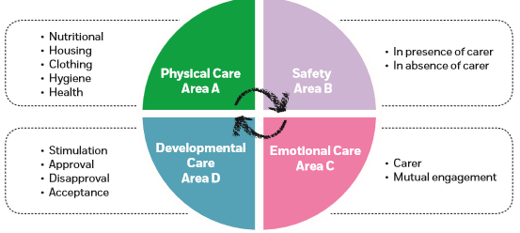
What does it measure?
Based on Maslow hierarchy of needs the tool is separated into 4 domains. The assessment is timebound and measures the current care of the child.

Slide 5

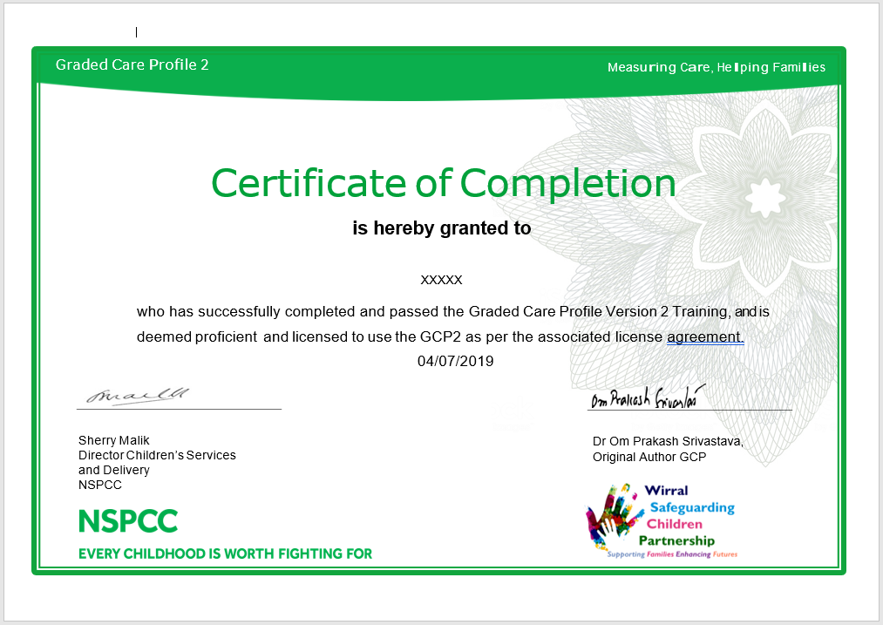
Who can use the tool??
The tool can be used by any professionals who want to evaluate the care of a child where concerns about neglect exists.
The tool is also a useful measure of parenting.
However in order to use the tool professionals need to attend the full days training and successfully complete an assessment as part of that training.
For more information on availability of training please go to https://www.wirralsafeguarding.co.uk/training/courses/

