Slide 1

Domestic Abuse
Basic Awareness
Narrated Powerpoint Presentation

Slide 2
Objectives
By the end of training participants will:
Have more confidence in recognising domestic abuse
Have a clearer understanding of the impact of domestic abuse on the victim and the children in the family
Know where to seek support for themselves and the families they are working with.

Slide 3

Domestic abuse definition
Any incident of controlling, coercive, threatening behaviour, violence or abuse between those aged 16 or over who are or have been intimate partners or family members, regardless of gender or sexuality. This can encompass but is not limited to the following types of abuse:
Psychological; Physical; Sexual; Financial; Emotional.

Slide 4
Coercive control
Coercive control can involve a range of criminal offences including assault, rape, threats to kill, burglary and criminal damage. Coercive control is a criminal offence even if you have not experienced any physical violence or damage to your property.

Slide 5
Why does domestic abuse occur?
One major factor in many abusive relationships is the power of one partner over another. This abuse can take the form of physical violence, restriction of movement and contact with friends and family, restriction of access to money, and emotional abuse, such as blaming, minimising and using intimidation.
However in some relationships both partners are equally abusive and this often involves a relationship dynamic in which conflict occasionally gets 'out of hand’. This form of abuse can range from aggressive behaviour such as throwing objects, to more aggressive behaviours such as pushing, slapping, biting, hitting. However this occurs out of anger or frustration rather than as a means of gaining control and power over the other partner.
It is important to note that whichever dynamic the abusive relationship takes, the impact on the children can be severe and long lasting.

Slide 6

Children and domestic abuse
In a relationship where there is domestic abuse, children will experience the abuse in a number of different ways. People may believe that children are unaware of what was happening, but they can often remember it exactly. They may see or hear or even be involved in the abuse.
Besides possible physical abuse, children will almost certainly suffer emotional abuse either by being shouted at, told they are stupid or are not trying hard enough, or by witnessing the abuse of a loved parent. These emotionally damaging actions often have a long-lasting effect on the children.

Slide 7
Children and domestic abuse
Statistics from the NSPCC show:
1 in 5 children have been exposed to domestic abuse
1 in 5 teenagers have been physically abused by their boyfriends or girlfriends
Domestic abuse is a factor in over half of children’s serious case reviews
A third of children witnessing domestic violence also experienced another form of abuse - the link between child physical abuse and domestic violence is high.
In 90% of cases of violence the children were in the same or the next room
at the time of the incident.

Slide 8

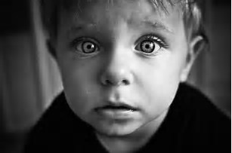
The impact of domestic abuse on children
Domestic abuse will have an impact on children of any age. We can recognise it by understanding some of the signs in the children we work with.
Birth – 2: Children in the first year of their life are influenced by emotional and behavioural trauma experienced by their mother. Signs could include constant crying, poor eating/sleeping, colic type symptoms, clingy/anxiety separation or withdrawn
2-4 years: Toddlers are just learning how to communicate with language. Signs may include becoming anxious or depressed, they may have difficulty sleeping, they may complain of physical symptoms such as tummy aches, or have constipation.

Slide 9
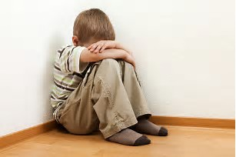

The impact of domestic abuse on children
6-12 - Children at this age often feel that they are responsible for the violence in their family. They need and want to have explanations for what is happening in “their world”. Signs of concerns may include bed wetting, they may behave as though they are much younger than they are, there may be problems at school, or they may start truanting, they may start to display aggressive behaviour.
Teenagers - Teens who grow up in abusive homes often rebel against authority and over identify with their peers, they may choose friends who support their poor self-image and who will approve of their self-destructive behaviour. They may become violent themselves in response to threats (in school or at home), there could be attempts at suicide or self-harm, they may start to use alcohol or drugs, they could be very protective towards victim

Slide 10

Domestic abuse and young people
It is important not to lose sight of the fact that domestic abuse is experienced within young people's own intimate relationships.
Research from the University of Bristol and the NSPCC shows that 25% of girls aged 13-17, and 17% of boys, have experienced the use of physical force (pushing, slapping, hitting or being held down) in a relationship.
Technology is often used against them, for example to keep surveillance of where they are and what they are doing and by monitoring their social media accounts.

Slide 11

What might increase the risk of domestic abuse?
Victim's perception of risk of harm: victims of domestic abuse often tend to underestimate their risk of harm from perpetrators of domestic violence.
Separation: victims who attempt to end a violent relationship are strongly linked to intimate partner homicide.
Pregnancy/new birth: domestic abuse can start or get worse in pregnancy.
Community issues/isolation: needs may differ amongst ethnic minority victims, newly arrived communities, asylum seekers, older people, people with disabilities, as well as travelling or gay, lesbian, bisexual or transgender people.
This will include the isolation of the COVID-19 lockdown.
Stalking: persistent and consistent calling, texting, sending letters, following.

Slide 12
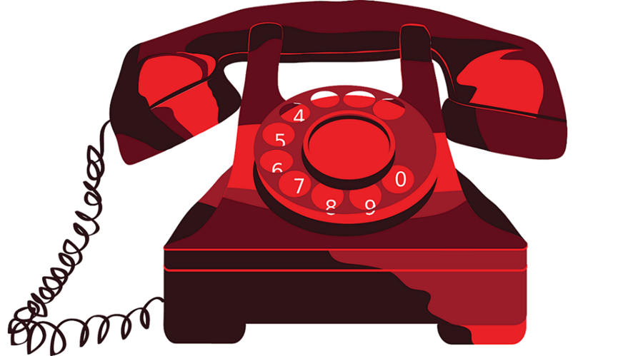
How should we respond?
If you have concerns that the child or anyone in the family are at immediate risk of harm, you should contact the police urgently by calling 999.
If you believe a child is experiencing domestic abuse you should contact the Wirral Integrated Front Door: 0151 606 2008 (Monday to Friday 9am-5pm). Outside of these hours please call the Emergency Duty Team on 0151 677 6557. The IFD will take any referral and advise and signpost to further agencies of support.

Slide 13
Further information and support
Tomorrow’s Women Wirral: Support for women in abusive relationships the team will offer advice and a listening ear. Please call 0151 647 7907
Wirral Women and Children’s Aid: Provides a 24/7 helpline. Please call 0151 643 9366 for guidance and support. Women’s Aid: https://www.womensaid.org.uk/information-support/
National Domestic Violence Helpline: 0808 2000 247 (24 hours).
Worst Kept Secret Helpline: 0800 028 3398.
Refuge: (includes information for men) | refuge.org.uk | 0808 200 0247 (24 hours) The Men’s Advice Line: for male domestic abuse survivors, 0808 801 0327.
National LGBT+ Domestic Abuse Helpline: 0800 999 5428.
Samaritans (24/7 service): 116 123.
Respect: The Respect Phoneline is a key source of support for people concerned about their behaviour and wanting to manage and change it. 0808 8024040
Useful website:
https://www.reducingtherisk.org.uk/cms/content/home

