Slide 1


The Role of a Designated Safeguarding Lead (DSL)
Narrated PowerPoint
Notes:
The role of a Designated Safeguarding Lead (or DSL) has evolved over the last 15 years and this briefing will highlight the role and key responsibilities of a DSL in an educational setting.

Slide 2


The Emergence of DSL’s
The role of the Designated Safeguarding Person was specified in the Children Act (2004) to ensured that every organisation had a “named person” for safeguarding children and young people.
Notes:
Prior to that, for a number of years, the role had frequently been known as the Child Protection Officer. The Designated Safeguarding Person has safeguarding responsibility at both a strategic level within the organisation and on a day to day basis.
Keeping Children Safe in Education (2015) was the first time the government set out the role of the Designated Safeguarding Lead in an formalised way for the Education Sector, (in Annex B). Often schools have a DSL and deputy DSL and they should have the status and authority within the school to carry out the duties of the post, including committing resources and supporting and directing other staff.

Slide 3

National Commitment
The role of the DSL ‘should be given the time, funding, training, resources and support to provide advice and support to other staff on child welfare and child protection matters, to take part in strategy discussions and inter-agency meetings – and/or to support other staff to do so – and to contribute to the assessment of children’
(Keeping Children Safe in Education – 2015: 11)
Notes:
The designated safeguarding lead should receive appropriate DSL training, to be refreshed every two years in order to:
Understand the assessment and referral process for providing early help and intervention
Have a working knowledge of how local authorities conduct a child protection case conference and a child protection review conference and
be able to attend and contribute to such meetings effectively when required to do so

Slide 4
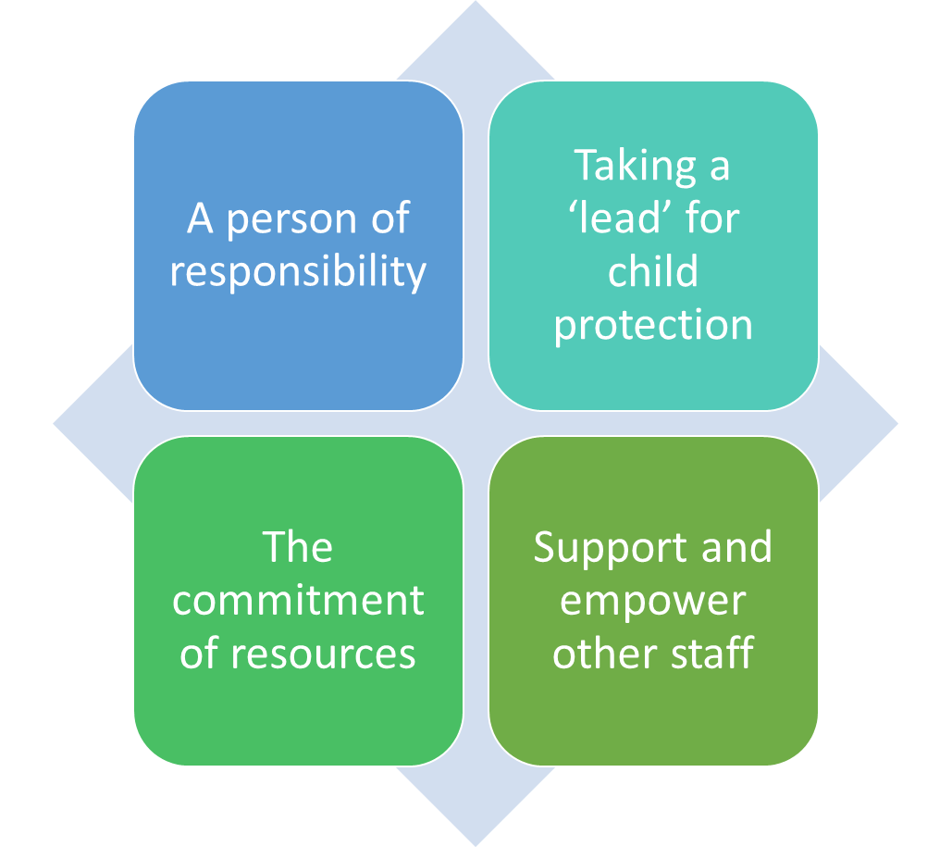

Key Role of a DSL
A Designated Safeguarding Lead is the person who has responsibility for ensuring a school’s safeguarding policy is adhered to
Notes:
It is important to note that Safeguarding children is everyone's responsibility, regardless of whether you have a Designated Safeguarding Lead or not.
Ensure each member of staff has access to and understands the school’s child protection policy and safeguarding procedures, especially new and part time staff.

Slide 5
Responsibilities
MANAGING REFERRALS
Support and empower staff
RAISING AWARENESS
REFER TO THE LADO WHEN NEEDED
Notes:
Liaise with Head Teacher/Senior Leaders regarding Section 47 inquiries (child protection) & support keeping detailed, accurate, secure written records of concerns and referrals
Provide advice and support to staff on protecting children across a range of safeguarding concerns
Attend ‘Safeguarding’ Meetings such as Child Protection conferences, Child In Need and Looked After Children reviews and Team Around the Family

Slide 6

Empower Staff to:
Recognise signs of abuse, how to respond to disclosures and when it is appropriate to make a referral
Have access to and understand schools Child Protection Process and the Safeguarding Policy
Have a working knowledge of Wirral Safeguarding Children Partnership and of the Integrated Front Door
Notes:
Encourage a culture of listening to children and taking account of their wishes and feelings, among all staff, in any measures the school or college may put in place to protect them
Provide advice and support to staff on protecting children across a range of safeguarding concerns

Slide 7
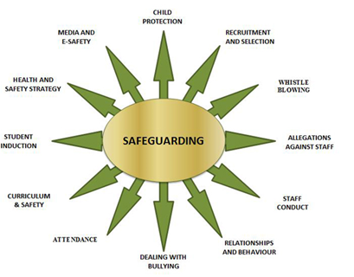
Support for staff
Notes:
Visit www.wirralsafeguarding.co.uk to find out more

Slide 8
Changes due to COVID19
safeguarding responsibilities remain the same
Other staff may need to take on the dsl role if team numbers decrease
Use your support networks
STAFF MAY NEED TO STEP INTO THE DSL ROLE
Notes:
The government released safeguarding support documents for schools on 27 March and it highlighted that the role of the DSL remains the same. Statutory SG duties are also unchanged, however we will need to respond to SG concerns in a variety of ways. DSL’s need to be available to staff, but this can be virtually, on the phone.
DSL’s whose training may lapse during the current pandemic as to carry on their SG role. If numbers in a team decrease, other members of the team may need to step into the support role. The government are urging that senior leadership teams in school support each other to respond to safeguarding concerns quickly and pro-actively.

Slide 9

Referral Route:
INTEGRATED FRONT DOOR – 0151 606 2008
IFD@wirral.gov.uk
Outside of these hours call 0151 677 6557.
In an emergency always dial 999
Wirral Safeguarding Children Partnership (WSCP) – www.wirralsafeguarding.co.uk
Notes:
If a child or young person is at risk of harm, abuse or neglect please report it to the Wirral Integrated Front Door on 0151 606 2008 9am – 5pm Monday to Friday. Outside of these hours call 0151 677 6557 / In an emergency always dial 999
Contact IFD regarding child and safeguarding concerns / Use WSCP website to stay up to date about safeguarding

