Slide 1



Slide 2




W
E
C
M
E
L
O
and
R
O
D
U
C
T
I
O
N
S
I
N
T

Slide 3
Agenda for the Meeting
Welcome from Safeguarding Partners and Independent Scrutineer
Opening Item – Memory Box Scheme
WSCP –The first 6 months
  Safeguarding Performance Report inc. Case Reviews
  Progress against Priorities
Focus on Supporting Families Enhancing Futures
Break
Independent Scrutiny – first 6 months report
Focus on Early Help

Slide 4
Slido
This event is using Slido (https://www.sli.do/ enter code #2206) to enable you to send and respond to questions before and during the event
WiFi password for the Floral Pavilion is: to be added

Slide 5
Opening Item –
Memory Box Scheme

Slide 6

Memory Boxes
Michelle Beales-Shaw to populate

Slide 7
Memory Boxes
Michelle Beales-Shaw to populate

Slide 8

WSCP The first 6 Months - Reflections

Slide 9
Purpose of new Local Arrangements
to support relevant agencies to work together in a system where:
excellent practice is the norm
partner agencies hold one another to account effectively
there is early identification of ‘new’ safeguarding issues
learning is promoted and embedded
information is shared effectively
the public can feel confident that children are protected from harm

Slide 10
How Strong is Our System?
-Your reflections
Activity
During the course of the morning please share your reflections with us about the 1st six months – including suggestions, on the paper in front of you. Please also share your comments on Slido

Slide 11
WSCP Reflections
WSCP was successfully launched in September 2019
WSCP is meeting its statutory responsibilities
Committees are established – representation is strong
Website continues to be very well used
Training offer remains very strong

Slide 12
WSCP Reflections
QA process and reporting significantly strengthened
Auditing and accountability model is strong
Scrutiny model in place
Priority areas launched – still work to do
Partnership inspection reports encouraging – positive direction of travel

Slide 13
WSCP Reflections – to do list
Work remains to be focused on evidencing outcomes – framework under development
Includes development of strategy for distance travelled
SFEF to be firmly embedded in practice
Communication from WSCP to all agencies/professionals to be strengthened

Slide 14
Improved Communication – proposed change to structure
Current
Statutory Safeguarding Partnership Group
Statutory Safeguarding Partners Executive Group
Pan Merseyside
Groups
Independent Scrutiny of arrangements
Business Intelligence & QA Unit
Safeguarding Vulnerable Children Groups
Communication about WSCP activity identified as a weakness
- QA Committee
- Case Review Committee
- Training Committee and Pool
- Local Policies and Procedures
Committees:
Contextual Safeguarding
Quality Assurance
Evidencing Outcomes
Domestic Abuse
Task and Finish Groups

Slide 15

Improved Communication – proposed change to structure
New
Statutory Safeguarding Partnership Group
Statutory Safeguarding Partners Executive Group
Pan Merseyside
Groups
Independent Scrutiny of arrangements
Business Planning Group
New group co-ordinates all committee activity including communication
New group including committee chairs and agency reps
Business Intelligence & QA Unit
Safeguarding Vulnerable Children Groups
- QA Committee
- Case Review Committee
- Training Committee and Pool
- Local Policies and Procedures
Committees:
Contextual Safeguarding
Quality Assurance
Evidencing Outcomes
Domestic Abuse
Task and Finish Groups

Slide 16


Safeguarding Performance Report
- first 6 months

Slide 17
Quality Assurance Committee
The WSCP Quality Assurance Committee oversees multi-agency audit, performance information and Section 11 which enables the safeguarding partners to assess the effectiveness of services for children in need of help and protection.
The following slides include an overview of the activity and findings over the last 6 months.

Slide 18
Multi-agency Auditing
The Quality Assurance Committee has undertaken 3 multi-agency audits in the last 6 months. Some of the main findings were:
understanding and application of thresholds is strong across the partnership
quality of partnership working is good although the quality of the response tends to be better the higher up the threshold of need you are
quality of assessments and analysis still needs to improve, especially as part of the SFEF model to understand the lived experience of the child
plans can be task and risk focused rather than being smart and devised against the background of the profile of individual families

Slide 19
Section 11
Section 11 places duties on a range of organisations and individuals to ensure their functions safeguard and promote the welfare of children. The main findings from this year’s audit were:
138 education settings and 87 agencies completed the Section 11 this year
Section 11 audits revealed a universal commitment to safeguarding and aﬃrms that children are being appropriately safeguarded by agencies across the borough
All agencies said that their staff have received or attended training regarding their safeguarding responsibilities

Slide 20
Section 11
Agencies are confident that their staff know how to report safeguarding concerns and how to access relevant policies and procedures. Agencies providing regular reflective supervision to their staff significantly improved this year
greater awareness of county lines and the pan Merseyside missing protocol is required, particularly within school settings.
understanding of the Supporting Families Enhancing Futures approach is inconsistent across the partnership

Slide 21
Performance Information
Headline performance over the last 6 months:
there has been a fall in the number of children on a Child Protection plan (355), this is the lowest figure recorded since May 2018 (307)
the number of Children Looked After remains high (824)
introduction of Family Matters has led to a significant increase in the no. of early help cases closed with needs met
The number of referrals to MACE and children discussed has increased over the last 6 months, however the number of re-referrals is reducing

Slide 22
Multi-agency RAG rating
Agencies have identified the following areas of performance in the last 6 months:
Youth Justice Service: Funding is available from the Violent Reduction Unit to develop an education programme for children and young people in Wirral, including school and group work focusing on knife crime, peer on peer violence and gang culture.
Knife crime and criminal exploitation awareness training has also been commissioned.
Youth Justice Service: Youth Justice Service has trained a number of young people to become cyber champions. A group of Year 12 students are now delivering basic internet safety training to year 7 pupils.
Merseyside Fire and Rescue Service: have delivered courses with Everton in the Community to work with CYP who are excluded from school and not engaging with alternative provision and at risk of CE. This was successful and highlighted in the Liverpool Echo.
Merseyside Police: The Compass Team continue to hold a meeting every morning with partners. This meeting is to ensure there is a real time exchange of information with regards to children who are vulnerable or a significant risk of child exploitation. This has been identified as best practice.
Highlight
GREEN: Highlight good practice and positives

Slide 23
Multi-agency RAG rating
Merseyside Police: Carrying of knives is clearly an emerging issue/pattern of concern in Wirral. Operation Target has been running since June following a grant from central government. There is a program of high visibility policing around certain schools, parks and beaches.
Wirral Community Health and Care Trust (WCHCT): The number of MARAC cases with children involved has increased significantly between Q1 and Q3. WCHC is monitoring this closely and working with the LA to support the daily domestic abuse meeting in the Integrated Front Door which aims to reduce the number of cases progressed to MARAC.
Wirral Attendance Service: There has been an increase in the number of elected home educated children nationally and on Wirral over the last 5 years. Wirral Attendance Service is waiting for government legislation to change to support with safeguarding this ever increasing number of children more effectively.
Cheshire and Wirral Partnership (CWP): During the CQC inspection, long CAMHS waiting lists for children were recognised. CWP is working with the CCG and LA to address these issues. The CCG has commissioned an external agency to work with the waiting list to support children on the waiting list.
Inform
AMBER: We need to be aware

Slide 24
Multi-agency RAG rating
Early Help: Early Help report that there are concerning patterns in relation to families escalating and de-escalating in short periods of time. Contributing factors appear to be inconsistent application of thresholds and drift.
Cheshire and Wirral Partnership (CWP): There has been an increase in the number of parents committing suicide in Wirral. It has been acknowledged that in some cases the parents were known to Children’s Services. Although the children were not seen as ‘at risk of significant harm’ there is no system in place to convene multi-agency reviews on these deaths when there appears to be some lessons to be learnt. This has been raised with the designated nurse.
Flag
RED: Flag as an area of Concern

Slide 25



Progress Against Priorities
- first 6 months

Slide 26
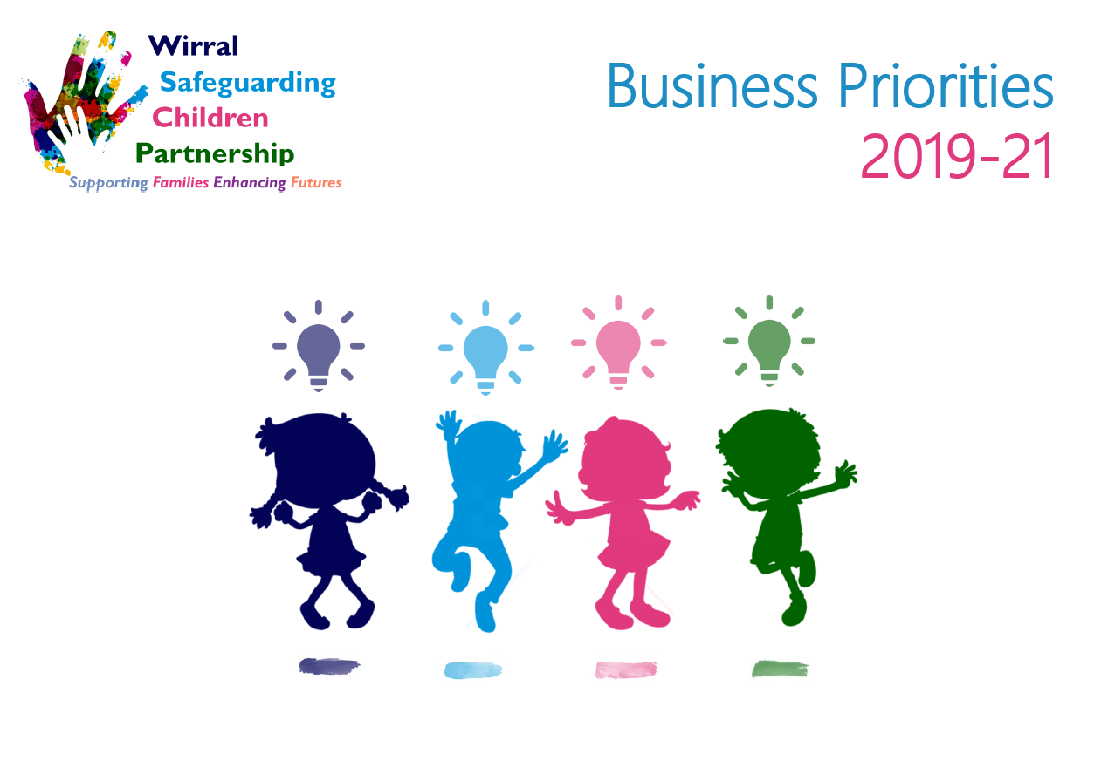
Four Priorities for 2019-21
1
Emotional Health and Wellbeing
Contextual Safeguarding
2
3
Intergenerational Abuse
Working Together
4

Slide 27
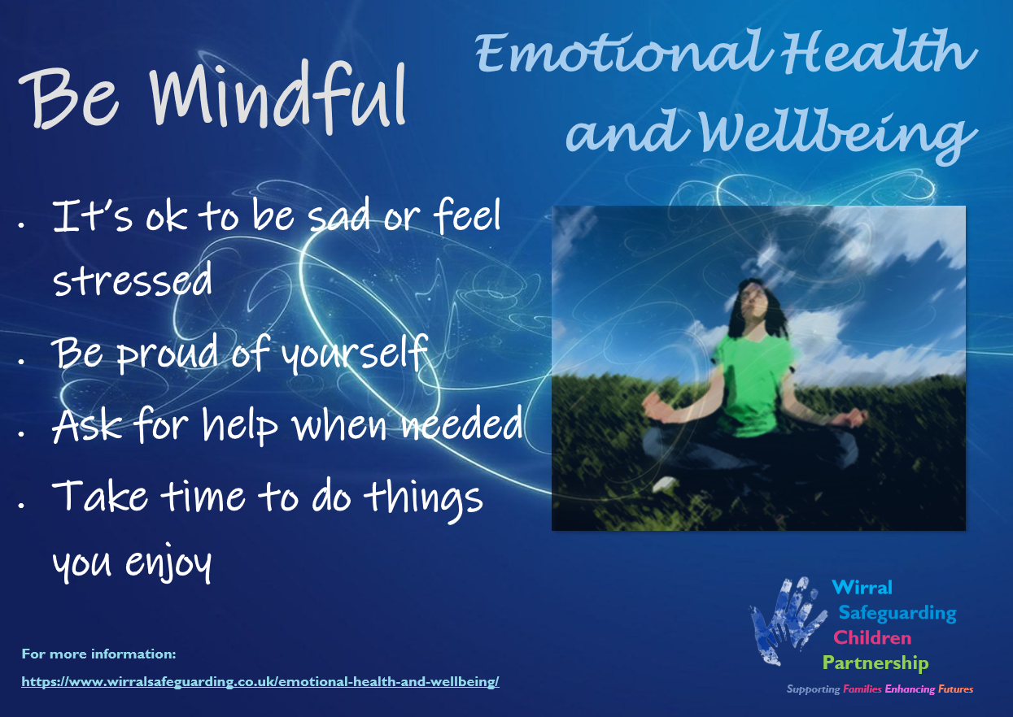
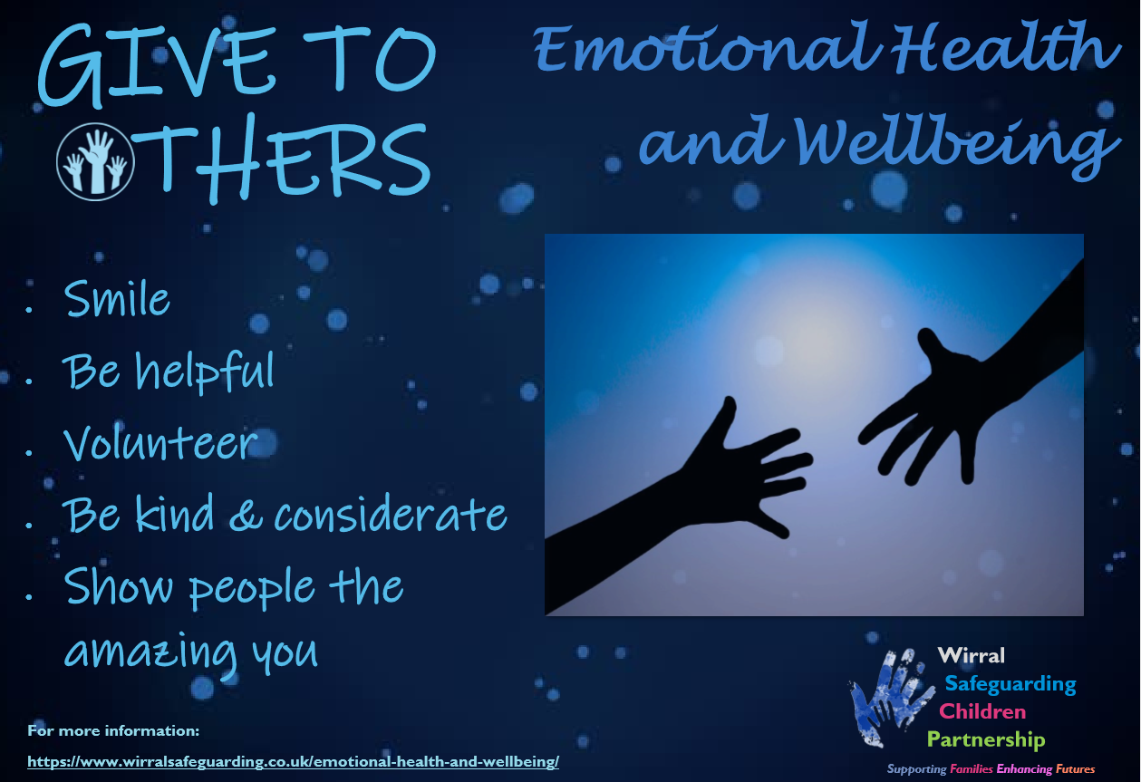
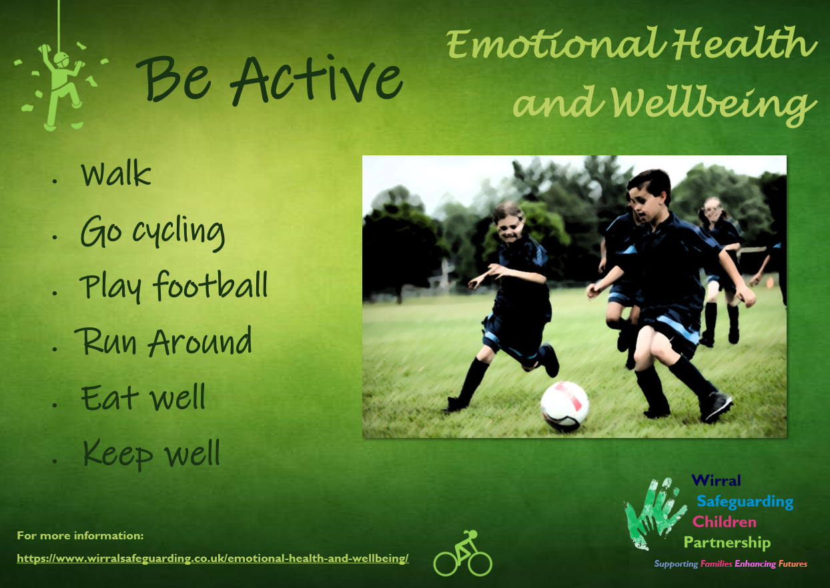
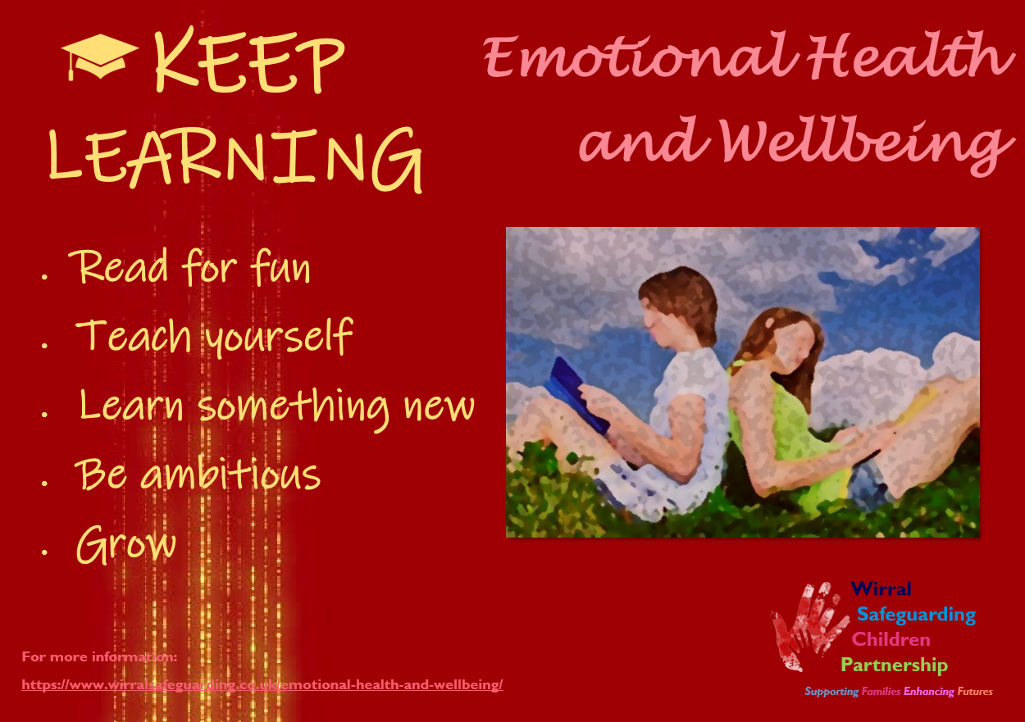
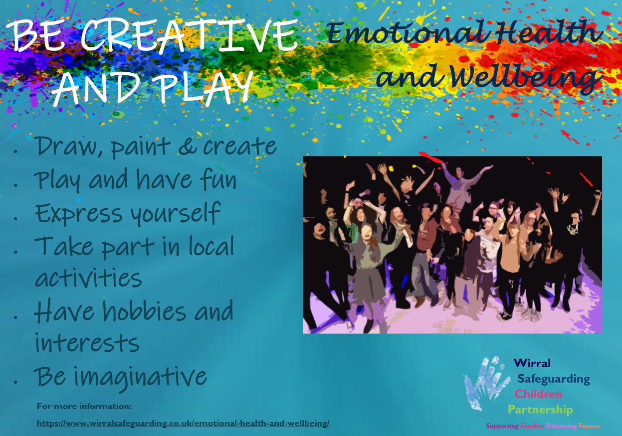
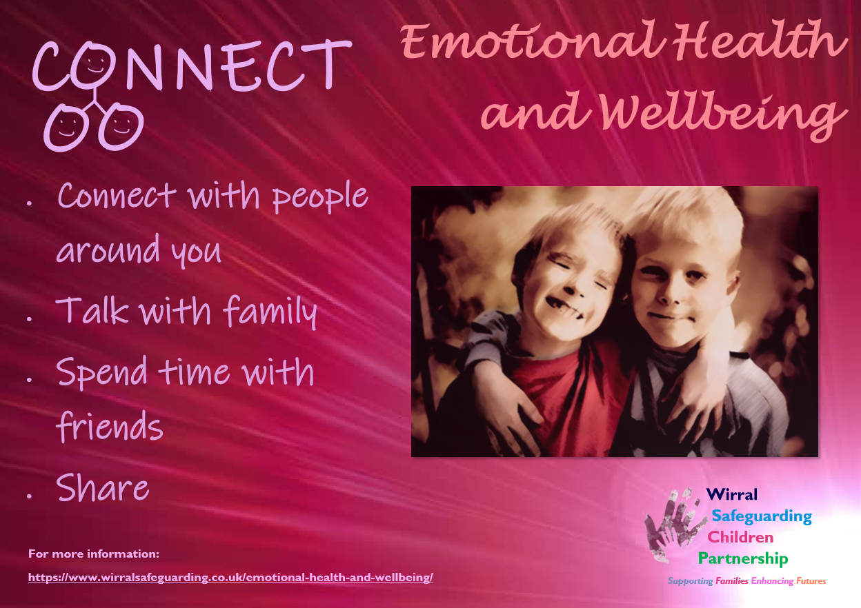
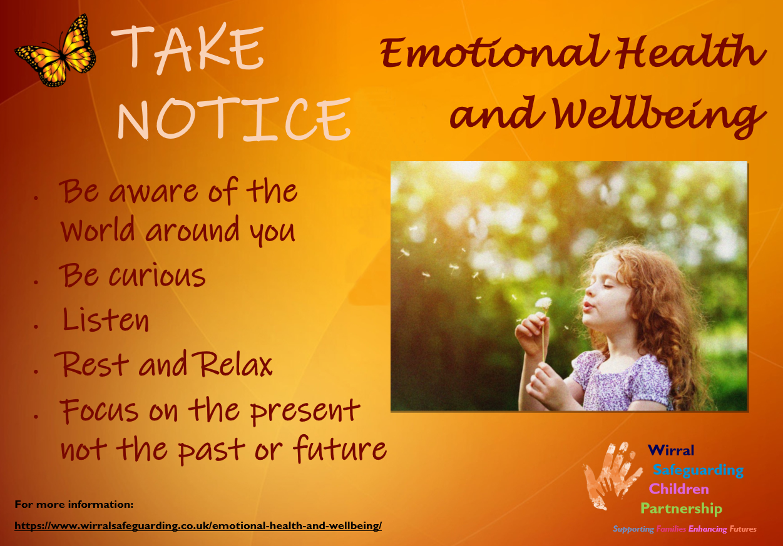
1. Emotional Health and Wellbeing
Campaign begun with resources on website:

Slide 28
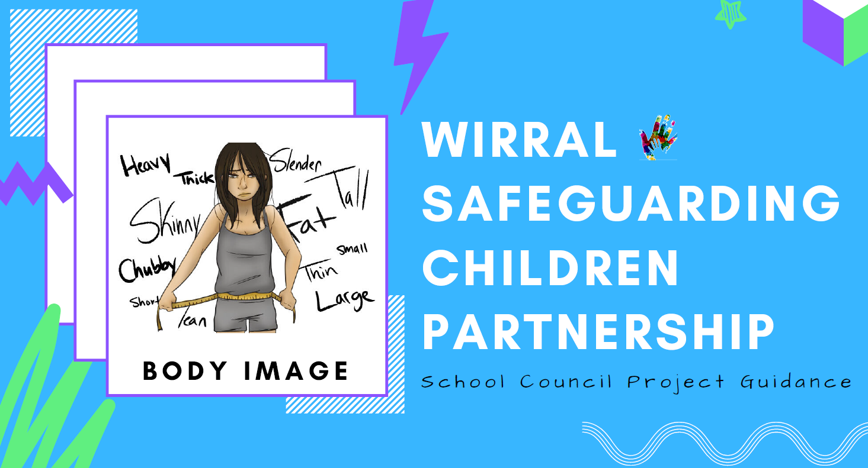
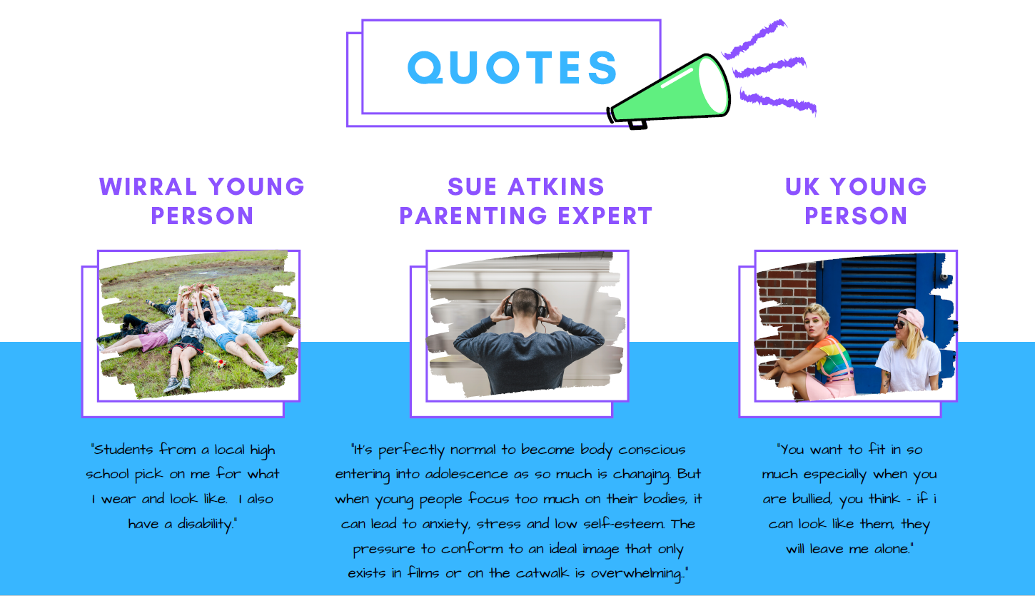
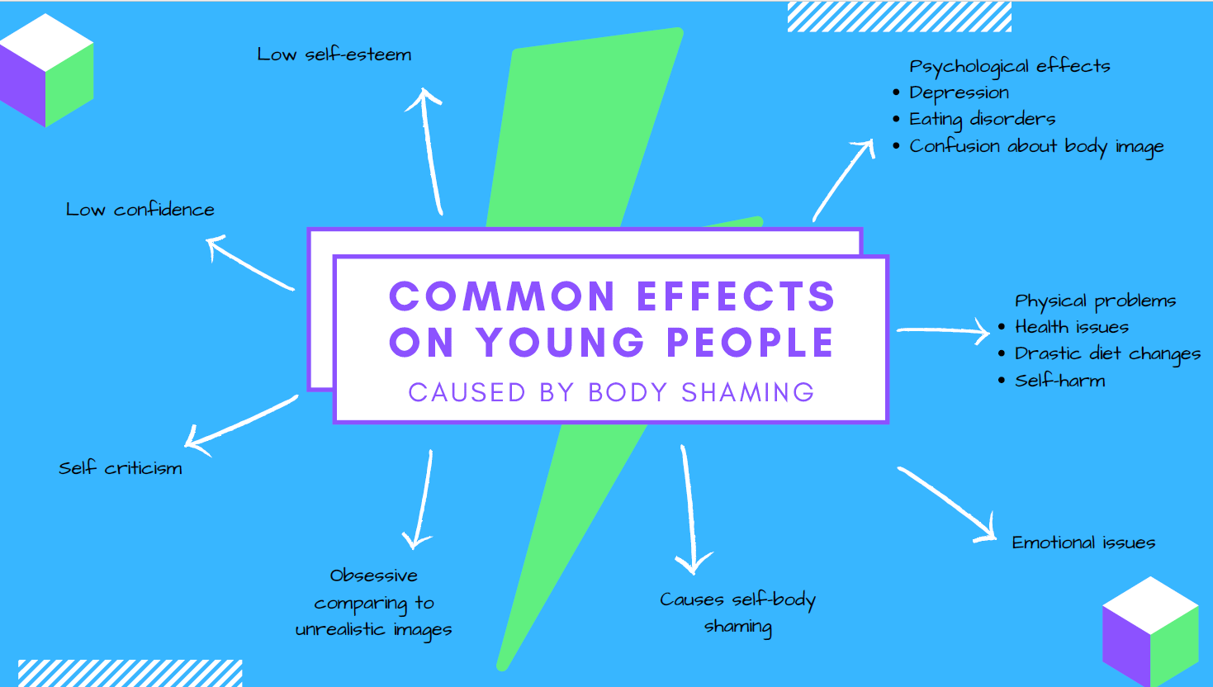
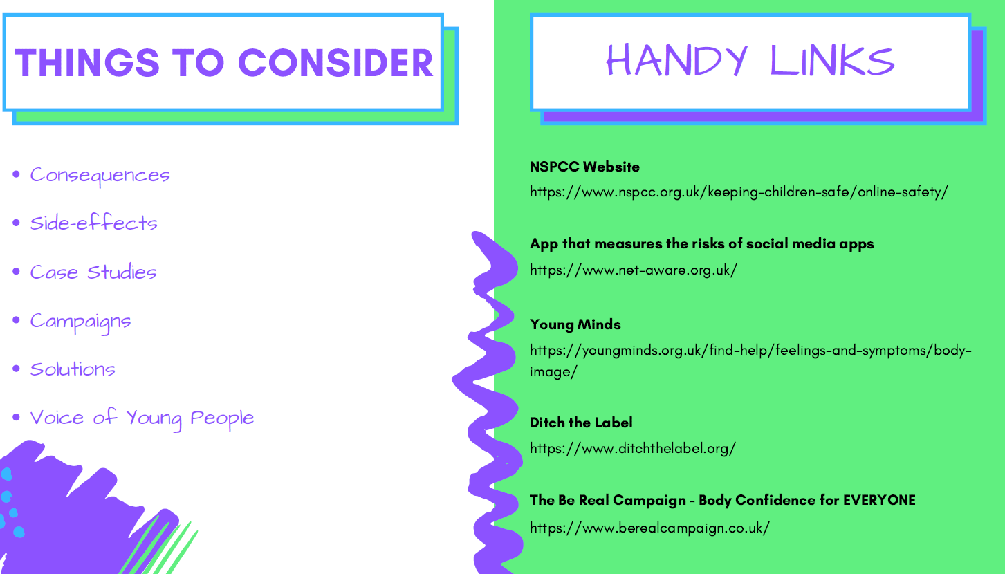
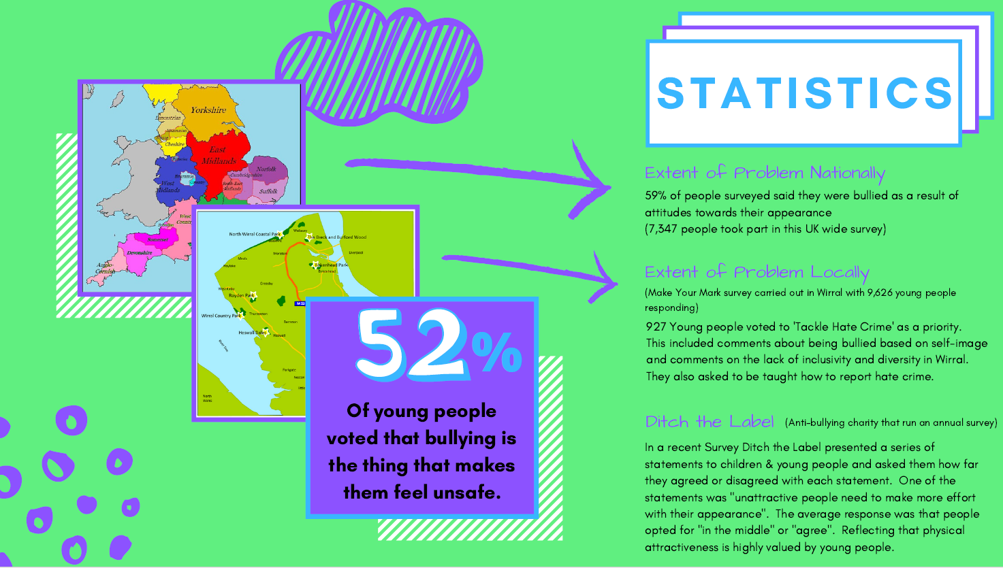
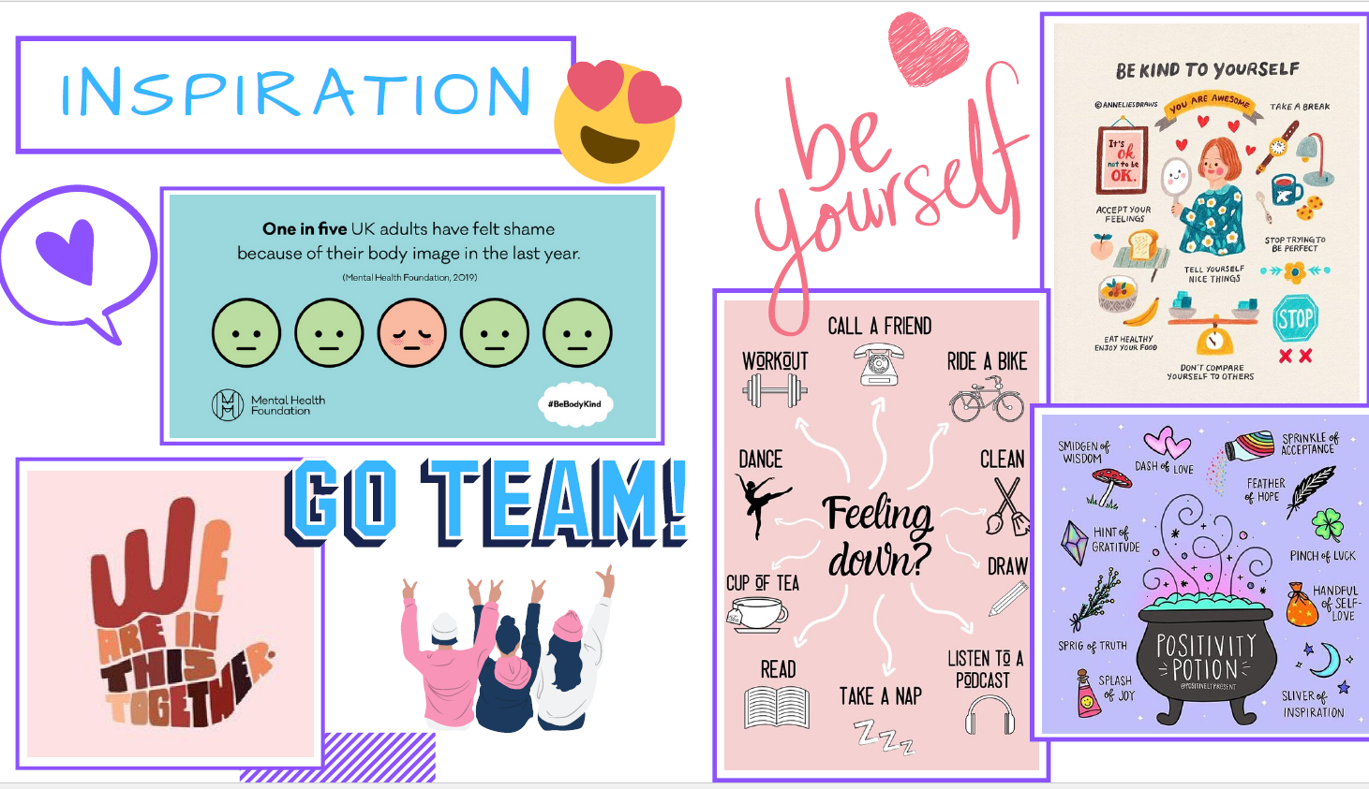
Emotional Health and Wellbeing
Projects being trialled with Primary schools:

Slide 29

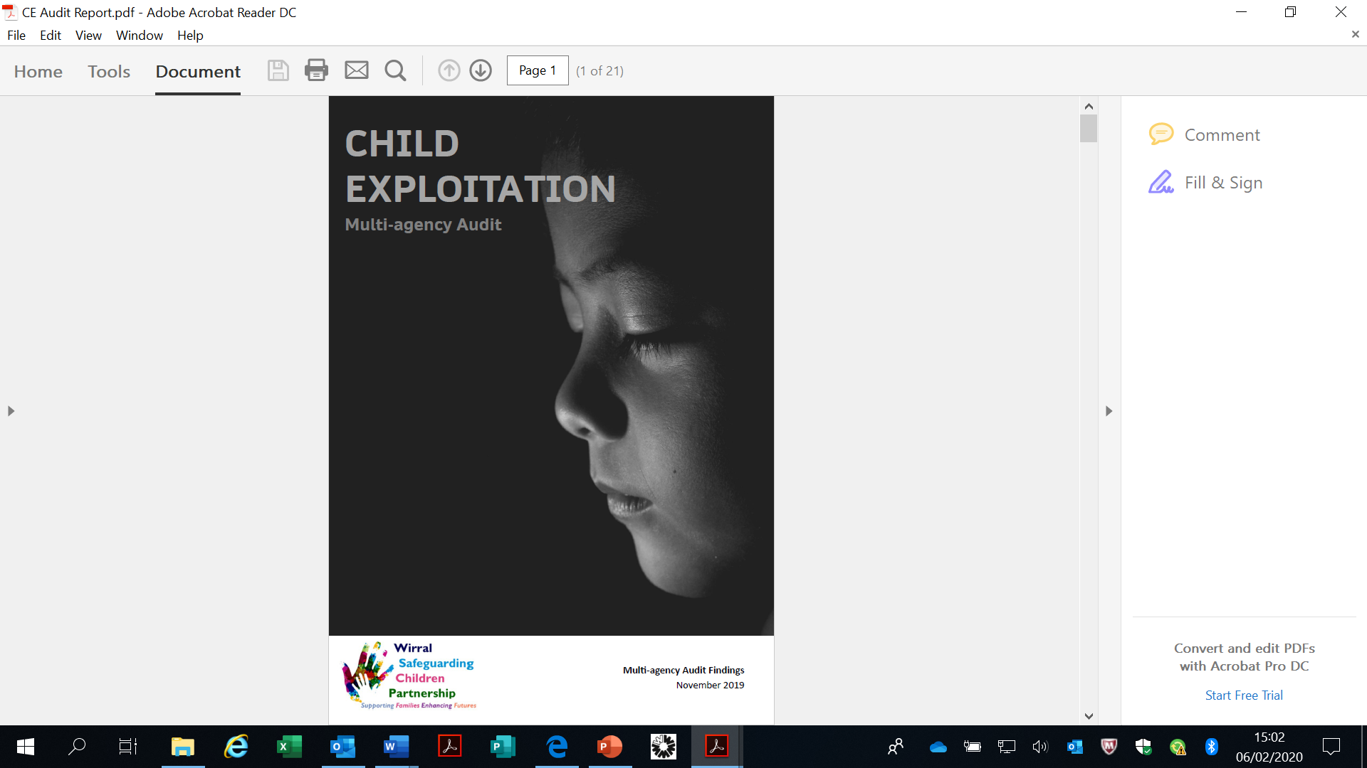

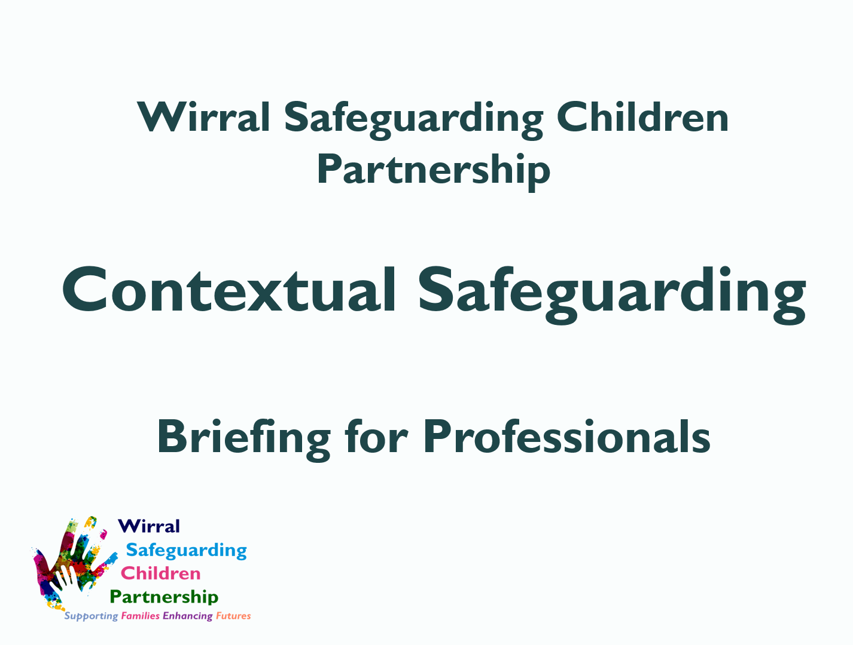
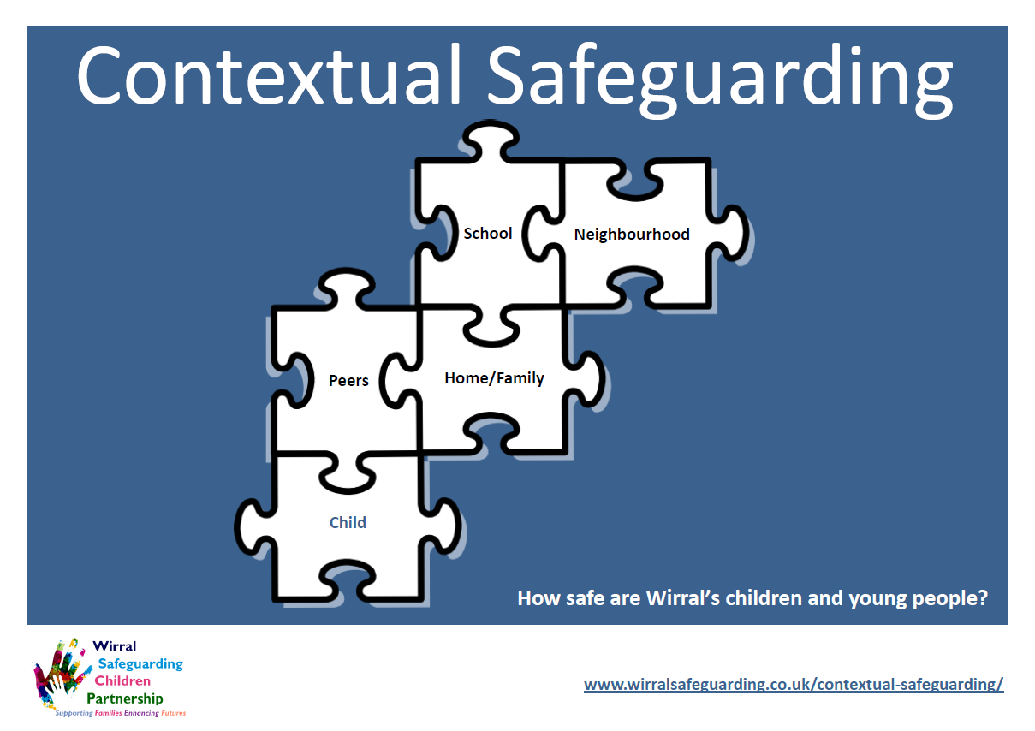
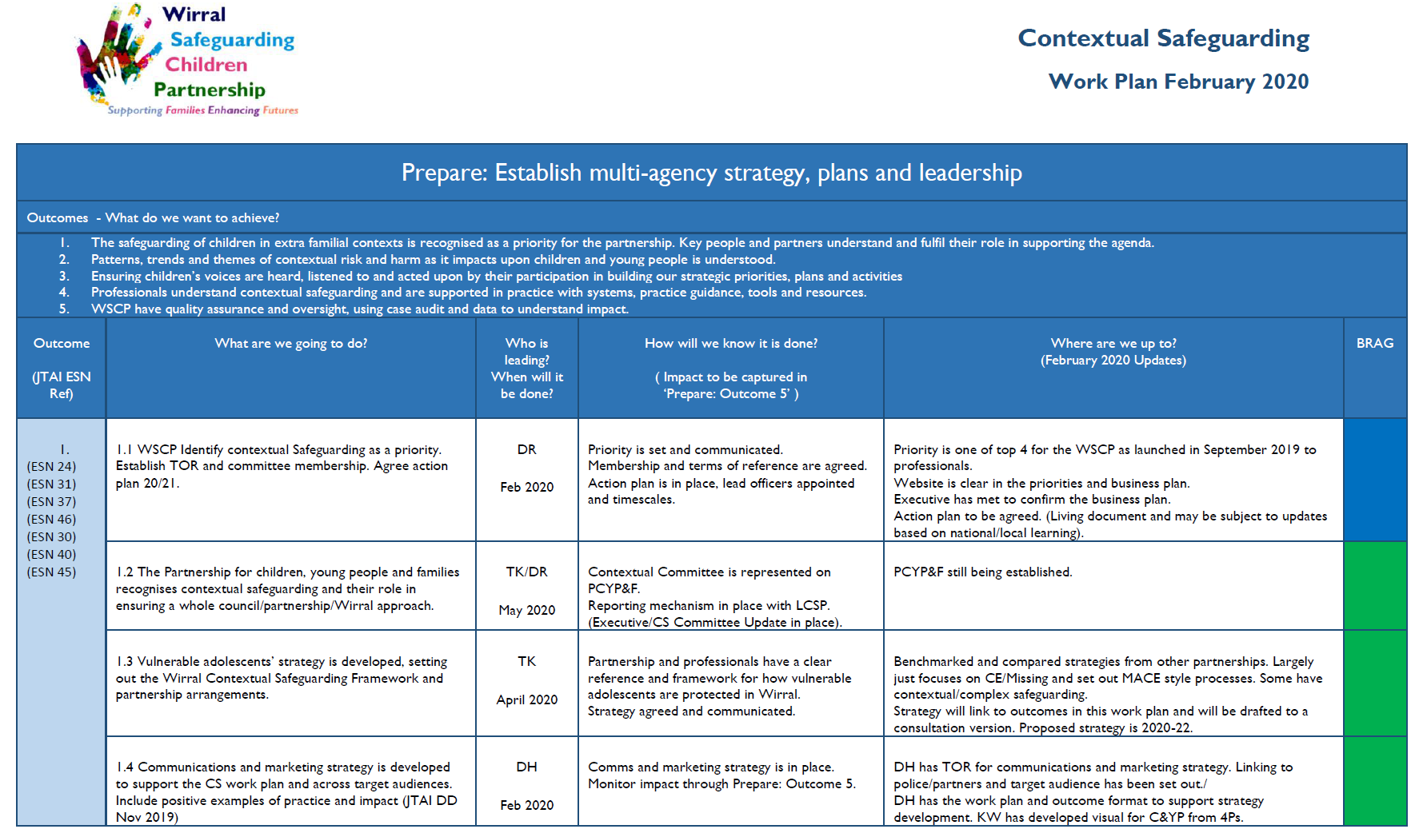
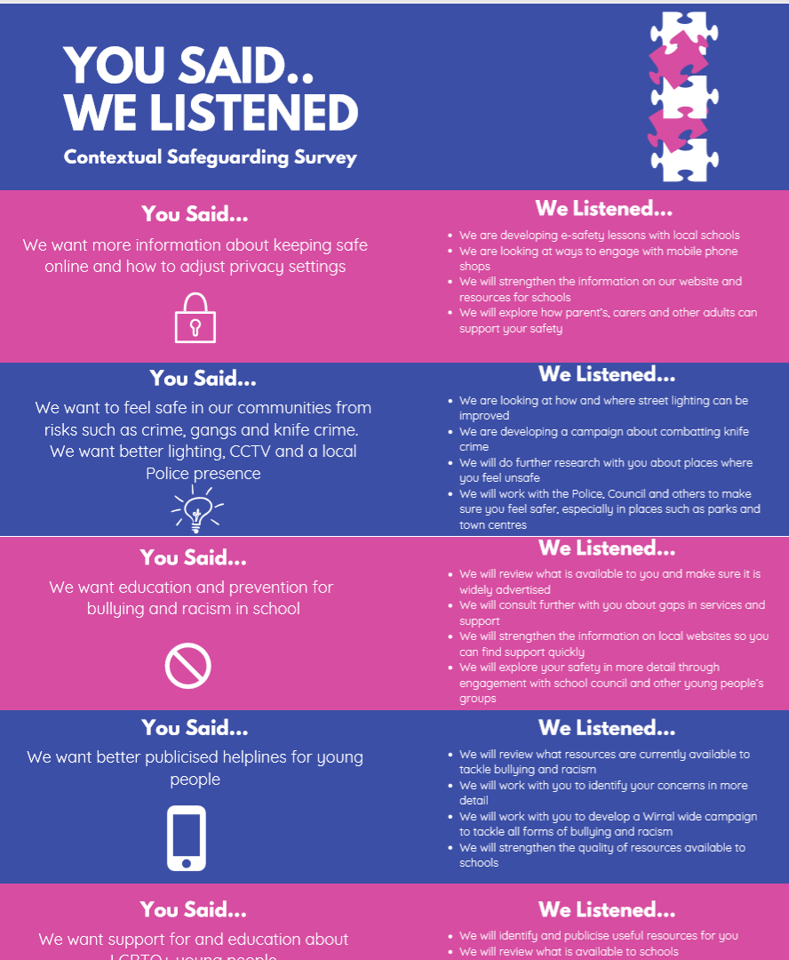
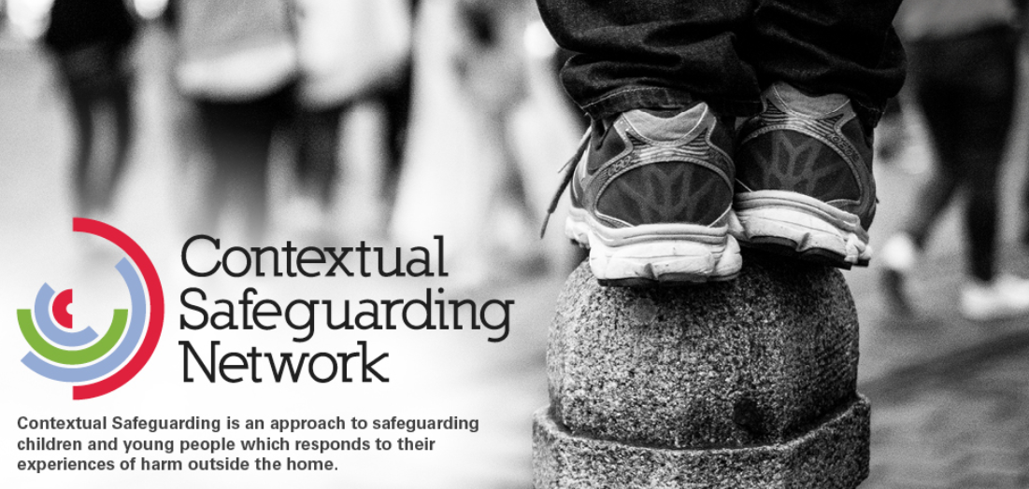
2. Contextual Safeguarding
New Contextual Safeguarding Committee – with action plan
Multi-agency Training delivered since January 2019 – now updated
Contextual Safeguarding Survey completed by 2000+ young people
CE Audit completed and National CSPR on CE published
Behind the Mask drama commissioned
Local intelligence gathered and reviewed

Slide 30
3. Intergenerational Abuse
Children and young people are protected from intergenerational abuse and neglect and partners work together to break the cycle
Recent deep dive audit revealed risks to children of ‘gateway’ families
Ongoing case reviews will provide learning about breaking the generational cycle of neglect
Local and national research will help direct partnership work in this area

Slide 31
4. Working Together
• All children and young people have a right to be safe from abuse and neglect;
• All our work is underpinned by the principles of the UN Convention on the Rights of the Child;
• Children and young peoples' well-being and safety will be at the heart of all our work;
• All children and young people are unique, and all our work will consider and address issues of diversity and vulnerability;
• Agencies and their staff have a shared responsibility to work together and safeguard children and young people and promote their welfare;
• Prevention strategies will be an important aspect of our work to safeguard children and young people;
• The active involvement of children, young people and their families will be incorporated in our work.
Agreement of Principles:
Embedding SFEF

Slide 32
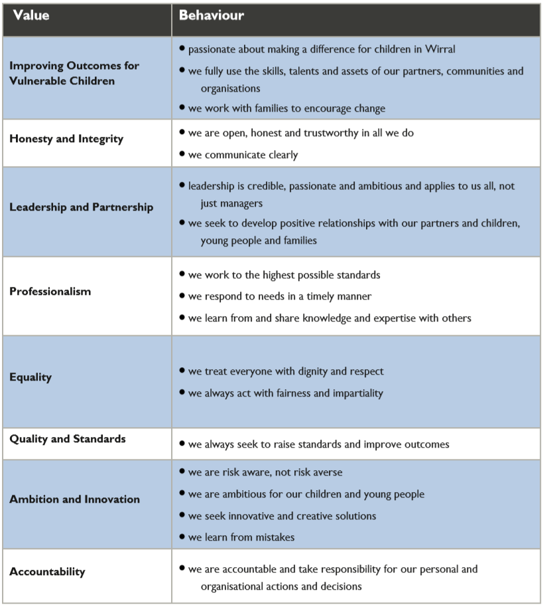
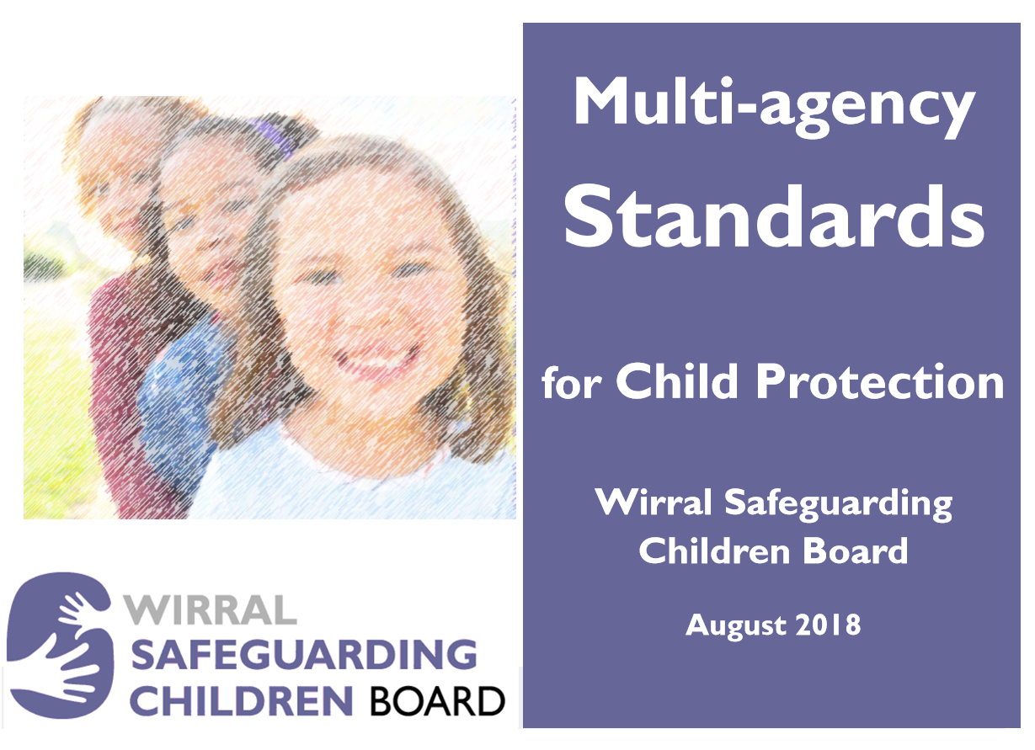

4. Working Together
Agreement of Values and Behaviours
Next stage is to test, and test compliance with agreed standards:

Slide 33

Case Reviews
Serious
Case Review
Child K

Slide 34
Current Status of Case Reviews
One SCR Published – Child Liam (methadone ingestion) – Feb 20
One CSPR underway– Child L (sexual assault) – July 20
Two multi-agency learning reviews underway: Children 16 (neglect) – April 20; Child 18 (exploitation) – July 20
Two pending cases: Child 19 (neglect); Child 20 (suicide)
Three active action plans (1 SCR, 1 LR)

Slide 35
Focus on Neglect
Neglect is a significant features of two recent learning reviews (and 44% of all local reviews undertaken since 2012 have neglect as a feature)
Early learning from these reviews tells us:
  professionals struggle to identify neglect, especially long-term neglect
  professional curiosity is lacking
  use of evidence-based tools such as GCP2 is still very rare – challenge to partners

Slide 36
‘Liam’ Serious Case Review
Liam, aged 20 months, was admitted to hospital with potentially fatal methadone poisoning. Parents both treated for addiction
At that point, Liam was a child in care, placed with his mother
Liam was subject of a care order as he had sustained serious head injuries when ML had dropped him, as a new-born, and had concealed this from medical practitioners
His mother didn’t engage in proceedings very well. No parenting assessment completed but all children placed at home with mother

Slide 37
‘Liam’ Serious Case Review
Lack of understanding about drugs testing falsely reassured professionals (as did involvement of substance misuse service)
Impact of substance misusing parent not understood (or of a parent prescribed methadone)
Liam’s father remained on periphery of family as far as professionals were concerned
Change of professionals and lack of supervision hampered oversight and assessment
Professionals often over optimistic about progress

Slide 38
‘Liam’ Serious Case Review
Following incident of methadone ingestion parents arrested and children removed from mother’s care
Significant learning for the partnership:
  understanding of substance misuse (including methadone) needs to be better understood
  placement with parent’s procedure needs to be reviewed
  professionals must balance optimism with objective evidence
  father’s must be included in relevant assessments

Slide 39
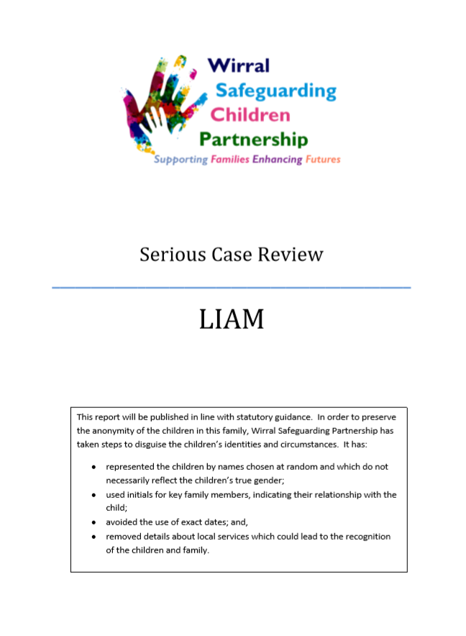
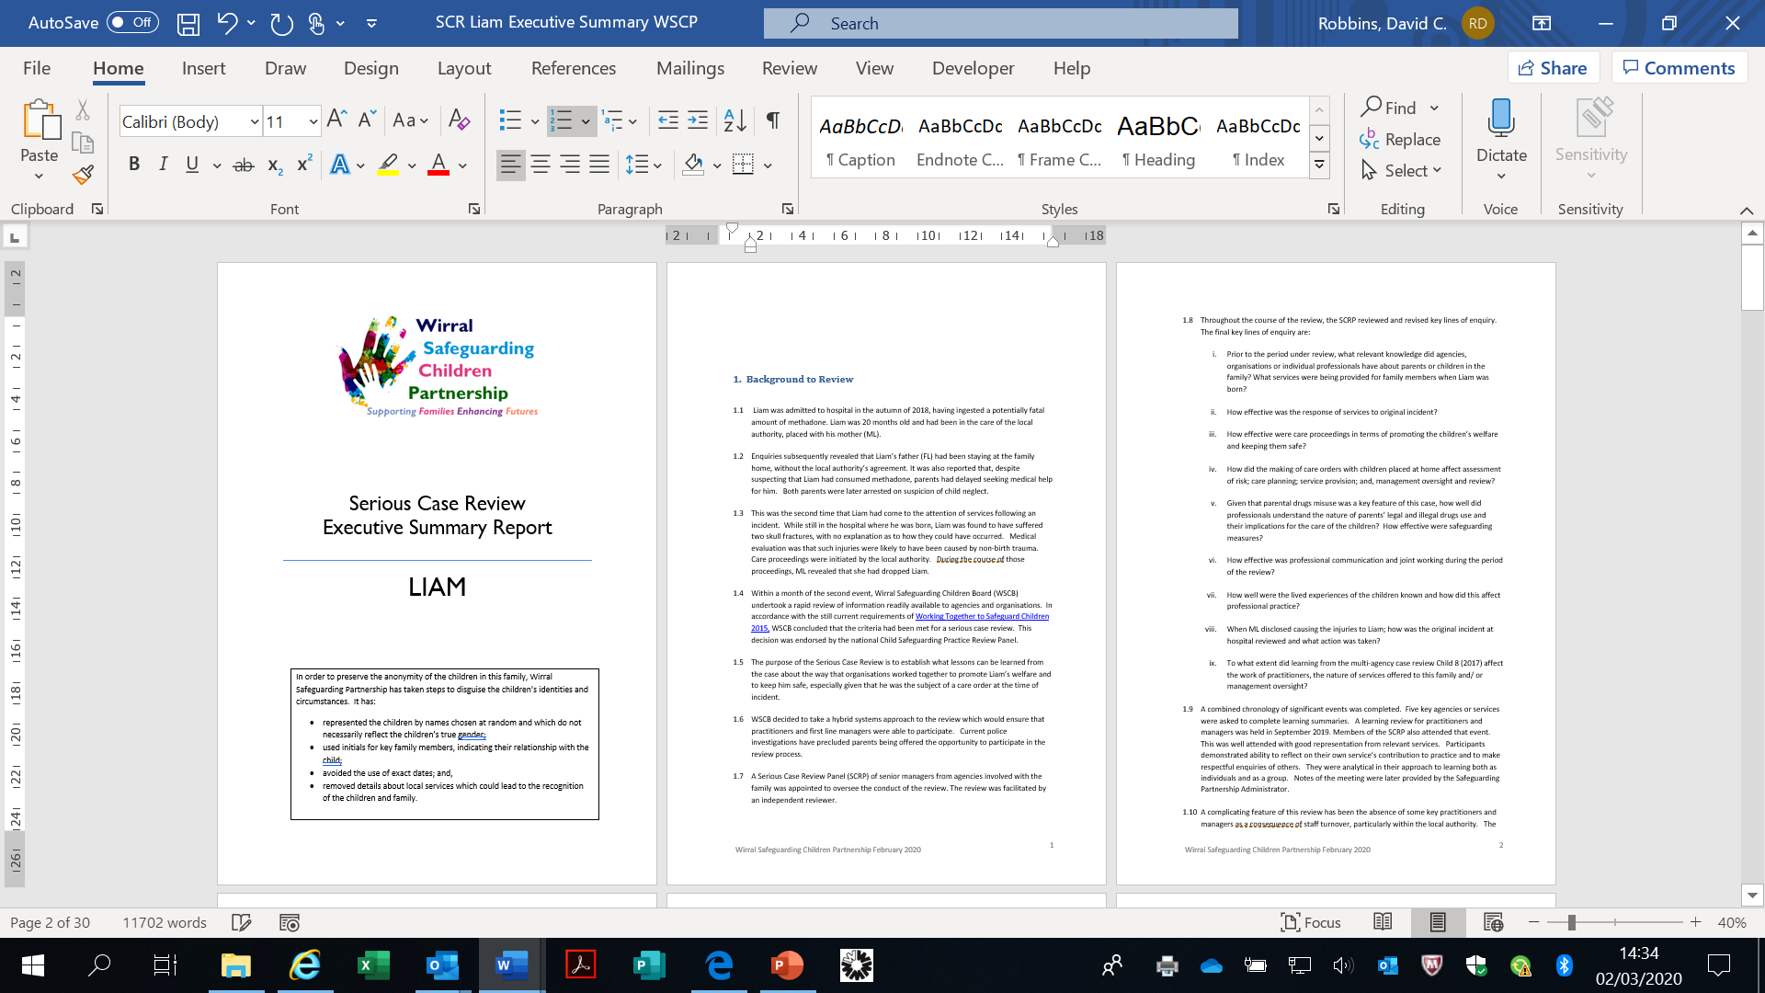
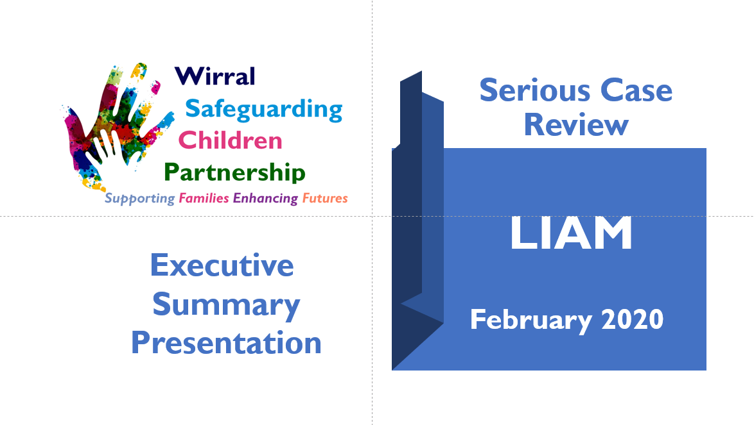
‘Liam’ Serious Case Review
SCR Report
Exec Summary
Powerpoint

Slide 40
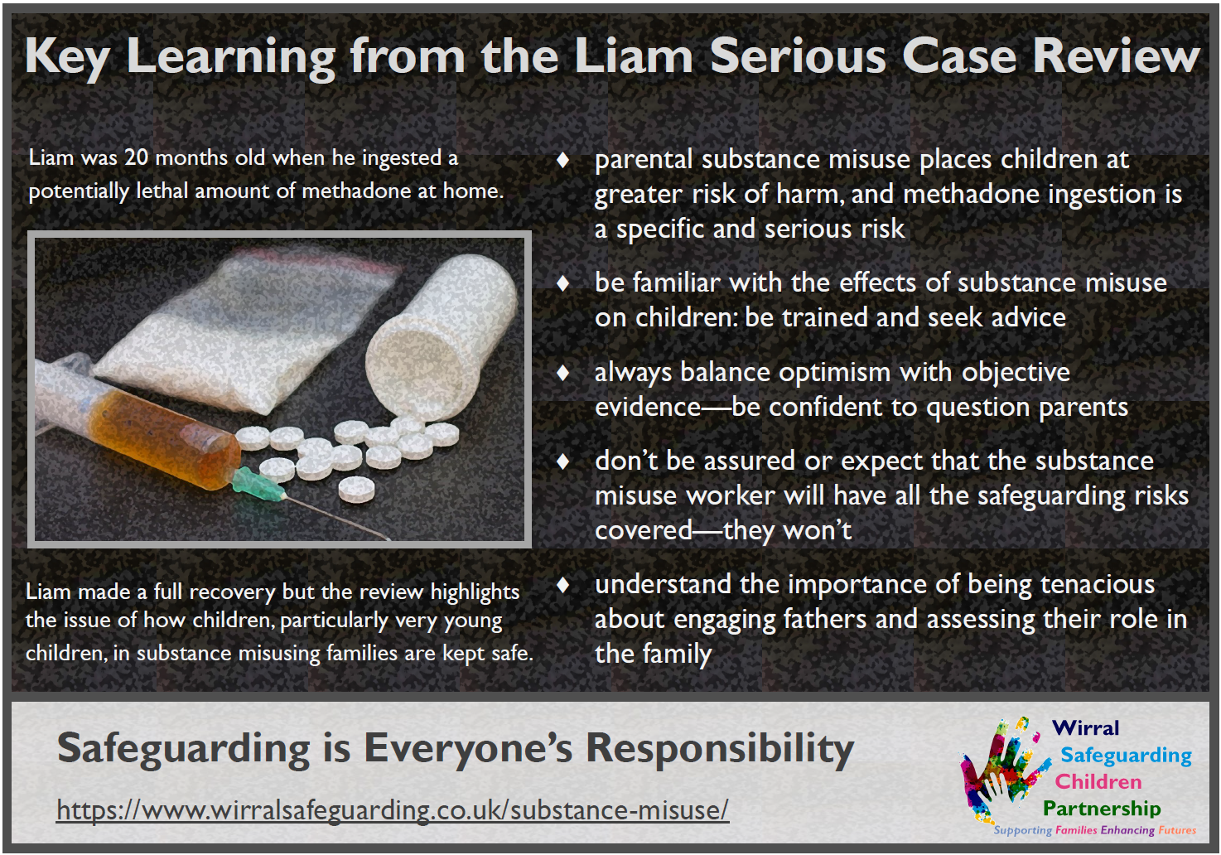
‘Liam’ Serious Case Review
Learning Poster

Slide 41
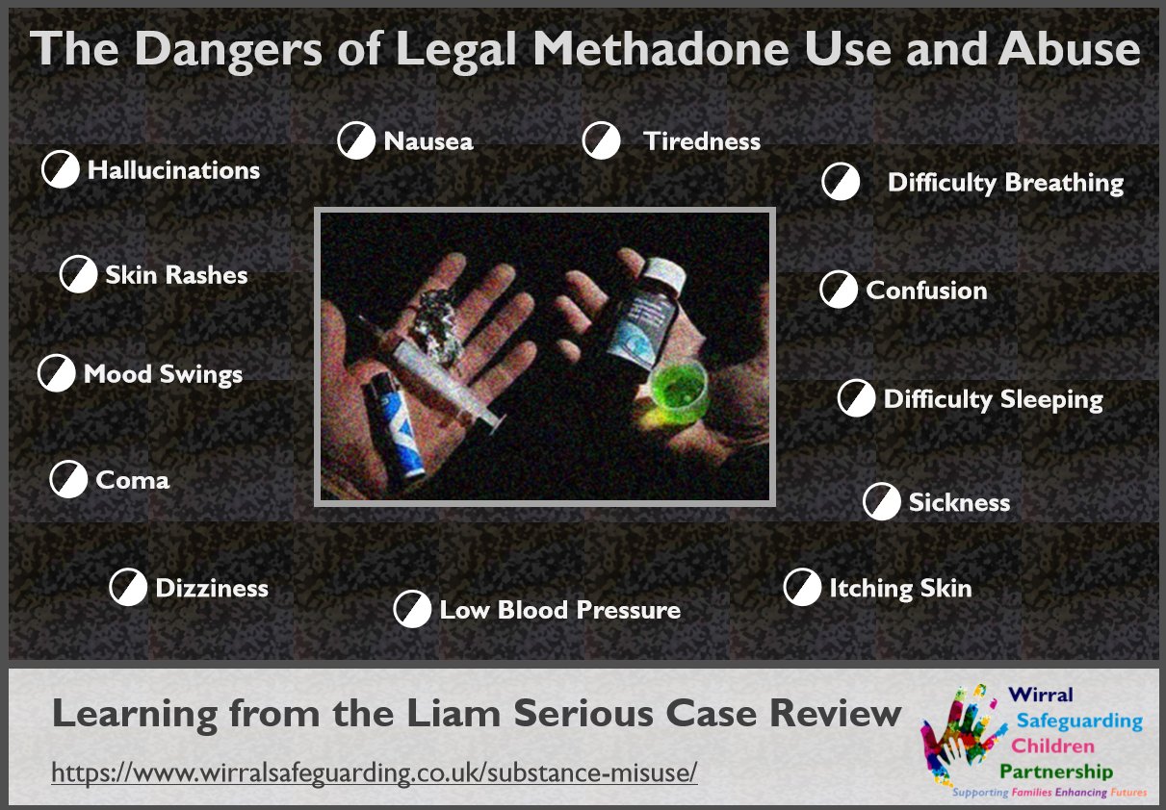
‘Liam’ Serious Case Review
Learning Poster

Slide 42


Focus on Supporting Families Enhancing Futures
S F E F

Slide 43
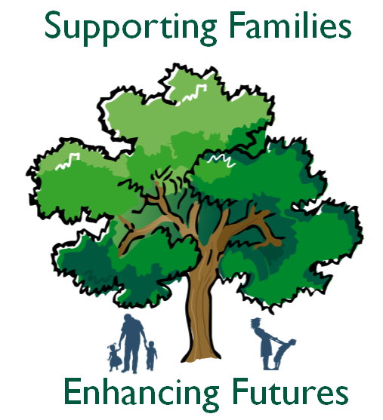
What is SFEF?
Supporting Families Enhancing Futures is a child centred approach used across the continuum of need that enables professionals to gain an insight into the world of the child(ren) and adults by capturing their lived experiences, ensuring actions and interventions to improve outcomes are child focused.

Slide 44
SFEF
SFEF is the agreed multi-agency model for working with Wirral children, young people and families
SFEF was launched in October 2017
since 2017

Slide 45
SFEF – Key Features
i.e. why we should be using it
SFEF provides insight into the daily lived experience of children and adults
It identifies both strengths and concerns which are RAG rated
It is outcome focused and centred on the child
It supports professional curiosity
It supports open multi-agency working and the trusted professional

Slide 46
SFEF – Is it Embedded in Practice?
Evidence so far would suggest that SFEF isn’t embedded in practice within or across agencies
WSCP is committed to ensuring partners are supported to be able to embed SFEF
SFEF is the agreed model in Wirral
Observations from Stockport will be very helpful

Slide 47
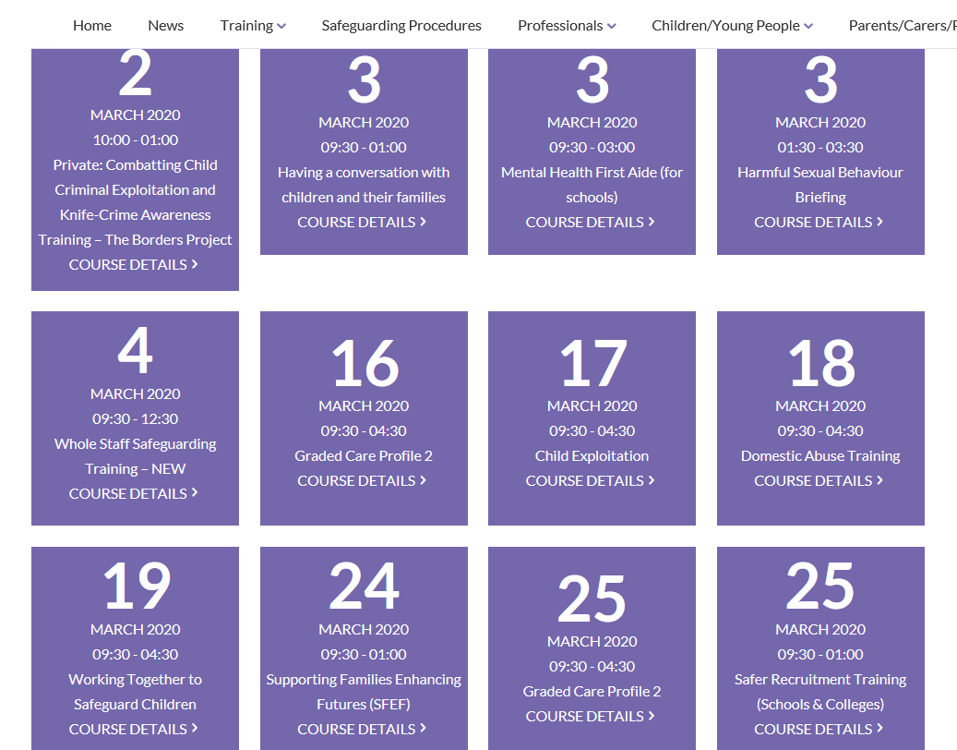

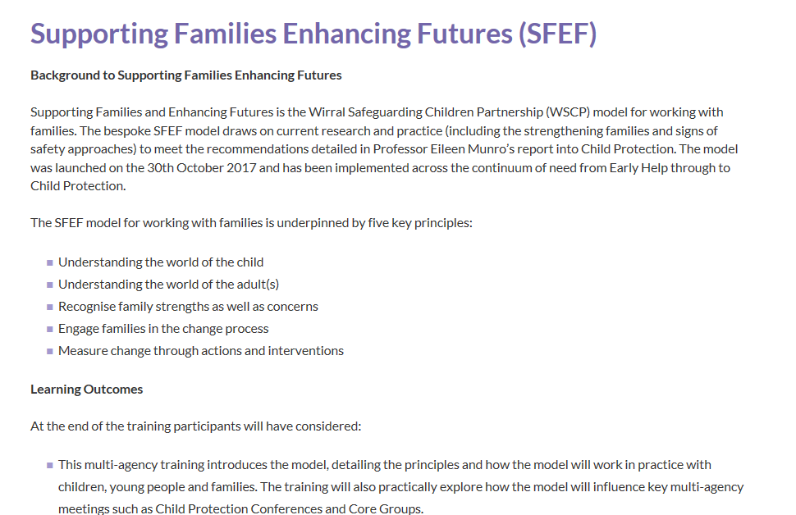
Training for Professionals
SFEF Training is a staple of the WSCP calendar
A comprehensive programme of multi-agency training and briefings in place
Briefings by Lynne Elton, SFEF Practice Lead

Slide 48
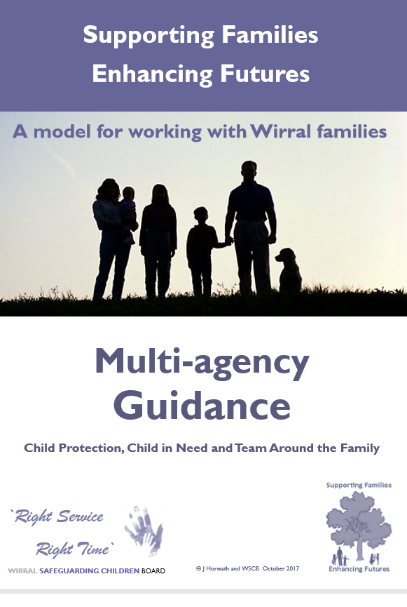
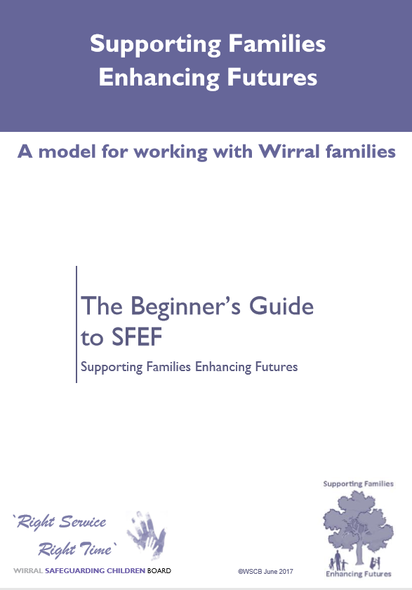

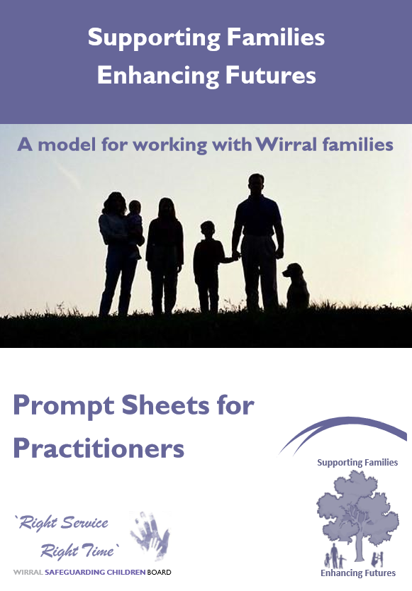
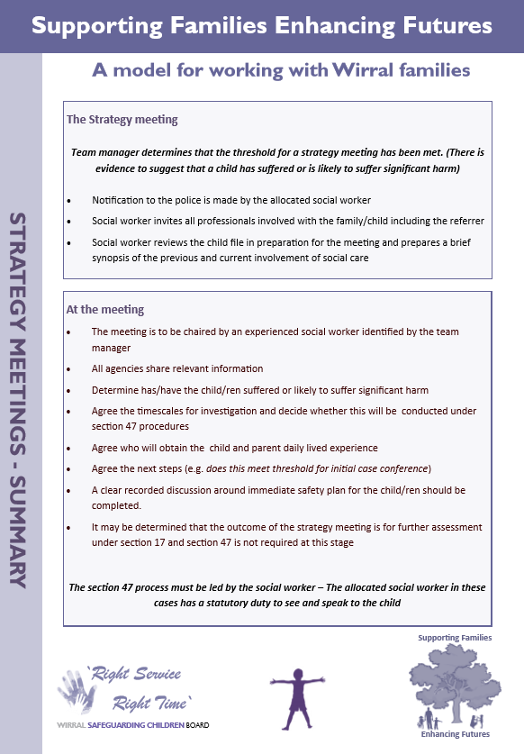
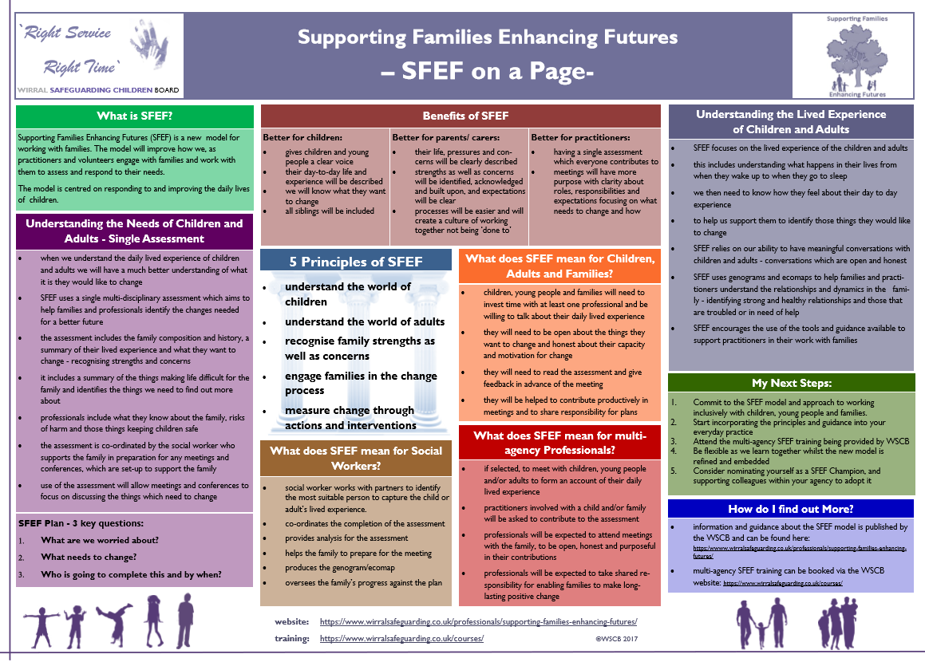
HighlightingSFEF
A dedicated webpage with 25+ resources including practice guidance, beginners guide, prompts for professionals and information sheets.

Slide 49
SFEF – Embedding SFEF in Practice
Challenges to Relevant Agencies:
Have your staff attended SFEF training? Do you need support with this? How is the training applied in practice?
Is SFEF actively promoted in your organisation? Is it embedded in practice? Discussed in supervision? Tested in audit?
Is the daily lived experience, of children and adults, being captured? How do you know?
Do you have good practice examples to share?

Slide 50
SFEF – Task
Partner agencies will be invited to share feedback/ thoughts from tabletop exercise

Slide 51

Break

Slide 52

Independent Scrutiny – First 6 months Report

Slide 53
Independent Scrutiny
Independent scrutiny of safeguarding arrangements is a statutory requirement and is designed to provide assurance in judging the effectiveness of multi-agency arrangements to safeguard and promote the welfare of all children.
Safeguarding partners should ensure independent scrutiny is objective, acts as a constructive critical friend and promotes reflection to drive continuous improvement.
Working Together 2018

Slide 54
Independent Scrutiny
Voice of children and young people crucially important to the scrutiny process
Emerging reflections and findings after the first 5-6 months of working under the new model:

Slide 55
1. The establishment of the partnership
The WSCP was established through collaboration and co-construction
The model built on the learning and development approach of the WSCB
Partnership participation and consultation was wide & strong
Partnership benefits from a strong relationship with LA Scrutiny Committee

Slide 56
2. How the partnership was developed in practice
The three-layer model (Practice, Services, Governance) was well thought out and suited Wirral
The unique, bespoke SFEF model is at the centre of practice
Strong relationships need to be forged with other significant groups including the emerging Children’s Partnership
Governance layer to ensure communication is strong

Slide 57
3. Configuration, terms of reference, membership and attendance of subcommittees
Not having a multi-membership Board is a challenge for the statutory safeguarding partners and relevant agencies
Greater responsibility now sits with committees
The three statutory partners must hold themselves and all agencies to account, and ensure that communication is strong
The start, so far, has been positive

Slide 58
4. The work undertaken to date: reasons to celebrate
Executive has grown and developed in a short space of time to be focused and strategic– momentum is strong
Wirral’s Be The Difference campaign highlights positive and inspirational work that is making the difference to C and YP
Wirral CRC has been leading vital work on improving support for children of prisoners
Real quality and depth of discussion emerging in committees, including focus on outcomes rather than processes

Slide 59
4. (continued) The work undertaken to date: reasons to celebrate
Partner agencies are honest and transparent about their own agencies’ practice
Case Review committee highlighted for the strength, frankness and thoroughness of its work
Accountability meetings with Relevant Agencies revealed honesty and showed appetite for change
Training offer and Section 11/175 auditing are strengths

Slide 60
5. The work to come next: areas for continued development
Pace cannot slacken as the partnership continues its journey to good and outstanding
The embedding and commitment to SFEF is crucial
Consideration needed to add a layer in the partnerships structure between the Executive and committees to ensure work is ‘joined up’ and key messages are communicated
Relevant agencies desire opportunities for involvement

Slide 61
The Scrutineer’s work in coming months:
Continue to attend and observe meetings
Meet with partner relevant agencies (contact DR to arrange a meeting)
Meet with Children and Young People’s groups
Meet with elected members, members of other statutory and non statutory groups
Prepare an annual report in September

Slide 62
Scrutiny– Task
Partner agencies will be invited to share feedback/ thoughts from tabletop exercise

Slide 63

Focus on Early Help

Slide 64
Focus on Early Help
to be populated

Slide 65
Focus on Early Help
to be populated

Slide 66
Early Help – Task
Partner agencies will be invited to share feedback/ thoughts from tabletop exercise

Slide 67
End of Presentation
https://www.wirralsafeguarding.co.uk/

