Slide 1
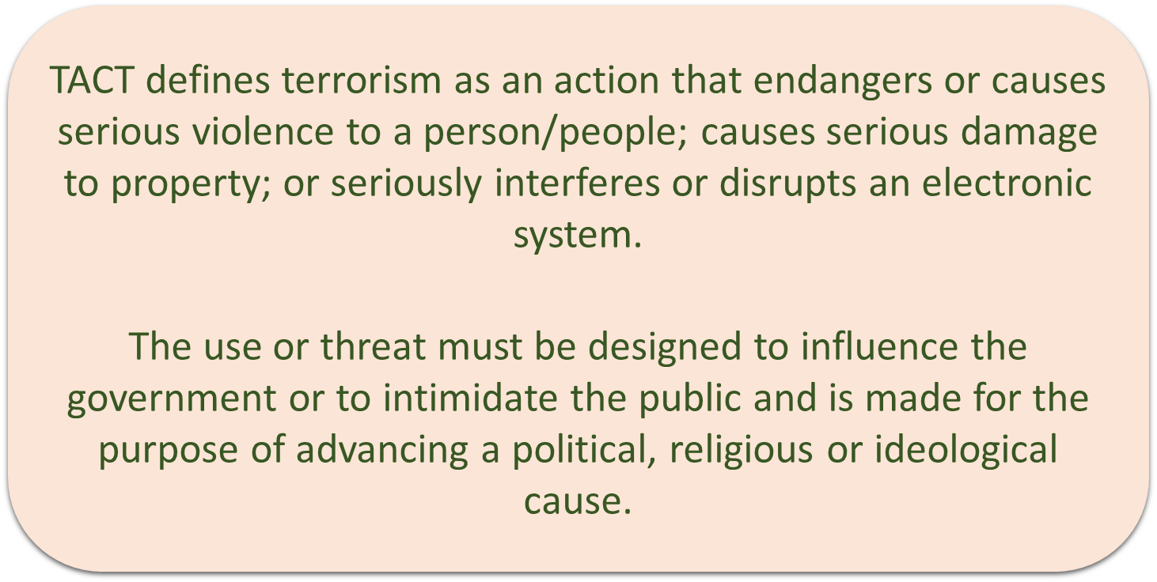

Slide 2
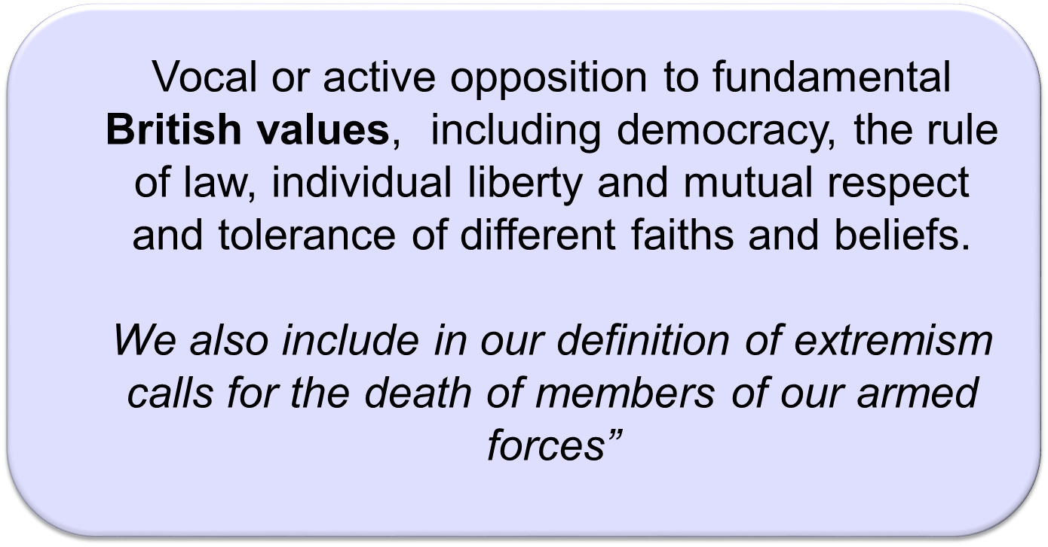

Slide 3
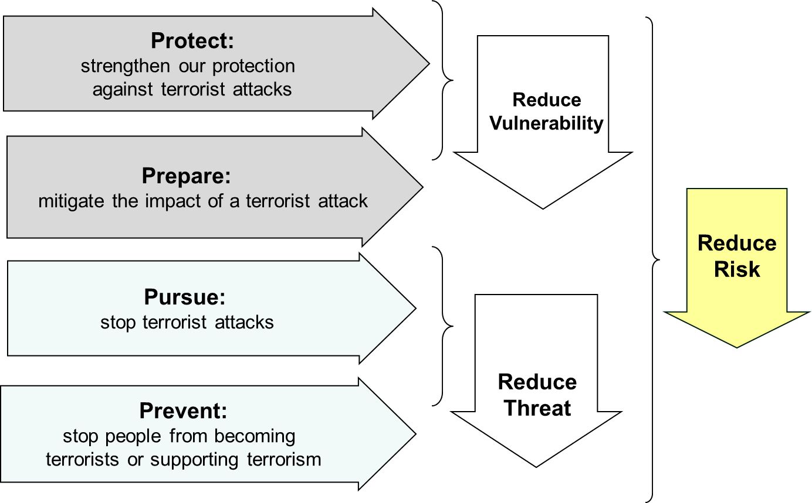

Slide 4
“Safeguarding vulnerable people from radicalisation is no different from safeguarding them from other forms of harm”
Home Office, The Prevent Strategy

Slide 5
expression of extreme or violent views
accessing or sharing radical and extremist sites/ YouTube clips
graffiti on school books (symbols of XFR and Daesh)
prejudicial behaviour
change in physical appearance - specific tattoos
withdrawn – when previously very sociable
aggressive behaviour
suddenly very outspoken on a particular issue – prescriptive speech
closed to new ideas or views

Slide 6
18
88
14
28
23

Slide 7
Far right numbers
18
88
14
28
23
1 = A 8 = H
Far right code for Adolf Hitler
8 = h, 88 = HH
Heil Hitler
Neo Nazi greeting/salute
We must secure the existence of our people and a future for White children
2 = B, 8 = H
The number represents
Blood & Honour
23 = W
This simply means White

Slide 8












Far-right symbols
Nazi swastika
C18 Death’s Head/
SS logo
Triskele – Christian FR
Racist Celtic cross
C18 number badge
British Movement
National Action
Ku Klux Klan
Identarian Symbol
Odal Rune
Creativity Alliance
Fascist Logo

Slide 9
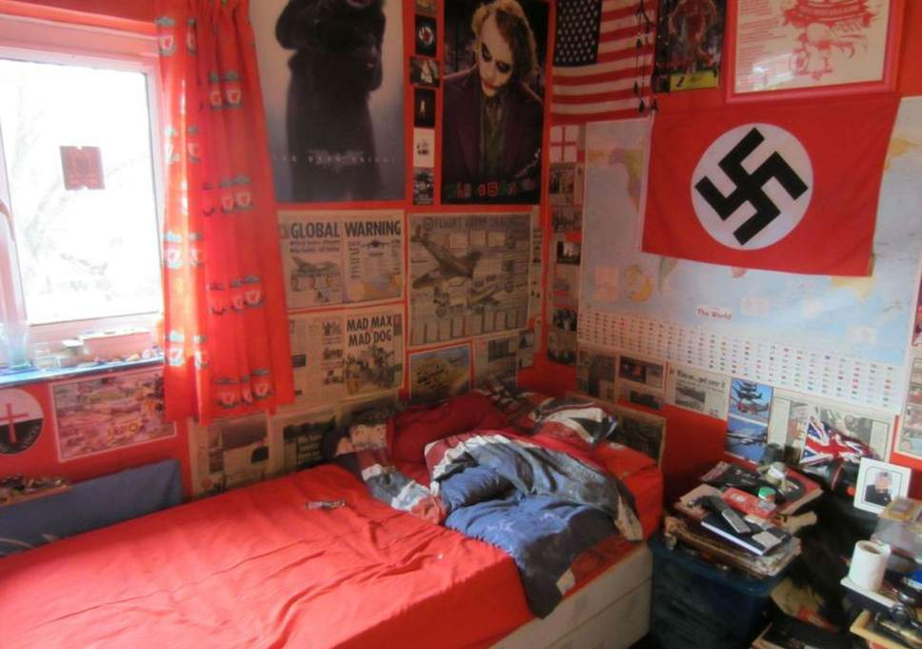

Slide 10

As the Mail points out, the symbol of the Knights Templar, which has inspired both the English Defence League and Anders Breivik, can be seen on the left of the photograph.

Slide 11





Slide 12
The local Channel programme
A multi-agency referral process which provides support for those who may be vulnerable from being drawn into terrorism
The Channel panel is chaired and hosted by the local authority.
(1) Confidential and (2) Voluntary
Types of Support
  Diversionary activity
  Sports participation
  Faith Groups
  Education support
  Housing
  Skills training
  Mentorship
  Employment support
  Theological/ Political
Referral Process
Referral is received
Information gathered by local authority
Multi-agency discussion panel
Risk assessment carried out
-----------------------------------------
Voluntary intervention
Post intervention assessment

Slide 13
Should you or your teams require any verbal advice on completing the forms or general information regarding Channel / Prevent referrals –
Declan Sammin Channel Supervisor on 0151 233 0343 or 07394559105 declan.sammin@liverpool.gov.uk
Alison Burnett, Single point of contact for Liverpool & Wirral:
07394559106
Alison.Burnett@liverpool.gov.uk
Claire Wright, Single point of contact for Sefton, Knowsley & St. Helens: 07934559107
Claire.Wright@liverpool.gov.uk
Bev Hurst, Single point of contact for Cheshire:
07394559108
Bev.Hurst@liverpool.gov.uk

