Slide 1

Proposal for pan Merseyside Level of Need Windscreen Model for Children
Colin Briscoe
Preventative Policing Project
Multi Agency Safeguarding Hub (MASH)
Project Sponsor: ACC Julie Cooke
Project Lead: Superintendent Paul White

Slide 2
Contents
1.0 Current Merseyside LON Windscreen Models
2.0 Current levels, common factors and proposed wording
3.0 Current Overarching principals, common factors and proposed wording
4.0 Proposal of pan Merseyside Windscreen Model

Slide 3
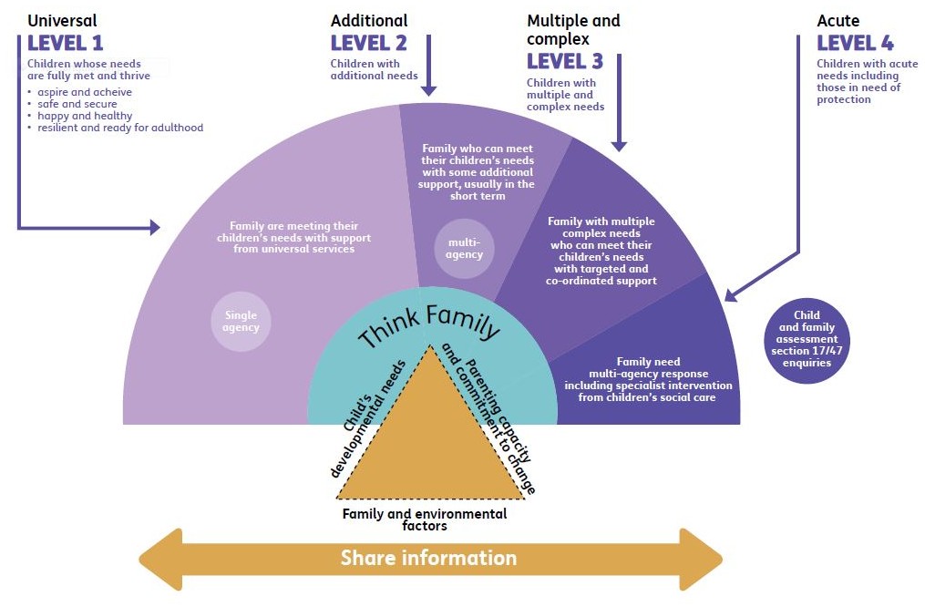
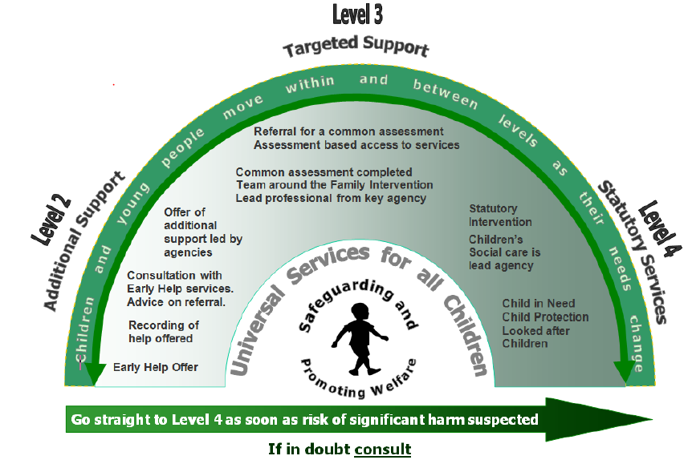
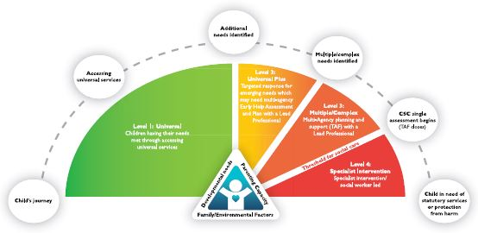
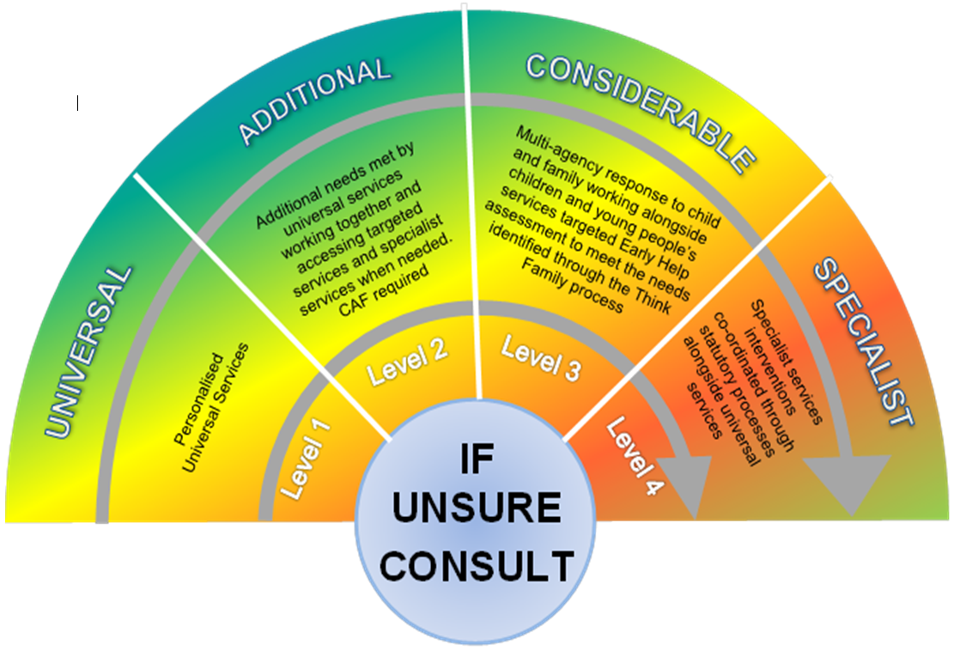
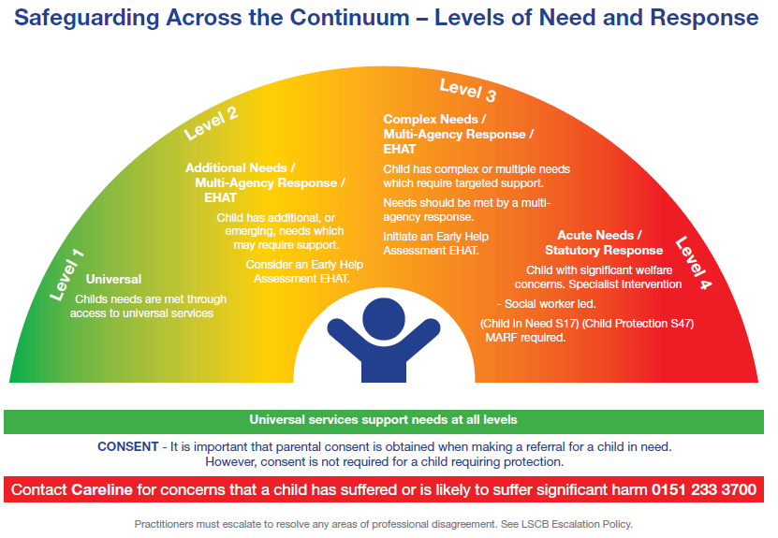
1.0 Current Merseyside LON Windscreen Models
Sefton
Wirral
Knowsley
St Helens
Liverpool
Notes:
5 different models – differing complexity in diagram and wordings
1 very clear – what would a practitioner want to see when viewing the Levels of Need Documents

Slide 4
1.1 Problem and Purpose
Problem
There are five different windscreen models pan Merseyside of varying complexity in design
Merseyside Police works with all five boroughs using these differing models
Merseyside Police is centralising a Vulnerable Persons Referral Unit and implementing technological changes to serve the five boroughs
Purpose
To analyse the five windscreen models, assess common ground and propose a pan Merseyside model
To assess and share best practice pan Merseyside
To standardise referral mechanisms from the Police Vulnerable Persons Referral Unit pan Merseyside
Notes:
This is the first proposal for consideration – for discussion on presentation with partner agency leads.
To be shared with LSCB legal / trainers etc. for future decisions to be made.

Slide 5
2.0 Current levels and common factors - Level 1
Boroughs | Sefton | Wirral | Knowsley | St Helens | Liverpool
Wording outside windscreen | Children whose needs are fully met and thrive aspire and achieve Safe and secure Happy and healthy Resilient and ready for adulthood |  | Child’s journey Accessing universal services
Headings | Universal | Universal Services | Universal | Universal | Universal
Wording within windscreen | Family are meeting their children’s needs with support from universal services Single Agency | Has needs met within universal provision (e.g. schools, GP’s). May need limited intervention to avoid needs (Not on Windscreen from at-a-glance doc) | Children having their needs met through accessing universal services | Personalised universal services | Childs needs are met through access to universal services
Notes:
Green wording demonstrates the numerous similarities in wordings between boroughs – Child’s Journey only in Knowsley
Wirral does not have a Level 1 displayed on diagram

Slide 6
2.1 Proposed Level 1 wording
Boroughs | Pan Merseyside
Wording outside windscreen
Headings | Universal
Wording within windscreen | Childs needs are met through access to universal services
Notes:
This is the first proposal for consideration – for discussion on presentation with partner agency leads.
To be shared with LSCB legal / trainers etc. for future decisions to be made.

Slide 7
2.2 Current levels and common factors - Level 2
Boroughs | Sefton | Wirral | Knowsley | St Helens | Liverpool
Wording outside windscreen | Children with additional needs |  | Additional Needs Identified
Headings | Additional | Additional Support | Universal Plus | Additional | Additional Needs / Multi-Agency Response / EHAT
Wording within windscreen | Family who can meet their children’s needs with some additional support, usually in the short term (Multi-Agency) | Offer of additional support led by agencies. Consultation with Early Help services. Advice on referral. Recording of help offered. Early Help Offer. | Targeted response for emerging needs which may need multi-agency Early Help Assessment and Plan with a lead professional | Additional needs met by universal services working together and accessing targeted services and specialist services when needed. CAF required. | Child has additional, or emerging, needs which may require support. Consider an Early Help Assessment EHAT.
Notes:
Sefton uses Multi-Agency in Windscreen wording but Single Agency in LON Guidance wording /Wirral uses Single Agency in LON Guidance
Some words not shared surprising like working together St Helens……..CAF no longer used in Working Together 2018
Universal Plus not different enough from Level 1

Slide 8
2.3 Proposed Level 2 wording
Boroughs | Pan Merseyside
Wording outside windscreen
Headings | Additional Needs
Wording within windscreen | Child with additional or emerging needs who may require multi-agency targeted support and an Early Help Assessment.

Slide 9
2.4 Current levels and common factors - Level 3
Boroughs | Sefton | Wirral | Knowsley | St Helens | Liverpool
Wording outside windscreen | Children with Multiple and Complex needs |  | Multiple Complex Needs Identified
Headings | Multiple and Complex | Targeted Support | Multiple Complex | Considerable | Complex Needs / Multi-Agency Response / EHAT
Wording within windscreen | Family with multiple complex needs who can meet their children’s needs with targeted and co-ordinated support | Referral for a Common Assessment. Assessment based access to services. Common Assessment completed. Team around the Family Intervention. Lead professional from key agency. | Multi-Agency planning and support (TAF) with a lead professional | Multi-agency response to child and family working alongside children and young peoples services, targeted Early Help assessment to meet the needs identified through the Think Family process. | Child has complex or multiple needs which required targeted support. Needs should be met by a multi-agency response. Initiate an Early Help Assessment EHAT.
Notes:
Working Together 2018 – does not include CAF - now centred around Early Help evidential based assessments

Slide 10
2.5 Proposed Level 3 wording
Boroughs | Pan Merseyside
Wording outside windscreen
Headings | Multiple and Complex Needs
Wording within windscreen | Child has multiple and complex needs requiring targeted Multi-Agency support with a lead professional to initiate an Early Help Assessment.

Slide 11
2.6 Current levels and common factors - Level 4
Boroughs | Sefton | Wirral | Knowsley | St Helens | Liverpool
Wording outside windscreen | Children with acute needs including those in need of protection Child and family assessment section 17/47 enquiries |  | CSC Single Assessment begins (TAF closes) Child in need of statutory services or protection from harm
Headings | Acute | Statutory Services | Specialist Intervention | Specialist | Acute Needs / Statutory Response
Wording within windscreen | Family need multi-agency response including specialist intervention from children’s social care | Statutory Intervention. Children’s Social Care is the lead agency. Child in Need. Child Protection. Looked after Children. | Specialist Intervention Social worker led | Specialist services interventions co-ordinated through statutory processes alongside universal services | Child with significant welfare concerns. Specialist intervention - Social worker led. (Child in Need S17) (Child Protection S47) MARF required.
Notes:
Surprising that significant harm / multi-agency is not shared across boroughs

Slide 12
2.7 Proposed Level 4 wording
Boroughs | Pan Merseyside
Wording outside windscreen
Headings | Statutory Services
Wording within windscreen | Statutory response with specialist services intervention led by Children’s Social Care, to decide whether the child is a child in need (section 17), or is suffering or likely to suffer significant harm (section 47).

Slide 13

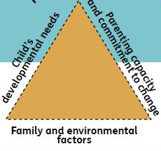



3.0 Current Overarching principals and common factors
Boroughs | Sefton | Wirral | Knowsley | St Helens | Liverpool
Wording | Think Family | Children and young people move within and between levels as their needs change Universal Services for all Children | Child’s Journey
Universal services support needs at all levels
Consent – It is important that parental
consent is obtained when making a referral
for a child in need.
However, consent is not required for a child
requiring protection.
Contact Careline for concerns that a child has
suffered or is likely to suffer significant harm
0151 233 3700
Practioners must escalate to resolve any areas
of professional disagreement. See LSCB
Escalation Policy.
Share Information
(Threshold for
Social Care
Between LON 3 and 4)
Go straight to Level 4 as soon as risk of significant harm is suspected
If in doubt consult
Notes:
Perhaps the biggest difference of information displayed
If a professional consults the models, they will need information that is easy to understand quickly

Slide 14
3.1 Overarching principals proposal
If unsure consult
Notes:
I have chosen the child image so that any child is at the centre of all our thoughts and actions
Liverpool’s image is also the simplest figure form
The wording to be kept to a minimum so it’s immediately obvious to users

Slide 15
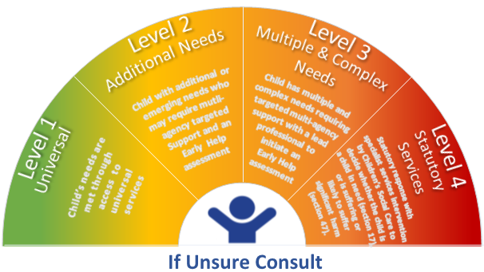
4.0 Proposed pan Merseyside Windscreen Model

Slide 16
Any Questions?

