Slide 1

Launch of Multi-agency Safeguarding Arrangements
26th September 2019 v2 DRAFT

Slide 2

Welcome and Introduction from the Safeguarding Partners
https://www.wirralsafeguarding.co.uk/

Slide 3

Agenda for the Morning
Welcome
Presentation of the WSCP Model inc. Case Reviews
Contextual Safeguarding Survey Results
WSCP Priorities for 19-21
Launched Today
Independent Scrutiny
#bethedifference
NSPCC
https://www.wirralsafeguarding.co.uk/

Slide 4
Slido
This event is using Slido (https://www.sli.do/ enter code K336) to enable you to send and respond to questions before and during the event
WiFi password for the Floral Pavilion is: to be added
https://www.wirralsafeguarding.co.uk/

Slide 5
Introduction
The Children and Social Work Act 2017 replaced Local Safeguarding Children Boards (LSCBs) with new local safeguarding arrangements, led by the three statutory safeguarding partners:
  Wirral Council (Paul Boyce)
  Merseyside Police (Rachel Wilson)
  Wirral Clinical Commissioning Group (Lorna Quigley)
It also includes new child death review arrangements led by the Council and CCG
https://www.wirralsafeguarding.co.uk/

Slide 6
Purpose of new Local Arrangements
to support and enable local relevant agencies to work together in a system where:
excellent practice is the norm
partner agencies hold one another to account effectively
there is early identification of ‘new’ safeguarding issues
learning is promoted and embedded
information is shared effectively
the public can feel confident that children are protected from harm
https://www.wirralsafeguarding.co.uk/

Slide 7



Overview of the WSCP Model
https://www.wirralsafeguarding.co.uk/

Slide 8



New Arrangements in Wirral
There are 3 central parts to the model:
3. Governance
arrangements developed last to ensure they reflect how we want the model to work
2. Services
Strong partnership arrangements are crucial to the success of the model. This includes how we arrange services to ensure positive outcomes for children
1. Practice
Developing excellent practice will be the basis of the model. Supporting Families Enhancing Futures approach will sit at the centre of our approach and include shared values and behaviours

Slide 9
A Local Partnership Approach
The local model includes approaches to :
• arrangements to ensure children receive the right help at the right time – including publication of thresholds
• a model and methodology for undertaking local reviews
• continued development and evaluation of SFEF
• arrangements for monitoring, scrutiny and challenge
• arrangements for embedding and testing of learning
• arrangements for multi-agency training
• local governance arrangements including relationships with other bodies and the mechanisms for independent scrutiny and annual reporting
https://www.wirralsafeguarding.co.uk/

Slide 10
A Regional Approach
Opportunities for local and regional collaboration will be pursued where beneficial. This will include:
Policies and Strategy
Workforce Development and sharing learning
Communication
Child Death Reviews
Approaches to Section 11/175 Audits
Approaches to Case Reviews
Peer Reviews
https://www.wirralsafeguarding.co.uk/

Slide 11

Overview of Model
Statutory Safeguarding Partners Executive Group
This is the statutory ‘holding to account’ function of the partnership
Group includes LA, Police, Health, committee chairs and other agencies as required
https://www.wirralsafeguarding.co.uk/

Slide 12
Overview of Model
Wirral Safeguarding Partnership Group
Statutory Safeguarding Partners Executive Group
The partnership group is the ‘stakeholder’ group including representation from relevant agencies and the wider community. You are all part of this group
https://www.wirralsafeguarding.co.uk/

Slide 13
Overview of Model
Wirral Safeguarding Partnership Group
Statutory Safeguarding Partners Executive Group
Business Intelligence & QA Unit
Business Unit
  Forums/ Focus Groups
  Feedback from Inspections and Peer Reviews
  Feedback CYP and Families
  Local Policies and Procedures
QA Committee
S11/175 & Audit Activity
  Performance Data and thematic/agency reports
  Frontline Practitioners Group
Case Review Committee
statutory reviews
  multi-agency learning reviews
Training Committee and Pool
multi-agency and single agency
training
Local Policies and Procedures
This is the function which provides the partners with data and intelligence from audit, reviews, feedback, training etc.
https://www.wirralsafeguarding.co.uk/

Slide 14
Overview of Model
Wirral Safeguarding Partnership Group
Statutory Safeguarding Partners Executive Group
Multi-agency groups maintaining oversight of key safeguarding issues and processes and feeding back into the Executive.
Business Intelligence & QA Unit
Safeguarding Vulnerable Children Groups
Business Unit
  Forums/ Focus Groups
  Feedback from Inspections and Peer Reviews
  Feedback CYP and Families
  Local Policies and Procedures
QA Committee
S11/175 & Audit Activity
  Performance Data and thematic/agency reports
  Frontline Practitioners Group
Case Review Committee
statutory reviews
  multi-agency learning reviews
Training Committee and Pool
multi-agency and single agency
training
Local Policies and Procedures
Child Exploitation and Missing (including Contextual Safeguarding)
Domestic Abuse and Harmful Practices Steering Group
(through DA alliance)
Evidencing Outcomes Group
(including oversight of SFEF)
Themed Task and Finish Groups (Commissioned by Partners e.g. GCP2, Thresholds, Priorities)
https://www.wirralsafeguarding.co.uk/

Slide 15
Overview of Model
Wirral Safeguarding Partnership Group
Pan Merseyside
Statutory Safeguarding Partners Executive Group
Overseen by Business Unit
Policies and Strategy
Workforce Development
Communication
Child Death Reviews³
Reciprocal Peer Reviews
Business Intelligence & QA Unit
Safeguarding Vulnerable Children Groups
Business Unit
  Forums/ Focus Groups
  Feedback from Inspections and Peer Reviews
  Feedback CYP and Families
  Local Policies and Procedures
QA Committee
S11/175 & Audit Activity
  Performance Data and thematic/agency reports
  Frontline Practitioners Group
Case Review Committee
statutory reviews
  multi-agency learning reviews
Training Committee and Pool
multi-agency and single agency
training
Local Policies and Procedures
Child Exploitation and Missing (including Contextual Safeguarding)
Domestic Abuse and Harmful Practices Steering Group
(through DA alliance)
Evidencing Outcomes Group
(including oversight of SFEF)
Regional Collaboration
Themed Task and Finish Groups (Commissioned by Partners e.g. GCP2, Thresholds, Priorities)
https://www.wirralsafeguarding.co.uk/

Slide 16
Overview of Model
Independent Scrutiny of arrangements
Wirral Safeguarding Partnership Group
Pan Merseyside
Statutory Safeguarding Partners Executive Group
Overseen by Business Unit
Policies and Strategy
Workforce Development
Communication
Child Death Reviews³
Reciprocal Peer Reviews
Business Intelligence & QA Unit
Safeguarding Vulnerable Children Groups
Business Unit
  Forums/ Focus Groups
  Feedback from Inspections and Peer Reviews
  Feedback CYP and Families
  Local Policies and Procedures
QA Committee
S11/175 & Audit Activity
  Performance Data and thematic/agency reports
  Frontline Practitioners Group
Case Review Committee
statutory reviews
  multi-agency learning reviews
Training Committee and Pool
multi-agency and single agency
training
Local Policies and Procedures
Scrutiny of arrangements led by Maggie Atkinson
Child Exploitation and Missing (including Contextual Safeguarding)
Domestic Abuse and Harmful Practices Steering Group
(through DA alliance)
Evidencing Outcomes Group
(including oversight of SFEF)
Themed Task and Finish Groups (Commissioned by Partners e.g. GCP2, Thresholds, Priorities)
https://www.wirralsafeguarding.co.uk/

Slide 17
Overview of Model
Independent Scrutiny of arrangements
Wirral Safeguarding Partnership Group
Pan Merseyside
Statutory Safeguarding Partners Executive Group
Overseen by Business Unit
Policies and Strategy
Workforce Development
Communication
Child Death Reviews³
Reciprocal Peer Reviews
MoU’s with statutory partnership arrangements and Commissioning Groups
Business Intelligence & QA Unit
Safeguarding Vulnerable Children Groups
Business Unit
  Forums/ Focus Groups
  Feedback from Inspections and Peer Reviews
  Feedback CYP and Families
  Local Policies and Procedures
QA Committee
S11/175 & Audit Activity
  Performance Data and thematic/agency reports
  Frontline Practitioners Group
Case Review Committee
statutory reviews
  multi-agency learning reviews
Training Committee and Pool
multi-agency and single agency
training
Local Policies and Procedures
Child Exploitation and Missing (including Contextual Safeguarding)
Domestic Abuse and Harmful Practices Steering Group
(through DA alliance)
Relationships with other statutory bodies and groups
Evidencing Outcomes Group
(including oversight of SFEF)
Themed Task and Finish Groups (Commissioned by Partners e.g. GCP2, Thresholds, Priorities)
https://www.wirralsafeguarding.co.uk/

Slide 18

Final Model
Independent Scrutiny of arrangements
Wirral Safeguarding Partnership Group
Pan Merseyside
Statutory Safeguarding Partners Executive Group
Overseen by Business Unit
Policies and Strategy
Workforce Development
Communication
Child Death Reviews³
Reciprocal Peer Reviews
MoU’s with statutory partnership arrangements and Commissioning Groups
Business Intelligence & QA Unit
Safeguarding Vulnerable Children Groups
Business Unit
  Forums/ Focus Groups
  Feedback from Inspections and Peer Reviews
  Feedback CYP and Families
  Local Policies and Procedures
QA Committee
S11/175 & Audit Activity
  Performance Data and thematic/agency reports
  Frontline Practitioners Group
Case Review Committee
statutory reviews
  multi-agency learning reviews
Training Committee and Pool
multi-agency and single agency
training
Local Policies and Procedures
Child Exploitation and Missing (including Contextual Safeguarding)
Strength of the model is the strength of multi-agency participation
Domestic Abuse and Harmful Practices Steering Group
(through DA alliance)
Evidencing Outcomes Group
(including oversight of SFEF)
Especially here
Themed Task and Finish Groups (Commissioned by Partners e.g. GCP2, Thresholds, Priorities)
https://www.wirralsafeguarding.co.uk/

Slide 19

Child Safeguarding Practice Reviews
https://www.wirralsafeguarding.co.uk/

Slide 20
Child Safeguarding Practice Reviews
In the new arrangements SCR’s are replaced by Local Child Safeguarding Practice Reviews
Reviews are triggered by notification of incidents to the National Child Safeguarding Review Panel by the Local Authority
Notifications should be made for all cases where:
  abuse or neglect of a child is known or suspected and
  the child has died or been seriously harmed
The LA has 5 days to make the notification
https://www.wirralsafeguarding.co.uk/
Act will replace LSCB’s with new local arrangements by Sept 2019 (1st Sept. in Wirral)
In the new arrangements SCR’s are replaced by Local Child Safeguarding Practice Reviews
New National Child Safeguarding Review Panel will consider all notifications of serious incidents and commission any National Reviews
Safeguarding partners are required to undertake a rapid review within 15 working days following any notifications
Child Safeguarding Practice Panel will be consider the case and makes a decision on whether an SCR is undertaken at either a national or local level.

Slide 21
The Rapid Review
The National Panel require the safeguarding partners to undertake a Rapid Review on any referred cases
The aim of the rapid review is to:
- gather the facts about the case
- determine whether a Local Safeguarding Practice Review should take place
- discuss whether there is any immediate action needed to ensure children’s safety
- identify and share and immediate learning
The partners have 15 days to undertake the rapid review
https://www.wirralsafeguarding.co.uk/

Slide 22
Outcomes
Outcomes from the rapid review include:
- undertaking a local child safeguarding practice review
- advising the Panel that a national review needs to be undertaken
- undertaking a (no-statutory) multi-agency learning review
- requiring a single or dual agency review
- taking no further action
Rationale must be agreed by the National Panel
https://www.wirralsafeguarding.co.uk/

Slide 23

Contextual Survey Results
How Safe are Wirral’s Children?
https://www.wirralsafeguarding.co.uk/

Slide 24
Contextual Survey Results
WSCP designed a questionnaire for children and young people to determine the issues and places where children and young people feel unsafe and the contextual safeguarding risks in Wirral.
The WSCP provided all professionals with guidance to prepare children and young people for completing the survey to ensure that the child understood its purpose and how their views will be used.
The WSCB recommended that the survey was completed in a supervised environment to ensure that the child could ask questions and raise any concerns or worries.
Findings from the survey will enable the WSCP and the wider partnership to co-ordinate a response and bring focus to these areas.
https://www.wirralsafeguarding.co.uk/

Slide 25
Contextual Survey Results
Over 2000 children and young people aged 10 – 19+ in Wirral participated in the contextual safeguarding survey, supported by their school, youth club or community group.
Although this approach is fairly new in Wirral, professionals are already starting to become familiar with contextual safeguarding issues. 4 briefing sessions have been delivered to 76 multi-agency professionals so far this year.
The survey tells us that children and young people in Wirral generally feel safe, however there are a number of common areas where they feel vulnerable.
According to individual responses, Children and young people living in Meols/Hoylake and West Kirby feel the most safe and children and young people residing in Birkenhead and Wallasey feel the least safe.
https://www.wirralsafeguarding.co.uk/
Notes:
Places where children and young people said that they feel most unsafe:
· Seacombe Ferry
· Central Park
· Woodchurch Estate
· Area around The Hive/Charing Cross
· Birkenhead Town Centre
· Areas with poor street lighting
· Tower grounds

Slide 26
Contextual Survey Results
50% of children and 32% of young people said that they (or someone they know) has felt under pressure to do something that they didn’t want to do.
Children and young people told us that crime in the community is the main issue that makes them feel unsafe or threatened.
We asked children to tell us about one thing that would help them feel safer, a number of children said that there isn’t anything that could be done to make them feel safer however the table below illustrates the most common responses.
Better street lighting particularly in West Wirral | CCTV in parks and public areas where young people congregate | More visible Police and patrols | Education and prevention for bullying and racism
Better publicised helplines for young people | More information about keeping safe online and how to adjust privacy settings | Tackling gangs and knife crime | Support for and education about LGBTQ+ young people
https://www.wirralsafeguarding.co.uk/
Notes:
50% of children and 32% of young people said that they (or someone they know) has felt under pressure to do something that they didn’t want to do.
Most common responses: Bullying other children, Drinking, drugs and anti social behaviour

Slide 27
Contextual Survey Response
The Contextual Safeguarding steering group will design, develop and implement a Wirral Contextual Safeguarding Strategy to ensure a multi-agency response to identified contextual safeguarding risks
A number of follow up activities and deeper dives will take place with agencies and children and young people
The steering group will ensure connectivity between children and adolescent focused organisations and those who influence community, environmental, business, planning and design decision makers
Children and young people in Wirral will be assured that their views are being considered and that progress is being made to address contextual safeguarding issues in the area
https://www.wirralsafeguarding.co.uk/
Notes:
Quotes from children and young people:
‘Young people should be able to give their views and opinions in relation to local decisions, especially if it affects our future’
‘I would feel safer if there was more education and awareness of LGBT and the issues that we face out in the community’
‘I feel unsafe walking to work on Woodchurch estate as students from the local high school pick on me for what I wear and look like -
I also have a disability’
‘Due to bullying on the bus to school, I have had to start getting a later bus which does not always get me to school on time’
‘as a young person who attends activities of an evening, I have to walk home through parks or past them and I want to feel safe. If parks could be closed at night or have more security this would help’
‘improved online security and knowing how to stay safe online would make me feel safer. There should be more people monitoring and dealing with people who target young and vulnerable people online’

Slide 28

WSCP Priorities for 2019-21
https://www.wirralsafeguarding.co.uk/

Slide 29
WSCP Priority Areas
1. Emotional Health and Wellbeing
Children and young people who require support with their emotional wellbeing can access high quality services quickly
Understanding of need for different responses to mental health and emotional health and wellbeing
Ensuring sufficiency of services
Children are protected by a skilled and knowledgeable workforce
Strong transitional arrangements ensures needs are met into adulthood
https://www.wirralsafeguarding.co.uk/

Slide 30
WSCP Priority Areas
2. Contextual Safeguarding
Extra-familial risks to children and young people are identified, understood and responded to at the earliest opportunity
Ensuring effective multi-agency arrangements are in place to safeguard children and young people
Good training and awareness ensures children are protected in the wider community
A dedicated contextual service improves outcomes
Young people inform the identification, commissioning and testing of services
https://www.wirralsafeguarding.co.uk/

Slide 31
WSCP Priority Areas
3. Impact of Intergenerational Abuse and Neglect
Children and young people are protected from intergenerational abuse and neglect and partners work together to break the cycle
Identifying patterns of intergenerational abuse in Wirral
Understanding the long term impact on children of exposure to abuse, violence and neglect
Ensuring an effective response to the generational cycle of abuse, violence and neglect
Ensuring effectiveness of services
https://www.wirralsafeguarding.co.uk/

Slide 32
WSCP Priority Areas
4. Working Together Partnership
A strong partnership based on common values, approach and principles ensures children are protected from harm
Introducing and embedding the new multi-agency safeguarding arrangements
Agreeing common goals, values and outcomes
Ensuring SFEF and the lived experience of children inform the safeguarding arrangements
Testing the strengths of partnership arrangements to safeguard children
https://www.wirralsafeguarding.co.uk/

Slide 33


Launched Today
https://www.wirralsafeguarding.co.uk/

Slide 34
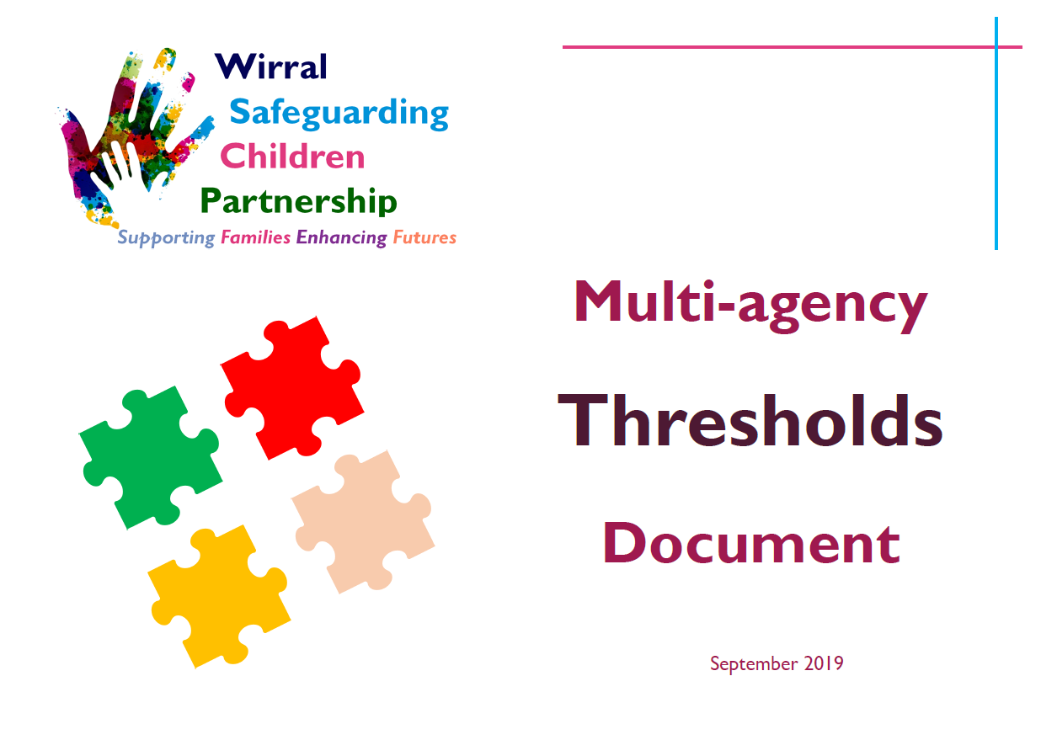
New Multi-agency Thresholds Document
New updated thresholds document
4 Levels remain but new titles:
-1 Universal
-2 Additional Support
-3 Multi-agency Support
-4 Statutory Services
https://www.wirralsafeguarding.co.uk/

Slide 35
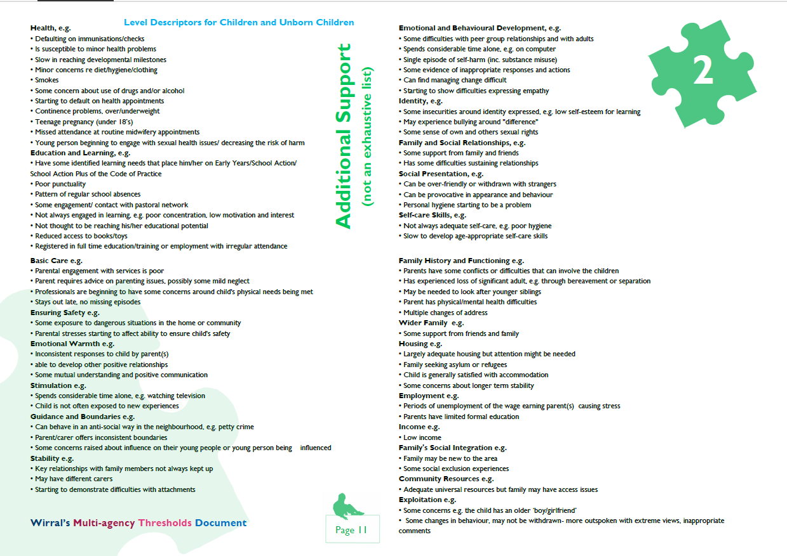
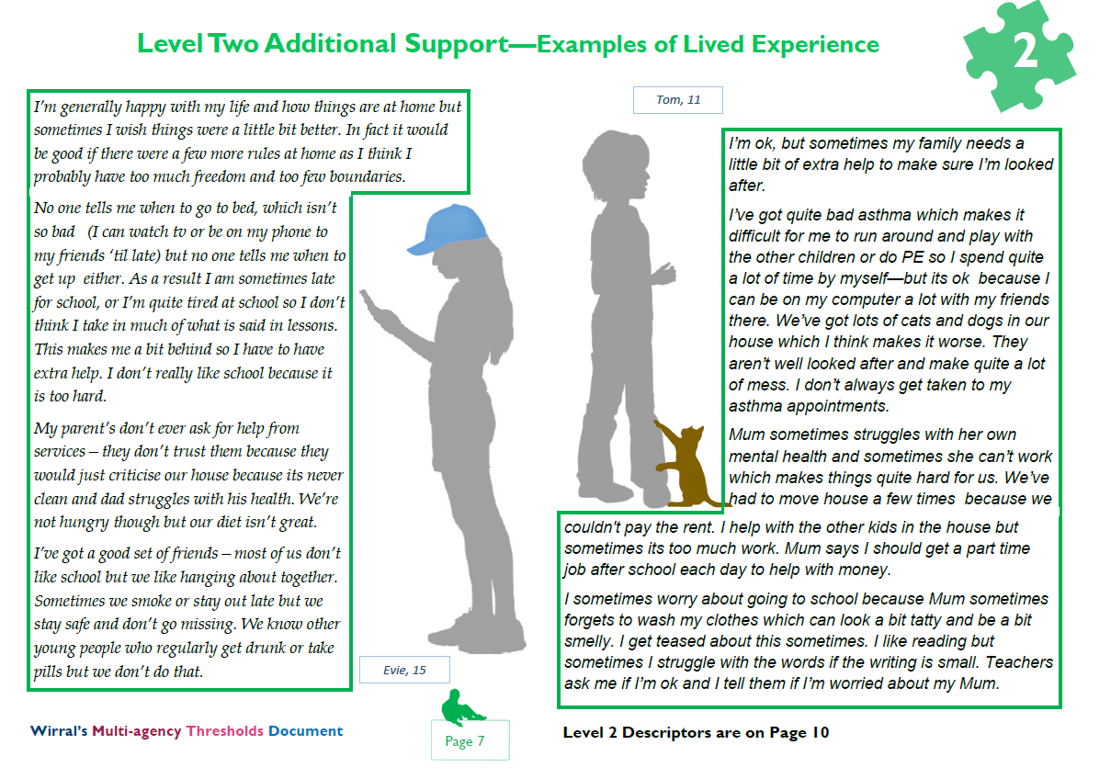
New Multi-agency Thresholds Document
Lived experience examples added
Traditional level descriptors remain
https://www.wirralsafeguarding.co.uk/

Slide 36
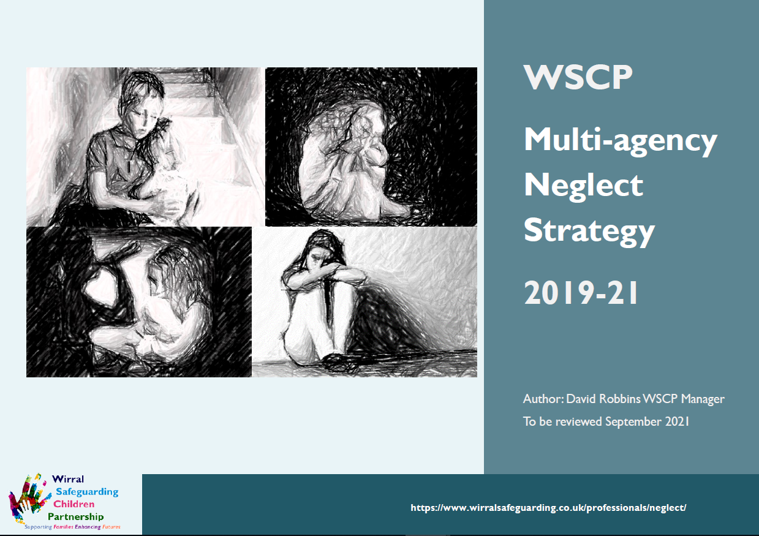
New Multi-agency Neglect Strategy
Includes learning from SCR’s
Linked to SFEF and lived experience
Incorporates commitment to GCP2
https://www.wirralsafeguarding.co.uk/

Slide 37
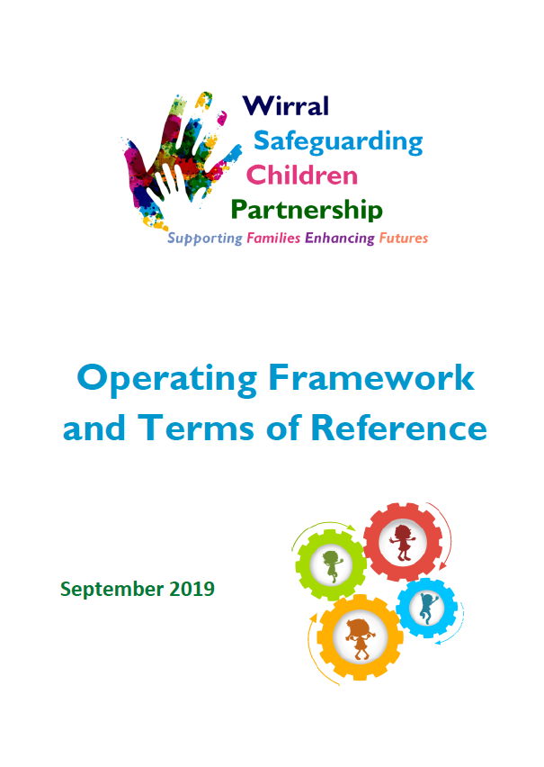
WSCP Operating Framework
Includes:
ToR for all Committees
Partnership agency and member responsibilities
Partnership principles, values and behaviours
https://www.wirralsafeguarding.co.uk/

Slide 38

Questions and Feedback
https://www.wirralsafeguarding.co.uk/

Slide 39
Questions and Feedback
Remember you can send questions and comments using Slido (https://www.sli.do/ enter code K336)
WiFi password for the Floral Pavilion is: to be added
https://www.wirralsafeguarding.co.uk/

Slide 40

BREAK
15
Mins
https://www.wirralsafeguarding.co.uk/

Slide 41

Independent Scrutiny and Reporting
https://www.wirralsafeguarding.co.uk/

Slide 42
Independent Scrutiny
The new arrangements must be subject to independent scrutiny
Maggie Atkinson is our independent scrutineer
The purpose is to provide assurance in judging the effectiveness of the multi-agency safeguarding arrangements, including case reviews
And, to consider how effectively the arrangements are working for children, families and practitioners
https://www.wirralsafeguarding.co.uk/

Slide 43
Independent Scrutiny
The independent scrutiny ‘function’ will include:
chairing bi-annual safeguarding partnership meetings and providing an assessment of local arrangements
scrutinise QA activity including audits, case reviews, training function, meetings and events
partnership response to inspections
meeting with relevant agencies
ensure the voices of children, families and professionals are heard
https://www.wirralsafeguarding.co.uk/

Slide 44
Reporting
The safeguarding partners will publish an annual report, setting out:
what they have done as a result of the arrangements
reviews undertaken
effectiveness of arrangements
evidence of the impact of the work of the partners and relevant agencies on outcomes for children and families
report will also include an annual scrutiny report
https://www.wirralsafeguarding.co.uk/

Slide 45

#BETHEDIFFERENCE
https://www.wirralsafeguarding.co.uk/

Slide 46


The Council and its partners have pledged to #BeTheDifference by working together through this initiative.
The campaign captures and recognises the great work and difference already being made to the lives of children and their families.
The initiative is based on five key principles, written from the perspective of a child, that works as a reminder of what children, young people and their families need
https://www.wirralsafeguarding.co.uk/

Slide 47

https://www.wirralsafeguarding.co.uk/

Slide 48
Aim to recognise colleagues going extra mile
Made a difference to a child or family no matter how small
Nominate a colleague or yourself
Nomination form on the Safeguarding Children Partnership Website
https://www.wirralsafeguarding.co.uk/bethedifference/
https://www.wirralsafeguarding.co.uk/

Slide 49

NSPCC
https://www.wirralsafeguarding.co.uk/

Slide 50
NSPCC
Content to be added by the NSPCC
https://www.wirralsafeguarding.co.uk/

Slide 51

Plenary
https://www.wirralsafeguarding.co.uk/

Slide 52



End of Launch
https://www.wirralsafeguarding.co.uk/

